Slide 1
§8.0-8.3: Data Storage and Number Bases
27 Oct 2008
CMPT14x
Dr. Sean Ho
Trinity Western University

Slide 2
Announcements
XSLT competition:
  Wed 5 Nov 1:00-2:30pm
  Register by Fri 31 Oct for free tutorial
  Orion Ifland <orion.ifland@twu.ca>
  www.twu.ca/xsltcompetition
Math Sciences Club event:
  Thu 30 Oct, 1:10-2:20pm Neu 41
  Alma Barranco, “Electronic Learning”
  Free pizza!

Slide 3
Essay / Paper
Computing scientist as Godly Christian Leader:
  Not just knowledge about tools, but
  Wisdom of how to use tools
    To serve others and
    To give glory to God
Write a short essay on a topic of your choosing about computers and society:
    Approx 5 pages typed double-spaced 12pt 1in margins
    Submit half-page topic by Fri 9Nov
    Paper due last week of class (Mon 3Dec)
      Electronic submission (email, eCourses)

Slide 4
Sample paper topics
Censorship and free speech
  Pornography, gambling, hate groups, etc.
Violence in video games (Columbine etc.)
Privacy: online banking, ID theft, etc.
Blogs: effect on politics, social interaction, etc.
File sharing: Napster, Gnutella, etc.
Artificial intelligence: the nature of sentience
Online dating (e.g. eHarmony): pros/cons
Equity of access / rural digital divide
..... come up with your own topic!

Slide 5
Tips for essay writing
Your essay should be a position paper:
  The topic should have at least two sides (e.g. pro/con)
  You should state (in the introductory paragraph) what your position is (thesis)
  You should have at least 2-3 points, each, both for and against your position
    It is not necessary to rebut every point that contradicts your position:
    Be honest about the faults/limitations of your thesis
  Summary intro/conclusion paragraphs
  Proper English (spelling, grammar) is important!

Slide 6
Ch8: Data storage and I/O
As programmers, you're already expert users of various datatypes and file I/O
Now we peek under the hood to see what the compiler and the OS are really doing to implement these
Every variable we declare takes up space in memory (RAM):
  How much space does each variable need?
  How is our data stored?

Slide 7
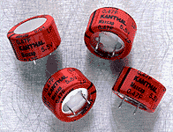
Binary numbers
At the lowest level, all computer data are stored using logical bits: each bit can be either 0 or 1
  High voltage (1) vs. low voltage (0)
  Most memory chips use a big bank of tiny capacitors: has charge (1) vs. no charge (0)
We use groups of bits to represent data (numbers, characters, strings, etc.):
  e.g., this pattern of eight bits: 0 1 0 0 0 0 1 1
    Could represent the decimal number 35
    Or it might represent the character “#”
    Or something else – depends on how we interpret it

Slide 8
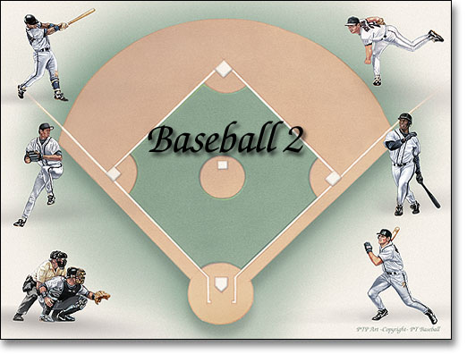
Number bases
God gave us 10 fingers; so we often count in base 10:
  “5927” interpreted as a decimal number:
    5 units of (10³ = 1000)
    9 units of (10² = 100)
    2 units of (10¹ = 10)
    7 units of (10⁰ = 1)
Counting in binary is similar:
  “0110” interpreted as a binary number:
    0 unit of (2³ = 8)
    1 unit of (2² = 4)
    1 unit of (2¹ = 2)
    0 unit of (2⁰ = 1)

Slide 9
Hexadecimal, octal
Hexadecimal is base 16: we use 'A'..'F' to represent the “digits” ten, eleven, twelve, etc.
  “BEEF” as a hexadecimal number:
    B (11) units of (16³ = 4096) => 45056
    E (14) units of (16² = 256) => 3584
    E (14) units of (16¹ = 16) => 224
    F (15) units of (16⁰ = 1) => 15
    Total: BEEF (hex) => 48879 (dec)
There's also octal, base 8:
  only the digits 0..7 are used

Slide 10
Using bases in Python
Python has special notation for expressing integer literals in hexadecimal and octal:
  Hexadecimal: prefix “0x”
hexNum = 0xBEEF # 48879
  Octal: prefix “0”
octNum = 0115 # 1(8²) + 1(8¹) + 5(8⁰) = 77
Convert into strings with hexadecimal/octal notation:
hexStr = hex(48879) # '0xbeef'
octStr = oct(77) # '0115'

Slide 11
Bits, bytes, nibbles, words
One hexadecimal digit can be represented by four bits: one nibble
Two nibbles (eight bits) is called a byte
  One byte can be used to store one CHAR
A group of bytes can be used to represent one datum: this is called a word
  Pentium CPUs generally use 4-byte words (32 bits)
  Newer CPUs can use 8-byte words (64 bits)
  Word is the smallest unit of data the machine can store or retrieve

Slide 12

Accessing memory
A computer's main memory
(generally, RAM) stores everything
it needs to do its current tasks
A location within memory is uniquely identified by its address
  Most modern CPUs use 32-bit words to store memory addresses
  This means there is a maximum of 2³² unique memory addresses (the address space)
  If each location stores one byte of data, then there is 2³² bytes = 4GB of addressable memory

Slide 13
Units of measure
SI abbreviations:
  K = kilo = 1,000
  M = mega = 1,000,000
  G = giga = 1,000,000,000
When working with binary data:
  KB = kilobyte = 1,024 bytes = 2¹⁰ bytes
  MB = megabyte = 1,024,576 = 2²⁰ bytes
  GB = gigabyte = 1,073,741,824 = 2³⁰ bytes
  But hard drive manufacturers use SI abbrevs

Slide 14
Units of measure, cont.
Kilobytes vs. kilobits:
  KB = kilobyte = 1,024 bytes = 8192 bits
  Kb = kilobit = 1,024 bits
  RAM chip manufacturers often use kilobits
Also, in SI abbreviations,
  M = mega = 10⁶: e.g., megawatt = 10⁶ watt
  m = milli = 10⁻³: e.g., milliwatt = 10⁻³ watt
But not everyone is consistent, so be careful

Slide 15


Storage
A page of memory is generally 256 bytes
A sector is a unit of disk storage, also commonly 256 bytes (but sometimes 512 bytes)
A block of disk storage is usually 512 bytes
Hard disks are made up of platters, accessed by magnetic heads on movable arms
The platters have concentric tracks that (across all heads) make up cylinders
Hard drive geometry is often expressed in C/H/S: # cylinders / # heads / # sectors per track

Slide 16
Summary of today (§8.0-8.3)
Number bases:
  Binary
  Hexadecimal (0xBEEF)
  Octal (0115)
Units of measure of memory:
  Bits, nibbles, bytes, words, pages
Units of measure for hard disks:
  C/H/S geometry
SI units vs binary units, KB vs. Kb, etc.

