Slide 1
Intro: “BASIC” STATS
CPSY 501 Advanced stats requires successful completion of a first course in psych stats (a grade of C+ or above) as a prerequisite
That requirement allows students to build on that experience to work toward familiarity with ANOVA and multiple regression analysis as applied in counselling psychology
This review covers topics that would be covered in prereq courses. Not all courses are identical, of course, and some students may have to “catch up” in some areas
Notes:
Thanks to Krista Socholotiuk for her work in putting these notes together, the first draft coming for the fall of 2007.

Slide 2
Note & apology: there seem to be some formatting problems with colours, belatedly noted…. MM

Slide 3
Basic Stats: Conceptual Heart
Research Questions: numbers vs. “data”
Variables & “levels of measurement”
Designs: Between & within “subjects”
  EX: t-tests →
Theory & conceptual work: description vs. inference,
Uses of t -tests, correlations, Χ², etc.

Slide 4
Correlation
a measure of the linear relationship between variables
How do we tell if variables have a linear relationship?
It’s connected to variance (we are interested whether the variables ‘co-vary’)

Slide 5
Correlation
Thus, when one variable deviates from it’s mean – does the other variable of interest also deviate from it’s mean in a similar (or directly opposite) way?
There are a number of ways variables can be related:
  Positive Relationships
  Negative Relationships
  Not Related

Slide 6
Correlation
SPSS provides a variety of correlational procedures that standardize the covariance (the relationship between variables), and provide us with a value that lies between -1 and +1
This is called the ‘correlation coefficient’

Slide 7
Pearson’s Product-Moment Correlation Coefficient [r]
Requires parametric data (b/c it’s based upon ‘average deviation from the mean’).
It is the default option in SPSS
Example: (ExamAnx.Sav)
A researcher has collected data on anxiety, time spent reviewing material, and exam performance…
  Anxiety was measured before the exam
  Exam performance was assessed via the student’s percentage mark on the exam
  Time Spent Revising measured exam revision time

Slide 8
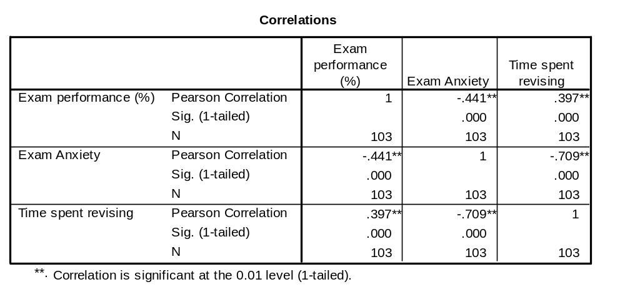
Pearson’s Correlation Coefficient
Name of Correlation Statistic
Significance
Value
Each variable is perfectly correlated with itself
Notes:
*Exam Performance is NEGATIVELY RELATED to Exam Anxiety (and there is a less than .001 probability that a correlation coefficient this big would have occurred by chance in a sample of 103 people).
-we can have confidence that this relationship is ‘genuine’
*Exam Performance is POSITIVELY RELATED to Time Spent Revising
*Time Spent Revising is NEGATIVELY RELATED to Exam Anxiety (the less amount of time you spent revising, the higher your pre-exam anxiety).
*There is a complex interrelationship between these three variables – can you see it?

Slide 9
Spearman’s Rho [ρ, or r_{s}]
a non-parametric statistic, and so can be used when your data violate parametric assumptions and/or distributional assumptions.
Spearman’s tests work by first ranking the data, and then applying Pearson’s equation to those ranks.
Example (grades.sav)
-Is there a relationship between students’ grade on a national math exam (GCSE) and their grade in a university stats course (STATS)?
-NB: STATS grades coded according to ‘letter’ (so, A=1, B=2, C=3, et.c); GCSE coded similarly.

Slide 10
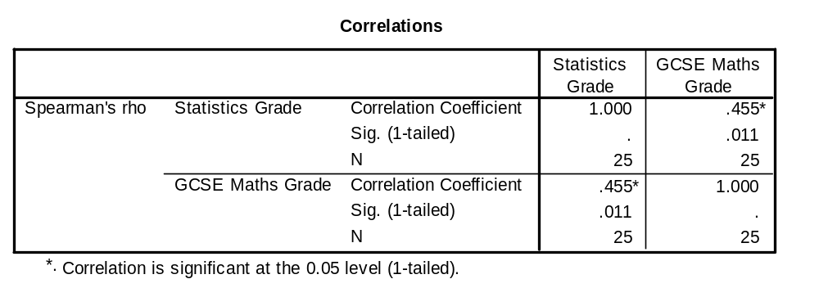
Spearman’s Rho [ρ, or r_{s}]
(Non-parametric Correlations)
Name of Correlation Statistic Used
The correlation is positive
Sample Size
Notes:
The correlation is positive: can conclude that as GCSE Grades improve, there is a corresponding improvement in grades for statistics.

Slide 11
Chi-Square [Χ²]
Evaluates whether there is a relationship between 2 categorical variables
The Pearson chi-square statistic tests whether the 2 variables are independent…if the significance is small enough (i.e., conventionally, significance is less than .05), we reject the hypothesis that the two variables are independent (unrelated), and accept the hypothesis that they are in some way realted.

Slide 12
t-Tests:
Comparing Two Means
Moving beyond correlational research…
We often want to look at the effect of one variable on another by systematically changing some aspect of that variable
That is, we want to manipulate one variable to observe it’s effect on another variable.

Slide 13
t-Tests
Related/Dependent t-tests
A repeated measures experiment that has 2 conditions (levels of the IV)
the same subjects participate in both conditions
We expect that a person’s behaviour will be the same in both conditions (external factors – i.e., age, gender, IQ, motivation – will not change from Condition 1 to Condition 2.
Experimental Manipulation: we do something different in Condition 1 than what we do in Condition 2 (so the only difference between conditions is the manipulation the experimenter made)

Slide 14
t-Tests
Independent samples t-tests
We still have 2 conditions (levels of the IV), but different subjects participate in each condition.
So, differences between the two group means can possibly reflect:
  The manipulation (i.e., systematic variation)
  Differences between characteristics of the people allotted to each group (i.e., unsystematic variation)
  Question: what is one way we can try to keep the ‘noise’ in an experiment to a minimum?
Notes:
*Error variance will almost always be larger in Independent Samples T-Tests for the (Unsystematic Variation) reason (i.e., noise).

Slide 15
t-Tests
t-tests work by identifying sources of systematic and unsystematic variation, and then comparing them.
The comparison lets us see whether the experiment created considerably more variation than we would have got if we had just tested the participants w/o the experimental manipulation.

Slide 16
Example: Dependent samples t-Tests (or “paired samples”)
12 ‘spider phobes’ exposed to a picture of a spider (picture), and on a separate occasion, a real live tarantula (real)
Their anxiety was measured at each time (i.e., in each condition).

Slide 17
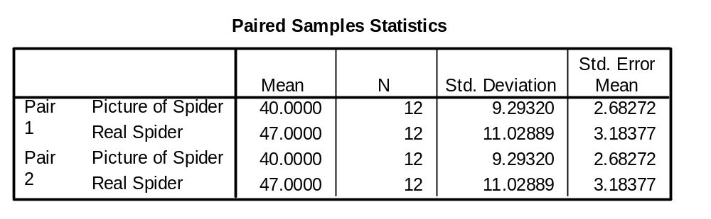
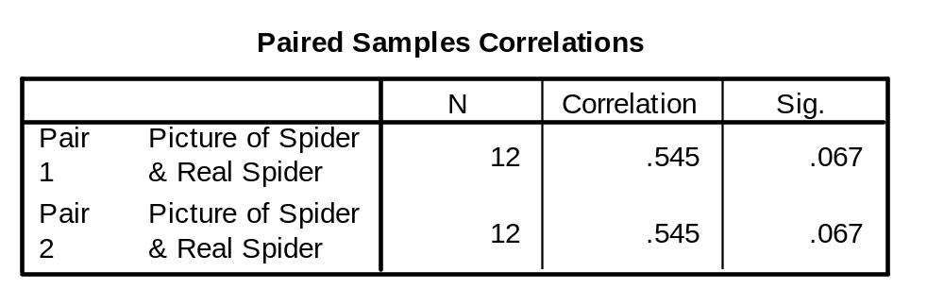
Example: Dependent samples
(paired) t-Tests

Slide 18
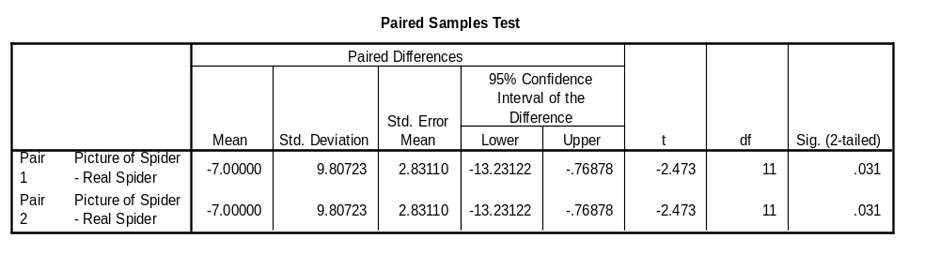
Example: paired t-Tests
Degrees of Freedom (in a repeated measures design, its N-1)
The probably that ‘t’ occurred by chance is reflected here
Standard Deviation of the difference between the means
SPSS uses df to calculate the exact probability that the value of the ‘t’ obtained could occur by chance
Standard error of the differences b/w subjects’ scores in each condition
Notes:
Most Important of the tables – tells us whether the difference between the means of the two conditions was large enough to not be a chance result

Slide 19
Example: Independent samples t-Test
Recall: Used in situations where there are 2 experimental conditions – and different participants are used in each condition
Example: SpiderBG.sav
12 spider phobes exposed to a picture of a spider (picture); 12 spider phobes exposed to a real-life tarantula
Anxiety was measured in each condition

Slide 20
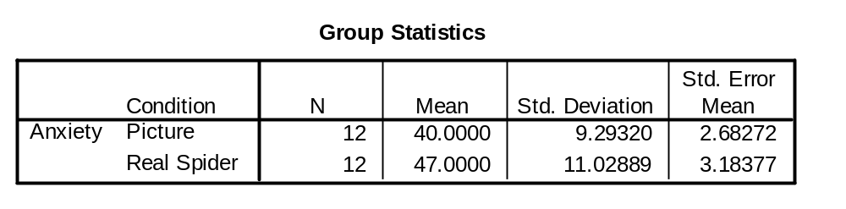
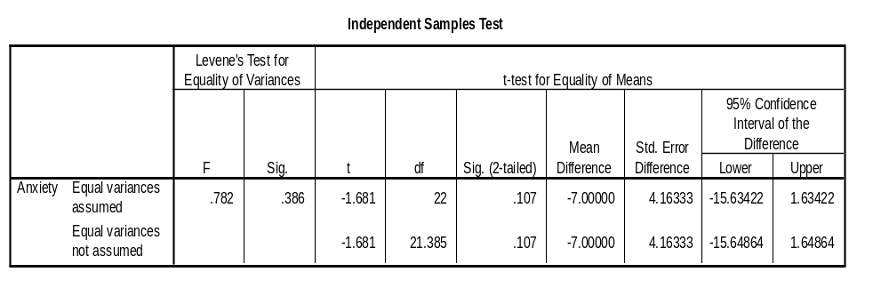
Summary Statistics for the 2 experimental conditions
(N1 + N2) - 2 = 22
Significance value of ‘t’: since 0.107 > .05 (criterion of significance) there is no significant difference between the means of the 2 samples
Assumption of parametric tests (e.g., t-tests) is that variances in the experimental conditions are ‘roughly’ equal.
If Levene’s test is significant, the assumption of homogeneity of variances has been violated
Notes:
*t-tests ‘require’ parametric data – and an assumption of parametric data is that variances in the experimental conditions are ‘roughly’ equal.
*in reality – there are adjustments that can be made in situations where variances are not equal – these rows related to whether the assumption has been broken: How do we know if it’s been broken? Look at the variances and see whether they’re similar (i.e., know the SD of the groups are 9 and 11) – and if we square these values, we get the variances.
*We can use Levene’s test (if it’s ‘significant’ – there is a significant amount of variance between groups – and the assumption of homogeneity of variances has been VIOLATED).

