Slide 1
CPSY 501: Class 2 Outline
Please log-in and download the lec-2 data set from the class web-site.
Statistical significance
Effect size
Combining effect size & significance
Sample size determination
Statistical Modelling
Navigating SPSS

Slide 2

Using Statistics to Inform Decision-Making
Statistical models are designed to provide information to facilitate the decision-making of researchers, practitioners and policy-makers.
The 2 main questions that inferential statistics can answer are (a) is there a real effect/relationship; and (b) how strong is that effect/relationship?
In statistical output, what information do we attend to, to find out:
  If there a real effect/relationship?
  How strong that effect/relationship is?

Slide 3
4 “Faces” of Statistical Relationships
Conceptually, every statistical relationship describes a connection between 2 vars with 4 facets:
Power, Effect size, Alpha, N
e.g., .80 .05 t-tests, ANOVA,…
From existing research or conventions
Calculatable//

Slide 4
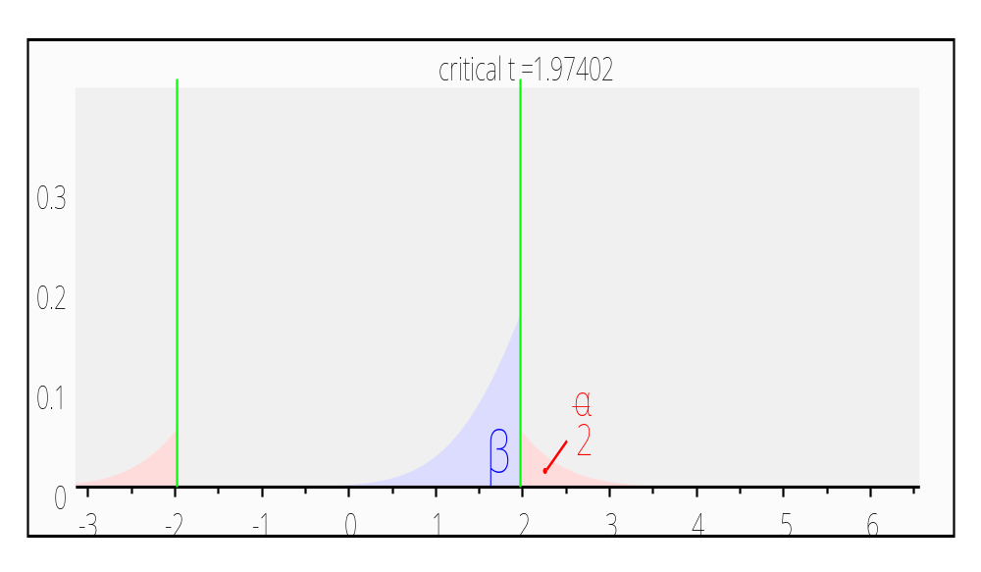
Indep. Grps. t-test diagram
Notes:
2-tailed test; power = .90; medium effect size – d = .5; N = 172, n1 = n2; significance = alpha = .05

Slide 5
Face #1: Statistical Significance
Logic: An effect is “real” (i.e., statistically significant) if the probability of obtaining the scores that we did by random variation (i.e., fluke) alone is so small, that we can reject random variation as an explanation.
In psychology, (a) what is the accepted amount of probability to reject the null, (b) and why do we use that particular value?
Notes:
In statistical world, there is a general agreement that only when we are 95% certain that a result is genuine (not a chance finding) should be accept it as true. Put another way: if there is only a 5% probability of something (an effect) occurring by chance, then we can accept it as a true finding (i.e., we say it’s a ‘statistically significant finding’).
Effect? = systematic variation in our statistical model

Slide 6
Face #1: Statistical Significance
Common Erroneous Beliefs about Significance Tests
“If a result is non-significant, it proves that there is no effect”
“The obtained significance level indicates the reliability of the research finding”
“The significance level tells you how big or important an effect is”
“Statistical significance is synonymous with clinical significance”

Slide 7
Face #1: Statistical Significance
Selecting of the level of statistical significance (i.e., the ‘alpha’ level) is a negotiation – striking a balance between caution, and being so cautious that we’re being foolish).
In G*power, you can try inputting various levels of significance (.05, .01) and observe how various alpha levels influence the other ‘3’ faces of statistical relationships

Slide 8
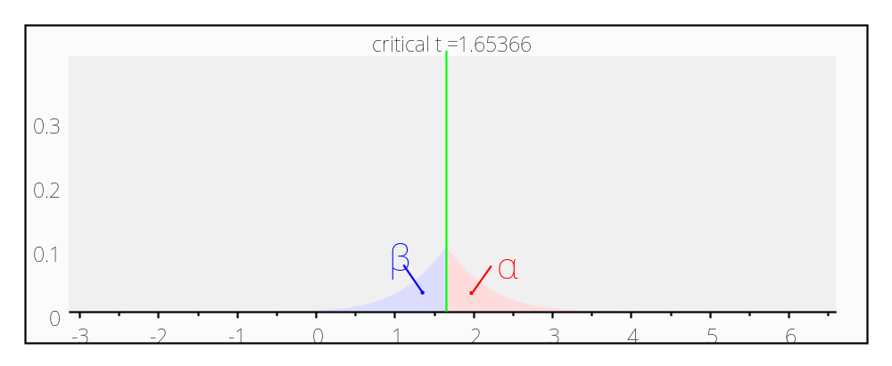
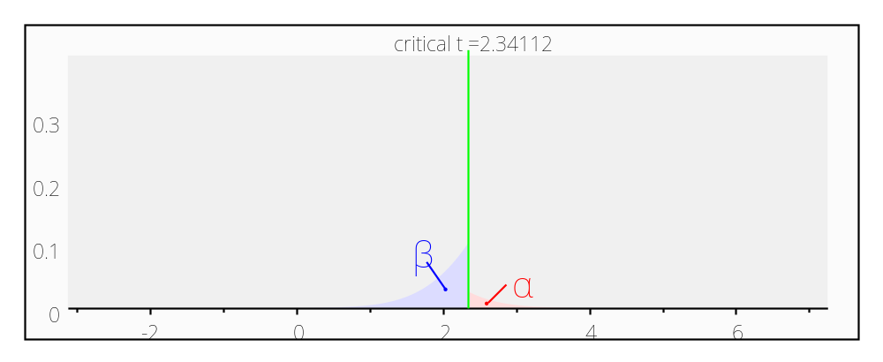
Significance: Is the effect real? Relying on probability theory (basis of inferential statistics), we can use alpha levels to help us decide…
The probability of falsely accepting the HA when the HO is true
Alpha error probably = .05
Alpha error probably = .01

Slide 9
Face #2: Effect Size
Historically, became more widely accepted in psychology as the inadequacies of significance testing became recognized.
Current standards for research practice in psychology require effect sizes to be reported alongside the p values.
Addresses the question of “how strong” an effect is
Definition: an estimator of the magnitude of the findings of a statistical procedure (i.e, the size of the difference or the relationship)

Slide 10
Measures of Effect Size
Bivariate correlations (e.g., Pearson, Spearman, Kendall’s tau): r and r²
the proportion of the variability in one variable that is associated the variability in the other variable (i.e., that is due to the relationship between the variables)
Regression: R² and R² Change
the proportion of the variability in the outcome that is attributable to the total prediction model (R²) and the specific predictors added in in each step of the model (R² Change).

Slide 11
Measures of Effect Size (cont.)
ANOVA: η² (eta-squared)
The overall effect of the IV on the DV (not the difference between a specific pair of groups in the IV).
Any between-groups comparison: M₁ – M₂ (mean difference). Cohen’s d or r_{contrast}
The magnitude of the difference between the two groups, as applied to the general population.

Slide 12
Meaning of Effect Size
Ideally, the meaning of the effect size score should be derived from the existing literature about the phenomenon of interest.
If there is no consensus in the literature, then it may occasionally be useful to use Cohen’s rough guidelines (see Rosnow & Rosenthal, 2003; Cohen, 1992 for details)
However, note that Cohen’s values, although widely accepted, are somewhat arbitrary, and should be used with caution.

Slide 13
Combining Information from Significance Testing Effect Size
Traditional: Just attend to significance, and ignore effect size completely
Radical / meta-analytic: Just attend to effect size, because p-values are too dependent on sample-size, and effect size provides more information
Integrative: Attend to both simultaneously, making judgments about which information to give priority to, on a case by case basis

Slide 14
Faces #1 & 2: Statistical Significance & Effect Size
Applied Example: Let’s try running a dependent t-test in SPSS using the SpiderBG.sav data set…
Just to review…
In this study, there were 12 individuals with a phobia of spiders. On the first occasion, these folk were exposed to a picture of a spider (variable called picture), and on a separate occasion, a real live tarantula (variable called real)
Their anxiety (the dependent variable) was measured at each time (i.e., in each condition).
Let’s open SPSS and get started!

Slide 15
Looking at Significance and Effect Size Together…
Significance = Is the “effect” real?
t(11)=-2.473, p<.05
Are we 95% certain that the result is genuine?
Or…
Is the probability of obtaining a test statistic value (like this one) by chance less than 5%?
Effect Size = What is the magnitude (the strength) of the effect?
P. 294 in text
Compute effect size (r) using the formula
r = .60 (recall ‘rough guidelines’ to aid interpretation)

Slide 16
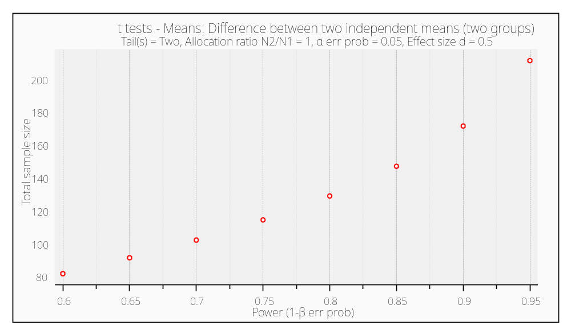
Power & sample size (t-test)

Slide 17
Sample Size Determination
(for quantitative research)
Key Question: What is the minimum sample size required to allow a reasonable chance of finding significance, if there is real effect/relationship?
In typical counselling psychology studies, the level of power that researchers strive for is .80 (i.e., an 80% chance of concluding that an effect is significant, if a real effect exists)
Power can also be conceptualized as the opposite of type 2 error, or 1 – β (where β = type 2 error).

Slide 18
Sample Size Determination (cont.)
Conceptually, the relationship between power and sample size is:
Power : (effect size, alpha, n, test-specific parameters)
e.g., .80 .05 multiple regression
From existing research or Cohen’s estimates
Calculatable

Slide 19
Sample Size Determination (cont.)
Process:
Define your α and β levels (probably .05 and .80)
Review literature to obtain estimate of population effect size
Using those values and the appropriate formula for your specific type of study to get your n. Calculations can be performed using existing sample-size calculation programs (e.g., G*Power)
Note: G*Power 3.0.x program, etc., can be downloaded from http://www.psycho.uni-duesseldorf.de/abteilungen/aap/ gpower3/download-and-register
Notes:
http://www.psycho.uni-duesseldorf.de/abteilungen/aap/gpower3/download-and-register

Slide 20
G*Power examples

Slide 21
Contingency tables
Chi-square effect size: Field, p. 693, Cramer’s V
Cohen’s effect size g is used on GPower (BRM, p. 18)

Slide 22
SPSS: General Tips
Use “_” (the underscore key) instead of blank spaces in the “name” variable. NB: can be more than 8 characters long in SPSS 13 (but not previous versions)
Consider making all your variables numeric in terms of it’s type.
Always include a descriptive label with all your variables (except for variables where the “label” would actually be the same as the “name”).
Code missing data using assigned values, rather than leaving them blank in SPSS; but make those values obviously different from legitimate scores.

Slide 23
SPSS: General Tips (cont.)
Always create a variable to represent the unique ID Number of each participant/case
Consider adding labels or deleting unneeded sections of your SPSS outputs, to make it more readable
Plan out the number and characteristics of your variables before you start entering your data
Move variables around as needed, to cluster similar ones together
Make use of the help button in SPSS (but as a guide for where to look things up in your texts, rather than as the final answer)

