Slide 1

CPSY 501: Class 4 Outline
Please download the “04-Record2.sav” dataset.
Pro-D talk on REB: Thu 30Sep ~1:50 RNT125
Correlation and Partial Correlation
OLS Linear Regression
Using Regression in Data Analysis
Regression Requirements: Variables
Regression Requirements: Sample Size
Assignments & Projects
Notes:
DATA SETS: Chapter 5, Field: p. 152 (record1) & p. 158 (record2);

Slide 2

Inferences from correlation
In some situations, it is possible to make some inferences about causality using correlational methods.
To do so usually involves:
Three or more variables in the correlation
Re-framing “causality” as an issue of direction of influence, rather than finding the one thing that is ultimately responsible for changes in another variable

Slide 3
Inferences from correlation (cont.)
These inferences are based primarily on theory and/or prior empirical evidence.
Additionally, it is necessary to rule out other competing explanations for the relationship
The temporal sequencing of the variables can strengthen claims about direction of influence
When correlational methods are used in the context of identifying direction of influence, we often use the term “regression.”

Slide 4
Direction of Influence …
Psychological Well-being
Level of Acculturation
Psychological Well-being
Language Ability
Language Ability
1 year
Time 1
Time 2

Slide 5
Partial Correlation
Purpose: to measure the unique relationship between two variables (after the effects of other variables are “controlled for”).
The SPSS calculation of partial correlations assumes parametric data (although regression strategies works for nominal variables & sometimes other non-parametric variables as well)
analyse>correlate>partial
OR
analyse>regression>linear>statistics>”part and partial correlations”

Slide 6
Partial Correlation (cont.)
Variable 2
Variable 1
Mediating Variable

Slide 7
Partial Correlation (cont.)
Other mediator
Partial Correlation

Slide 8
Partial Correlation
Purpose: to measure the unique relationship between two variables (after the effects of other variables are controlled for).
The SPSS calculation of partial correlations assumes parametric data to (although, theoretically, should be possible to partial out the effects of non-parametric variables as well)
analyse>correlate>partial
OR
analyse>regression>linear>statistics>”part and partial correlations”

Slide 9

Ordinary Least Squares (OLS)
Linear Regression
Combining the influence of a number of variables (predictors, “IVs”) to determine their total effect on another variable (outcome, “DVs”).
OLS Regression

Slide 10
Simple Regression: 1 predictor
Simple regression: predicting scores on an outcome variable from a single predictor variable (mathematically similar to bivariate correlation)
Regression

Slide 11
Simple Regression (cont.)
In OLS regression, the “best” model is defined as the line which results in the lowest sum of squared differences between model and data.
Conceptual description of regression line:
Y = b₀ + b₁X_{1i} + (B₂X_{2i} … + B_{n}X_{ni}) + ε_{i}
Outcome
Intercept
Gradient
Predictor
Error

Slide 12
Simple Regression (cont.)
Calculational Model of regression line:
Ŷ = B₀ + B₁X₁ + (B₂X2_{i} … + B_{n}X_{ni}) (error defined as zero)
Ŷ + ε_{i} = B₀ + B₁X₁ + (B₂X2_{i} … + B_{n}X_{ni}) + ε_{i}
In a model predicting anxiety (Ŷ) from study time, SPSS generates a regression model of Intercept = 9.5, and a gradient = -.5 for the only predictor variable in the model
If somebody studies for 1 hour, what will her predicted exam anxiety be?
If somebody else studies for 10 hours, what will his predicted anxiety be?

Slide 13
Fitting a Regression Model
R² in regression = the proportion of the variance in outcome accounted for by predictors
It is also possible to determine how adequate the R² model is, as a reflection of the actual obtained data (goodness of fit) through significance testing
F ratio in regression: variance attributable to the model divided by the amount of variance attributable to error. The p-value associated with the F-ratio shows whether the “fit” is good.
=
analyze> regression> linear

Slide 14
Example: Record Sales
Outcome variable: Record sales
Predictor: Advertising Budget
R² = .335, R²_{adj} = .331;
F (1, 198) = 99.587, p < .001
Ŷ = .578 x AB_{z} + 134
Notes:
→ NO ASSUMPTIONS CHECKED, ETC.

Slide 15
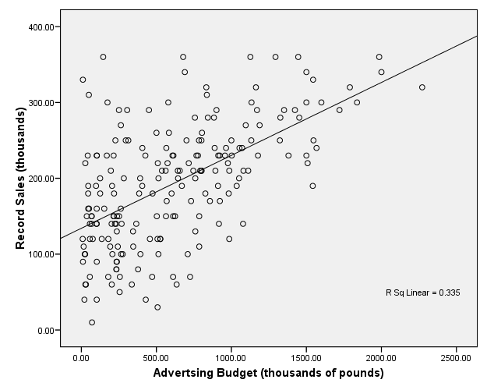

Slide 16
Multiple Regression
2 or more predictor variables in the model
How can we use multiple regression?
Regression techniques can implement all versions of the General Linear Model
ANOVA and ANCOVA
curvilinear models
mediation & path analysis; etc.

Slide 17
Regression Modelling Process
Sequence for building & testing an OLS regression model:
Develop research question (RQ), select appropriate ways to measure predictor & outcome variables, & determine required sample size (G*Power)
After data collection and entry, identify and deal with data entry errors, outliers and missing data problems, fixing as necessary
Explore variables to check for requirements of OLS regression, fixing as necessary

Slide 18
Regression Process (cont.)
Model Building: RQ specifies entry method, so run a series of regressions to “see” what effects fit with your model specifications
Model Testing: assess for “diagnostic” issues. If there are multivariate outliers or overly influential cases, fix them and return to Model Building stage.
Model Testing: assess for “generalizability” issues. If there are violations of regression assumptions, fix them and return to Model Building stage.
Run final, tested model and interpret the results
Notes:
NOTE THE CYCLE OF EXPLORE, ANALYSIS, & REVISIT

Slide 19
Selecting Variables in Regression
According to your model or theory, what variables relate to your outcomes?
Is there anything in available research literature to suggest important variables?
Do the variables meet all the requirements for an OLS multiple regression? (see subsequent slides)
Record sales example: what is a possible outcome & why?
what are possible predictors & why?

Slide 20
Derived Variables in Regression: Examples
Transformed variables: for assumptions
Interaction terms: “moderating” variables
Dummy variables: coding for categorical predictors
Curvilinear variables: for non-linear regression

Slide 21

Sample Size Requirements
Required sample size depends on anticipated size of effect, and total number of predictors.
Sample size calculation:
  Use G*Power to determine exact sample size.
  Rough estimates available on pp. 172-174 of Field.
Consequences of insufficient sample size:
  Regression model may be overly influenced by individual participants (i.e., model may not generalize well to others)
  Insufficient power to detect “real” effects of moderate size.
Solutions:
  Collect more data from more participants;
  Reduce the number of predictor variables in the model

Slide 22
Requirements of Regression Variables
The Outcome (Dependent) Variable should:
Be interval/continuous (examine the variable).
Consequences if violated: mathematics will not work
Solutions: If categorical, use Logistic Regression. If ordinal, use Ordinal Regression, or possibly convert into categorical form.
2) Have a normal distribution (normality tests, etc.).
Consequences if violated: significance testing in the model will not work properly.
Solutions: Check for outliers, etc., OR data transformations OR use caution in interpreting the significance parts of the results.

Slide 23
Requirements of Regression Variables
The Outcome (Dependent) Variable should:
3) Have an unbounded distribution (obtained range of responses versus possible range of responses).
Consequences if violated: artificially deflated R²
Solutions: Collect data from people from the missing portion, OR use a more sensitive instrument
4) Have independence of scores (examine the research design).
Consequences if violated : invalid conclusions
Solutions: redesign your data set to ensure independence; use multi-level modelling instead of OLS regression.
Notes:
More on assumptions, see class#5 outline

