Slide 1

CPSY 501: Lecture 5
Please download and open in SPSS:
04-Record2.sav (from Lec04) and 05-Domene.sav
Steps for Regression Analysis (continued)
Hierarchical regression, etc.: Strategies
SPSS & Interpreting Regression “Output”
Residuals, Outliers & Influential Cases
Practice, practice, … ! [domene data]
Notes:
FIELD, CHAPT. 5; OCT. 5

Slide 2
M. Regression Process Outline
Review: Record Sales data set for examples
  State research question (RQ) → sets Analysis strategy
  data entry errors, univariate outliers and missing data
  Explore variables (Outcome –“DVs”; Predictors –“IVs”)
  Model Building: RQ gives order & method of entry
  Model Testing: multivariate outliers or overly influential cases
  Model Testing: multicollinearity, linearity, residuals
  Run final model and interpret results
DATA ANALYSIS SPIRAL

Slide 3

Sample Size: Review
Required sample size depends on desired sensitivity (effect size needed) & total number of predictors
Sample size calculation:
  Use G*Power to determine exact sample size
  Estimates available on pp. 172-174 of Field text (Fig. 5.9)
Consequences of insufficient sample size:
  Regression model will be overly influenced by the individual participants (i.e., model may not generalize well to others)
  Insufficient power to detect “real” significant effects
Solutions:
  Collect more data from more participants
  Reduce the number of predictor variables in the model

Slide 4
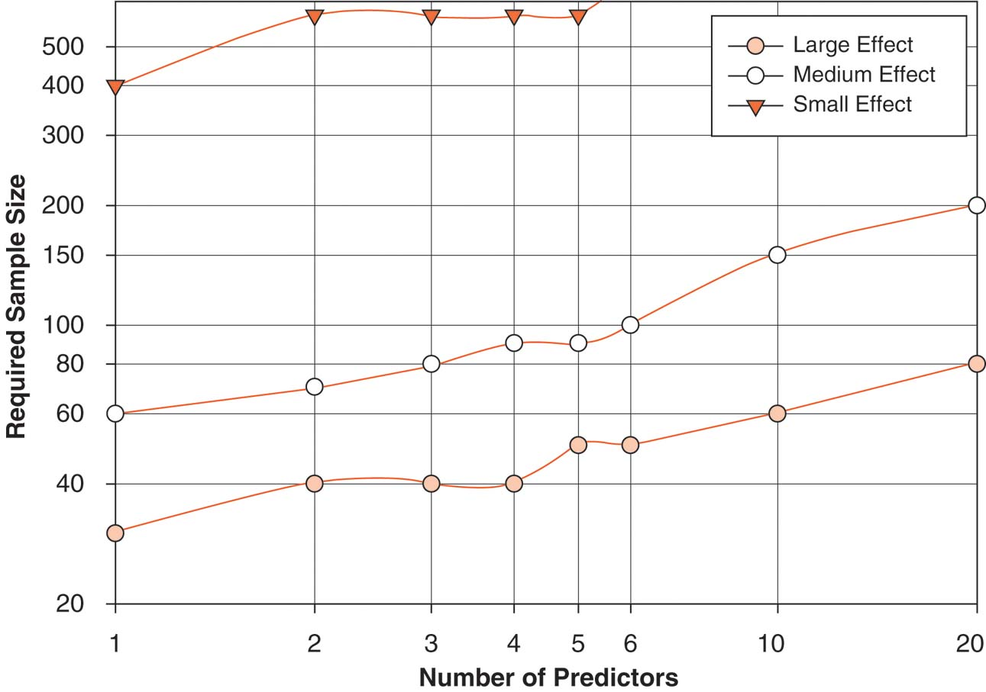
Figure 5.9

Slide 5
Guide to Predictor Variables -IVs
1) Simplest version: interval OR categorical var’s
  Categorical variables with > 2 categories need to be dummy-coded before entering into regression (which has implications for sample size)
Consequences of problems: Distortions, low power, etc.
Strategies: Collapse ordinal data into categories; possibly use ordinal predictor as interval IF enough values; etc.
2) Variability in predictor scores needed (check the distribution of all scores: possible problem if > 90% of scores are identical).
Consequences for violating: low reliability, distorted estimates.
Solutions: eliminate and/or replace weak predictors

Slide 6
Example: Record Sales data
Record Sales: Outcome, “criterion,” (DV)
Advertising Budget (AB): “predictor,” (IV)
Airtime (AT): “predictor,” (IV)
2 predictors, both with good ‘variability’ & sample size (N) is 200 → see data set
RQ: Do AB and AT both show unique effects in explaining Record Sales?
Notes:
Importance defined as largest unique variance? Or largest variance per se?

Slide 7
Example: Record Sales data
RQ: Do AB and AT both show unique effects in explaining Record Sales?
Research design: Cross-sectional, correlational study with 2 quantitative IVs & 1 quantitative DV (1 year data?)
Analysis strategy: Multiple regression (MR)

Slide 8
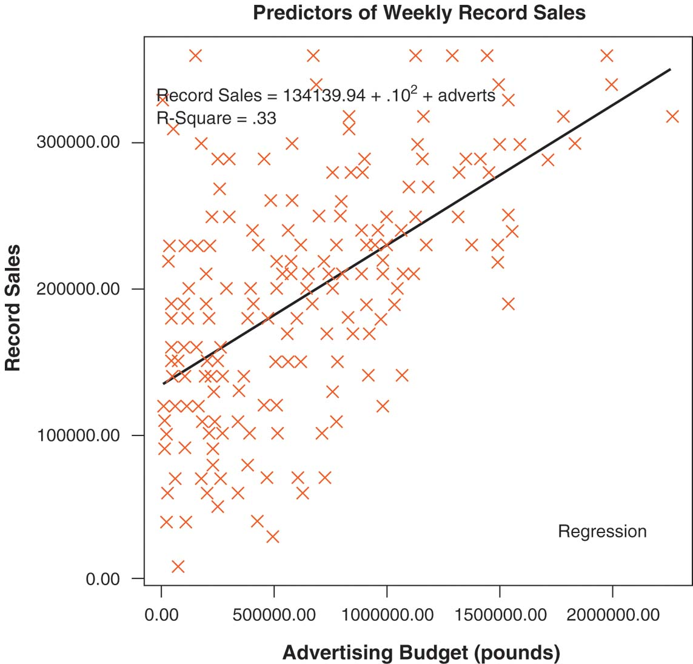
Figure 5.4

Slide 9
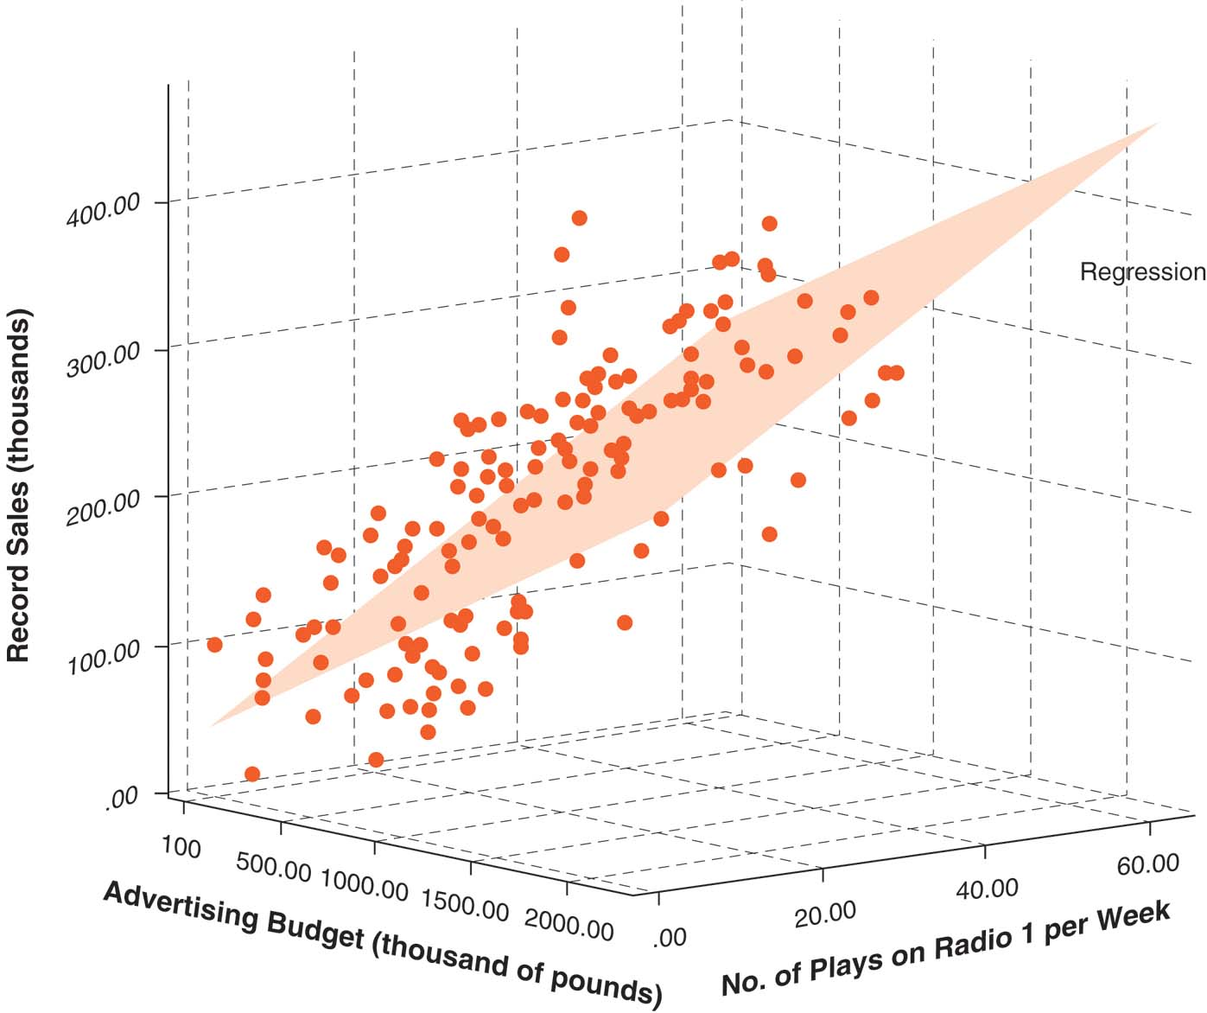
Figure 5.6

Slide 10
How to support precise
Research Questions
What does literature say about AB and AT in relation to record sales? → RQ
Previous literature may be theoretical or empirical; it may focus on exactly these variables or similar ones; previous work may be consistent or provide conflicting results; etc. All these factors can shape our analysis strategy. The RQ is phrased to fit our research design.

Slide 11
How to ask precise
Research Questions
RQ: Is AB or AT “more important” for Record Sales?
This “typical” phrasing is artificial. We want to know whatever AB & AT can tell us about record sales, whether they overlap or not, whether they are more “important” together or separately, and so on. This simple version just “gets us started” for our analysis strategy: MR.

Slide 12
How to ask precise
Research Questions - 2
RQ: Do AB and AT both provide unique effects in accounting for the variance Record Sales?
This kind of phrasing is more accurately phrased for most research designs in counselling psych. “Importance” versions (previous slide) of RQs are common in journal articles, so we need to be familiar with them as well.

Slide 13
Regression Process Outline
Review: “data analysis spiral” describes a process
  State research question (RQ) → sets Analysis strategy
  data entry errors, univariate outliers and missing data
  Explore variables (Outcome –“DVs”; Predictors –“IVs”)
  Model Building: RQ gives order and method of entry
  Model Testing: multivariate outliers or overly influential cases
  Model Testing: multicollinearity, linearity, residuals
  Run final model and interpret results

Slide 14
SPSS steps for regressions
To get to the main regression menu:
Analyse> regression> linear> etc.
Enter the outcome in the “dependent” box, and your predictors in the “independent” box; and specify which variables go in which blocks, and the method of entry for each block
To obtain specific information about the model, click the appropriate boxes in the “statistics” sub-menu (e.g., R² change, partial correlations)

Slide 15
Record sales: SPSS
analyse> regression> linear>
Records sale (RS) as “dependent”
Advertising Budget (AB) & Airtime (AT) as “independent”
“OK” to view a ‘simultaneous’ run
Review the output: t–test for each coefficient tests the significance of unique effects for each predictor

Slide 16
Regression Process Outline
Review: Record Sales data set for examples
  State research question (RQ) → sets Analysis strategy
  data entry errors, univariate outliers and missing data
  Explore variables (Outcome –“DVs”; Predictors –“IVs”)
  Model Building: RQ gives order and method of entry
  Model Testing: multivariate outliers or overly influential cases
  Model Testing: multicollinearity, linearity, residuals
  Run final model and interpret results

Slide 17
“Shared” vs. “Unique” Variance
When different predictors account for ‘overlapping’ portions of variance in an outcome variable, order of entry will help “separate” shared from ‘unique’ contributions to ‘accounting for’ the DV (i.e., the “effect size” includes shared & unique ‘pieces’)

Slide 18
Shared variance is a conceptual, not statistical, question …
Shared var = ???

Slide 19
Shared variance: Design issue
Correlations between IVs can lead to overlapping, “shared” variance in the prediction of an outcome variable
Meanings of correlations between IVs: e.g., redundant (independent) effects; mediation of effects; shared background effects; or population dependencies of IVs (all of which require research programs to sort out)

Slide 20
Order of Entry: Rationales
Theoretical & Conceptual basis: establish the order that variables should be entered into the model from (a) your underlying theory, (b) existing research findings, or (c) ones that occur earlier in time should be entered in first (all from design & RQ).
Exploratory: try all, or many, possible sequences of predictor variables, reporting unique variance and shared variance for that set of predictors (RQ)
Problems with ‘automated’ methods of data entry:
  Failure to distinguish shared & unique effects
  Order may not make sense
  Larger sample needed to compensate for arbitrary sample features, leading to lowered generalizability

Slide 21
Order of Entry: Strategies
Theoretical & conceptual strategies require the analyst (you) to choose the order of entry for predictor variables. This strategy is called Hierarchical Regression. (This approach is also required for mediation & moderation analysis, curvilinear regression, and so on.)
Simultaneous Regression: adding all IVs at once
A purely “automated” strategy is called Stepwise Regression, and you must specify the method of entry (“backward” is often used). [rarely is this option used well, especially while learning regression: it blurs shared & unique variances]
Notes:
If you use an automated strategy at any stage of your model-building, pick the “backward” method of variable entry (it is the best way to keep suppressor variables in the model).

Slide 22
Record sales example
analyse> regression> linear – ‘Block’ & ‘stats’
RS as “dependent” -- AB & AT as IVs
First run was “simultaneous” regr
“Statistics” button: R squared change
AB in “first block” and AT in 2nd block for a 2nd run
AT in 1st block & AB in 2nd block for the 3rd run

Slide 23
Calculating shared variance
As shown in the output, Airtime unique effect size is 30% and Advertising Budget unique effect size is 27%.
Also from the output, the total effect size for the equation that uses both IVs, is 63%.
Shared variance = Total minus all unique effects = 63 – 30 – 27 ≈ 6%

Slide 24
General steps for entering IVs
  First, create a conceptual outline of all IVs and their connections & order of entry. Then run a simultaneous regression, examining beta weights & their t -tests for an overview of all unique effects.
  Second, create “blocks” of IVs (in order) for any variables that must belong in the model (use the “enter” method in the SPSS window). [These first blocks can include covariates, if they have been determined; a last block has interaction or curvilinear terms]

Slide 25
Steps for entering IVs (cont.)
  For any remaining variables, include them in a separate block in the regression model, using all possible combinations (preferred method) to sort out shared & unique variance portions.
  → Record sales example: calculations were shown above (no interaction terms are used)
  Summarize the final sequence of entry that clearly presents the predictors & their respective unique and shared effects.
  Interpret the relative sizes of the unique & shared effects for the Research Question
Notes:
Reminder: Stepwise (with “backward” method) of entry helps to confirm “suppressor” effects.

Slide 26
Entering IVs: SPSS tips
Plan out your order and method on paper
For each set of variables that should be entered in at the same time, enter them into a single block. Other variables & interactions go in later blocks.
For each block, the method of entry is usually the default, “Enter” (“Stepwise,” or “Backward” are available if a stepwise strategy is appropriate)
Confirm correct order & method of entry in your SPSS output (practically speaking, small IVs sets are common)

Slide 27
Reading Regression Output
Go back to the Record Sales output for this review
“Variables Entered” lists the steps requested for each block

Slide 28
“Model Summary” Table
R² =: The variance in the outcome that is accounted for by the model (i.e., the combined effect of all IVs)
- interpretation is similar to r ² in correlation
- multiply by 100 to convert into a percentage
Adjusted R² =: Unbiased estimate of the model would fit, always smaller than R²
R² Change = ΔR² =: Effect size increase from one block of variables to the next. The F -test checks whether the “improvement” is significant.

Slide 29
ANOVA Table
Summarizes results for the model as a whole: Is the “simultaneous” regression a better predictor than simply using the mean score of the outcome?
Proper APA format for reporting F statistics (see also pp. 136-139 of APA publication manual):
F (3, 379) = 126.43, p < .001
df “regression”
F Ratio
p value / statistical significance
df “residual”

Slide 30
“Coefficients” Table Summary
Summarizes the contribution of each predictor in the model individually, and whether it contributes significantly to the prediction model.
b (b-weight): The amount of change in outcome, for every one unit of the associated predictor.
beta (β) : Standardized b-weight. Compares the relative strength of the different predictors.
t -test: Tests whether a particular variable contributes a significant unique effect in the outcome variable for that equation.

Slide 31
Non-significant Predictors in Regression Analyses
When the t-tests reveal that one predictor (IV) does not contribute a significant unique effect:
In general, the ΔR² is small. If not, then you have low power for that test & must report that.
If there is a theoretical reason for retaining it in the model (e.g., low power, help for interpreting shared effects), then leave it in, even if the unique effect is not significant.
Re-run the regression after any variables have been removed to get the precise numbers for the final model for your analysis.

Slide 32
Regression Process Outline
Review: Record Sales data set for examples
  State research question (RQ) → sets Analysis strategy
  data entry errors, univariate outliers and missing data
  Explore variables (Outcome –“DVs”; Predictors –“IVs”)
  Model Building: RQ gives order and method of entry
  Model Testing: multivariate outliers or overly influential cases
  Model Testing: multicollinearity, linearity, residuals
  Run final model and interpret results

Slide 33
Residuals in a Regression Model
Definition: the difference between a person’s actual score and the score predicted by the model (i.e., the amount of error for each case).
Residuals are examined in trial runs containing all your potential predictors, entered simultaneously into the regression equation.
Obtained by analyse> regression> linear> save> “standardized” and/or “unstandardized”

Slide 34
Model Testing:
Multivariate Outliers
Definition: A case whose combination of scores across predictors is substantially different from the remainder of the sample (assumed to come from a different population)
Consequence: distortion of where the regression “line” is drawn, thus reducing generalizability
Screening: Standardized residual more than ±3, and Cook’s distance > 1
Solution: remove outliers from from sample, (if they exert too much influence on the model)

Slide 35
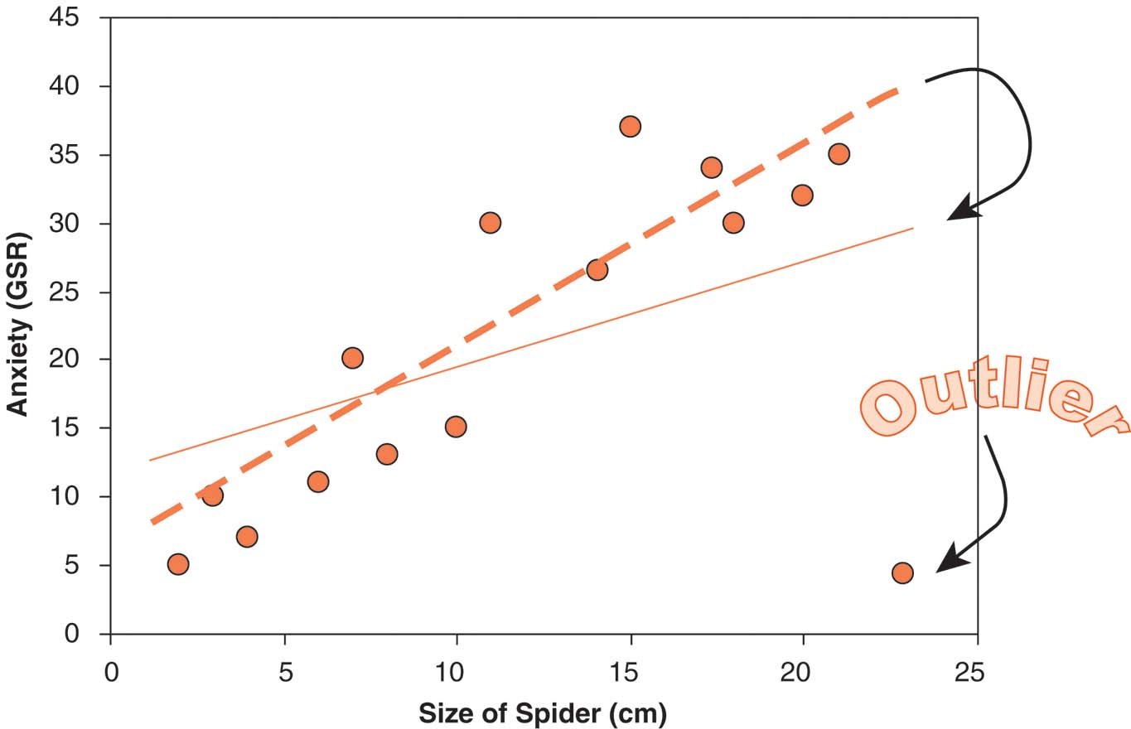
Figure 5.7

Slide 36
Model Testing:
Influential Cases
Definition: A case that has a substantially greater effect on where the regression “line” is drawn than the majority of other cases in the sample
Consequence: reduction of generalizability
Screening & Solution:
if max. leverage value ≤ .2 then safe;
if > .5 then remove;
if in between, examine max. Cook’s distance and remove if that is > 1
Notes:
Remind people to use SPSS “help” info: Cook's. A measure of how much the residuals of all cases would change if a particular case were excluded from the calculation of the regression coefficients. A large Cook's D indicates that excluding a case from computation of the regression statistics changes the coefficients substantially. Leverage values. Measures the influence of a point on the fit of the regression. The centered leverage ranges from 0 (no influence on the fit) to (N-1)/N.

Slide 37
Outliers & Influential cases (cont.)
Outliers and influential cases should be examined and removed together
Unlike the screen process for other aspects of MR, screening & fixing of outliers/influential cases should be done only once.
Why wouldn’t you repeat this screening?
SPSS: analyse> regression> linear> save
“standardized” “Cook’s” “leverage values”
Then examine Residual Statistics table, and the actual scores in the data set (using the sort function)

Slide 38
Absence of Multicollinearity
Definition: The predictor variables should not co-vary too highly (i.e., overlap “too much”) in terms of the proportion of the outcome variable they account for
Consequences: deflated R² is possible, may interfere with evaluation of βs (depends on RQ & design)
Screening: analyse> regression> linear> statistics> Collinearity Diagnostics
Indicators of possible problems:
- any VIF score > 10
- average VIF is NOT approximately = 1
- Tolerance < 0.2
Solution: delete one of the multicollinear variables; possibly combine or transform them (reflects RQ).
Notes:
REVISE THIS point, esp. exceptions: some predictors, e.g., mediators & moderators, ARE & should be collinear.

Slide 39
Independence of Errors/Residuals
Definition: The error (residual) for a case should not be systematically related to the error for other cases.
Consequence: Can interfere with alpha level and power, thus distorting Type I, Type II error rates
Screening: Durbin-Watson scores that are relatively far away from 2 (on possible range of 0 to 4) indicate a problem with independence.
  (make sure that the cases are not inherently ordered in the SPSS data file before running the test)
Solution: No easily implemented solutions. Possibly use multi-level modelling techniques.

Slide 40
Normally Distributed Errors
Definition: Residuals should be normally distributed, reflecting the absence of systematic distortions in the model (NB: not variables, residuals).
Consequence: the predictive value of the model is distorted, resulting in limited generalizability.
Screening: examine residual plots & histograms for non-normal distributions: (a) get the standardize residual scores for each participant; (b) run usual exploration of normality analyze> descriptives> explore> “normality tests with plots”
Solution: screen data-set for problems with the predictor variables (non-normal, or based on ordinal measurements), and deal with them

Slide 41
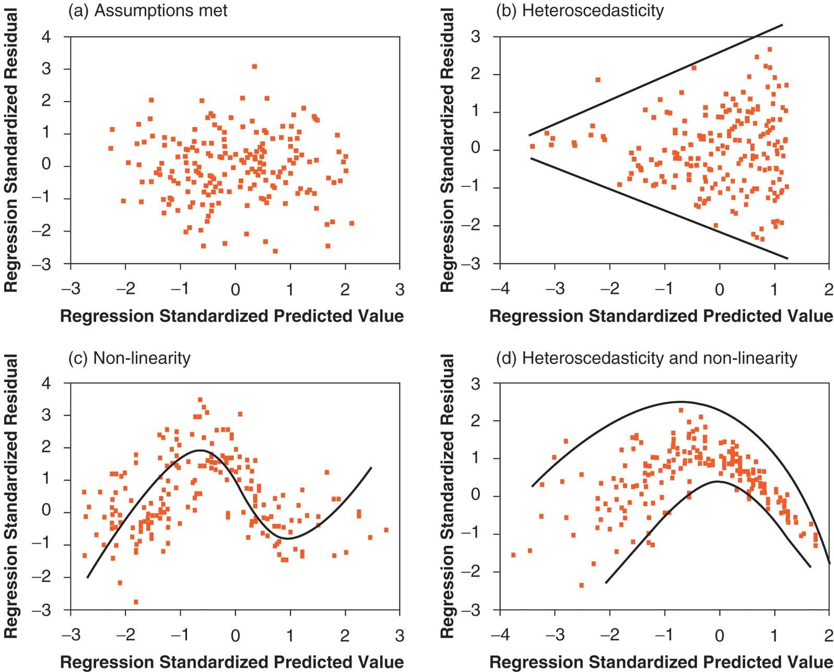
Figure 5.18

Slide 42
Homoscedastic Residuals
Definition: Residuals should have similar variances at any given point on the regression line.
Consequence: the model is less accurate for some people than others
Screening: examine residual scatterplots for fan-shapes (see p. 203 of text for what to look for) analyse> regression> linear> plots> X: “Zedpred” Y: “ZResid”
Solution: identify the moderating variable and incorporate it; use weighted OLS regression; accept and acknowledge the drop in accuracy

Slide 43
Non-linear Relationships
Definition: When relationship between a Predictor and the Outcome is not linear (i.e., a straight line).
Consequences: sub-optimal fit for the model (the R² is lower than it should be)
Screening: examine resid. scatterplots OR use curve estimation: analyse > regression > curve estimation
Solutions: accept the lower fit, or approximate the non-linear relationship by entering a polynomial term into the regression equation (predictor squared if the relationship is quadratic; predictor cubed if it is cubic).
ΔR2

Slide 44
Regression Process Outline
  State research question (RQ) shows analysis strategy
  data entry errors, univariate outliers and missing data
  Explore variables (Outcome –“DVs”; Predictors –“IVs”)
  Model Building: RQ gives order and method of entry
  Model Testing: multivariate outliers or overly influential cases
  Model Testing: multicollinearity, linearity, residuals
  Run final model and interpret results
  Write up the results (in a format using APA style)

Slide 45
Exercise: Running regression in SPSS
For yourselves, build a regression model with:
  “educational attainment” as the outcome variable;
  “academic performance” in a first prediction block;
  “educational aspirations” and “occupational aspirations” simultaneously, in a second prediction block
Make sure you force enter all the variables (i.e., use the Enter method)
Tell SPSS that you want it to give you the R²-change scores, and the partial correlation scores.

