Slide 1

CPSY 501: Lecture 6 Outline
Please download the “05-Domene” & “Peattie_2004-demo” datasets
  HW Assignment #2 is posted, due next Fri
Moderator Variables in Regression
Mediator Variables in Regression
Reading Journal Articles: Hierarchical Regression
Project: finishing up & signing REB applications

Slide 2
Review: Regression Modelling Process
Sequence for building and testing an OLS regression model:
  Develop research question
  data entry errors, univariate outliers and missing data
  Explore variables (Outcome; Predictors)
  Model Building: Mediation & Moderation
  Model Testing: multivariate outliers or overly influential cases
  Model Testing: multicollinearity, linearity, residuals
  Run final model & interpret results

Slide 3
Moderators in Regression Analysis
Definition: When a variable interacts with a predictor to change the relationship between that predictor and the outcome variable: increase, decrease, or change direction (e.g., pos to neg).
Assessing for moderation effects depends on the characteristics of your predictor and moderator:
    If both are categorical, either factorial ANOVA or regression (MR used for examining shared variance)
    If at least one is an interval/continuous variable, use multiple regression methods
Notes:
http://www.victoria.ac.nz/psyc/staff/paul-jose/files/modgraph/modgraph.php

Slide 4
Testing for Moderators (Interactions)
Process of testing for Moderators:
  Centre your (interval-level) predictor and moderator (recode: variable – mean score of the variable)
  Create your interaction term (Compute: centered predictor*centered moderator)
  Include the centered predictor, centered moderator in the regression equation in their normal order, but then add the interaction term in a subsequent block.
  In the new model, if the interaction term is significant, you have a moderator (interactions are common in research areas of counselling psych).

Slide 5
Interpreting Moderators
Significant interaction effects require us to rethink the “main effects” – the effects of each IV.
The presence of a moderating effect indicates that the relationship between the predictor and the outcome variable is different for different kinds of people (kind being defined by the moderator).
Theory is needed to determine how to interpret the interactions. Analytically, we need to graph the interaction to say what is going on. E.g., Birgitte Peattie’s thesis on marriage, stress, & sanctification.

Slide 6
Moderation: Peattie (2004)
Studying Buffering Effects of Marriage and Marital Satisfaction
DV: Marital Satisfaction
IV: Negative Life Events (NLE, stress)
Mod: Joint Religious Activities (JRA)
Buffering: high levels of a “buffer” weaken the impact of stress: => interaction

Slide 7
Moderation: Online tool
Paul Jose @Victoria University of Wellington
  http://www.victoria.ac.nz/psyc/staff/paul-jose/files/modgraph/modgraph.php
Continuous moderator, Peattie (2004)
  Y-axis (DV): Marital Satisfaction
X-axis (IV): NLE (centred):
  B=-.071, mean=.8650, SD=4.11572
Moderator: JRA (centred):
  B=.056, mean=-.264386, SD=1.497915
Interaction term: B=.037
Constant: 5.757
Notes:
http://www.victoria.ac.nz/psyc/staff/paul-jose/files/modgraph/modgraph.php

Slide 8
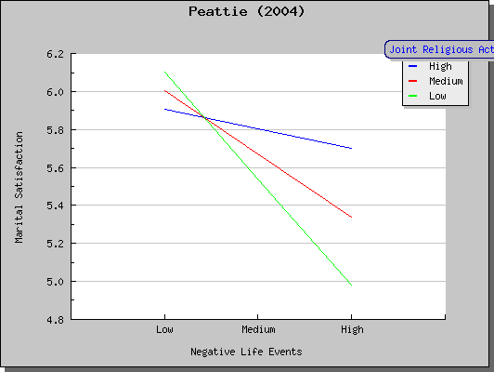
ModGraph: Results

Slide 9
Interpreting Interactions
Slope of IV regression lines differ for various levels of the moderating variable
Peattie study examples: hi levels of JRA show a weakening of the (negative) relationship of stress with marital satisfaction

Slide 10
CPSY501 Lecture 06 Outline
Moderator Variables in Regression
Mediator Variables in Regression
Reading Journal Articles – Hierarchical Regression

Slide 11
Mediators in Multiple Regression: IV→M→DV
Definition: A variable that, when entered into the regression model, explains or accounts for the relationship between a predictor and an outcome variable, so that the original relationship disappears or is attenuated (partial mediation).
For a variable to qualify as a potential mediator, it must be “located” between the predictor and the outcome: according to theory, the predictor must “precede” the mediator in some clear manner.

Slide 12
Testing for Mediators: IV→M→DV
Process of testing for Mediators:
  All three variables must be significantly correlated, and the predictor must be significant in regression model
  Run a simple regression with just (a) the predictor, and (b) the mediator as the outcome variable. Is the predictor significant in the new model?
  In the original regression model, enter the predictor and mediator in the same block as the predictor variable (force enter): If the predictor is no longer significant, then there is a mediation effect.
  (If there are other predictors in the model, they should be retained in the model, in the appropriate blocks).

Slide 13
Jose’s site for mediation
  http://www.victoria.ac.nz/psyc/staff/paul-jose/files/medgraph/medgraph.php
Strobel test: one strategy for checking partial mediation (weaknesses include power issues)
  http://people.ku.edu/~preacher/sobel/sobel.htm

Slide 14
Interpreting Mediators
Conclude that what appeared to be a real relationship between the predictor and outcome is actually an indirect relationship, and due to the mediator variable.
Report (a) the relationships (βs & effect sizes) between the predictor and the outcome variable before, and after the mediator is entered into the model, and (b) the relationships between the mediator and predictor, and mediator and outcome variable (in the final model). [see Jose’s example]

Slide 15
Further Reading - Articles
See articles/ directory under today’s lecture:
    http://cpsy501.seanho.com/lectures/06

Slide 16
CPSY501 Lecture 06 Outline
Moderator Variables in Regression
Mediator Variables in Regression
Reading Journal Articles – Hierarchical Regression

Slide 17
Reading a Journal Article
Multiple Regression:
Missirlian, T. M., Toukmanian, S. G., Warwar, S. H., & Greenberg, L. S. (2005).
Emotional Arousal, Client Perceptual Processing, and the Working Alliance in Experiential Psychotherapy for Depression.
Journal of Consulting and Clinical Psychology, 73(5), 861-871.

Slide 18
Overview: Emotional Arousal, Client Perceptual Processing, and the Working Alliance in Experiential Psychotherapy for Depression
Research Question:
“…client emotional arousal, perceptual processing, and the working alliance, together, would be a better predictor of therapy outcome than any one of these variables alone” (Missirilian, Toukmanian, Warwar, & Greenberg, 2005, p. 862)
Participants:
32 of 500 individuals recurited met criteria for inclusion - screened to ensure mild to moderate levels of depression (no comorbid dx, no Axis II dx, no medications, not receiving treatment elsewhere)
Method:
Participants completed pre-treatment measures of depression (BDI); randomly assigned to 1 of 11 possible therapists to complete between 14 and 20 manualized sessions; 4 outcome measures were collected at 3 phases (early, middle, late) in the therapeutic process.

Slide 19
Overview: Emotional Arousal, Client Perceptual Processing, and the Working Alliance in Experiential Psychotherapy for Depression
Three Predictor Variables (i.e., therapeutic processes)
Emotional Arousal: Two independent and blind raters rated the intensity of the emotional arousal clients reached in early, mid and late sessions using the Client Emotional Arousal Scale-III (they had a video tape of the session, as well as a transcript). An ‘average’ emotional arousal score was determined for each client across each session viewed.
Perceptual Processes: Two other independent judges watched the same portions of the therapy process, rating the client’s level of perceptual processing using the Levels of Client Perceptual Processing (from ‘recognition’ at one end to ‘integration’ at other).
Working Alliance: Clients completed at the Working Alliance Inventory at the end of each session.

Slide 20
Overview: Emotional Arousal, Client Perceptual Processing, and the Working Alliance in Experiential Psychotherapy for Depression
Four Outcome Variables: (i.e., Therapeutic Outcome)
Depression: Beck Depression Inventory (BDI)
Self-esteem: Rosenberg Self-Esteem Scale (SES)
Stress due to Interpersonal Sources: Inventory of Interpersonal Problems (IIP)
Psychopathology: Global Symptom Index (GSI) of the Symptom Checklist-90 (SCL-90)

Slide 21
Method?
Think back to the Research Question…
“…client emotional arousal, perceptual processing, and the working alliance, together, would be a better predictor of therapy outcome than any one of these variables alone”
What kind of a design are we working with?
Longitudinal: Correlations between variables observed over time
Procedure: Manualized therapy for clients with depression
Measures: Coding of transcripts of therapy sessions (arousal, perceptions) & some self-report measures (BDI, WAI)
Used a series of hierarchical regression analyses to test the predictive ability of the three therapeutic process measures in relation to the four outcome measures.
Notes:
Characteristics of Hierarchical Regression (review):
Regression predictors selected based on past work
Experimenter decides what order to enter the predictors into the model (known predictors always entered first according to order of importance).
New predictors can then be entered ‘all in one go’ (stepwise) or hierarchically (predictor expected to be most important entered first).

Slide 22
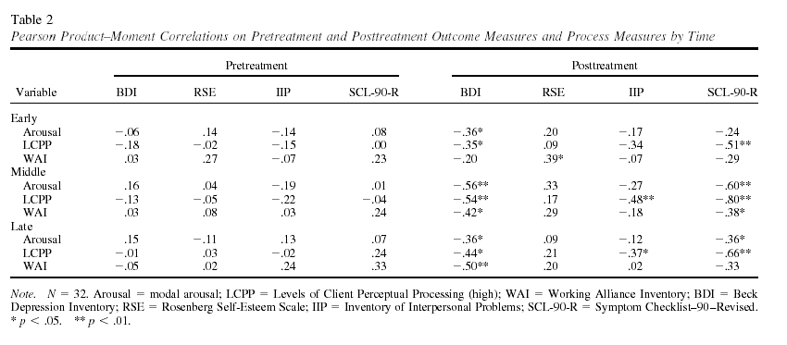
Correlation matrix: Observing trends in the data
*NO perfect multicollinearity: no perfect linear relationship b/w 2 or more predictors
*Linearity: Assume the relationship we’re modelling is a linear one

Slide 23
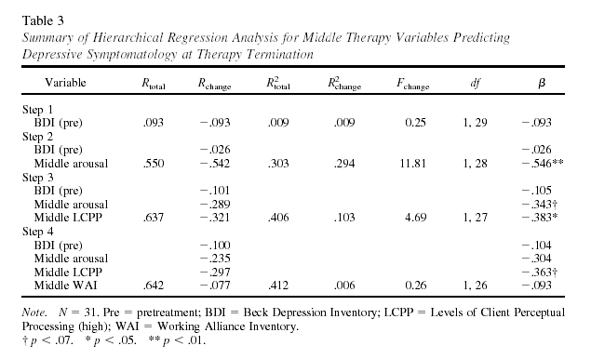
Results
‘Arousal’ adds only marginal
Unique improvement over
Perceptual Processes
At mid-treatment, Emotional Arousal + Perceptual Processes significantly increased
outcome prediction for Depression

Slide 24
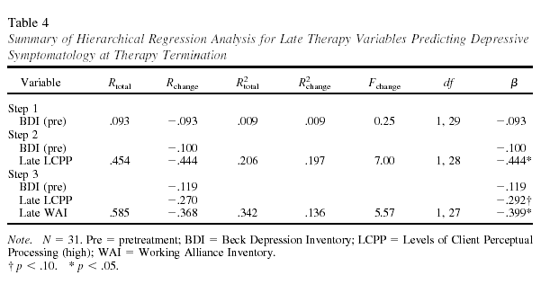
Results
LCPP only adds ‘marginally’
unique improvements over WAI
Adding the Working Alliance to the model containing Perceptual Processes
Improved prediction of depressive symptoms during late-therapy (explaining
34% of the variance)

Slide 25
Note: The small sample size (N = 31) does give these analyses limited power.
Also: Experiment-wise (Family Wise) error rates are increased by the
process of analyzing data using a model where later tests are built
on findings of preceding statistical tests
So: be careful not to dismiss results due only to ‘marginal significance’…
Remember to pay attention to effect size too!

Slide 26
Study limitations…suggestions?
Homogenous sample (mild to moderate depression only) doesn’t mirror the reality of the clinical world.
Self-report inventories for outcome measures (influenced by ‘demand characteristics’).

