Slide 1

CPSY 501: Lecture 07
Please download the “treatment4.sav” dataset
☺!
Comparing means: t -tests & beyond
Core concepts of ANOVA: … with pictures …
Basics of running ANOVAs in SPSS
Following up “omnibus” F –statistics (Post Hoc means comparisons) vs. “Planned Comparisons”
ANCOVA & therapy research
Assumptions of ANOVA & ANCOVA

Slide 2
ANOVA: Trends in Research
As the following Figure shows, there are major trends in usage patterns of statistical tools (Buhi & al., 2007).
ANOVA is still a major tool, although its prominence is declining while Structural Equation Modelling (SEM) is increasing in the literature indexed by PsychINFO.
ANOVA is also a conceptual “building block” for stats more broadly.

Slide 3
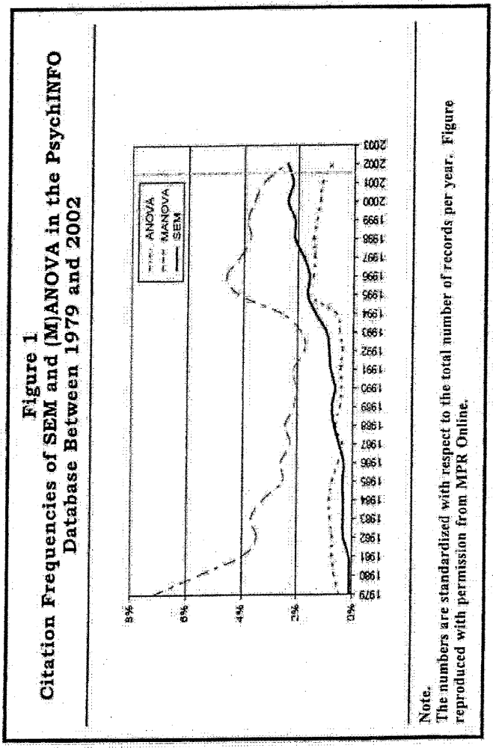
Notes:
Methods of Psychological Research -- http://www.mpr-online.de/ Source: Buhi & al. (2007). Structural Equation Modeling: A Primer for Health Behavior Researchers.

Slide 4
Summary: Versions of ANOVA (comparing means of more than 2 Groups)
One-way ANOVA: One IV, with more than two groups (“levels”) [& parametric DV, as for all ANOVAs…]
Example: ___________ [treatment4 data set]
Factorial (“between subjects”) ANOVAs: Two or more IVs, and interactions between IVs
Example: “2 x 3 factorial ANOVA” = ________
Repeated Measures (“within subjects”) ANOVAs: Each participant is observed more than once on each IV (one or more IVs).
Example: “RM ANOVA on Time” = ________
Notes:
t-test for 2 groups, only

Slide 5
Versions of ANOVA … (cont.)
Mixed (Between-Within) ANOVA: ANOVAs where 1 or more IVs are “betw,” & 1 or more are “within”
Example: “3 x (3) mixed design ANOVA” =…
MANOVA: ANOVAs with 2 or more outcome variables, correlated, & in the same analysis
Examples? _______________
ANCOVA: Any of the above designs, & trying to “control for” an “extraneous” influence on the DV
Example? → video-primed anxiety & phobias
Notes:
Miller & Chapman (2001) example: video-primed anxiety & phobias – IV = social vs. simple phobia, Cov = length of personalized videos where average length of videos the same for both groups; DV = anxiety ratings, with correlation showing between video length & anxiety levels

Slide 6
Core Concepts of ANOVA
Cannot do multiple t-tests to compare multiple groups, because the probability level across the whole set of comparisons (i.e. the “family-wise” error, FWE) will be greater than .05 [Field, p. 310]*
ANOVA is approx.** a form of regression, where all “predictor” variables are categorical (usually with more than two different categories for a One-Way).
F-Ratio: “MS_{model}/MS_{residual}” As such, it is an indicator of the size of the prediction model (i.e., the effect size of differences between cells or groups)
Notes:
* family-wise error = 1 – (.95)^{n} for ‘n’ tests; ** = ANOVA includes non-linear effects in its calculations

Slide 7
Core Concepts of ANOVA (cont.)
F-Ratio “logic”: The “model” vs “residual” distinction can also be described as “between cell” variation as distinguished from “within cell” variation.
“Cells” are the sets of observations (data) on all possible groups of participants (or “subjects”). Groups of participants are formed from all possible combinations of values of all IVs.
In the treatment4 data set, the cells for today are: CBT grp, CBS grp, & WL control (“outcome” as DV).
Notes:
* family-wise error = 1 – (.95)^{n} for ‘n’ tests; ** = ANOVA includes non-linear effects in its calculations

Slide 8
A Picture–within cell variation
Error bar charts help show both the “betw” and “w/i” variation
Confidence intervals around cell means describe within-cell variation (residual)
Cell mean differences describe between-cell variation (effect of IV)
SPSS: graphs >…> error bar > “simple” & “groups of cases” > use DV & IV for the One-Way ANOVA …
Notes:
ONE-WAY ANOVA EXAMPLE

Slide 9
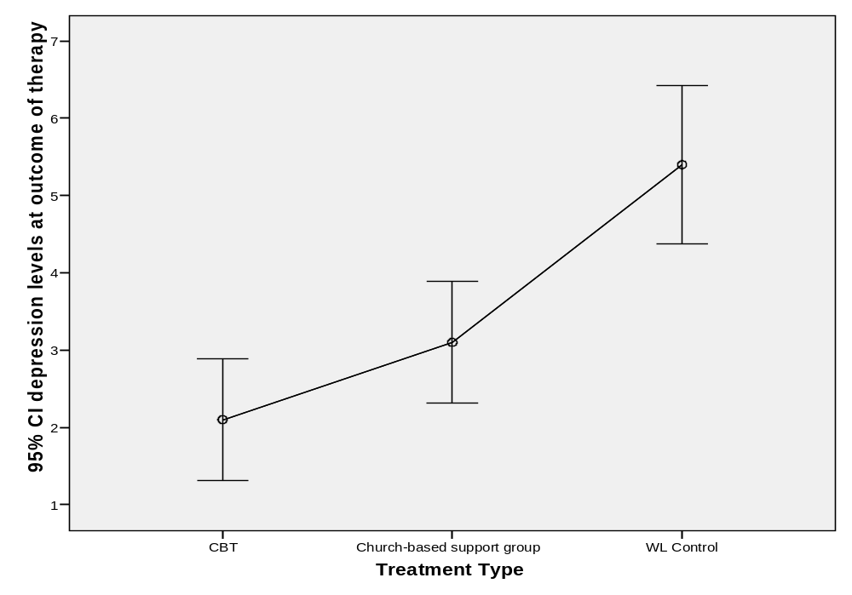

Slide 10
Another Picture: repeated measures
SPSS: graphs >…> error bar > “simple” & “separate variables” > use all depression scores as DVs to show repeated measures ANOVA …
The graph shows the decrease in depression scores over treatment and at follow-up, for the whole group (“collapsed” across all treatment groups)

Slide 11
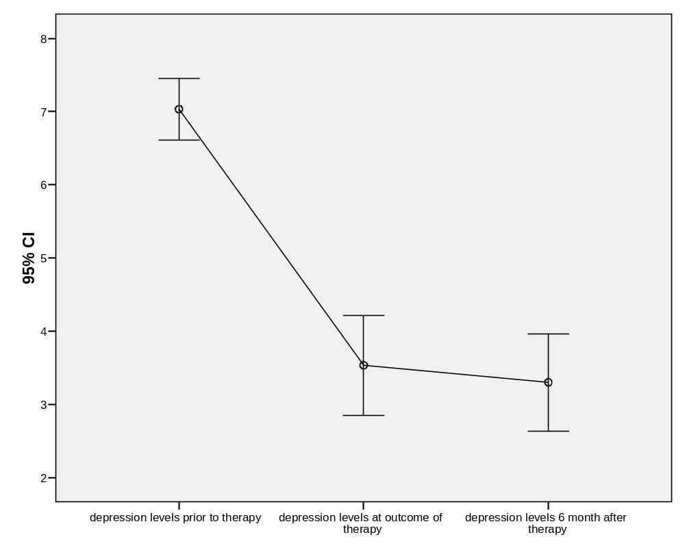

Slide 12
Another Picture
SPSS: graphs >…> error bar > “clustered” & “separate variables” > use DVs & IVs for Mixed-design ANOVA
repeated measures for each group

Slide 13
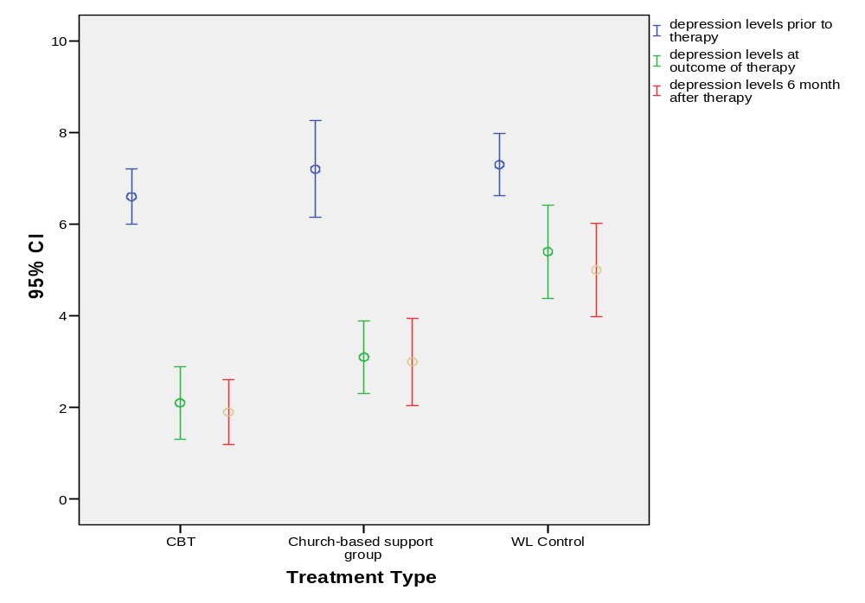

Slide 14
Running ANOVAs in SPSS …
All univariate ANOVAs can be obtained through:
analyse > general linear model > univariate…
- Outcome in “dependent variable”
- IVs in “fixed factor(s)” (for most designs we use)
- effect size in >options>“estimates of effect size”
- means for each group in >options>“descriptives”
[in ANCOVA, the “third variables” go in “covariates”]
If overall model is significant, determine where the specific group differences are (post hoc tests). Or Planned contrasts can replace this “omnibus” test.
Notes:
Random factors: more likely in experimental work, wanting to cover many levels of an IV

Slide 15
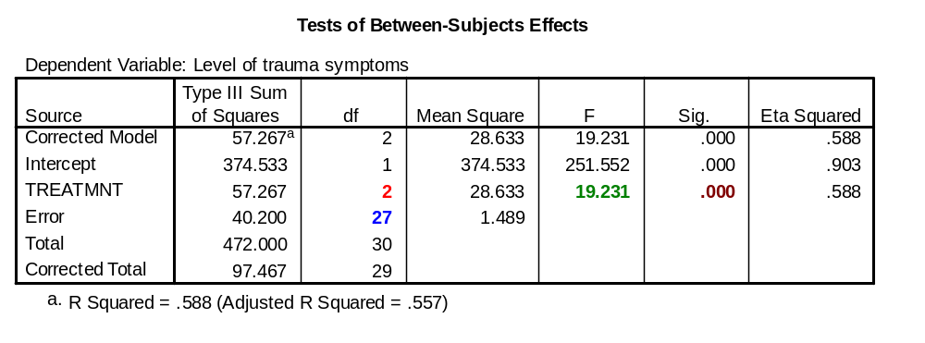
Interpreting SPSS Output: an ANOVA
depression symptoms
There is a significant effect of treatment type on depression,
F (2,27) = 19.23, p < .001
This is a strong / large effect, η² = 59%

Slide 17
Example (continued):
Eta-squared is an estimate of the overall effect of the IV, but which means are different from the others?
Minimally: We can say that the highest cell mean is significantly different from the lowest cell mean ….but what about the cell means “in the middle”?
To find out, we can conduct “Post Hoc (after the fact) tests of mean differences”
For post hoc comparisons, use analyse >general linear model > univariate >options >”display means for” “compare main effects”
Notes:
If we have concluded that the overall model is significant, post hoc tests are required to determine which specific groups are different from the other groups

Slide 18
Determining Specific Differences:
Post Hoc means comparison tests
Definition: Identifying specific between-groups differences by adjusting the alpha levels of each comparison test to ensure that the “significance level” across the overall analysis remains at .05.
Advantages: allows for more complete exploration of the results; simple to get these results (in SPSS)
Disadvantages: harder to “find” significant differences than with planned comparisons; also, as number of groups increases, it also becomes harder to distinguish significant differences

Slide 19
Post Hoc comparisons (cont.)
Uses of post hoc strategies: When you are doing exploratory research (i.e., without specific directional hypotheses), or if there are pre-planned comparisons that are “non-orthogonal”
Procedure: choose what post hoc tests should be performed by clicking the appropriate boxes in analyse >general linear model >univariate >
“post hoc”

Slide 20
Types of Post Hoc Tests
Tukey or REGW Q (Ryan, Einot, Gabriel & Welch): most powerful, accurate options, if your groups are of equal size and variances are equal.
Gabriel’s or Hochberg’s GT2: For equal variances but different group sizes. Gabriel’s is better when the sizes are relatively similar (say, within 10% of each other); Hochberg’s is better in other situations.
Games-Howell: for when equality of variances is violated. (If you are not sure, you can always try this one in addition to one of the others, and see if the answers are similar.)

Slide 21
Notes on Post hoc comparisons
SPSS has limited planned comparison and post hoc options “built in” to the menu system. Use MR for more complex options. [syntax commands also provide more options]
Use either the Bonferroni or Sidak confidence interval adjustments
Pairwise comparisons tables help us to see where specific differences lie
Note that there is no option for an “equality of variances not assumed” for post hocs

Slide 22
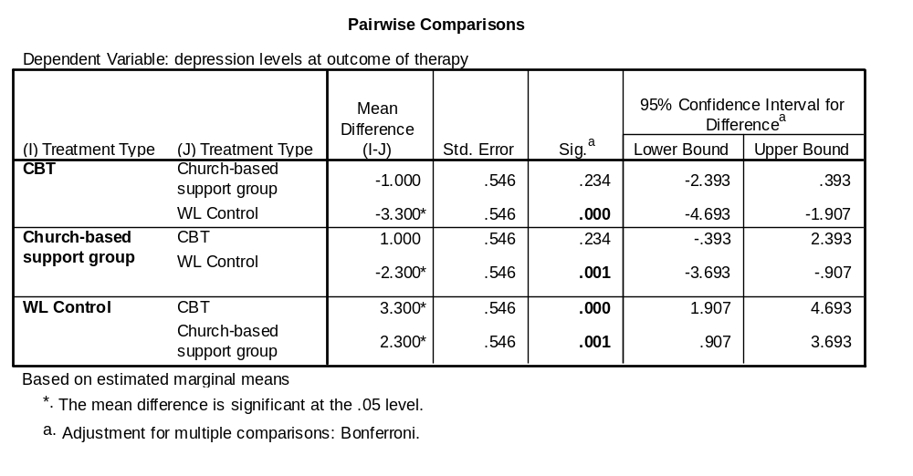
SPSS “post hocs” output

Slide 23
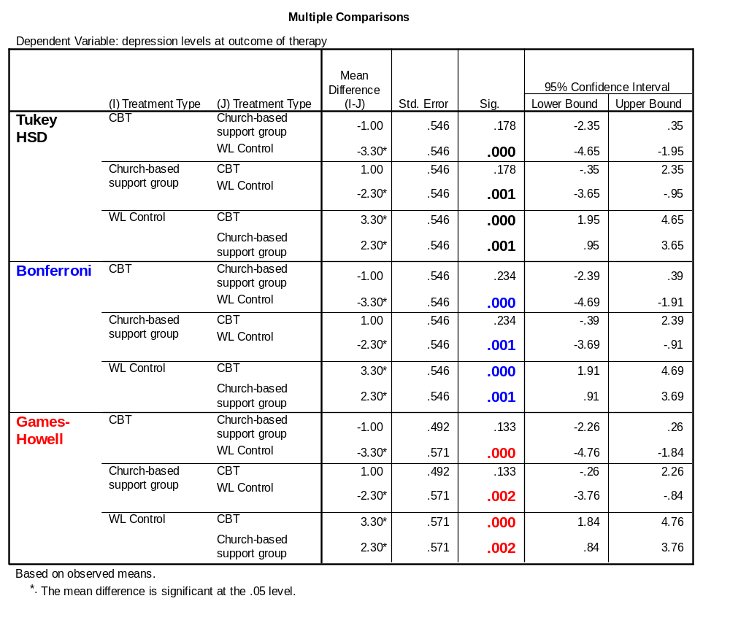
*Equality of variances not assumed

Slide 24
Summary for Post hocs
The various options for testing all say that the control group (WL) is significantly different than treatment groups (CSG & CBT), but the treatment groups are not different from one another
Some choices are more “conservative” – with lower significance levels reported

Slide 25
Specific Mean Differences in ANOVA, Part 2: Planned comparisons
“A Priori” (“before the fact”) or “planned” tests of mean differences between groups → also called “planned comparisons” or “planned contrasts”
Planned contrasts may help with power, thus making these strategies more “sensitive” (when we have a good conceptual reason to select this strategy) → Conducted instead of omnibus F
Planned comparisons, like post hoc tests, help to overcome the problem of inflated type 1 error due to conducting multiple significance tests

Slide 26
Planned Comparisons between Means
Definition: Identifying specific between-groups differences by partitioning the DV total variance (breaking down the variance into component parts, tied to specific cells, for later comparison)
Advantages: May be easier to find significant results (tied to specific conceptual issues in the study); & allows for sets of groups to be compared
Cautions: There are conceptual limits, ‘trade-offs’ in choosing comparisons; & SPSS options for planned contrasts are limited in Factorial or Repeated Measures designs (so must use MR)*
Notes:
*Complex designs require learning use of MR, whether for planned comparisons or other purposes; cf. also syntax options

Slide 27
Planned Comparisons (cont.)
Weighting Rules (to ensuring Orthogonality):
Using the above rules, what are some examples of possible planned comparisons for our data set?
- describe what we want to compare?
- what/where do we assign the weights?
All Positively weighted groups will be compared against all negatively weighted groups
The sum of the weights in a comparison must be zero
If a particular group is not involved in a comparison, assign it a weight of zero
If a variable has been partitioned into one section, it cannot be combined with variables from the other section in subsequent comparisons

Slide 28
SPSS Example for our data set
“Contrasts” are sets of comparisons among groups (levels of the IV). For example:
(a) we can compare a control group with the 2 treatment groups (CBT & CSG vs. WL)
(b) we can also compare the two treatment groups (CBT vs. CSG)
Contrast (a) = 1, 1, -2 & (b) = 1, -1, 0
We have 2 degrees of freedom, & one contrast for each df → this choice illustrates “orthogonality”

Slide 29
Planned Comparisons (cont.)
Weighting Rules (repeated here for the example)
All Positively weighted groups will be compared against all negatively weighted groups
The sum of the weights in a comparison must be zero
If a particular group is not involved in a comparison, assign it a weight of zero
If a variable has been partitioned into one section, it cannot be combined with variables from the other section in subsequent comparisons

Slide 30
Planned Comparisons in SPSS
First, define your comparison Analyse >compare means >one-way… and assign your weightings: “contrasts” type in each weighting, in the correct order
Also, obtain the Levene’s test, and means for each group: “options”> “Descriptives” and “homogeneity of Variance”
In the output screen, make sure you select the appropriate result (equality assumed OR equality not assumed) from the “contrast tests” box.

Slide 31
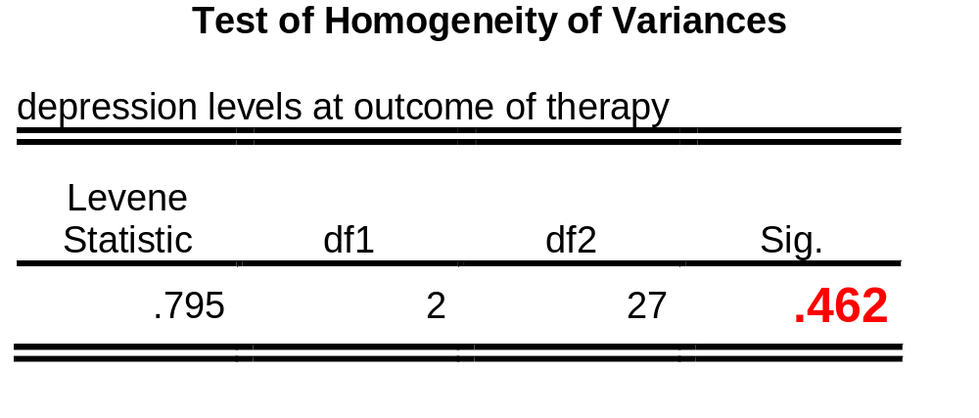
Results: reading output

Slide 32
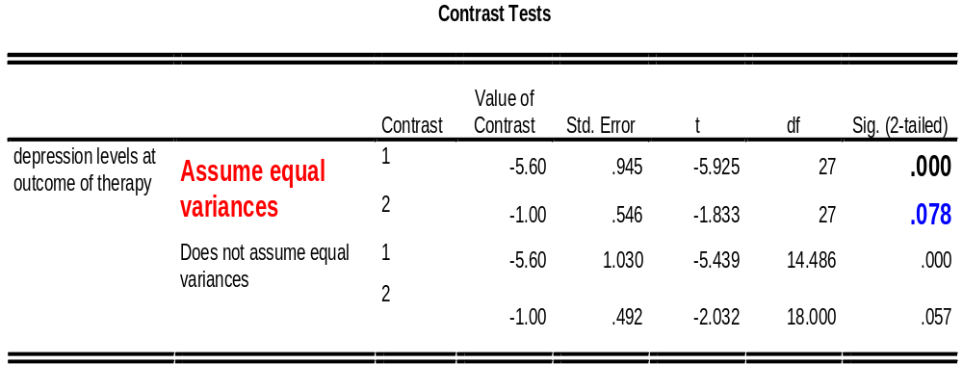
Results: reading output
/CONTRAST= 1 1 -2 /CONTRAST= 1 -1 0

Slide 33
Example data set
The control group is different from the average of the treatment groups
The difference between the treatment groups is not significant

Slide 34
Planned Comparisons: Review
Use: When you have specific hypotheses to test (derived from your theory / research questions).
It is normal practice to select only orthogonal contrasts for your planned comparisons (i.e., you are only ever comparing independent components of DV variance, defined in connection with IVs)
Different formulae are used when the variances are equal (i.e. ‘homogenous’), and when they are unequal. In the SPSS output, assess for homogeneity of variance, and attend to the appropriate results.

Slide 35
Planned Comparisons (cont.)
Other suggestions for doing planned comparisons:
Plan them out when designing your study, not after you have already run your ANOVA
Comparisons are tied conceptually to your variables
You may not be able to make all the comparisons that you want to make in one study
In SPSS, it is possible to manually assign weightings for planned contrasts in 1-way ANOVA & in GLM univariate (using the “contrasts” button); complex designs can also be addressed using Multiple Regression methods.
Notes:
#4: For GLM univariate, remember to select contrast & also click on “change” to get your contrasts output.

Slide 36
ANOVA Assumption: DV “parametricity”
Interval level DV (“quantitative”): look at how you are measuring it
Normally distributed DV: Check for outliers; run Kolmogorov-Smirnov & Shapir-Wilks tests
Analyze >Descriptive Statistics >Explore >plots “normality plots with tests”
Equality of variances: run a Levene’s test Analyse>general linear model>univariate>“options” > “homogeneity tests” [select treatment groups]
Independence of scores: look at your design and your data set

Slide 37
Assumptions of ANOVA (cont.)
However, ANOVA is a fairly robust procedure, that is usable even with some violations of assumptions, under certain conditions.
Violations that ANOVA is not robust enough to deal with are a) interval level DV (use non-parametric statistics instead), and b) dependence of scores
(use Repeated Measures ANOVA / MLM instead)
ANOVA becomes more robust when:
      sample sizes are larger
      the groups are closer to being equal in size
      violations are minor rather than extreme

Slide 38
Assumptions of ANOVA (cont.)
If normality is violated (after dealing with outliers):
  Check to see if scores on the DV are close to being normal (histogram) and, if so, proceed
  Otherwise, create separate histograms of each group, and if they are skewed in a similar way, proceed: Graphs > histogram > move your IV into the “rows” box
  If the groups are skewed in different ways, use a non-parametric comparison test

Slide 39
Assumptions of ANOVA (cont.)
If equality of variances is violated:
  Check sample size for each comparison group. If equal (or at least close), you can proceed
  Otherwise, use the Welch’s F procedure to approximate what the F should actually be analyse> compare means > one-way ANOVA > Options
  Remember to also use the appropriate post hoc tests (Games-Howell)

Slide 40
Assumptions-testing “Practice”
Using the treatment4 data set, assess all the assumptions for a study where “Age” is the IV, and “follow-up” is the DV.
  What assumptions are violated?
  For each violation, what should we do?
(Treat the different scores in “age” as categories, rather than participants’ actual ages).

Slide 41
Introduction to ANCOVA
Analysis of variance where 1 or more covariates are included in the model. These covariates are continuous “predictor” variables that are best used as methodological “control” factors to help power.
“Covariates” often become IVs when they are conceptually linked to other IVs or to the outcome.
ANCOVA works by statistically accounting for part of the variance in the outcome variable, thus altering the F-ratio. (Caution is required when Cov are correlated with IVs – creating conceptual links)
Notes:
Miller & Chapman (2001).

Slide 42
Main Use of ANCOVA in Research
Reduction of error variance: Covariate(s) related to the DV are included in the model, accounting for some of the within-group error variance, thus reducing MS_{resid} and increasing the F ratio.
DV
IV
Covariate
F-ratio = MS Model
MS Resid
F-ratio = MS Model
MS Resid

Slide 43
A “Cautious” Use of ANCOVA in Research 1:
Studying “confounding” variables: Occasionally, ‘external’ variables, as “Cov,” may systematically influence an experimental manipulation. This can be identified through theory, and statistically “controlled for” by entering them as covariates (but this might not improve the F -ratio).
DV
IV
Covariate?
Notes:
Correct this we

Slide 44
A “Cautious” Use of ANCOVA in Research 2: Solutions
“Confounding” variables?: Some authors confuse confounding, ‘external’ variables with another IV. Any time the Cov is ‘linked’ conceptually with another IV or with the DV, then treat the Cov as an IV. Any interactions or interpretable IV-Cov correlations then become part of the analysis.
DV
IV
‘Covariate’ or ‘IV’?

Slide 45
Pre-test Outcome Scores & “ANCOVA” in Therapy Research
“Pre-treatment” outcome scores: A common & controversial analysis issue is how to analyze therapy studies when there are pre-treatment differences between experimental groups in symptom levels. Solution: When in doubt, treat pretest scores as another IV, not as a Cov.
DV
IV
Pretest scores = ‘IV’?
Notes:
Miller & Chapman (2001) for some additional strategies. Then there is no random assignment, it is best to analyze & interpret any pre-treatment diffs as an IV.

Slide 46
Assumptions of ANCOVA
Parametricity of DV
  typical ANOVA assumptions
Homogeneity of regression slopes:
  Regression of the DV on the Cov is the same for all groups
  Can be tested as an interaction between IV & Cov
Conceptual independence of Cov & IV
  (so shared variance is “external” to RQ)

Slide 47
Doing ANCOVA in SPSS
Identical to GLM ANOVA, except with the addition of one or more variables in the “covariates” box analyse>general linear model>univariate>
  NB: make sure that the model is on “full factorial” and no longer on “interactions” model that was used to check for homogeneity of correlation slopes.
Results of an ANCOVA can be reported as “Controlling/accounting for the influence of the covariate, the effect of the IV on the Outcome is/is not significant,
F (df_{IV}, df_{error}) = __, p = __.”

