Slide 1

CPSY 501: Class 8, Oct. 26
Please down-load the “treatment5” & “MusicData” data-sets
Review & questions from last class; ANCOVA; correction note for Field; …
Intro to Factorial ANOVA
Doing Factorial ANOVA in SPSS
Follow-up procedures for Factorial ANOVA
Interactions, main effects, & simple effects
Examples

Slide 2
ANCOVA (review exercises)
For the treatment data set: What are some other potential covariates besides age? (see this new version of data set)
Why might age be a valid covariate for this data set?
If age interacts with post-treatment scores and thus becomes another IV instead of a covariate, what might that tell us about this treatment?
Data exercise: does “income” fit as a possible covariate for this data set? [first, we check correlations…]

Slide 3
Aside: controversies in stats
Field’s advice is sometimes incomplete (surprise!). Missing data = MD
On p. 399, Field talks about sums of square (SS) models & missing data (MD), but doesn’t note “missing cells” designs & strategy disagreements.
SPSS help files for information on SS models are also incomplete. MD = “messy”
In practice, most designs we use ANOVA Type III SS and regression techniques for more complex designs. Type III & IV can give the same results with MD.

Slide 4
Introduction to Factorial ANOVA
Definition: Analysis of variance where there is more than one “between subjects” IV in the model at the same time.
Commonly described in terms of the number of categories or groups per IV (e.g., a “5 x 4 x 4 design” means 3 IVs, with one that has 5 values in it [groups], and two IVs with 4 categories for each one).
There is usually a distinct group [“cell”] for every possible combination of categories, on the different IVs.

Slide 5
Intro to Factorial ANOVA (cont.)
The data are independent (each participant’s observations are unrelated to others’ observations)
Each participant only experiences a single combination of variables: nobody is in more than one group & each person is observed on the DV only once.
Factorial ANOVA gives a more complete picture of how different IVs work together than just running a series of one-way ANOVAs: (a) they provide results that account for variance attributed to other IVs (but shared variance between IVs might be ignored when it reflects meaningful effects).

Slide 6
Intro to Factorial ANOVA (cont.)
Factorial ANOVAs (b) allow interaction effects to be identified (part of a more complete picture).
Two-way interaction effects: When the effects of one IV are different for different conditions on the other IV. Graphs are normally needed for adequate interpretation.
More complex interactions (3-way, 4-way, etc.) are also possible, and often are challenging to interpret clearly.

Slide 7
Factorial ANOVA in SPSS
Procedure:
(a) After checking assumptions, enter all the IVs together in the “Fixed Factor(s)” box of the ANOVA menu
  Analyse >general linear model >univariate> & “Options” >effect size & homogeneity tests
(b) SPSS default for “full factorial” model is usually most appropriate (checking for all main effects & interactions).
(c) Type III Sums of Squares (& marginal means) provide information on the “unique” effects for “unbalanced” designs (= unequal cell sizes). ”Balanced” designs = equal cell sizes = no overlapping among separate effects.
Examine each effect in the model separately …

Slide 8
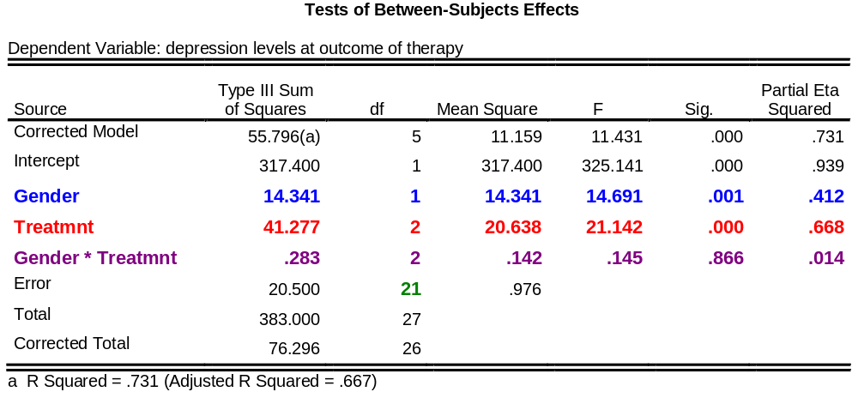
Interpreting Output for Factorial ANOVA
There were significant effects for treatment type,
F (2, 21) = 21.14, p < .001, η² = .668,
and gender, F (1, 21) = 14.69, p = .001, η² = .412, but
no significant interaction, F (2, 21) = 0.15, p > .05, η² = .014
Notes:
NOTE: Type IV SS give identical results for this data set. The eta squared cannot be additive; recall upward bias.

Slide 9
Follow-up Procedures
For significant main effects: Proceed with post hoc tests as for a one-way ANOVA.
analyse>general linear model>univariate> post hoc
Note: SPSS examines the post hocs for each IV separately (i.e., as if you were running multiple one-way ANOVAs)
Report the means and SDs for each category of each significant IV (option: report the marginal means, corresponding to “unique effects”)
analyse> general linear model> univariate> options> “descriptives”

Slide 10
Post hocs: Treatment5
Levene’s is not significant, so post hoc choice can assume equal variance.
No post hocs needed for Gender – why?
The Wait List control group has significantly higher depression levels at post-treatment [graphs are available]

Slide 11
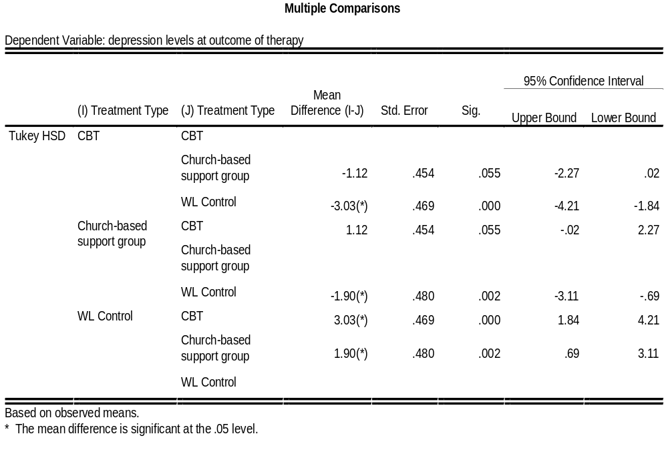

Slide 12
Follow-up Procedures (cont.)
Estimated Marginal Means: The estimate of what the mean scores would be in the population rather than the sample, accounting for (a) the effects of the other IVs and (b) the effects of any covariates.
analyse>general linear model> univariate>options> move the IVs / interactions into “display means for”> check off “compare main effects”> select appropriate confidence interval adjustment
Can be used to obtain estimated means for (a) each group within an IV, and (b) each cell/sub-group that exists in a particular interaction.

Slide 13
Follow-up Procedures (cont.)
Note that SPSS plots the estimated marginal means, rather than the actual group means. [This usually makes little difference on a graph.]
If you want to graph the exact cell means,
graph> line>multiple>define>
  DV entered in Lines Represent menu, as “Other Statistic”
  IVs entered as “Category Axis” and “Define Lines By”

Slide 14
Follow-up Procedures (cont.)
For significant interactions: Graph the interaction effects to see which groups are being affected in a different way
analyse>general linear model>univariate>plots
Tips for graphing:
  The variable with the most groups should go into “horizontal axis”
  But if the graph does no making sense conceptually, switch the axes around
  For 3-way interactions, use “separate plots.” (More complicated interactions require more work.)

Slide 15
Interactions EX: Music Data
The text provides some examples of interactions for study.
Open the music data set & run a factorial ANOVA after selecting the plot for the interaction term as described above.

Slide 16
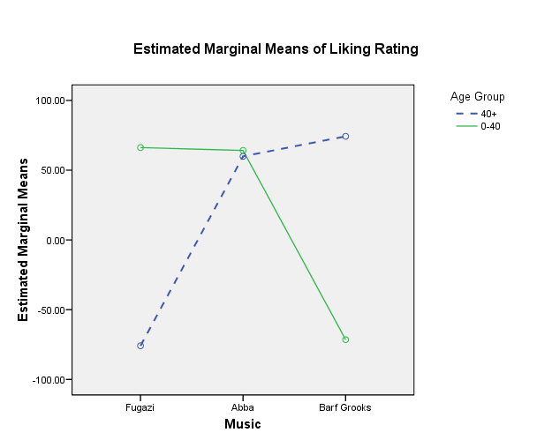

Slide 17
Simple effects: Interaction follow-up
When interaction AND main effects are significant: report on both in the Results section, but, in the Discussion section, interpret the findings primarily in terms of, “in light of,” the interaction.
Frequently, we want to go beyond just saying “it depends” and clarify what the results say. Do old folks like “barf grooks” more than young folks? …
This question raises what are called “simple effects” in ANOVA = comparing means for subsets of cells from our design.
Notes:
http://www.ats.ucla.edu/stat/spss/faq/sme.htm
http://www.psych.nyu.edu/cohen/simpleff_SPSS1.pdf

Slide 18
Simple effects (continued)
Simple effects analysis can help with main effects or interaction interpretation (with interactions)
The topic can easily become complex, requiring advanced tools from SPSS – sometimes using “Syntax”
There are also simple strategies that are helpful, even though not good enough for final, published analyses

Slide 19
Simple effects: demos …
This demo gives us too little power for a proper analysis because we divide the data & the error terms are then too big
SPSS procedure: Data>split file> “compare groups” & put “music” in the window
Now rerun an ANOVA for each level of music: GLM>univariate> “liking” & “age” with options for effect size (& Levene’s tests…)
The output is ≈equivalent to running 3 t –tests for age, separately for each music group.
In this example, it is interpretable because power is not an issue. [or we can switch age & music around]

Slide 20
Follow-up Procedures (cont.)
If the interaction is not significant, you have an additional decision to make:
  Leave the interaction term in the model (it has some minor influence, which should be acknowledged)
  Remove the interaction effect, then re-run the ANOVA to see what the main effects are without the interaction in the model (can sometimes improve the F -ratios)
Notes:
Interactions often have lower power, so if interaction ESs are close to the size of main effects, one often leaves them in.

Slide 21
Follow-up Procedures (cont.)
Procedure for removing a non-significant interaction from a factorial ANOVA model:
analyse>general linear model>univariate>“model”
  (a) Use “custom” model
  (b) Change the Build Term to “main effects”
  (c) Move all the IVs across into the “model” column, but leave the interaction term out of the model.

Slide 22
Assumptions of Factorial ANOVA (Parametricity)
Interval-level DV (categorical IVs): look at how you are measuring it
Normal distribution for the DV: run K-S & S-W tests
Homogeneity / Equality of variances: run Levene’s tests for each IV
Independence of scores: look at your design and your data set
Use the same strategies for (a) increasing robustness and (b) dealing with violations of assumptions as you would in one-way ANOVA

Slide 23
Assumptions-testing Practice
Using the treatment5 dataset, assess all the assumptions for a study with “Age” and “treatment” as IVs, and “follow-up” is the DV.
  What assumptions are violated?
  For each violation, what should we do?
(Treat the different scores in “age” as categories, rather than participants’ actual ages).
After assessing the assumptions, run the Factorial ANOVA, and interpret the results.

Slide 24
Notes….
Many readers will recall the recent controversy about methods for computing sums of squares in unbalanced analysis of variance. Many statisticians believe this controversy has been settled, with the conclusion being that the sums of squares commonly known as "SAS Type III" or "SPSS ANOVA Unique" are appropriate in most cases. I have written a paper that disagrees with this conclusion. The paper proposes that the sums of squares known as "SAS Type II" or "SPSS ANOVA Experimental" are appropriate in most cases. The reasoning is an extension of earlier writers' reasoning about the hypotheses being tested. Donald Macnaughton <donmac@matstat.com> 1997
Notes:
n article by Howell and McConaughy (1982, Educ. & Psychol. Measurement, 42, 9-24) -- trad’l – type III
→ Analysis of Messy Data By George A. Milliken, Dallas E. Johnson

