Slide 1

CPSY 501: Lecture 09, 31Oct
Please download “treatment5.sav” & “ModeratingTxOutput.pdf” for today
Repeated-Measures ANOVA
  Assumptions, SPSS steps, Post-hoc follow-up
Mixed-Design ANOVA
  Interaction Effects: finding, interpreting
  Using Simple Effects to aid in interpretation
  Extra Main Effects

Slide 2
TREATMENT RESEARCH DESIGN | Pre-Test | Post-Test | Follow-up
Cognitive-Behavioural Therapy
Church-Based Support Group
Wait List control group
Factorial ANOVA
Repeated Measures ANOVA

Slide 3
Between-Subjects vs.
Within-Subjects Factors
Between-Subjects Factor: An IV where different sets of participants experience each group
  e.g., an experimental manipulation is done between different individuals).
  One-way and Factorial ANOVA
Within-Subjects Factor: An IV where the same set of participants contribute scores to each “cell”
  e.g., the experimental manipulation is done within the same individuals
  Repeated Measures ANOVA

Slide 4
Treatment5 Study
DV: Depressive symptoms
  (healing = decrease in reported symptoms)
IV1: Treatment groups
  Cognitive-behavioural therapy
  Church-based support groups
  Wait-list control
IV2: Time (pre-, post-, follow-up)
There are several research questions that can fit different aspects of this data set

Slide 5
Treatment5:
Research Questions
Do treatment groups differ in depressive symptoms
after treatment?
  One-way ANOVA (only at post-treatment time point)
Do people “get better” while they are waiting to start counselling (on the wait-list)?
  RM ANOVA (only WL control, over time)
Do people in the study generally get better over time?
  RM ANOVA (all participants over time, ignore treatment group)
Does active treatment (CBT, CBSG) decrease depressive symptoms more than time passing for the Wait List group? (Treatment effect over time)
  Mixed-design ANOVA (combine RM and between-groups)

Slide 6

Repeated-Measures ANOVA
Concept: ANOVA with only one group of participants, who experience all the levels of the IV, which requires each person to be measured on the DV multiple times.
Helps to sort out patterns of results when scores are
not independent of each other.
In counselling psych, two common kinds of research questions that RM ANOVA is used for are:
(a) developmental change (change over time) &
(b) therapy / intervention research (i.e., pre- vs. post-).
  Also sometimes when comparing other scores that are not independent of each other (e.g., parent-child).

Slide 7
Why Use RM ANOVA?
Advantages:
(a) Power is improved by reducing background variability
  MS Error is reduced b/c same people are in each cell).
(b) Needs fewer participants (important for studying “specialized” populations).
Disadvantages: (a) Assumption of sphericity can be hard to achieve. (b) Individual variability is “ignored” rather than studied directly, which can reduce the generalizability of results.
Suitable in many situations where One-way or Factorial ANOVA are simply inappropriate.

Slide 8
Why Use RM ANOVA?
Advantages:
Power is improved by reducing background variability
  MS Error is reduced because same people are in each cell
Needs fewer participants
(important for studying “specialized” populations)
Disadvantages:
Assumption of sphericity can be hard to achieve
Individual variability is “ignored” rather than studied directly: may reduce generalizability of results
RM is suitable in many situations where One-way or Factorial ANOVA are simply inappropriate

Slide 9
Assumptions of RM ANOVA
Parametricity (mostly): (a) interval level variables, (b) normal distribution, (c) equality of variances.
→ But not independence of scores!
Sphericity: The covariances of the differences between each pair of levels (cells) of the within-subjects factor should be similar to each other.
  Test in SPSS: Mauchly’s W score should not significantly differ from 1.
  If there are only 2 cells in the study, the W will be exactly 1, and no significance test is needed.

Slide 10
Treatment5, first test:
3-level RM ANOVA
Analyze > General Linear Model >
Repeated Measures
Specify “Factor Name” as “Time”
Set number of repetitions (level) to 3, then
Define: identify the specific levels of the
“within-subjects variable”
  Make sure you enter them in in the right order!
For this first test, we won’t put in treatment groups yet (this shows an overall pattern across groups)
Options: Effect size
Plots: “Time” will usually go on the horizontal axis
→ Look through the output for Time only!

Slide 11
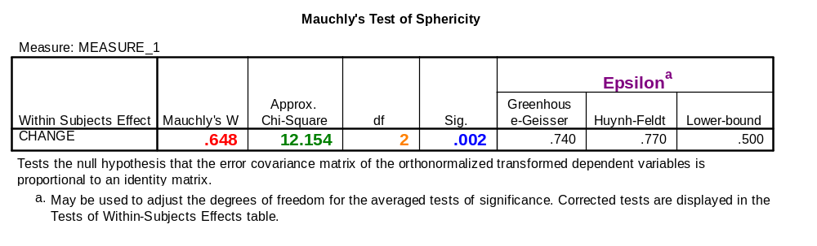
Assumptions of RM
ANOVA (cont.)
“The assumption of sphericity was violated,
Mauchly’s W = .648, χ²(2, N = 30) = 12.16, p = .002.”
When significant, the Epsilon adjustments (primarily the Greenhouse-Geisser score) must be used to determine how to proceed (scored from 0 to 1, with 1 = perfect sphericity)

Slide 12
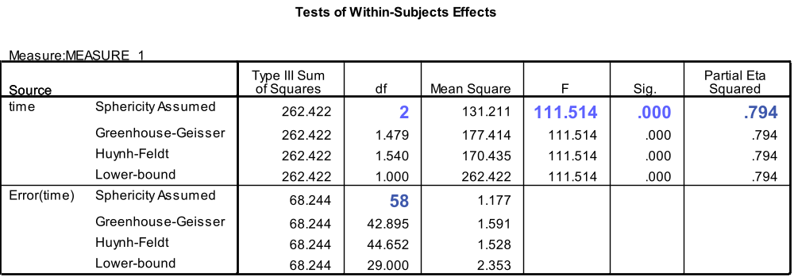
If sphericity is satisfied:
Interpret “Tests of Within-Subjects Effects” as normal, using F -ratio, df, p, & effect size from Sphericity Assumed line.
APA style: “F (2, 58) = 111.5, p < .001, η² = .794”
If the omnibus test for the ANOVA is significant, identify specific group differences using post hoc tests as needed (see notes later today).

Slide 13

If sphericity is violated:
Consequences: can inflate OR deflate the F -ratio, thus making the ANOVA results distorted / unclear
There are several options for how to proceed:
  Consider multi-level modelling instead
  (requires much larger sample size)
  If Greenhouse-Geisser epsilon < .75
  and sample size is ≥ 10 + (# of “within” cells),
  use the multivariate F-ratio results instead:
    “Wilk’s λ = .157, F (2, 28) = 75.18, p < .001,
    η² = .843”

Slide 14
If sphericity is violated (cont):
(c) Adjust the degrees of freedom in the ANOVA by the appropriate sphericity correction:
“Greenhouse-Geisser adjusted F (1.48, 42.90) = 111.51, p < .001, η² = .794”
The procedure for adjusting df is:
(1) Check the Greenhouse-Geisser epsilon score that goes with the significant Mauchly’s test.
(2) If it is ≤ .75, use the Greenhouse-Geisser adjusted F -ratio. Otherwise use the Huynh-Feldt adjusted F -ratio.
(3) Then, if the F -ratio is significant with the appropriate adjustment, conduct follow-up tests as needed.
Notes:
Levine (1991), p. 29: if both epsilons are high, use the H-F; if both are low, use G-G; if they split, can calculate both Fs & compare.

Slide 15
Following-Up a Significant RM ANOVA: post hoc comparisons
If the overall RM ANOVA indicates a significant effect, differences between specific cells/times can be explored via analyse >general linear model >repeated measures >define >options >
In this options menu, “display means for” the RM factor, click on “compare means” and apply the Bonferroni “confidence interval adjustment”
(Sidak adjustment not appropriate for RM ANOVA)
To confirm the pattern that you found, you can plot the changes over time: plots>IV in “horizontal axis” > & click <add> [or error bar plots]

Slide 16
Post hoc comparisons (cont.)
Note: The post hocs button gives no options for this design (as it should)
Bonferroni results show that the mean Pre-test scores are significantly higher than the mean Post-test & Follow-up scores – but the Post- & Follow-up scores are not significantly different (“Pairwise Comparisons” table & the confidence intervals, “Estimates” table).
Notes:
NOTE: THIS ANALYSIS IS ONLY OF INTEREST FOR DEMONSTRATION PURPOSES. SEE BELOW!

Slide 17
Practise: Field-Looks_Charis.sav
Conduct a RM ANOVA on Field’s “Looks & Charisma” data set:
Look at changes between “attractiveness” scores
Do a second analysis for “charisma” scores
Then, combine both IVs in a factorial RM analysis (using both IVs)
Attending to sphericity issues, interpret the results
Conduct follow-up tests to see which kinds of people are evaluated more (and less) positively

Slide 18
Types of ANOVA
Factorial and RM designs can be combined:
  Factorial RM ANOVA: two or more within-subjects (RM) factors
  Mixed Design ANOVA: one or more within-subject factors, one or more between-subjects factors
Can also have Covariates:
  RM ANCOVA, Factorial RM ANCOVA, etc….

Slide 19
Mixed Design ANOVAs
Advantages: Provides a more accurate view of moderators, etc., for all the same reasons as factorial ANOVA. In particular, we can explore “treatment effects” of interventions (interactions for mixed design ANOVAs, Tx grps & pre-post DV). This is the design for the simplest therapy study!!
Disadvantages: “More work…” If we use lots of IVs in an ANOVA, it becomes more work to keep track of multiple interactions – and we need a program of research to trust complex results. Sometimes, larger sample sizes are required.

Slide 20
Data Screening in SPSS (reminder!)
How do we assess each of the following in SPSS?
Normality: _______________
Equality of (Co)variances: Box’s Test & _____’s
Sphericity: ________________
Interval-level outcomes and independence of between-subjects scores are assessed non-statistically, by conceptually examining the data and/or design and research procedure.

Slide 21
Mixed Designs: SPSS steps
SPSS: The analysis strategy is selected using the regular Repeated Measures ANOVA menu: analyse >general linear model >repeated measures >define), and with the between-subjects factors (and any covariates?) added in, in the centre of the repeated measures screen: “Between Subjects Factor(s)”
Options: effect size; Homogeneity tests; … (later: Display means & ‘compare main effects’….)
Assumptions: Note that sphericity holds for our data set from the Depression Treatment study once we include the treatment groups in the design! (Levene’s & Box’s… )

Slide 22
ANOVA Results Output …
Output: RM main effects & interactions involving a RM variable are in one box; the purely between-subjects effects are in a different table.
Examine the F -ratios for main effects & interaction effects to find significant differences (using epsilon-adjusted Fs, as required) & effect sizes
For effects that are significant, proceed to examining the specific differences between cells. Start by graphing interactions, & checking to see if main effects are interpretable beyond what the interactions are telling us. Plan follow-up analyses.

Slide 23
Follow-up for
Interaction effects
Identify the most complex “level” (2-way, 3-way, etc.) of interaction effects that are significant.
  (Lower complexity effects may be subsumed by more complex ones)
Graph all significant effects at that level of complexity: define > plots > [a RM factor in “Horizontal Axis”] > [other factors in other boxes]
Confirm by obtaining the Estimated Marginal Means for the interaction (in analyse>general linear model> repeated measures> define> “options”), and examine the confidence intervals
Notes:
More systematic options: Simple interaction effects, partioning effects, etc.

Slide 24
Interactions: Statistics
The interaction of treatment group by time is significant, F(4, 54) = 7.28, p < .001, η² = .350, demonstrating that …
Review: sphericity assumption fits
Interpretation of the main effects can only be explored after the interaction effect is clear → looking at the graph.

Slide 25
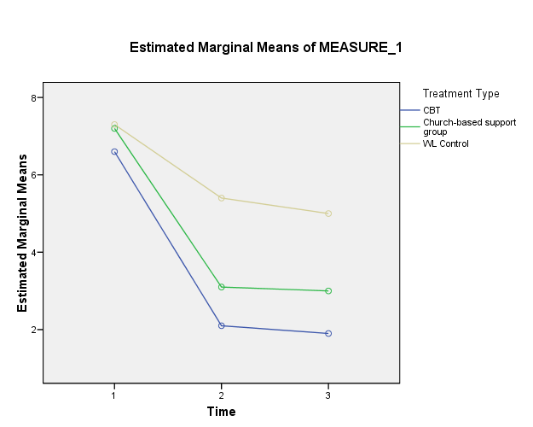

Slide 26
Simple Effects
Typically, the significant interaction can be followed up with simple effects testing to say precisely what treatment groups significantly different:
  E.g., one-way ANOVA with Bonferroni post hocs, only on times 2 or 3
The effect is strong & clear, so that even this conservative strategy shows that both treatment groups are lower than WL group, for times 2 & 3.

Slide 27
Simple Effects (cont)
Check simple effects by obtaining the Estimated Marginal Means for the interaction: (in analyse>general linear model> repeated measures> define> “options”), and look over the confidence intervals
Like the one-way ANOVA strategy, this SPSS option is “approximate” without requiring more technical versions of simple effects testing.

Slide 28
Interactions: Interpretation
The interaction of treatment group by time is significant, F(4, 54) = 7.28, p < .001, η² = .350, demonstrating that …
…the decrease in symptoms of depression from pre-test to post-test and follow-up was greater for the treatment groups than it was for the WL control group.

Slide 29
Main Effects (with interactions)
The main effects are only meaningful if they tell us something in addition to what the interaction tells us. As for the depression study, both the Group and Time main effects are merely “crude” reflections of part of the interaction effect. Only the interaction is reported fully with follow-up.
When there are only 2 cells/levels of the IV/repetitions, the difference for a main effect is simply the difference between the two levels.

Slide 30
Follow-up for Main Effects
To look for main effects beyond the interaction:
For any significant main effects where there are more than 2 cells/repetitions, basic strategies are:
  If the effect is for a between-subjects factor (IV), select the appropriate test in the “post hoc” menu, and interpret the patterns in the output.
  If the effect is for a within-subjects component, use the “compare means” option in the “options” menu. (Remember to switch the confidence interval adjustment to Bonferroni).

Slide 31
Depression Study: Treatment Effect Summary
The significant main effect for Time that we noted on the first run of SPSS was for demonstration purposes. It’s actually only an accurate description for the treatment groups, not the WL grp.
The treatment effect (Group x Time interaction) is the heart of the result for this data set.

Slide 32
Moderation Analysis: Depression Study
Although the treatment effect is clear and a direct response to our research question, we must be alert to possible moderating factors (interactions).
In much of counselling psych, gender is related to many aspects of health, therapy, etc.
This data sets helps show how we can check for moderating effects.

Slide 33
Gender as Moderator?
  We have missing gender values in this data set. In real analyses, we would take the time to sort out missing data patterns (but not today).
Research Question: Does treatment seem to work “the same” for women & men?
This issue raises several questions of our data set.

Slide 34
Gender as Moderator
Most directly, if gender moderates the treatment effect, look for a 3-way interaction: Gender x Group x Time.
As a second priority, Gender interacting with Time or Group (2-way) can also show important factors to take into account in therapy.
A main (1-way) effect for Gender by itself is not a major concern (for studying therapies).

Slide 35
Gender as a moderator: Analysis
The analysis strategy is simple: Add Gender as a 3rd IV in the ANOVA and check for interactions with other variables.
If any interaction effects show up, check them out (interpret them) and determine if that changes our understanding of treatment in this study.

Slide 36
Output: Gender effects
“Within” effects: no 3-way interaction, but Time x Gender effect is significant (21% effect size).
“Between” effects: the Gender x Group effect is clearly not significant.
Check the Time x Gender graph to see what implications might be important.

Slide 37
Summary: Moderation analysis
Women showed less improvement on average than did the men, but that did not depend on treatment group.
So gender moderates response to treatment (and to Waitlist…)
  We don’t have to qualify our treat effect. It still seems to “fit” women and men… & in the research, this “check” might not even be reported for the journal.

Slide 38
APA style notes
Provide evidence for your statements- explain why you think something, and report the statistics …
APA style: APA manual, pp. 136-46 & 122-36
  No space between the F and the ( ): F(2, 332) = ___
  R² is NOT the same as r²
  Kolmogorov-Smirnov written as “D(df) = etc.”
  Rounding: to two decimal places for most stats (except for p and η² – 3 decimal places for them; or unless it is confusing to do that for some reason)
  p and η²: italicize Latin letters, but not Greek letters …

Slide 39
Practise: Mixed ANOVA
For yourselves, conduct a Mixed ANOVA with just “outcome” and “follow-up” as the within-subjects factor, “relationship status” as a between-subjects factor – all in the “treatment5” data set.
First, determine whether it is appropriate to use Mixed ANOVA (assess for test assumptions). Even if it is not, proceed anyway.
Is there a significant interaction effect between pre-post treatment, and relationship status? If so, what is the interaction?

Slide 40
Added Notes: Covariates
in a Mixed Design ANOVA
Covariates can be added to a mixed ANOVA model in the main repeated measures menu, in the “covariates” box.
The covariate must remain constant across all repetitions of the within-subjects factor. If you have a “varying” covariate, enter it as a second RM IV in the model (or use multi-level modelling)
Analysis proceeds as “normal.” (Remember that the post hoc menu will be unavailable for use, and there should be no significant interactions between the covariates and the factors (to preserve homogeneity of regression slopes)

