Slide 1



CPSY 501: Lecture 11, Nov14
Please download “relationships.sav”
Non-Parametric Tests
  Between subjects:
    Mann-Whitney U; Kruskall-Wallis; factorial variants
  Within subjects:
    Wilcoxon Signed-rank; Friedman’s test
  Chi-square (χ²) & Loglinear analysis
Misc. notes:
  Exact Tests
  Small samples, rare events or groups
  Constructing APA formatted tables
Notes:
Ch. 13 & 16 in Field

Slide 2
Non-parametric Analysis
Analogues to ANOVA & regression
  IV & DV parallels
Between-subjects: analogous to
one-way ANOVA & t -tests, factorial
Within-subjects: analogous to
repeated-measures ANOVA
Correlation & regression: Chi-square (χ²) & loglinear analysis for categorical

Slide 3
Non-parametric “Between-Cell”
or “levels” Comparisons
Non-parametric tests are based on ranks rather than raw scores: SPSS converts the raw data into rankings before comparing groups
These tests are advised when (a) scores on the DV are ordinal; or (b) when scores are interval, but ANOVA is not robust enough to deal with the existing deviations from assumptions for the DV distribution (review: “assumptions of ANOVA”).
If the underlying data meet the assumptions of parametricity, parametric tests have more power.

Slide 4
Between-Subjects Designs: Mann-Whitney U
Design: Non-parametric, continuous DV; two comparison groups (IV); different participants in each group (“betw subjects” cells; cf. t-tests & χ²).
Examples of research designs needing this statistic?
Purpose: To determine if there is a significant “difference in level” between the two groups
“Data Structure” = Entry format: 1 variable to represent the group membership for each participant (IV) & 1 variable representing scores on the DV.

Slide 5
Mann-Whitney U in SPSS: Relationships data set
Running the analysis: analyze> nonparametric> 2 independent samples> “2 Independent samples” → “Grouping var” (IV-had any…) & “Test var” (DV-quality…) & “Mann-Whitney U”
Note: the “define groups” function can be used to define any two groups within the IV (if there are more than two comparison groups).
(If available) to switch from “asymptotic” method of calculation to “exact” analyze> nonparametric> 2 independent samples> “Exact” (requires optional SPSS module; see Notes at end of outline)

Slide 6
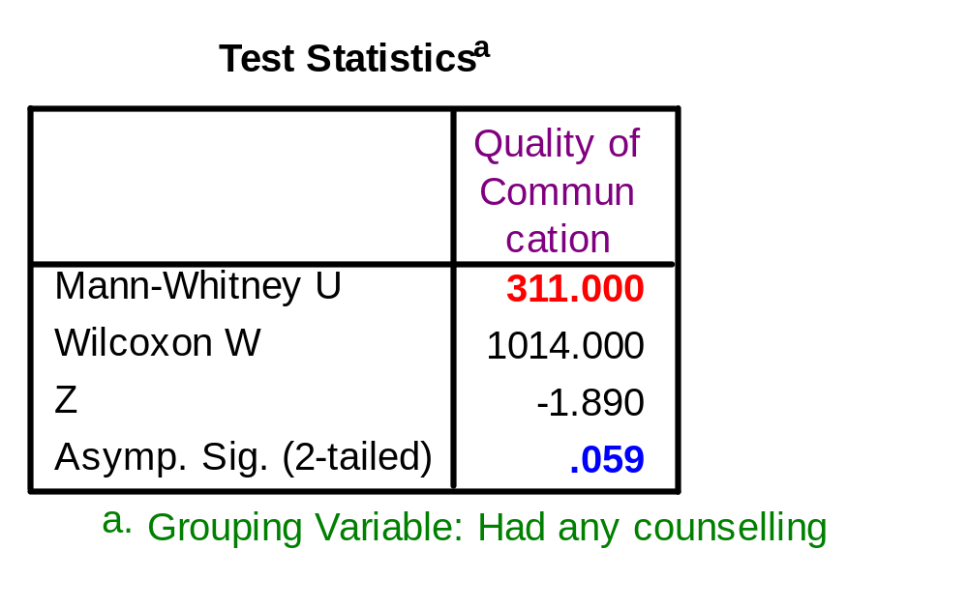
Mann-Whitney U in SPSS (cont.)
There was no significant effect of Having Counselling on Quality of Communication, U = 311.00, p = .059, Mdn_{H} = 4.0, Mdn_{N} = 3.0. [try Descriptive Stats>Explore]

Slide 7
Effect Size in Mann-Whitney U
Must be calculated manually, using the following formula:
Z
√N
- 1.89
√60
Use existing research or Cohen’s effect size “estimates” to interpret the meaning of the r score: “There is a small difference between the therapy and no therapy groups, r = -.24”
r = ̶ ̶̶ ̶ ̶̶
r = ̶ ̶̶ ̶ ̶̶ r = -.24499

Slide 8
Review & Practice: Mann-Whitney U
… There was no significant effect of Having Counselling on Quality of Communication, U = 311.00, p = .06, Mdn_{H} = 4.0, Mdn_{N} = 3.0. There is a small difference between the therapy and no therapy groups, r = -.24. …
Try: Is there a significant difference between spouses who report communication problems and spouses who have not (“Com_prob”), in terms of the level of conflict they experience (“Conflict”)?
What is the size of the effect?

Slide 9
Between-Subjects Designs: Kruskall-Wallis
Design: Non-parametric, continuous DV; two or more comparison groups; different participants in each group (parallel to the one-way ANOVA).
Examples of research designs needing this statistic?
Purpose: To determine if there is an overall effect of the IV on the DV (i.e., if at least 2 groups are different from each other), while controlling for experiment-wise inflation of Type I error
Data Structure: 1 variable to represent the groups in the IV; 1 variable of scores on the DV.

Slide 10
Running Kruskall-Wallis in SPSS
Running the analysis: analyze> nonparametric>
K independent samples> “Kruskall-Wallis H”
Enter the highest and lowest group numbers in the “define groups” box.
(If available) switch from “asymptotic” method of calculation to “exact” analyze> nonparametric>
2 independent samples> “Exact” (requires optional SPSS module & may require longer computing time)
For illustration in our data set:
IV = Type of Counselling & DV = Level of Conflict

Slide 11
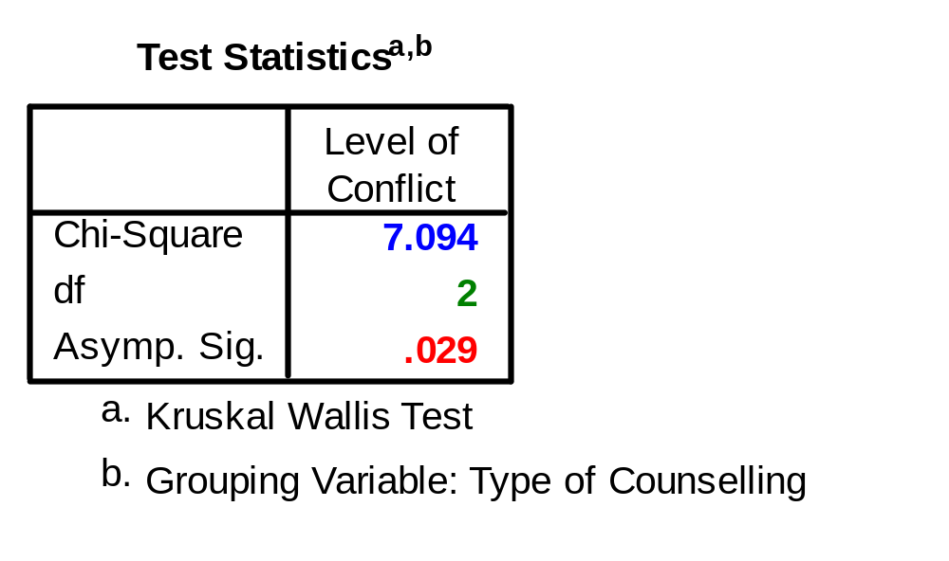
Kruskall-Wallis H in SPSS (cont.)
Type of counselling has a significant effect on participants’ level of conflict, χ²(2) = 7.09, p = .029. Specifically… [report medians & post hoc results…]
Notes:
Note: Asymptotic significance vs. Exact vs. Monte Carlo estimation

Slide 12
Following-up a Significant K-W Result
If overall KW test is significant, conduct a series of Mann-Whitney tests to compare the groups, but with corrections to control for inflation of type I error.
No option for this in SPSS, so manually conduct a Bonferroni correction (α = .05 / number of comparisons) and use the corrected α -value to interpret the results.
Consider comparing only some groups, chosen according to (a) theory, (b) your research question; or (c) listing from lowest to highest mean ranks, and comparing each group to next highest group

Slide 13
Effect Size in Kruskall-Wallis
SPSS has no options to calculate effect-size, so it must be done manually (by us…).
Instead of calculating overall effect of the IV, it is more useful to calculate the size of the difference for every pair of groups that is significantly different from each other (i.e., from the Mann-Whitney Us):
Z
√n _{groups}
r _{groups} = ̶ ̶̶ ̶ ̶̶
Number of participants in that pair of groups

Slide 14
Reporting Kruskall-Wallis analyses
… Type of Counselling has a significant effect on participants’ level of conflict, χ²(2) = 7.09, p = .029. Specifically, the No Counselling group had higher conflict scores, Mdn_{N} = 4.0, than did the Couples Counselling group, Mdn_{C} = 3.0, Mann-Whitney U = 176.5, Z = -2.61,
p = .009, r = -.37.
… also note that Field uses another notation for the K-W: … H(2) = 7.09 …
Note: Bonferroni correction: .05 / 3 = .017

Slide 15
Reporting K-W analyses (cont.)
Note: The median for the Individual Counselling grp is Mdn = 3.0, & sometimes is not reported → we often include this kind of information to give readers a more complete “picture” or description of results. In this case, we would need to give more detailed descriptions about the medians, and that would be too much detail.
Notes:
p. 548, Field

Slide 16
“Checking” nonparametrics…
Comparison of these results with the corresponding ANOVA may be able to lend more confidence in the overall adequacy of the patterns reported.
Nonparametric analyses tend to have less power for well-distributed DVs, but they can be more sensitive to effects when the DV is truly bimodal, for instance!

Slide 17
“Checking” nonparametrics: EX
E.g., Type of Counselling (IV) and Level of Conflict (DV) with a one-way ANOVA (run Levene test & Bonferroni post hoc comparisons) shows us comparable results: F(2, 57) = 4.05, p = .023, with the No Counselling group showing more conflict than the Couples Counselling group, M_{N} = 3.87 and M_{N} = 3.04 (“fitting” well with nonparametric results). → “approximations” help check

Slide 18
Non-Sig Kruskall-Wallis analyses
If the research question behind the analysis is “important,” we may need to explore the possibility of low power or other potential problems. In those cases, a descriptive follow-up analysis can be helpful. See the illustration in the Friedman’s ANOVA discussion below for some clues.

Slide 19
Non-Parametric Options for Factorial Between-Subjects Comparisons
SPSS does not provide non-parametric equivalents to Factorial ANOVA (i.e., 2 or more IVs at once).
One option is to convert each combination of the IVs into a single group, and run a Kruskall-Wallis, comparing groups on the newly created variable.
Disadvantages: (a) reduced ability to examine interaction effects; (b) can end up with many groups
Advantages: (a) can require “planned comparison” approaches to interactions, drawing on clear conceptualization; (b) can redefine groups flexibly
Alternatives: Separate K-W tests for each IV; convert to ranks and do a loglinear analysis; and others.

Slide 20
Example: Nonparametric “Factorial” Analysis
Research question: How do Marital Status & Type of Counselling relate to conflict levels? → Type of Counselling & Marital Status (IVs) and Level of Conflict (DV)
Crosstabs for the 2 IVs show that cell sizes are “good enough” (smallest cells, for individual counselling, have 5 & 6 people per group)

Slide 21
Nonparametric “Factorial” …
6 Groups: Individual counsel & married; Individ & divorced; Couples counselling & Married; Couples counselling & divorced; No counselling & Married; No counselling & Divorced.
Create a new IV, with these 6 groups, coded as 6 separate groups (using Transform > Recode into Different Variables & “If” conditions, for instance)

Slide 22
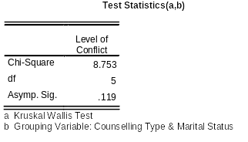
The K-W test for the combined variable is not significant. This result suggests that the significant effect for Counselling Type is masked when combined with Marital Status.

Slide 23
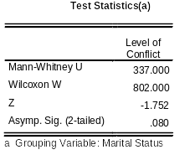
The idea of a “masking effect” of Marital Status shows as well when we test that main effect alone.

Slide 24
Interaction issues: A note
Divorced-No counselling group assumed to have high conflict levels can be compared some of the other 5 groups with Mann-Whitney U tests, as a “theoretically guided” replacement for interaction tests in non-parametric analysis. The choice depends on conceptual relations between the IVs.

Slide 25
More Practice: Kruskall-Wallis
Is there a significant effect of number of children (“children,” with scores ranging from 0 to 3) on quality of marital communication (quality)?

Slide 26
Within-Subjects 2-cell Designs: Wilcoxon Signed-rank test
Requirements: Non-parametric, continuous DV; two comparison cells/times/conditions; related (or the same) participants in both repetitions. → this analysis parallels the “paired-samples” t-test
Examples of research designs needing this statistic?
Purpose: To determine if there is a significant difference between the two times/groups.
Data Entry: Separate variables to represent each repetition of scores on the DV.

Slide 27
Running Wilcoxon Signed-rank in SPSS
Running the analysis: analyze > nonparametric
> 2 related samples> “Wilcoxon”
Select each pair of repetitions that you want to compare. Multiple pairs can be compared at once (but with no correction for doing multiple tests).
  (If available) switch from “asymptotic” method of calculation to “exact” analyze > nonparametric >
  2 related samples> “Exact”
Practise: does level of conflict decrease from pre-therapy (Pre-conf) to post-therapy (Conflict)?

Slide 28
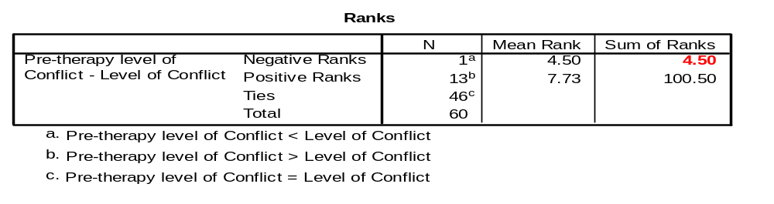
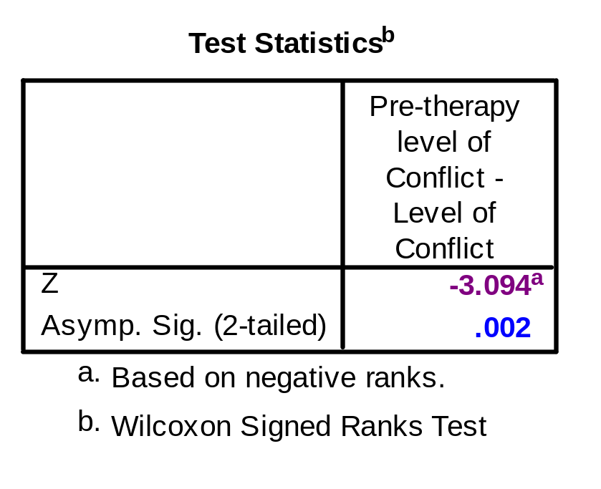
Running Wilcoxon Signed-rank in SPSS (Cont.)
There was a significant reduction in level of conflict after therapy, T = 4.5, p = .002 OR Z = -3.09, p = .002 [effect size added here]
Notes:
T = the smallest of the sums of ranks (Field).

Slide 29

Effect Size in Wilcoxon Signed-rank test
Must be calculated manually, using the following formula:
Z
√N _{observations}
- 3.09
√120
The N here is the total number of observations that were made (typically, participants x 2 when you have two levels of the w/i variable [times], & so on)
r = ̶ ̶̶ ̶ ̶̶
r = ̶ ̶̶̶ ̶ ̶̶ ̶ ̶ r = -.28

Slide 30
Wilcoxon Signed-rank: Practice
Is there a significant change between pre-therapy levels of conflict (Pre_conf) and level of conflict 1 year after therapy (Follow_conf)?
If so, calculate the size of the effect. Note that participant attrition at time 3 (i.e., Follow_conf) changes the total number of observations that are involved in the analysis.
EX: “There was a significant reduction in level of conflict after therapy, T = 4.5, p = .002
[OR Z = -3.09, p = .002], r = -.28.”

Slide 31
Within-Subjects Designs for 3 or more cells: Friedman’s ANOVA
Requirements: Non-parametric, continuous DV; several comparison groups/times; related (or the same) participants in each group. Repeated measures
Examples of research designs needing this statistic?
Purpose: To determine if there is an overall change in the DV among the different repetition (i.e., if scores in at least 2 repetitions are different from each other), while controlling for inflated Type I error.
Data Entry: A separate variable for each repetition of scores on the DV (= each “cell”).

Slide 32
Running Friedman’s in SPSS
Running the analysis: analyze >nonparametric
>K related samples > “Friedman”
Move each repetition, in the correct order, into the “test variables” box.
(If available) switch from “asymptotic” method of calculation to “exact” analyze> nonparametric
> K related samples> “Exact” (requires optional SPSS module

Slide 33
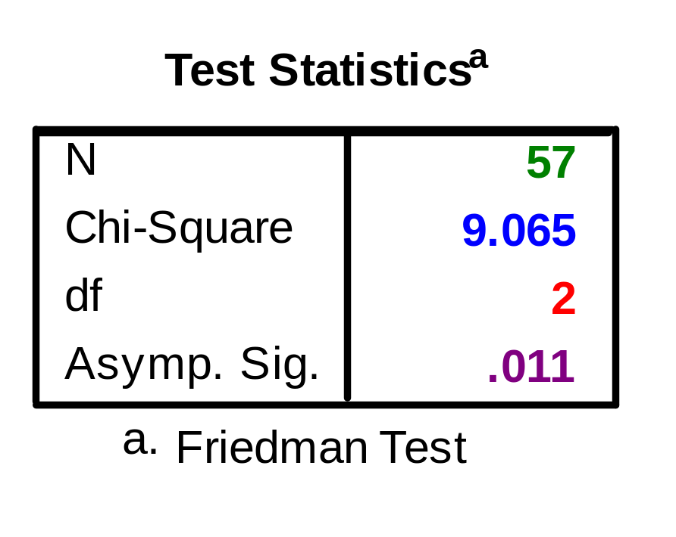
Running Friedman’s ANOVA in SPSS (Cont.)
There was a significant change in levels of conflict over time, χ²(2, N = 57) = 9.07, p = .011. Specifically… [report of post hoc results goes here]

Slide 34
Following-up a Significant Friedman’s Result: Post hoc tests
If Friedman’s is significant, one may conduct a series of Wilcoxon Signed-ranks tests to identify where the specific differences lie, but with corrections to control for inflation of type I error.
Calculate a Bonferroni correction to the significance level (α = .05 / number of comparisons) and use the corrected α-value to guide your interpretation of the results. Reminder: Bonferroni corrections are overly conservative, so they might not be significant.

Slide 35
Post hoc Median comparisons following a Friedman’s Test: 2
If you have many levels of the IV (“repetitions,” “times,” etc.) consider comparing only some of them, chosen according to (a) theory or your research question; or (b) time 1 vs. time 2, time 2 vs. time 3, time 3 vs. time 4, etc.
Strategy for the No. of Comparisons: For instance, one makes only k – 1 comparisons (max), where k = # of levels of the IV. This suggestion for restricting comparisons is more important if the effect sizes or power are low, or the # of cells is large, thus exaggerating Type II error.

Slide 36
Our Example: 3 cells
Post hoc analyses: 3 Wilcoxon’s @ .05 overall p. → Bonferroni correction is .017 as a significance level cutoff
Pre-Post comparison: z = - 3.09, p = .002, r = -.28
Pre-One year later: z = - 2.44, p = .015,
r = -.22; Post-to-One year later: ns
Thus, improvement after therapy is maintained at the follow-up assessment.

Slide 37
REPORT in article…
There was a significant change in levels of conflict over time, χ² (2, N = 57) = 9.07, p = .011. Specifically, conflict reduced from pre-therapy levels at post-therapy observations, Z = -3.09, p = .002, r = -.28, and levels remained below pre-therapy conflict levels one year later, Z = -2.44, p = .015, r = -.22.
Notes:
<There was no additional decrease in conflict levels after therapy was completed, Z = -.28, p = .782.>

Slide 38
Following-up a Non-significant Friedman’s Result
If Friedman’s is not significant, we often need to consider whether the results reflect low power or some other source of Type II error. This holds for any analysis, but we can illustrate the process here.
Conduct a series of Wilcoxon Signed-ranks tests, but the focus of attention is on effect sizes, not on significance levels (to describe effects in this sample).
If the effect sizes are in a “moderate” range, say > .25, then the results could be worth reporting.
Enough detail should be reported to be useful with future meta-analyses.

Slide 39
Friedman’s Practice
Load the “Looks or Personality” data set (Field)
Is there a significant difference between participants’ judgements of people who are of average physical appearance, but present as dull (“ave_none”); somewhat charismatic (“ave_some”), or as having high charisma (“ave_high”)?
If so, conduct post-hoc tests to identify where the specific differences lie.

Slide 40
Between-Subject Designs
Non-Parametric
Mann-Whitney /
Wilcoxon rank-sum
Kruskal-Wallis
  Further post-hoc tests if significant (H or χ²)
  Use Mann-Whitney
Parametric
Independent samples
t-test (1 IV, 1 DV)
One-way ANOVA
(1 IV w/ >2 levels, 1 DV)
  Further post-hoc tests if F-ratio significant
Factorial ANOVA
( ≥2 IVs, 1 DV)
  Further post-hoc tests if F-ratio significant

Slide 41
Within-Subjects Designs
Non-Parametric
Wilcoxon Signed-rank
Friedman’s ANOVA
  Further post-hoc tests if significant
Parametric
Paired/related samples t-test
Repeated Measures ANOVA
  Further investigation needed if significant

Slide 42
Categorical Data Analyses
Chi-square (χ²): Two categorical variables. Identifies whether there is non-random association between the variables. (review)
Loglinear Analysis: More than two categorical variables. Identifies the relationship among the variables and the main effects and interactions that contribute significantly to that relationship.
McNemar / Cochran’s Q: One dichotomous categorical DV, and one categorical IV with two or more groups. Identifies if there are any significant differences between the groups. McNemar is used for independent IVs, Cochran for dependent IVs.

Slide 43
Assumptions & Requirements to Conduct a χ² Analysis
Usually two variables: Each variable may have two or more categories within it.
Independence of scores: Each observation/person should be in only one category for each variable and, therefore, in only one cell of the contingency table.
Minimum expected cell sizes: For data sets with fewer cells, all cells must have expected frequencies of > 5 cases; for data sets with a larger numbers of cells, 80% of cells (rounded up) must have expected frequencies of > 5 cases AND no cells can be empty. Analyse >descriptives >crosstabs >cells> “expected”

Slide 44
Doing χ² Analysis in SPSS
Data entry: It is often better to enter the data as raw scores, not weighted cases (for small data sets).
Assess for data entry errors and systematic missing data (but not outliers). Assess for assumptions and requirements of chi-square.
(If available, change the estimation method to Exact Test Analyse>descriptives> crosstabs>exact…> “Exact” This requires an additional SPSS module.)
Run the main χ² analysis: Analyse >descriptives
>crosstabs >statistics > “chi-square”

Slide 45
Types of χ² Tests
Pearson Chi-square: Compares the actual scores you observed in each cell, against what frequencies of scores that you would have expected, due to chance.
Yates’ Continuity Correction: Adjustment to Pearson Chi-square, to correct for inflated estimates when you have a 2 x 2 contingency table. However, it can overcorrect, leading to underestimation of χ².
Likelihood Ratio Chi-square (Lχ²): Alternative way to calculate chi-square, based on maximum likelihood methods. Slightly more accurate method of estimation for small samples, but it’s less well known.

Slide 46
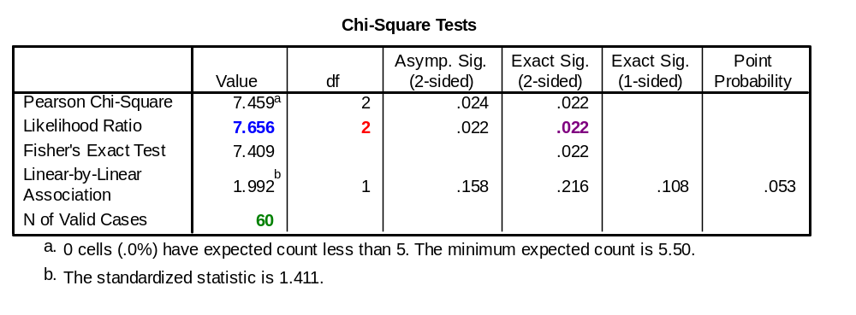
Interpreting a χ² Result
Ideally, all three types of χ² will yield the same conclusion. When they differ, the Likelihood Ratio is preferred method (esp. for 2 x 2 contingency tables).
There is a sig. association between marital status and type of therapy, Lχ² (2, N = 60) = 7.66, p = .022, with [describe strength of association or odds ratios].

Slide 47
Effect Sizes in χ²
Strength of Association: There are several ways to convert a χ² to run from 0 to 1, to be able to interpret it like a correlation (r not r²):
  (a) Phi Coefficient (accurate for 2x2 designs only);
  (b) Cramer’s V (accurate for all χ² designs);
  (c) Contingency Coefficient (estimates can be too conservative… normally, do not use this one).
Analyse >descriptives >crosstabs >statistics> “Phi and Cramer’s V”
Odds Ratio: For a 2 x 2 contingency table, calculate the odds of getting a particular category on one variable, given a particular category on the other variable. Must be done “by hand” (see p. 694 of text).

Slide 48
From χ² to Loglinear Analysis
Χ² is used commonly with two categorical variables.
Loglinear Analysis is usually recommended for three or more categorical variables.

Slide 49
Preview: Loglinear Analysis …
…Used as a parallel “analytic strategy” to factorial ANOVA when the DV is categorical rather than ordinal (but a conceptual DV is not required)
So the general principles also parallel those of multiple regression for categorical variables
Conceptual parallel: e.g., Interactions = moderation among relationships.

Slide 50
Journals: Loglinear Analysis
Fitzpatrick et al. (2001). Exploratory design with 3 categorical variables.
Coding systems for session recordings & transcripts: counsellor interventions, client good moments, & strength of working alliance
Therapy process research: 21 sessions, male & female clients & therapists, expert therapists, diverse models.

Slide 51
Abstract: Interpreting a study
Client ‘good moments’ did not necessarily increase with Alliance
Different interventions fit with Client Information good moments at different Alliance levels.
“Qualitatively different therapeutic processes are in operation at different Alliance levels.”
Explain each statement & how it summarizes the results.

Slide 52
Research question
What associations are there between WAI, TVRM, & CGM for experts?
Working Alliance Inventory (Observer version: low, moderate, high sessions)
Therapist Verbal Response Modes (8 categories: read from tables)
Client Good Moments (Significant Information-I, Exploratory-E, Affective-Expressive-A) (following T statements)
Notes:
N = 2007 statement pairs from those 21 sessions

Slide 53
Analysis Strategy
Loglinear analysis starts with the most complex interaction (“highest order”) and tests whether it adds incrementally to the overall model fit (cf. the idea of ΔR² in regression analysis).
The 3-way interaction can be dropped in a couple of analyses, but not in one.
Interpretation thus focuses on 2-way interactions & a 3-way interaction.

Slide 54
Sample Results
Exploratory Good Moments tended to occur more frequently in High Alliance sessions (2-way interaction).
Alliance x Interventions interaction: Structured interventions (guidance) take place in Hi or Lo Alliance sessions, while Unstructured interventions (reflection) are higher in Moderate Alliance sessions (see figure).

Slide 55
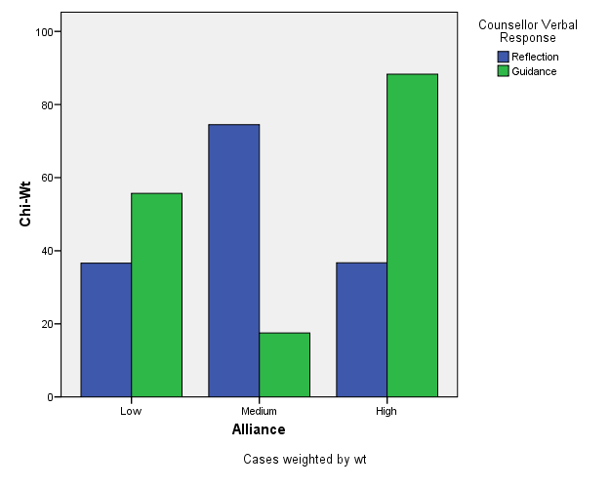
Notes:
From Table 5, p. 158; Fitzpatrick & al. (2001). Chi-square weights transformed in this graph can be interpreted as “relative deviation” descriptors, allowing comparability across cells, but without specific significance levels. (Parameter testing exaggerates experiment-wise error rates in this particular research design). N = 2007 T-C statement pairs in 21 therapy sessions, approx. 96 statements per session.

Slide 56
Explain: What does it mean?
Alliance x Interventions interaction: Structured interventions (guidance) take place in Hi or Lo Alliance sessions, while Unstructured interventions (reflection) are higher in Moderate Alliance sessions → describes shared features of “working through” and “working with” clients, different functions of safety & guidance.

Slide 57
Explaining “practice”:
(a) Explain: Exploratory Good Moments tended to occur more frequently in High Alliance sessions (2-way interaction).
(b) How does the article show that this effect is significant?
→ Relatively “easy” questions.

Slide 58
Appendixes
Slides with information on Exact tests
A slide on ways to format tables in accord with APA style

Slide 59
Exact tests: for small samples & rare occurrences
Assumptions. Asymptotic methods assume that the dataset is reasonably “large,” and that tables are densely populated and well balanced. If the dataset is small, or tables are sparse or unbalanced, the assumptions necessary for the asymptotic method have not been met, & we can benefit by using the “exact” or the Monte Carlo methods.
Notes:
SPSS Exact Tests provides you with more than 30 exact tests, which cover the entire spectrum of nonparametric and categorical data problems for small or large datasets. These tests include one-sample, two-sample and K-sample tests on independent or related samples, goodness-of-fit tests, tests of independence in RxC contingency tables and on measures of association.

Slide 60
EXACT TESTS
Exact. The probability of the observed outcome or an outcome more extreme is calculated exactly. Typically, a significance level less than 0.05 is considered significant, indicating that there is some relationship between the row and column variables.
Moreover, an exact test is often more appropriate than an asymptotic test because randomization rather than random sampling is the norm, for example in biomedical research.

Slide 61
Monte Carlo Estimates
Monte Carlo Estimate. An unbiased estimate of the exact significance level, calculated by repeatedly sampling from a reference set of tables with the same dimensions and row and column margins as the observed table. The Monte Carlo method allows you to estimate exact significance without relying on the assumptions required for the asymptotic method. This method is most useful when the data set is too large to compute exact significance, but the data do not meet the assumptions of the asymptotic method.

Slide 62
From SPSS help files
Example. Asymptotic results obtained from small datasets or sparse or unbalanced tables can be misleading. Exact tests enable you to obtain an accurate significance level without relying on assumptions that might not be met by your data. For example, results of an entrance exam for 20 fire fighters in a small township show that all five white applicants received a pass result, whereas the results for Black, Asian and Hispanic applicants are mixed. A Pearson chi-square testing the null hypothesis that results are independent of race produces an asymptotic significance level of 0.07. This result leads to the conclusion that exam results are independent of the race of the examinee. However, because the data contain only 20 cases and the cells have expected frequencies of less than 5, this result is not trustworthy. The exact significance of the Pearson chi-square is 0.04, which leads to the opposite conclusion. Based on the exact significance, you would conclude that exam results and race of the examinee are related. This demonstrates the importance of obtaining exact results when the assumptions of the asymptotic method cannot be met. The exact significance is always reliable, regardless of the size, distribution, sparseness, or balance of the data.

Slide 63
SPSS exact stats
SPSS has Exact stats options for NPAR TESTS and CROSSTABS commands
You may have to use syntax commands to use this option. See SPSS help files for further information.

Slide 64
Formatting of Tables (for Project, Thesis, etc.)
Use the “insert table” and “table properties” functions of MSWord to build your tables; don’t do it manually.
General guidelines for table formatting can be found on pages 147-176 of the APA manual.
Additional tips, instructions and examples for how to construct tables can be down-loaded from the NCFR web-site: http://oregonstate.edu/~acock/tables/
In particular, pay attention to the column alignment article, for how to get your numbers to align according to the decimal point (which is where it should be).

