Slide 1
CPSY 501: Lecture 12, Nov 21
Please download Hill & Lent (2006)…
Review non-parametric tests
Categorical analysis: χ², Log-Linear
Meta-analysis: e.g., Hill & Lent article
Review: Cycles in data analysis
MANOVA – journal article (by J.N.)

Slide 2
Between-Subject Designs
Non-Parametric
Mann-Whitney /
Wilcoxon rank-sum
Kruskal-Wallis
  Further post-hoc tests if significant (H or χ²)
  Use Mann-Whitney
Parametric
Independent samples
t-test (1 IV, 1 DV)
One-way ANOVA
(1 IV w/ >2 levels, 1 DV)
  Further post-hoc tests if F-ratio significant
Factorial ANOVA
( ≥2 IVs, 1 DV)
  Further post-hoc tests if F-ratio significant

Slide 3
Within-Subjects Designs
Non-Parametric
Wilcoxon Signed-rank
Friedman’s ANOVA
  Further post-hoc tests if significant
Parametric
Paired/related samples t-test
Repeated Measures ANOVA
  Further investigation needed if significant

Slide 4

Categorical Data Analyses
Chi-square (χ²): Two categorical variables. Identifies whether there is non-random association between the variables.
Loglinear Analysis: More than two categorical variables. Identifies the relationship among the variables and the main effects and interactions that contribute significantly to that relationship.
McNemar / Cochran’s Q: One dichotomous categorical DV, and one categorical IV with two or more groups. Identifies if there are any significant differences between the groups. McNemar is used for independent IVs, Cochran for dependent IVs.

Slide 5
Preview: Loglinear Analysis …
…Used as a parallel “analytic strategy” to factorial ANOVA when the DV is categorical rather than ordinal (but a conceptual DV is not required)
So the general principles also parallel those of multiple regression for categorical variables
Conceptual parallel: e.g., Interactions = moderation among relationships.

Slide 6
Journals: Loglinear Analysis
Fitzpatrick et al. (2001). Exploratory design with 3 categorical variables.
Coding systems for session recordings & transcripts: counsellor interventions, client good moments, & strength of working alliance
Therapy process research: 21 sessions, male & female clients & therapists, expert therapists, diverse models.

Slide 7
Research question
What associations are there between WAI, TVRM, & CGM for experts?
Working Alliance Inventory
(Observer rates: low, moderate, high)
Therapist Verbal Response Modes
(8 categories, read from tables)
Client Good Moments
Significant (I)nformation, (E)xploratory, (A)ffective-Expressive
Notes:
N = 2007 statement pairs from those 21 sessions

Slide 8
Abstract: Interpreting a study
Client ‘good moments’ did not necessarily increase with Alliance
Different interventions fit with Client Information good moments at different Alliance levels.
“Qualitatively different therapeutic processes are in operation at different Alliance levels.”
Explain each statement & how it summarizes the results.

Slide 9
Top-down Analysis
Loglinear analysis starts with the most complex interaction (“highest order”) and tests whether it adds incrementally to the overall model fit
  Compare with ΔR² in regression analysis
Interpretation focuses on a 3-way interaction and the 2-way interactions

Slide 10
Sample Results
2-way CGM-E x WAI interaction:
  Exploratory Good Moments tended to occur more frequently in High Alliance sessions
2-way WAI x Interventions interaction:
  Structured interventions (guidance) take place in Hi or Lo Alliance sessions, while
  Unstructured interventions (reflection) are higher in Moderate Alliance sessions
  (see figure).

Slide 11
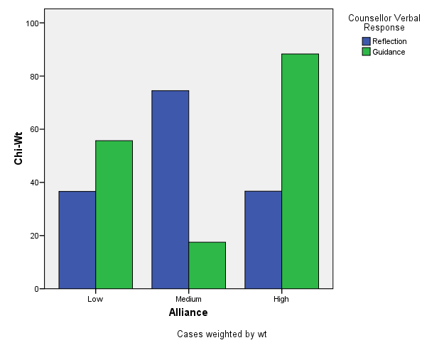
Notes:
From Table 5, p. 158; Fitzpatrick & al. (2001). Chi-square weights transformed in this graph can be interpreted as “relative deviation” descriptors, allowing comparability across cells, but without specific significance levels. (Parameter testing exaggerates experiment-wise error rates in this particular research design). N = 2007 T-C statement pairs in 21 therapy sessions, approx. 96 statements per session.

Slide 12
Explain: What does it mean?
Alliance x Interventions interaction:
  Structured interventions (guidance) take place in Hi or Lo Alliance sessions, while
  Unstructured interventions (reflection) are higher in Moderate Alliance sessions:
  Describes shared features of “working through” and “working with” clients, different functions of safety & guidance.

Slide 13
Explaining “practice”:
(a) Explain: Exploratory Good Moments tended to occur more frequently in High Alliance sessions (2-way interaction).
(b) How does the article show that this effect is significant?

Slide 14
Formatting of Tables in MS-Word
Use the “insert table” and “table properties” functions of Word to build your tables; don’t do it manually.
General guidelines for table formatting can be found on pages 147-176 of the APA manual.
Additional tips and examples for how to construct tables can be downloaded from the NCFR website: http://oregonstate.edu/~acock/tables/
In particular, pay attention to the column alignment article, for how to get your numbers to align according to the decimal point.

Slide 15
Meta-Analysis
The APA journal has basic standards for literature review in many areas
Meta-Analysis (MA) is a tool for combining results of quantitative studies in a systematic, quantitative way.
Example MA journal article:
Hill, C. E., & Lent, R. W. (2006). A narrative and meta-analytic review of helping skills training: Time to revive a dormant area of inquiry. Psychotherapy: Theory, Research, Practice, Training, 43(2), 154–172.

Slide 16
MA focuses on Effect Sizes
Choose groups of studies and subgroups of studies to combine and compare
g : difference between the means divided by the pooled standard deviation
d : unbiased estimates of the population effect size are reported by each study

Slide 17
Combining effect sizes (EX)
Example: r₁ = .22 and r₂ = .34
  N₁ = 125 and N₂ = 43
Unweighted average:
(.22 + .34) / 2 = .28
Weighted average:
[ .22(125)+.34(43) ] / (125 + 43) = .25
The larger sample has a smaller effect size!

Slide 18
Persuasiveness of MA:
Quality of studies (design, etc.)
Comparability of studies (variables, measures, participants, etc.) → esp. moderating factors
RQ: Differences among types of training? (instruction, modeling, feedback)
Do we have any information on the “amount” of training time examined in these various studies?
Clearly state what possible impact you can envision of the factor you raise in your question.

Slide 19
Hill & Lent (2006)
p. 159: summary of meta-analysis strategies & symbols used here
p. 160: list of studies being summarized
(k = 14) & outcome measures, etc.
Multiple measures were aggregated within each study by calculating a mean effect size and standard error
Use Cohen’s (1988) criteria:
d=.2 (small), d=.5 (med), d=.8 (large)

Slide 20
Global analysis
“Given its potential to disproportionately influence effect sizes, especially in a relatively small set of studies, the outlier study was omitted in our subsequent analyses.” (p. 161)
13 studies left …
Pros & cons of this omission?

Slide 21
Questions… pre-assignment
Note: The same group of studies is used in all sections of Hill&Lent…
How do the different research questions shape the MA calculations?
How do confidence intervals help us interpret effect sizes (ES)?
How do we integrate the results of different research questions?
Notes:
Being a professional means looking things up when you don’t know.

Slide 22
Review: Cycles in data analysis
Data preparation cycles
Plan Analysis
Exploration Stage
Clean / Fix Data

Slide 23
Data analysis cycles
Run Analyses
Formulate Results
post hocs & simple effects
follow-ups to non-significant results
(re)Format Data Set

Slide 24
Analysis ‘checking’ cycles
Background Analyses
Confirm results…
(non)parametric checks
Moderation analyses, etc.
(re)Explore Data Structure

Slide 25
Appendix: Factor Analysis
This term, we haven’t provided explanations of examples for introducing you to informed reading of journal articles.
The references we’ve used in the class do provide introductions as you continue to educate yourselves.
Another example:

Slide 26
Factor Analysis: Categorical data
Maraun, M. D., Slaney, K., & Jalava, J. (2005). Dual scaling for the analysis of categorical data. Journal of Personality Assessment, 85, 209–217.
This is an “introductory” discussion, for disseminating descriptions of this procedure to professionals

