Slide 1
CPSY 501: Lec13, 28Nov
MANOVA: reading and interpreting
  Lecture notes from Rubab Arim (UBC)
Sample journal article:
  Lecture notes from Jess Nee
Range, L. M., Kovac, S. H., & Marion, M. S. (2000). Does writing about the bereavement lessen grief following sudden, unintentional death? Death Studies, 24, 115-134.
Further reading: Factor Analysis

Slide 2

I think we all liked this one (-:
Notes:
I think we all liked this one

Slide 3
MANOVA: multiple DVs
Notes from Rubab G. Arim, MA: rubab@interchange.ubc.ca Dec06
Extension of ANOVA to multiple DVs, which may be correlated
Assumptions:
  Sample size, normality, outliers, linearity, multicollinearity, homogeneity of variance-covariance matrices

Slide 4
Checking assumptions
Descriptive Statistics
  Check N values (more subjects in each cell than the number of DVs)
Box’s Test
  Checking the assumption of variance-covariance matrices
Levene’s Test
  Checking the assumption of equality of variance

Slide 5
Interpretation of the output
Multivariate tests
  Wilks’ Lambda (most commonly used)
  Pillai’s Trace (most robust)
  (see Tabachnick & Fidell, 2007)
Tests of between-subjects effects
  Use a Bonferroni Adjustment
  Check Sig. column

Slide 6
Interpretation (cont’)
Effect size
  Partial Eta Squared: the proportion of the variance in the DV that can be explained by the IV (see Cohen, 1988)
Comparing group means
  Estimated marginal means
Follow-up analyses
  (see Hair et al., 1998; Weinfurt, 1995)
  Weinfurt, K. P. (1995). Multivariate analysis of variance.
  In L. G. Grimm, & P. R. Yarnold (Eds.), Reading and understanding multivariate statistics. Washington, DC: APA. [QA278 .R43 1995]
Notes:
Weinfurt, K. P. (1995). Multivariate analysis of variance. In L. G. Grimm, & P. R. Yarnold (Eds.), Reading and understanding multivariate statistics (pp. ____). Washington, DC: APA. [QA278 .R43 1995]

Slide 7
MANOVA Example: Range et al., 2000
Notes from Jess Nee
Writing about traumatic events produces improvement after intervention ends
  physical health
  psychological functioning
Need more systematic research to assess with specific populations
Current study: Writing about the events and emotions surrounding the death of a loved one by sudden, unintentional causes

Slide 8
Participants
N = 64 undergraduate students
  (20 did not complete…)
Bereaved within the past 2.5 years due to an accident or homicide, mildly to extremely close to the deceased, and upset by the death
Experimental design: random assignment to 2 different writing conditions:
Profound or Trivial (control condition)

Slide 9
Procedure
Pre-test measures of depression, anxiety, grief, impact, and non-routine health visits
Wrote 15 min per day for 4 days on either
  profound (on death of loved one) OR
  trivial (unrelated topic) topics
Post-test with same measures
Follow-up after 6 weeks

Slide 10
Measures
Multiple Affect Adjective Checklist-Revised (MAACL-R)
Self-rating Depression Scale (SDS)
Impact of Event Scale (IES)
Grief Recovery Questions (GRQ)
Grief Experience Questionnaire (GEQ)

Slide 11
Research Question
Range et al., 2000
RQ: Does writing about the accidental or homicidal deaths of loved ones improve bereavement recovery in the areas of physical and psychological functioning?
Hypotheses – The profound condition will show:
  More negative emotions and mood at post-testing than trivial condition
  More positive mood, more bereavement recovery, fewer health centre visits at follow-up than trivial condition
Notes:
Sociotropy: the degree to which an individual’s sense of self is dependent on his or her social relationships.

Slide 12
Variables
IV(s)
  Condition (Profound vs. Trivial)
  Time (Pre-, Post-, or Follow-up)
DV(s)
  MAACL-R
  SDS
  IES
  GRQ
  GEQ

Slide 13
Choice of Test?
Factorial ANOVA
Repeated Measures ANOVA
Mixed Design ANOVA
MANOVA (multivariate analysis of variance)
  – used to examine the effect of the independent variable(s) on a set of two or more correlated dependent variables
Notes:
Factorial ANOVA - when the experimenter wants to study the effects of two or more treatment variables

Slide 14
Why MANOVA?
Controlling against Type I error:
  Conducting multiple statistical tests increases the probability of falsely rejecting the null hypothesis.
Notes:
Concrete example of or illistration of
2 correlated dependent variable
if we do two univariate analyses on them how can we interpret the results?
e.g. Use Anxiety and Depression subscales
how would we interpret their ANOVAs?
What might their correlation be?
Hypothetical instance:
e.g. Correlation between anxiety & depression of MAACL of .8
if we have two significant ANOVAs, is the best interpretation that what's changing is anxiety or depression or both?
Another depression measure (SDS) that's not significant
is depression really changing? Or is it just the correlation
in counselling, if impacts only anxiety and not depression, want to know that

Slide 15
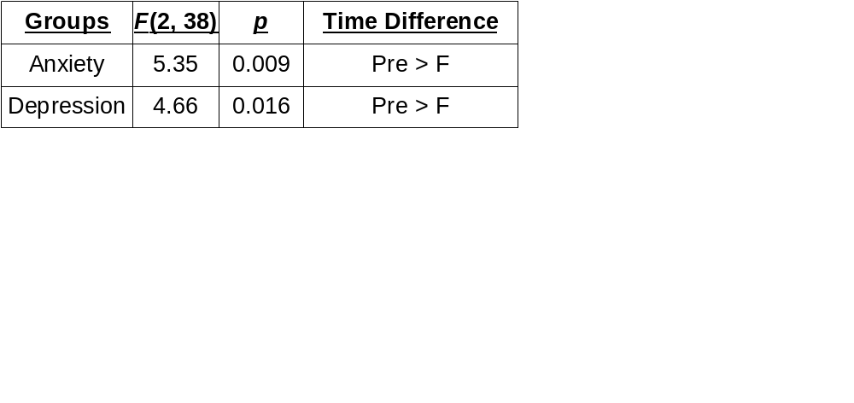
Why not multiple ANOVAs?
2 (Condition: Profound, Trivial) x 3 (Time: Pre-, Post-, Follow-up) separate ANOVAs:
If Anxiety and Depression had a correlation of r = .80, how would we interpret the ANOVAs?

Slide 16
Why MANOVA?
Controlling against Type I error
Multivariate analysis of effects
  If outcome measures (DV) are correlated,
  they may be partially redundant – MANOVA takes these correlations into account, removing redundancy
  Dependent variables treated as a whole system
Notes:
Concrete example of or illistration of
2 correlated dependent variable
if we do two univariate analyses on them how can we interpret the results?
e.g. Use Anxiety and Depression subscales
how would we interpret their ANOVAs?
What might their correlation be?
Hypothetical instance:
e.g. Correlation between anxiety & depression of MAACL of .8
if we have two significant ANOVAs, is the best interpretation that what's changing is anxiety or depression or both?
Another depression measure (SDS) that's not significant
is depression really changing? Or is it just the correlation
in counselling, if impacts only anxiety and not depression, want to know that

Slide 17
Tests
Range et al., 2000
A 2 (Condition: Profound vs. Trivial) x 3 (Time: Pre-, Post-, or Follow-up)
between-within repeated measures mixed-design MANOVA
on the SDS, IES, GRQ, GEQ, and the subscales of MAACL-R

Slide 18
Tests
TREATMENT RESEARCH DESIGN
Pre-Test
Post-Test
Follow-up
S
I
GR
GE
M
S
I
GR
GE
M
S
I
GR
GE
M
Profound
Trivial

Slide 19
Results
Range et al., 2000
Did not report multivariate statistic,
  e.g. Wilks' Λ
“Significant main effect for time”,
  F(18, 22) = 4.80, p = .001.
“No main effect for condition”
“No interaction”
Notes:
Type out table

Slide 20
Follow-up significant effects
Range et al., 2000
ANOVAs were used to follow-up the main effect for time
2 (Condition) x 3 (Time: Pre-, Post-, Follow-up) ANOVAs for each subscale
Notes:
Any information that's beneficial to practitioners?
Realistic in field?

Slide 21
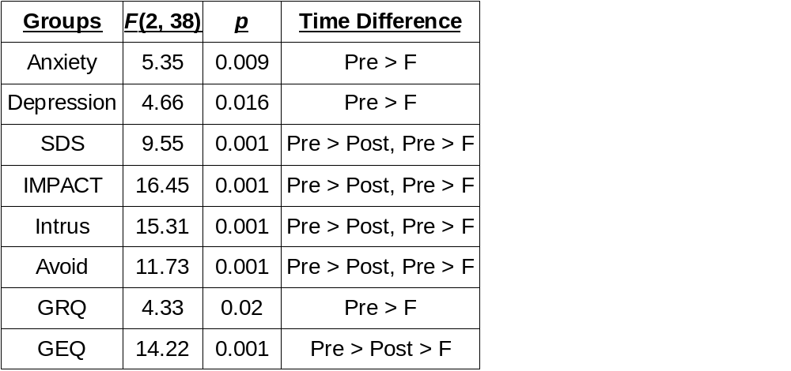
Follow-up main effect on Time
Range et al., 2000
ANOVA results for each DV
MAACL-R
Subscales
IES
IES Subscales
Tukey HSD for post hoc comparisons

Slide 22
Conclusions
Range et al., 2000
Hypotheses not supported
“Time heals all wounds”?

Slide 23
Factor Analysis
Typically in Psych, can have lots of IVs!
  Which are important?
Exploratory factor analysis (EFA)
  Explore the interrelationships among a set of variables
Confirmatory factor analysis (CFA)
  Confirm specific hypotheses or theories concerning the structure underlying a set of variables

Slide 24
Factor Analysis: References
Kristopher J. Preacher & Robert C. MacCallum (2003). Repairing Tom Swift’s Electric Factor Analysis Machine. UNDERSTANDING STATISTICS, 2(1), 13–43.
Anna B. Costello & Jason W. Osborne (2005). Best Practices in Exploratory Factor Analysis: Four Recommendations for Getting the Most From Your Analysis. Practical Assessment Research & Evaluation, 10(7), 1-9.

Slide 25
FA References: Categorical
Maraun, M. D., Slaney, K., & Jalava, J. (2005). Dual scaling for the analysis of categorical data. Journal of Personality Assessment, 85, 209–217.
This is an “introductory” discussion, for disseminating descriptions of this procedure to professionals

