Slide 1
ch17-18: Swing
  6 Feb 2008
  CMPT166
  Dr. Sean Ho
  Trinity Western University

Slide 2
What's on for today
Swing: vs. AWT, lightweight vs. heavyweight
  Superclass structure of Swing
    Nested and inner classes
  Event handling
    Delegate classes
    Subclasses of ActionEvent
    Sub-interfaces of EventListener
  Swing widgets
    JLabel, JTextField, JPasswordField
    JButton, JCheckBox, JRadioButton, JComboButton
    ItemListener interface and ItemEvent class

Slide 3
Delegate classes
Alternatively: use separate classes
    public class Histogram extends JPanel {
      public Histogram() { ...
        InputHandler handler = new InputHandler();
        widget.addActionListener( handler ); ... };
      private class InputHandler implements ActionListener {
        public void actionPerformed() { ... };
      }
    }
    public class HistogramTest { // in separate file
      public static void createAndShowGUI() { ... };
      public static void main() { ... };
    }
Uses inner class to define event handler

Slide 4
More on event handling
Event classes are in package java.awt.event
The ActionListener interface
uses the actionPerformed() method on
an ActionEvent object

Slide 5
Other EventListener interfaces
ActionListener is but one of many interfaces for handling events
KeyListener: KeyEvent
  Listen for keypresses
MouseListener: MouseEvent
  Press/release, enter/exit
MouseMotion: MouseEvent
  Move, drag

Slide 6
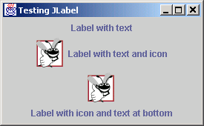
JLabel
Intended to be a text/image widget describing another component
    Label1 = new JLabel( “Rotation” );
  Change the text:
    label1.setText( “Rot” );
  Add a tooltip:
    label1.setToolTipText( “Rotation in degrees” );
  Add an icon:
    Icon rotIcon = new ImageIcon( “rot.gif” );
    label1.setIcon( rotIcon );

Slide 7
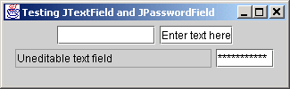
JTextField and JPasswordField
JTextField:
  Single-line widget for user to type in text
    text1 = new JTextField( 10 ); // field width
  Default text:
    text1 = new JTextField( “Type your name here” );
  Disable user editing:
    text1.setEditable( false );
JPasswordField: subclass that shows only dots
The ActionListener event handler should use
event.getActionCommand() to get the text

Slide 8
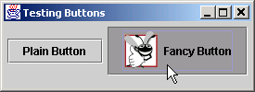
JButton
User clicks to trigger an ActionEvent
Several types:
  Command button, check box, toggle, radio
Abstract superclass: javax.swing.AbstractButton
    Icon rotIcon = new ImageIcon( “rot.png” );
    Icon rotIconDown = new ImageIcon( “rotdn.png” );
    rotButton = new JButton( “Rotate”, rotIcon );
    rotButton.setRolloverIcon( rotIconDown );

Slide 9
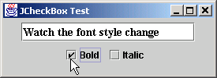
JCheckBox and ItemListener
JCheckBox uses a different listener interface:
    wireframe = new JCheckBox( “Wireframe” );
    MyItemHandler handler = new MyItemHandler();
    wireframe.addItemListener( handler );
ItemListener interface
uses itemStateChanged() method
on an ItemEvent object:
    private class MyItemHandler implements ItemListener {
      public void itemStateChanged( ItemEvent event ) {
        if ( event.getSource() == wireframe ) {
          if ( event.getStateChange() ==
          ItemEvent.SELECTED ) {
            ...

Slide 10
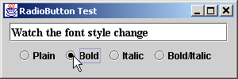
JRadioButton
    triButton = new JRadioButton( “Triangles”, false );
    quadButton = new JRadioButton( “Quads”, true );
    tristripButton = new JRadioButton( “Tristrips”, false );
Also uses ItemListener:
    MyItemListener handler = new MyItemListener();
    triButton.addItemListener( handler );
Usually put radio buttons into a ButtonGroup:
    geomGroup = new ButtonGroup();
    geomGroup.add( triButton );
    geomGroup.add( quadButton );
    geomGroup.add( tristripButton );
This is in addition to add()ing to the JPanel

Slide 11
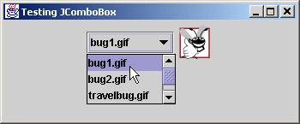
JComboBox
Drop-down list for user to choose one entry
    private String geom[] = { “Triangles”, “Quads”, “Tristrips” };
    geomCombo = new JComboBox( geom );
Show only three rows at a time:
    geomCombo.setMaximumRowCount( 3 );
Also uses ItemListener interface
See which entry user selected (0, 1, 2, etc.):
    geomCombo.getSelectedIndex()

