Slide 1
UML and Design Patterns
  2 April 2008
  CMPT166
  Dr. Sean Ho
  Trinity Western University

Slide 2
Quiz 6
Describe a situation in which a lock is required on a shared object. What are the two (or more) entities which access the shared object, and why is a lock needed? [6]
What do the following keywords mean in Java?
  synchronized, transient, protected [9]
This Python function works on int, float, str, etc. Outline a Java class/method to be just as flexible
    def double(x):
      return x + x

Slide 3
UML: Unified Modelling Language
Developed at same time as OO
Many kinds of diagrams
  Class diagram
  Inheritance hierarchy
  Use-case scenarios
Original idea from Christopher Alexander, “Notes on the Synthesis of Form”, Harvard University Press, 1964
Ref: Gamma, Helm, Johnson, Vlissides, “Design Patterns: Elements of Reusable OO Software”

Slide 4
UML class diagrams
Name, instance variables, methods
Modifiers:
  +: public
  #: protected
  ~: package access
  -: private

Slide 5
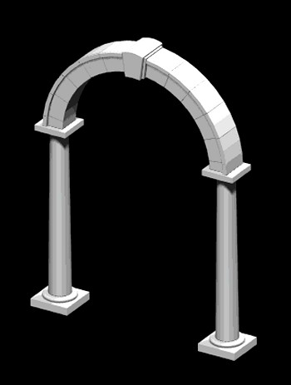
Design patterns
A pattern is a named abstraction
  from a recurring concrete form
  that expresses the essence of
  a proven general solution technique
A pattern has three parts:
  some recurring problem from the real world
  the context of the problem (when to solve it)
  the rule telling us how to solve it
Describe a class of problems and how to solve

