Slide 1
Design Patterns
  4 April 2008
  CMPT166
  Dr. Sean Ho
  Trinity Western University

Slide 2
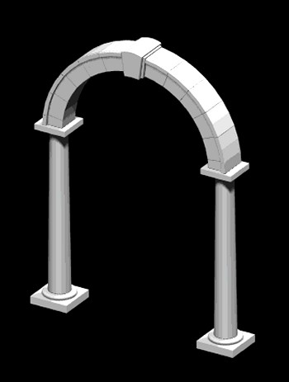
Design patterns
A pattern is a named abstraction
  from a recurring concrete form
  that expresses the essence of
  a proven general solution technique
A pattern has three parts:
  some recurring problem from the real world
  the context of the problem (when to solve it)
  the rule telling us how to solve it
Describe a class of problems and how to solve

Slide 3
Parts of a design pattern
Name: should be meaningful
Problem: desired goal and obstacles
Context: preconditions on problem
Forces: relevant constraints, trade-offs, caveats
Solution: structure, relationships, how-to
Related patterns: codependencies, “see also”
Known uses: example applications

Slide 4
Classes of patterns (high to low)
Conceptual/architectural
  Structural organization of software systems
  Set of predefined components
  Relationships between components
Design
  How to refine each component
  Commonly recurring structure of components
Programming idiom
  How to code a particular component feature

Slide 5
Classes of patterns
Creational patterns
  Interfaces to generate new objects
Structural patterns
  How to organize a large system in components
Behavioural patterns
  How components interact with each other to accomplish a common goal

Slide 6
Creational pattern: factory method
Define an interface for creating an object, but let subclasses decide which class to instantiate
  “Virtual constructor”
e.g., need to create a new Person; don't know in advance if it's Student, Staff, Faculty, or Alumnus
PersonCreator
makePerson()
Person
StudentCreator
makePerson()
Student

Slide 7
Creational pattern: abstract factory
Provide an interface to create families of related or dependent objects without specifying their concrete classes (“kit”)
  e.g., adaptable look-and-feel of GUI widgets
Can be implemented using a collection of factory methods
GUIFactory
newScrollbar()
Scrollbar
MacGUIFactory
newScrollbar()
MacScrollbar

Slide 8
Creational pattern: prototype
Specify the kinds of objects to create using a prototypical instance, and create new objects by copying this prototype
  e.g., sheet-music editor: copy and paste notes
    Staves are objects; each note is an object
  Design each object so it knows how to copy itself: clone() method
MusicElement
clone()
Note
clone()
Rest
clone()
Fermata
clone()

Slide 9
Creational pattern: singleton
Ensure a class only has one instance,
and provide a global point of access to it.
    e.g., child has only one mother
Often implemented by making constructor private
  Instantiate using static method
  Method checks if instance already exists
    public class Mother {
      private Mother theMom;
      private Mother() {}
      public static getMom() {
        if (theMom ≠ null) return theMom;

Slide 10
Structural patterns: facade
Provide a unified interface to a set of interfaces in a subsystem
  High-level interface: system is easier to use
  e.g., web front-end to complex database:
    want minimal number of widgets, input boxes
complex subsystem
user
facade

Slide 11
Other structural patterns
Adapter/ wrapper: Convert the interface of a class into another interface clients expect
  Lets otherwise incompatible classes cowork
Bridge: decouple an abstraction from its implementation so they can vary independently
Proxy: surrogate/placeholder for another object
Decorator: dynamically add responsibilities / functionality to an object
Flyweight: use sharing to support large numbers of fine-grained objects efficiently

Slide 12
Behavioural patterns: observer
One-to-many dependency between objects so
that when the subject changes state,
all its observers are notified and updated
  e.g., many students checking TWU website for snow closures
  e.g., server message “send to all” clients
subject
observer
observer
observer

Slide 13
Other behavioural patterns
Mediator: an object that encapsulates how a set of other objects interact.
  Promotes loose coupling by keeping objects from referring to each other directly
Chain of responsibility: avoid coupling sender directly to receiver by passing through chain
Iterator: access all elements of a collection
Memento: save/restore state of an object
Command: make requests objects
  queue/log requests, support undo, etc.

