Slide 1
Data Storage and Number Bases
4 Nov 2009
CMPT140
Dr. Sean Ho
Trinity Western University

Slide 2
Data storage and I/O
As programmers, you're already expert users of various datatypes and file I/O
Now we peek under the hood to see what the compiler and the OS are really doing to implement these
Every variable we declare takes up space in memory (RAM):
  How much space does each variable need?
  How is our data stored?

Slide 3
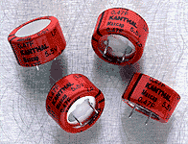
Binary numbers
At the lowest level, all computer data are stored using logical bits: each bit can be either 0 or 1
  High voltage (1) vs. low voltage (0)
  Most memory chips use a big bank of tiny capacitors: has charge (1) vs. no charge (0)
We use groups of bits to represent data (numbers, characters, strings, etc.):
  e.g., this pattern of eight bits: 0 1 0 0 0 0 1 1
    Could represent the decimal number 35
    Or it might represent the character “#”
    Or something else – depends on our interpretation

Slide 4
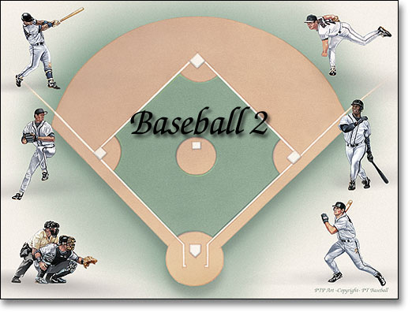
Number bases
God gave us 10 fingers; so we often count in base 10:
  “5927” interpreted as a decimal number:
    5 units of (10³ = 1000)
    9 units of (10² = 100)
    2 units of (10¹ = 10)
    7 units of (10⁰ = 1)
Counting in binary is similar:
  “0110” interpreted as a binary number:
    0 unit of (2³ = 8)
    1 unit of (2² = 4)
    1 unit of (2¹ = 2)
    0 unit of (2⁰ = 1)

Slide 5
Hexadecimal, octal
Hexadecimal is base 16: we use 'A'..'F' to represent the “digits” ten, eleven, twelve, etc.
  “BEEF” as a hexadecimal number:
    B (11) units of (16³ = 4096) => 45056
    E (14) units of (16² = 256) => 3584
    E (14) units of (16¹ = 16) => 224
    F (15) units of (16⁰ = 1) => 15
    Total: BEEF (hex) => 48879 (dec)
There's also octal, base 8:
  only the digits 0..7 are used

Slide 6
Using bases in Python
Python has special notation for expressing integer literals in hexadecimal and octal
(no function is required!)
  Hexadecimal: prefix “0x”
hexNum = 0xBEEF # 48879
  Octal: prefix “0”
octNum = 0115 # 1(8²) + 1(8¹) + 5(8⁰) = 77
Convert into strings with hexadecimal/octal notation:
hexStr = hex(48879) # '0xbeef'
octStr = oct(77) # '0115'

Slide 7
Bits, bytes, nibbles, words
One hexadecimal digit can be represented by four bits: one nibble
Two nibbles (eight bits) is called a byte
  One byte can be used to store one CHAR
A group of bytes can be used to represent one datum: this is called a word
  Most CPUs use 4-byte words (32 bits)
  Newer CPUs can use 8-byte words (64 bits)
  Word is the unit of data the CPU operates on

Slide 8

Accessing memory
A computer's main memory
(generally, RAM) stores everything
it needs to do its current tasks
A location within memory is uniquely identified by its address
  Modern 32-bit OSes use 32-bit words to store memory addresses
  So 2³² unique memory addrs (address space)
  If each location stores one byte of data
  (byte addressable), then there is
  2³² bytes = 4GB of addressable memory

Slide 9
Units of measure
SI abbreviations:
  K = kilo = 1,000
  M = mega = 1,000,000
  G = giga = 1,000,000,000
But when working with binary data:
  KB = “kibibyte” = 1,024 bytes = 2¹⁰ bytes
  MB = “mebibyte” = 1,024,576 = 2²⁰ bytes
  GB = “gibibyte” = 1,073,741,824 = 2³⁰ bytes
  But hard drive manufacturers use SI abbrevs

Slide 10
Units of measure, cont.
Kilobytes vs. kilobits:
  KB = kilobyte = 1,024 bytes = 8192 bits
  Kb = kilobit = 1,024 bits
  RAM chip manufacturers often use kilobits
Also, in SI abbreviations,
  M = mega = 10⁶: e.g., megawatt = 10⁶ watt
  m = milli = 10⁻³: e.g., milliwatt = 10⁻³ watt
But not everyone is consistent, so be careful

Slide 11


Storage
A page is a unit of memory used by a program
  Often 4KB, but changeable
A block is a unit of disk storage, often 512 bytes
Hard disks are made up of platters, accessed by magnetic heads on movable arms
Cylinders are concentric tracks across platters
Hard drive geometry is traditionally expressed in C/H/S: cylinders / heads / sectors-per-track
  E.g., 1024/255/63 (512B/block) = 8.4GB
  Now use LBA: just use one 32-bit addr

Slide 12
For more information
SI prefixes for binary multiples (e.g., mebibit)
  http://physics.nist.gov/cuu/Units/binary.html
The “Starman's Realm” on hexadecimal:
  http://thestarman.pcministry.com/asm/6to64bits.htm
Wikipedia entry on cylinder/head/sector:
  http://en.wikipedia.org/wiki/Cylinder-head-sector

