Slide 1
Review Lectures 14-26
16 Nov 2009
CMPT140
Dr. Sean Ho
Trinity Western University

Slide 2
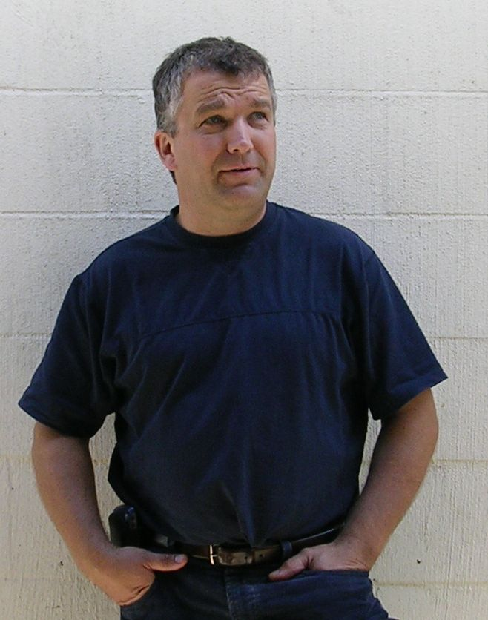



Engineering Meeting
Wednesday 18 November, 7:00-8:30 PM
NEU 36
Featuring
Founder
Adjunct Professor of Mechanical Engineering
Norbert Kott
“Engineering: Becoming an Apprentice in the Creation Department of God’s Kingdom”
Also speaking:
Dr. Arnold Sikkema
TWU Coordinator of Engineering Transfer
“Tips for a Successful Transfer to UBC (or elsewhere)”
RSVP Arnold.Sikkema@twu.ca by noon Tuesday

Slide 3
Topics in lectures 14-26
Applications:
  Stub programs: prime sieve
  Recursion: factorial, Fibonacci
  Libraries: Caesar cipher, pseudorandom
File I/O: open(), read()/write(), pickling
Exceptions
Number bases, memory, storage
Object-oriented programming
  Defining classes, copy vs. alias

Slide 4
Applications
Prime sieve
  How it works; do it by hand
  Using stub functions in development
Factorial and Fibonacci
  Recursion, stack, stack frame, backtrace
Caesar (substitution) cipher
  Designing libraries: header vs. implement.
Pseudo-random number generator
  How it works, seed, be able to code one

Slide 5
File I/O
Principles: file handle, I/O channels, streams
Code: open(), file modes (r, w, a, r+, and b)
Reading: read(), readline()
Seeking: seek(), tell()
Writing: write()
Buffered output and flush()
Pickling: pickle.dump() and load()
Standard I/O Channels: sys.stdout, stdin, stderr

Slide 6
Exceptions
try/except
  else, finally
Catching multiple exceptions: (a, b)
Assigning a caught exception to a name
    except ExceptionType as varname:
Common exceptions
    ZeroDivisionError, NameError, TypeError, IOError, KeyboardInterrupt, SyntaxError
The Python way to open files: with
    with open(“file.txt”) as myFile:

Slide 7
Number bases and storage
Decimal, binary, octal, hexadecimal
  Be able to convert amongst all!
  Notation: 0x, 0
SI vs. binary units of measure:
  Gigabytes vs. gibibytes
Bits, Bytes, Nibbles
Memory address, Words, Pages
Hard drive geometry: Cylinder/Head/Sector

Slide 8
Object-oriented programming
Objects, classes, instances
Methods, attributes, interfaces
Constructor/initializer, destructor
  Default parameters to initializer
  Instantiating an object by calling constructor
Designing classes
__str__()
Alias vs. shallow copy vs. deep copy
Creating a list of objects

