Slide 1
Stacks and Queues
25 Nov 2009
CMPT140
Dr. Sean Ho
Trinity Western University
Midterms back:
avg 51/70 ≈ 74%

Slide 2
Abstract Data Structures
An abstract data structure provides:
  A way of storing data
  Functions to access/operate on that data
And ADT can be implemented using a class:
  Attributes and methods
Actually, dictionaries, lists, etc. are ADTs
  Python has built-in implementations
Today we'll talk about two more: stacks, queues
  More in CMPT 231 (Data Structures) in Spr!

Slide 3
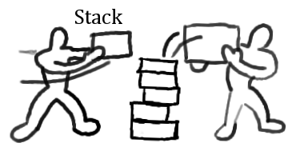
Stacks: theory
In a stack, the last item
added to the stack
is the first item off:
  LIFO: last in, first out
  Analogy: stack of boxes or papers on desk
Operations/methods:
  push(x): add item x to top of stack
  pop(): remove top item from stack and return it
  (also: peek(): get top item without removing it from the stack)
wisetome.com

Slide 4
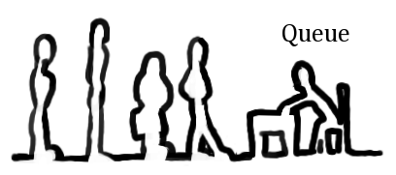
Queues: theory
With a queue, the first item
added to the queue
is the first item out of the queue:
  FIFO: first in, first out
  Analogy: waiting in line at bank, or
  tubes/pipes for water
Operations/methods:
  enqueue(x): add x to back of queue
  dequeue(): remove item from front of queue and return it
wisetome.com

Slide 5
Class design: Stack
Design an interface for a Stack class:
  Public methods: name, parameters, pre/post-conditions
  Worry about attributes later
    class Stack:
      def push( self, item ):
        """pre: check if stack full?
        post: stack has grown by 1; item is on top """
      def pop( self ):
        """pre: stack not empty
        post: return top item from stack;
        stack is smaller by one"""

Slide 6
Class design: Queue
Design an interface for a Queue class:
  Public methods: name, parameters, pre/post-conditions
    class Queue:
      def enqueue( self, item ):
        """pre: queue not full
        post: queue has grown by 1; item is at tail"""
      def dequeue( self ):
        """pre: queue not empty
        post: return item from head of queue,
        queue gets smaller"""

Slide 7
Implementing stacks
What attributes for our Stack class?
The ADT can be implemented using various different existing data structures:
  Plain C array; Python list; linked-list, etc.
Using plain C array:
  Fixed length → upper limit on size of stack
  Keep an index to track current top of stack
  push(x) stores item x in next entry of array
  pop() returns top entry and decrements idx

Slide 8
Implement Stack class
    class Stack:
Constructor sets up our empty list and index:
      def __init__(self, size=10):
        self.__list = range(size) # set size
        self.__top = -1
Use double-underscore ('__list') to hide private internal attributes
We have Python lists here, but if we were using plain C arrays, we'd need to declare the maximum size of the array and element type:
    int* __list = new int[size]

Slide 9
Implement push() and pop()
push() takes an item to add to the stack:
    def push( self, item ):
  Store item in array, and increment top idx:
      self.__top += 1
      self.__list[self.__top] = item
  What if array is already full?
pop() takes no arguments but returns an item:
    def pop( self ):
      self.__top -= 1
      return self.__list[ self.__top+1 ]

Slide 10
Stacks and queues in Python
Queues can also be implemented with C arrays.
It's much easier to implement stacks/queues using Python lists: (but not all langs have this!)
Stack:
  Push: use .append(): myList.append( item )
  Pop: use .pop(): myList.pop() (pops frm end)
Queue:
  Enqueue: use .append() (adds to end)
  Dequeue: use .popleft() (pops from start)

