Slide 1
Software Development Models and Doctest
4 Dec 2009
CMPT140
Dr. Sean Ho
Trinity Western University

Slide 2
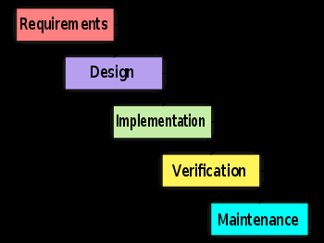
Top-down development
WADES!
Waterfall model: assumes every
step is done perfectly
But in the real world:
  Written requirements change
  (client changes mind)
  Apprehension of the requirements is fuzzy
  Design is incomplete at first
  Execution is sloppy (“spaghetti code”)
  Scrutinization results in endless debugging!

Slide 3
Software development process
Lots of people have tried to design better ways to develop that reflect the real world:
  Development process: how you do the work
No silver bullet: different projects, different people may require different processes
Be flexible: your future employer may demand that you use a particular process
  Or might not have any process in mind:
  then it's up to you to structure your time!
  Get results; make the client happy!

Slide 4
V development model
Design from Top-Down:
  What does the client want? (requirements)
  What will our system do? (specification)
  How will we do it? (design)
  What components will we need?
Test from Bottom-Up:
  Does each component work as it should?
  Do the components integrate correctly?
  Does it do what we promised it would?
  Is the client happy?

Slide 5
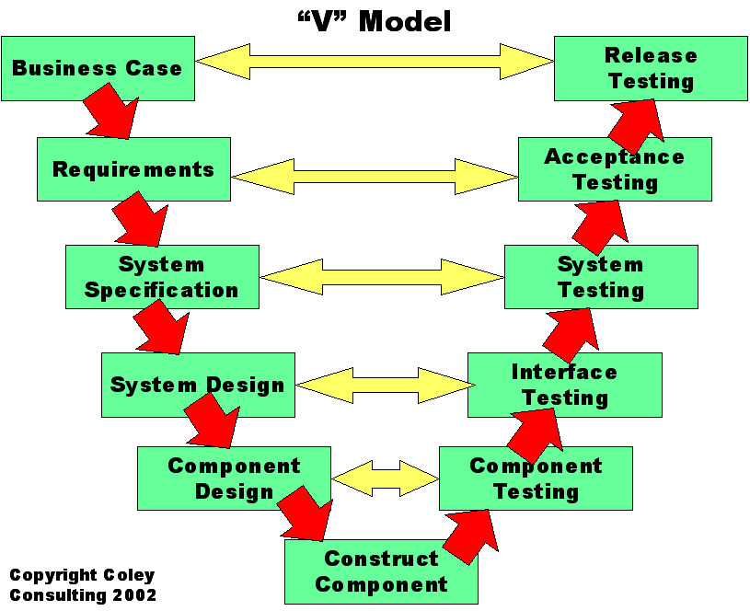
V model (Coley)
gate

Slide 6
Spiral development model
The spiral model is an iterative waterfall:
  Repeat parts of WADES, refining as you go
Get a prototype out early
Get feedback early
  Don't waste time developing what the client
  doesn't want
Client: “I'll know it when I see it”
  Developer: “Is this what you want?”
Anticipate several cycles/refinements!

Slide 7
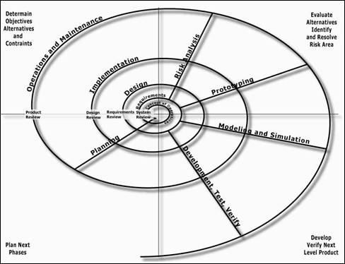
Spiral development: FHA

Slide 8
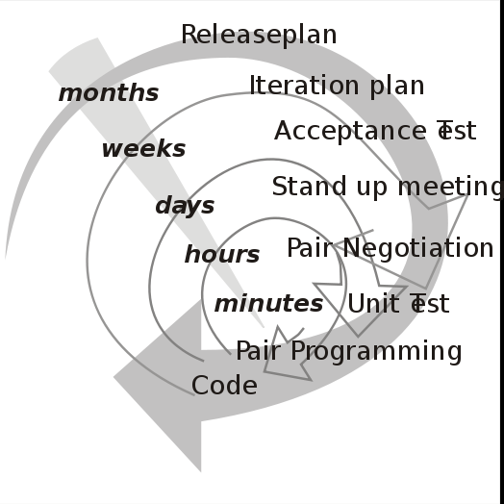
XP: Extreme Programming
Extreme programming was coined by Kent Beck in 1999 while developing Chrysler's payroll sys.
Form of spiral, with more and tighter spirals:
  Code: if there are two different solutions, implement both!
  See which works better.
  Test: it's the only way
  to be sure it works
Values: Communication,
Simplicity, Feedback,
Courage, and Respect
(wikipedia)

Slide 9
Agile development
XP is an example of agile development:
  Get results quickly
  Adapt to changing requirements
“Agile Manifesto” philosophy:
  Individuals+interactions vs. processes+tools
  Working software vs. comprehensive docs
  Customer collaboration vs.
  contract negotiation
  Responding to change vs. following a plan

Slide 10
Agile and the Toyota Way
Agile does not mean total anarchy!
  Clear goals, communication with client
  Rapid development with frequent feedback
Agile influenced the “Toyota Way”:
  Long-term philosophy/goal
  The right process
  Invest in people
  Continuously solve root problems

Slide 11
Test-first development
Frequent and thorough testing is an important component of all these development models!
Test-first development:
  Write your test cases before you code!
  Once you have the design/specification
  (e.g., pre/post-conditions of a method),
  Write test cases in the comments/docstring
  Then code and test along the way
Python's doctest module makes this easy

Slide 12
doctest: Python test cases
In your docstrings, include test cases as:
    >>> run_my_method(5)
    “expected output”
Prefix commands with '>>>'
  Can have multiple commands (script)
Put expected output on line by itself
  If you expect an exception, write the expected “red text” for the exception!
See factorialtest.py example
More details in Python doctest library docs

