Slide 1

CPSY 501: Advanced Statistics
No food/drink in
the computer lab,
please!
11 Sep 2009
Instructor: Dr. Sean Ho
TA: Marci Wagner
cpsy501.seanho.com
Please pick-up:
  Syllabus
  HW 1
  Project Handout
Please fill out
sign-in sheet

Slide 2
Outline for today
Welcome, devotional, introductions
Administrative details: syllabus, schedule
  MyCourses, SPSS, textbook
Stats review:
  Purpose, research questions
  Linear models
  Correlation, Spearman's ρ, χ², t-test
Data Analysis Project, HW Assignment 1
  Marci's SPSS tutorials

Slide 3
Stats review: purpose
What is the purpose of statistical analysis in counselling psychology research?
  → Research questions!
Statistics allows us to (1) pose new questions
and (2) answer them – decision-making tool
  Is an effect/relationship real? How strong?
Possible limitations, assumptions:
  Danger of extreme reductionism
  Neutrality of observation, objectivity
  Looking at groups, not individuals

Slide 4
Cycles in statistical analysis
Formulate research question
Data prep: input errors/typos, missing data, univariate outliers
Explore variables: IV, DV, descriptives
Model building: choose a model based on RQ
Model testing: are assumptions met?
  If not, either clean data or change model
  May need to modify RQ!
Run final model and present results

Slide 5
Research question: example
RQ: are men taller than women?
  Is this relationship real? How strong is it?
What are the variables? IV/DV? Level of meas?
  IV: gender (dichot), DV: height (scale)
  Levels of measurement: categorical, ordinal, scale (interval, ratio)
What type of test should we use?
  Independent samples: t-test
Limitations/assumptions of this test?

Slide 6
Model-building process
Operationally define a phenomenon: variables
Measure it (collect data)
Build a model: verify data meet assumptions and input data into model
Draw conclusions and/or predictions about the phenomenon in the “real world” population
  e.g., if child A holds 2 apples, B:6 apples, and C:1, how many apples is a child most likely to have?
  Individual vs. group

Slide 7
Statistical model: example
RQ: does self-esteem correlate with school performance?
Measure: questionnaire and marks
Choose model: correlation
Assumptions! Measures, procedures, model
Make conclusions: based on assumptions
  Objectivity, individual vs. group,
  Linearity is a big assumption!

Slide 8
Linear modelling
A linear model is a straight “line” that best fits the observed data
  Minimizes error (least-squares) of model
Use analytic techniques to derive the equation of the linear model directly from the data, or
Use optimization techniques to try to find the line that maximizes the goodness of fit between model and data:
  Test statistic =
  (variance due to model) / (due to error)

Slide 9
Linear modelling: summary
Statistics are used to build models of psychological phenomena out of observations gathered from specific samples of individuals
The most common type of statistical model is linear – straight “line” (or plane, or hyperplane, …) that minimizes distance from model to data
The adequacy of the model to explain the data can be calculated through test statistics
  If there is a poor fit, the model may need to be revised, or to consider additional confounding variables

Slide 10
Linear modelling: limitations
What if vars are not related in a linear way?
Many common procedures (some ANOVA, some regression) depend strongly on linearity
  If linearity is violated, results are only very approximate
  Even non-parametric models are often approximations using group patterns
Reifying models: “correct” the data to better fit the assumptions of the model!
Examples of psychological phenomena vars that are related non-linearly?

Slide 11
Linear Correlation
A measure of the strength of the linear relationship between two variables
Relies on measuring covariance between vars
  When one var deviates from mean, does the other var also deviate?
  Does it deviate in the same direction?
Correlation is a value between -1 and +1
  Close to +1: positive relationship
  Close to -1: negative relationship
  Close to 0: no relationship

Slide 12
Measuring correl: Pearson's r
The most common way to measure correlation is Pearson's product-moment correlation coefficient, named r:
Requires parametric data
  Indep obs, scale level, normally distrib!
Example: ExamAnxiety.sav
  Measured anxiety before exam,
  time spent reviewing before exam, and
  exam performance (% score)

Slide 13
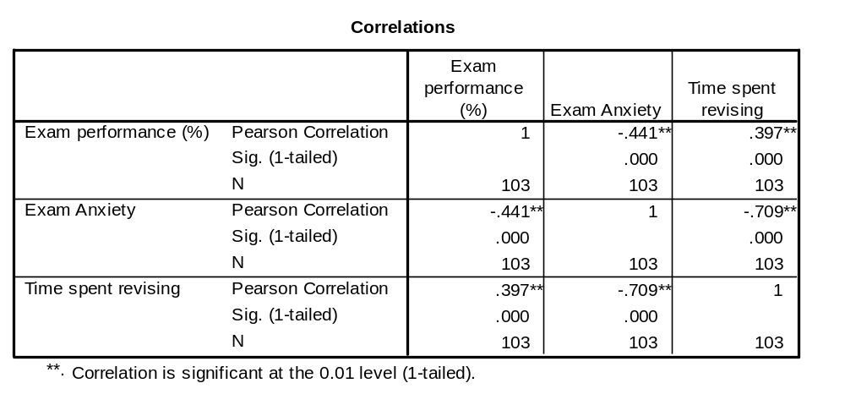
Pearson's correlation coeff
Name of Correlation Statistic
Significance Value (p)
Each variable is perfectly correlated with itself!

Slide 14
Spearman's Rho (ρ or r_{s})
Another way of calculating correlation
Non-parametric: can be used when data violate parametricity assumptions
No free lunch: loses information about data
Spearman's works by first ranking the data, then applying Pearson's to those ranks
Example (grades.sav):
  grade on a national math exam (GCSE)
  grade in a univ. stats course (STATS)
  coded by “letter” (A=1, B=2, C=3, ...)

Slide 15
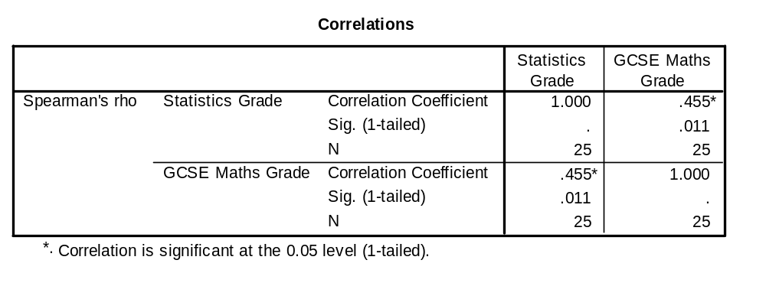
Spearman's Rho (ρ or r_{s}): ex
Name of Correlation Statistic
The correlation is positive
Sample Size
Notes:
The correlation is positive: can conclude that as GCSE Grades improve, there is a corresponding improvement in grades for statistics.

Slide 16
Chi-Square test (χ²)
Evaluates whether there is a relationship between 2 categorical variables
The Pearson chi-square statistic tests whether the 2 variables are independent
If the significance is small enough
(p<α, usually α=.05), we reject the null hypothesis that the two variables are independent (unrelated)
  i.e., we think that they are in some way related.

Slide 17
t-Tests: comparing two means
Moving beyond correlational research…
We often want to look at the effect of one variable on another by systematically changing some aspect of that variable
That is, we want to manipulate one variable to observe its effect on another variable.
t-tests are for comparing two means
Two types of application of t-tests:
  Related/dependent measures
  Independent groups

Slide 18
Related/dependent t-tests
A repeated measures experiment that has 2 conditions (levels of the IV)
the same subjects participate in both conditions
We expect that a person’s behaviour will be the same in both conditions
  external factors – age, gender, IQ, motivation, ... – should be same in both conditions
Experimental Manipulation: we do something different in Condition 1 than what we do in Condition 2 (so the only difference between conditions is the manipulation the experimenter made)
  e.g., Control vs. test

Slide 19
Independent samples t-tests
We still have 2 conditions (levels of the IV), but different subjects participate in each condition.
So, differences between the two group means can possibly reflect:
  The manipulation (i.e., systematic variation)
  Differences between characteristics of the people allotted to each group (i.e., unsystematic variation)
  Question: what is one way we can try to keep the ‘noise’ in an experiment to a minimum?
Notes:
*Error variance will almost always be larger in Independent Samples T-Tests for the (Unsystematic Variation) reason (i.e., noise).

Slide 20
t-Tests
t-tests work by identifying sources of systematic and unsystematic variation, and then comparing them.
The comparison lets us see whether the experiment created considerably more variation than we would have got if we had just tested the participants w/o the experimental manipulation.

Slide 21
Example: dependent samples
“Paired” samples t-test
12 ‘spider phobes’ exposed to a picture of a spider (picture), and on a separate occasion, a real live tarantula (real)
Their anxiety was measured at each time (i.e., in each condition).

Slide 22
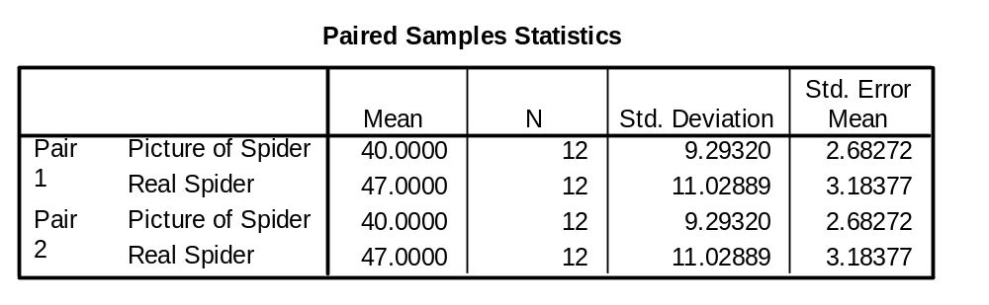
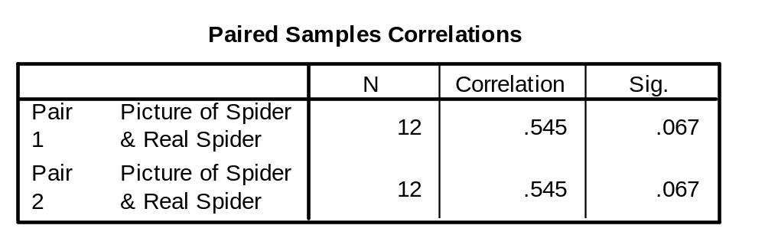
Paired samples t-test

Slide 23
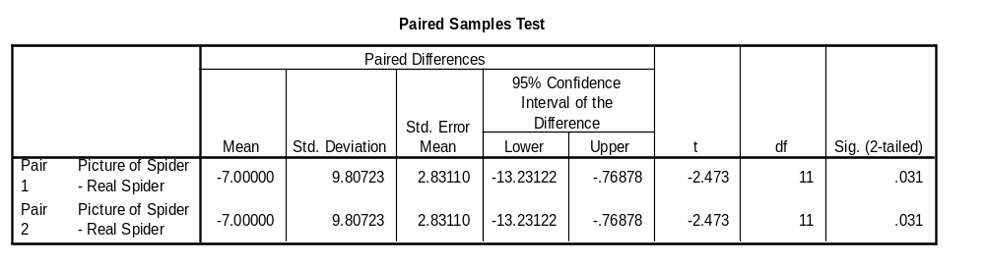
Example: paired t-Tests
Degrees of Freedom (in a repeated measures design, it's N-1)
The probability that ‘t’ occurred by chance is reflected here
Standard Deviation of the pairwise difference
Standard error of the differences b/w subjects’ scores in each condition
SPSS uses df to calculate the exact probability that the value of the ‘t’ obtained could occur by chance
Notes:
Most Important of the tables – tells us whether the difference between the means of the two conditions was large enough to not be a chance result

Slide 24
Example: indep samples t-test
Used in situations where there are 2 experimental conditions – and different participants are used in each condition
Example: SpiderBG.sav
12 spider phobes exposed to a picture of a spider (picture); 12 different spider phobes exposed to a real-life tarantula
Anxiety was measured in each condition

Slide 25
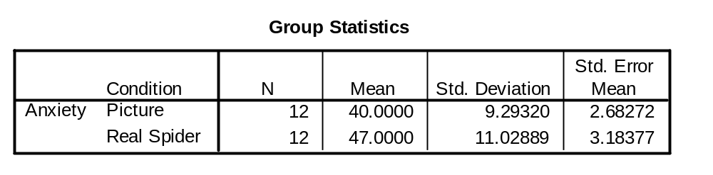
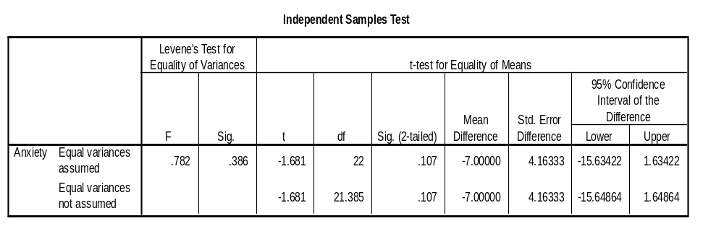
Summary Statistics for the 2 experimental conditions
(N1 + N2) - 2 = 22
Parametric tests (e.g., t-tests) assume variances in the experimental conditions are ‘roughly’ equal.
Significance (p-value): 0.107 > α=.05, so there is no significant difference between the means of the 2 samples
If Levene’s test is sig., the assumption of homogeneity of variance has been violated
Notes:
*t-tests ‘require’ parametric data – and an assumption of parametric data is that variances in the experimental conditions are ‘roughly’ equal.
*in reality – there are adjustments that can be made in situations where variances are not equal – these rows related to whether the assumption has been broken: How do we know if it’s been broken? Look at the variances and see whether they’re similar (i.e., know the SD of the groups are 9 and 11) – and if we square these values, we get the variances.
*We can use Levene’s test (if it’s ‘significant’ – there is a significant amount of variance between groups – and the assumption of homogeneity of variances has been VIOLATED).

Slide 26
Data Analysis Project
Half of this course is your semester-long
data analysis project:
  Find suitable existing data
  Propose a new statistical analysis of it
  Get approval by Research Ethics Board
  Go through “spiral” of statistical analysis
  Write it up in an APA-style manuscript
Groups of up to 3 people
  Can also be done individually
  Let me know when you have your group

Slide 27
Project step 1: Finding data
It must be existing data – you are not allowed to collect data for this course! (nor do you have time to)
  No simulated (made-up) data
Minimum sample size: 50
Minimum of 3 variables (2 IV, 1 DV)
Analysis: multiple regression or ANOVA
  Non-parametric alternatives w/permission
Possible sources: your own data, faculty members, CPSY dept thesis data, publicly available / government data (WHO, NIH, etc.)

Slide 28
Dataset description: due 2Oct
Written description of the dataset you will be using and the particular variables you consider
Preliminary explorations of the data
  Descriptives, histograms, boxplots, etc.
  Upload annotated SPSS output *.spv
APA manuscript style not needed, but please format it neatly in a document
  e.g., not a short email or Facebook msg!
Upload (1) write-up, and (2) SPSS output
to myCourses

Slide 29
Project step 2: Proposal/meeting
Written proposal of the particular analysis you plan to do on the dataset
  Old data, but new analysis
  State specific research questions
  Check sample size is sufficient (GPower3)
  Anticipate possible problems, plan
Book an appointment with me (Neu 5) by 9Oct
  All team members there
  Send me your proposal >24hrs before
  Bring/email your dataset on USB stick

Slide 30
Project step 3: REB (due 16Oct)
Approval by TWU Research Ethics Board is required before any new analysis may be done!
  Cursory exploration as in dataset description and proposal is okay
You are not allowed to start your new analysis until you get REB approval
Use the “Analysis of Existing Data” form
You need written permission from the original owner of the data
  For CPSY theses, the faculty supervisor
  None needed for publicly available data

Slide 31
Project step 4: Manuscript
The focus is to demonstrate your statistical knowledge, not to deal with the subject area in question
  It's okay if you don't find groundbreaking results for all of counselling psychology
  Methodology and statistics will be more detailed than a “real” research paper
Full APA manuscript format is required!
  Include tables/figures
Max length 15 pages + annotated SPSS output

Slide 32
HW Assignment 1: Stats review
Four homework assignments over the semester will give you practice on the concepts in lecture
HW assignment 1 (due 25Sep, in two weeks):
  Review of undergrad statistics
  Practice with SPSS
Download from our website: “Assignments”
  Assignment: HW1-Review.doc
  SPSS Dataset: AttnDefDis-1.sav

Slide 33
Practice reading for next week
For practice, try reading this journal article, focusing on their statistical methods: see how much you can understand
Missirlian, et al., “Emotional Arousal, Client Perceptual Processing, and the Working Alliance in Experiential Psychotherapy for Depression”, Journal of Consulting and Clinical Psychology, Vol. 73, No. 5, pp. 861–871, 2005.
Download from website, under today's lecture

Slide 34
For discussion next time:
What research questions do the authors state that they are addressing?
What analytical strategy was used, and how appropriate is it for addressing their questions?
What were their main conclusions, and are these conclusions warranted from the actual results /statistics /analyses that were reported?
What, if any, changes/additions need to be made to the methods to give a more complete picture of the phenomenon of interest (e.g., sampling, description of analysis process, effect sizes, dealing with multiple comparisons, etc.)?

Slide 35
SPSS tutorials by Marci
Our TA, Marci, has graciously agreed to do tutorials on getting started with SPSS
  After class today, in Wong Centre
    Just tag along with her
  Next Wed, see Marci for time

