Slide 1

The “Big 4” –
Significance, Effect Size,
Sample Size, and Power
18 Sep 2009
Dr. Sean Ho
CPSY501
cpsy501.seanho.com

Slide 2
Outline for today
Stats review:
  Correlation (Pearson, Spearman)
  t-tests (indep, paired)
Discussion of research article (Missirlian et al)
The “Big 4”:
  Statistical significance (p-value, α)
  Effect size
  Power
  Finding needed sample size
SPSS tips

Slide 3
Measuring correl: Pearson's r
The most common way to measure correlation is Pearson's product-moment correlation coefficient, named r:
Requires parametric data
  Indep obs, scale level, normally distrib!
Example: ExamAnxiety.sav
  Measured anxiety before exam,
  time spent reviewing before exam, and
  exam performance (% score)

Slide 4
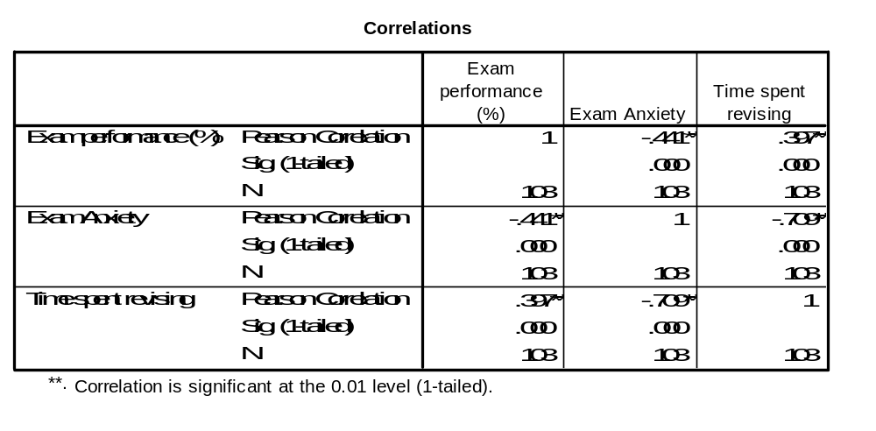
Pearson's correlation coeff
Name of Correlation Statistic
Significance Value (p)
Each variable is perfectly correlated with itself!

Slide 5
Spearman's Rho (ρ or r_{s})
Another way of calculating correlation
Non-parametric: can be used when data violate parametricity assumptions
No free lunch: loses information about data
Spearman's works by first ranking the data, then applying Pearson's to those ranks
Example (grades.sav):
  grade on a national math exam (GCSE)
  grade in a univ. stats course (STATS)
  coded by “letter” (A=1, B=2, C=3, ...)

Slide 6
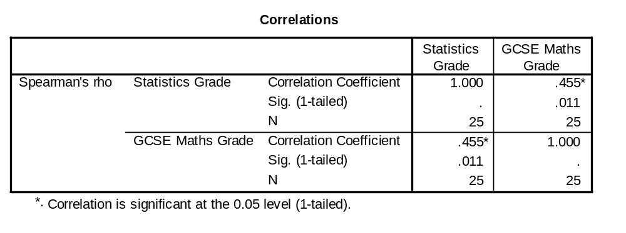
Spearman's Rho (ρ or r_{s}): ex
Name of Correlation Statistic
The correlation is positive
Sample Size
Notes:
The correlation is positive: can conclude that as GCSE Grades improve, there is a corresponding improvement in grades for statistics.

Slide 7
Chi-Square test (χ²)
Evaluates whether there is a relationship between 2 categorical variables
The Pearson chi-square statistic tests whether the 2 variables are independent
If the significance is small enough
(p<α, usually α=.05), we reject the null hypothesis that the two variables are independent (unrelated)
  i.e., we think that they are in some way related.

Slide 8
t-Tests: comparing two means
Moving beyond correlational research…
We often want to look at the effect of one variable on another by systematically changing some aspect of that variable
That is, we want to manipulate one variable to observe its effect on another variable.
t-tests are for comparing two means
Two types of application of t-tests:
  Related/dependent measures
  Independent groups

Slide 9
Related/dependent t-tests
A repeated measures experiment that has 2 conditions (levels of the IV)
the same subjects participate in both conditions
We expect that a person’s behaviour will be the same in both conditions
  external factors – age, gender, IQ, motivation, ... – should be same in both conditions
Experimental Manipulation: we do something different in Condition 1 than what we do in Condition 2 (so the only difference between conditions is the manipulation the experimenter made)
  e.g., Control vs. test

Slide 10
Independent samples t-tests
We still have 2 conditions (levels of the IV),
but different subjects in each condition.
So, differences between the two group means can possibly reflect:
  The manipulation (i.e., systematic variation)
  Differences between characteristics of the people allotted to each group (i.e., unsystematic variation)
  Question: what is one way we can try to keep the ‘noise’ in an experiment to a minimum?
Notes:
*Error variance will almost always be larger in Independent Samples T-Tests for the (Unsystematic Variation) reason (i.e., noise).

Slide 11
t-Tests
t-tests work by identifying sources of systematic and unsystematic variation, and then comparing them.
The comparison lets us see whether the experiment created considerably more variation than we would have got if we had just tested the participants w/o the experimental manipulation.

Slide 12
Example: dependent samples
“Paired” samples t-test
12 ‘spider phobes’ exposed to a picture of a spider (picture), and on a separate occasion, a real live tarantula (real)
Their anxiety was measured at each time (i.e., in each condition).

Slide 13
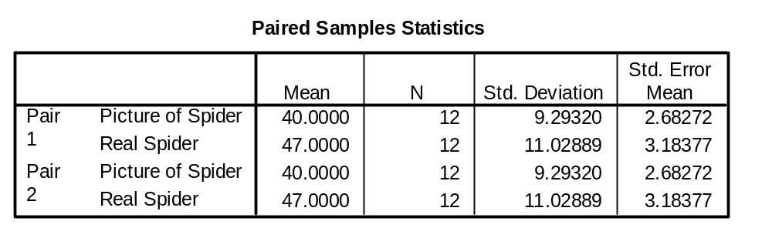
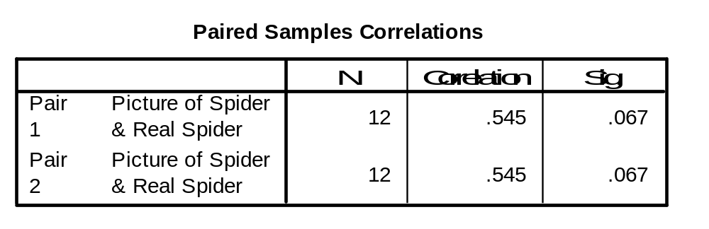
Paired samples t-test

Slide 14
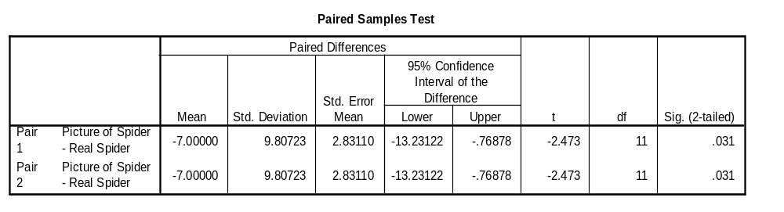
Example: paired t-Tests
Degrees of Freedom (in a repeated measures design, it's N-1)
The probability that ‘t’ occurred by chance is reflected here
Standard Deviation of the pairwise difference
Standard error of the differences b/w subjects’ scores in each condition
SPSS uses df to calculate the exact probability that the value of the ‘t’ obtained could occur by chance
Notes:
Most Important of the tables – tells us whether the difference between the means of the two conditions was large enough to not be a chance result

Slide 15
Example: indep samples t-test
Used in situations where there are 2 experimental conditions – and different participants are used in each condition
Example: SpiderBG.sav
12 spider phobes exposed to a picture of a spider (picture); 12 different spider phobes exposed to a real-life tarantula
Anxiety was measured in each condition

Slide 16
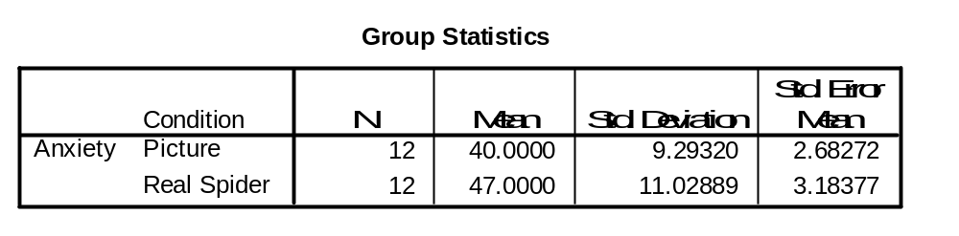
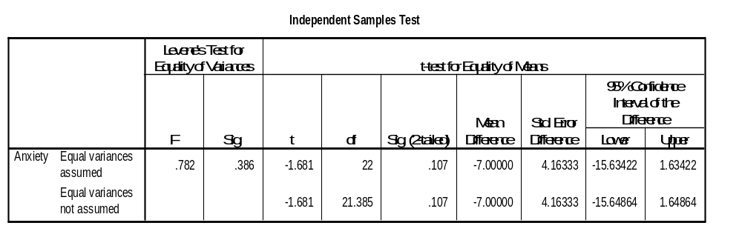
Summary Statistics for the 2 experimental conditions
(N1 + N2) - 2 = 22
Parametric tests (e.g., t-tests) assume variances in the experimental conditions are ‘roughly’ equal.
Significance (p-value): 0.107 > α=.05, so there is no significant difference between the means of the 2 samples
If Levene’s test is sig., the assumption of homogeneity of variance has been violated
Notes:
*t-tests ‘require’ parametric data – and an assumption of parametric data is that variances in the experimental conditions are ‘roughly’ equal.
*in reality – there are adjustments that can be made in situations where variances are not equal – these rows related to whether the assumption has been broken: How do we know if it’s been broken? Look at the variances and see whether they’re similar (i.e., know the SD of the groups are 9 and 11) – and if we square these values, we get the variances.
*We can use Levene’s test (if it’s ‘significant’ – there is a significant amount of variance between groups – and the assumption of homogeneity of variances has been VIOLATED).

Slide 17
Outline for today
Stats review:
  Correlation (Pearson, Spearman)
  t-tests (indep, paired)
Discussion of research article (Missirlian et al)
The “Big 4”:
  Statistical significance (p-value, α)
  Effect size
  Power
  Finding needed sample size
SPSS tips

Slide 18
Practice reading article
For practice, try reading this journal article, focusing on their statistical methods: see how much you can understand
Missirlian, et al., “Emotional Arousal, Client Perceptual Processing, and the Working Alliance in Experiential Psychotherapy for Depression”, Journal of Consulting and Clinical Psychology, Vol. 73, No. 5, pp. 861–871, 2005.
Download from website, under today's lecture

Slide 19
For discussion:
What research questions do the authors state that they are addressing?
What analytical strategy was used, and how appropriate is it for addressing their questions?
What were their main conclusions, and are these conclusions warranted from the actual results /statistics /analyses that were reported?
What, if any, changes/additions need to be made to the methods to give a more complete picture of the phenomenon of interest (e.g., sampling, description of analysis process, effect sizes, dealing with multiple comparisons, etc.)?

Slide 20
Outline for today
Stats review:
  Correlation (Pearson, Spearman)
  t-tests (indep, paired)
Discussion of research article (Missirlian et al)
The “Big 4”:
  Statistical significance (p-value, α)
  Effect size
  Power
  Finding needed sample size
SPSS tips

Slide 21
Central Themes of Statistics
Is there a real effect/relationship amongst certain variables?
How big is that effect?
We evaluate these by looking at
  Statistical significance (p-value) and
  Effect size (r², R², η, μ₁- μ₂, etc.)
Along with sample size (n) and statistical power (1-β), these form the “Big 4” of any test

Slide 22
The “Big 4” of every test
Any statistical test has these 4 facets
Set 3 as desired → derive required level of 4th
Alpha
0.05
as desired, depends on test
Effect size
Sample size
derived!
(GPower)
usually 0.80
Power

Slide 23
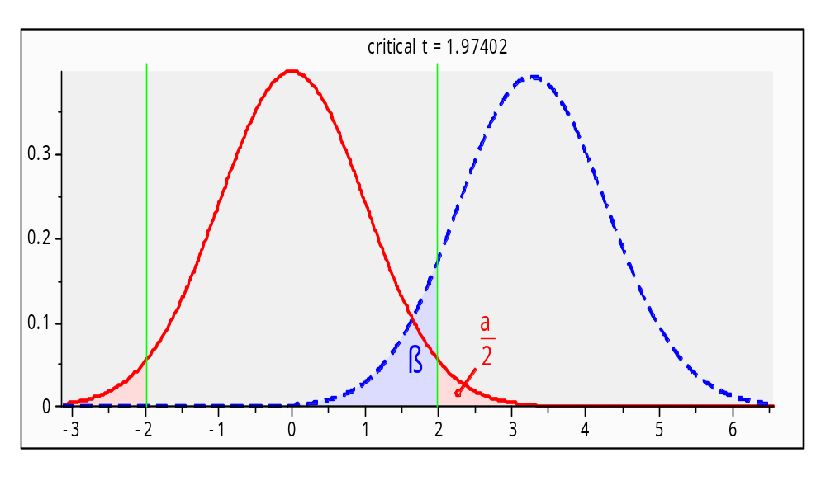
Significance (α) vs. power (1-β)
α is the chance of Type-I error: incorrectly rejecting the null hypothesis (H₀)
β is the chance of Type-II error: failing to reject H₀ when should have rejected H₀.
Power is 1-β
e.g., parachute
inspections
α,β in independent
groups t-test:

Slide 24
Statistical significance
An effect is “real” (statistically significant) if the probability that the observed result came about due to random variation is so small that we can reject random variation as an explanation.
  This probability is the p-value
Can never truly “rule out” random variation
Set the level of significance (α) as our threshold tolerance for Type-I error
If p < α, we confidently say there is a real effect
Usually choose α=0.05 (what does this mean?)

Slide 25
Myths about significance
  (why are these all myths?)
Myth 1: “If a result is not significant, it proves there is no effect.”
Myth 2: “The obtained significance level indicates the reliability of the research finding.”
Myth 3: “The significance level tells you how big or important an effect is.”
Myth 4: “If an effect is statistically significant, it must be clinically significant.”

Slide 26
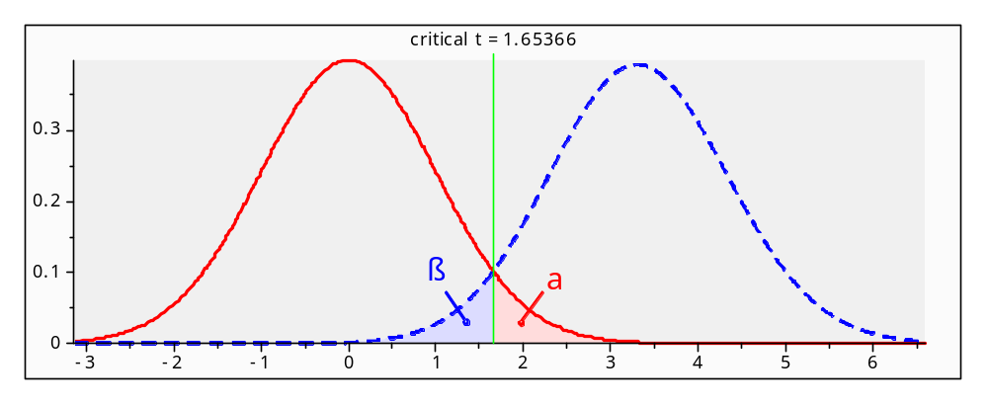
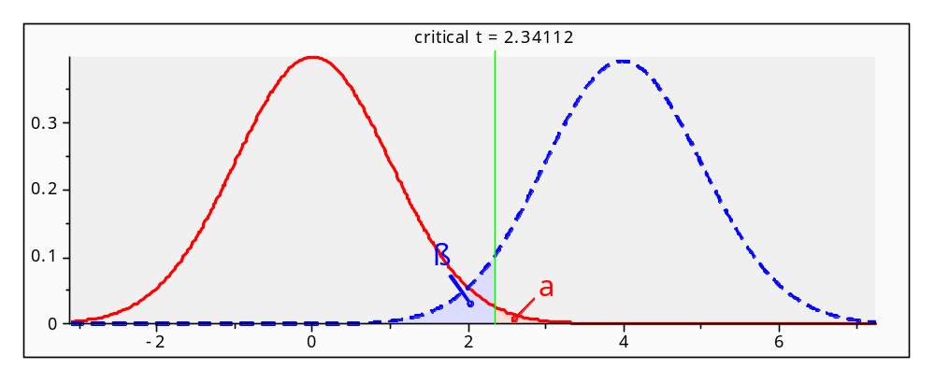
Impact of changing α
α=0.05
α=0.01

Slide 27
Effect size
Historically, researchers only looked at significance, but what about the effect size?
A small study might yield non-significance but a strong effect size
  Could be spurious, but could also be real
  Motivates meta-analysis –
  repeat the experiment, combine results
Current research standards require reporting both significance as well as effect size

Slide 28
Measures of effect size
For t-test and any between-groups comparison:
  Difference of means: d = (μ₁ – μ₂)/σ
For ANOVA: η² (eta-squared):
  Overall effect of IV on DV
For bivariate correlation (Pearson, Spearman):
  r and r²: r² is fraction of variability in one var explained by the other var
For regression: R² and ΔR² (“R²-change”)
  Fraction of variability in DV explained by overall model (R²) or each predictor (ΔR²)

Slide 29
Interpreting effect size
What constitutes a “big” effect size?
Consult literature for the phenomenon of study
Cohen '92, “A Power Primer”: rules of thumb
  Somewhat arbitrary, though!
For correlation-type r measures:
  0.10 → small effect (1% of var. explained)
  0.30 → medium effect (9% of variability)
  0.50 → large effect (25%)

Slide 30
Example: dependent t-test
Dataset: SpiderRM.sav
12 individuals, first shown picture of spider, then shown real spider → measured anxiety
Compare Means → Paired-Samples T Test
SPSS results: t(11)=-2.473, p<0.05
Calculate effect size: see text, p.332 (§9.4.6)
  r ~ 0.5978 (big? Small?)
Report sample size (df),
test statistic (t), p-value,
and effect size (r)
$r=\sqrt{\frac{t^{2}}{t^{2}+df}}$

Slide 31
Finding needed sample size
Experimental design: what is the minimum sample size needed to attain the desired level of significance, power, and effect size (assuming there is a real relationship)?
Choose level of significance: α = 0.05
Choose power: usually 1-β = 0.80
Choose desired effect size: (from literature or Cohen's rules of thumb)
→ use GPower or similar to calculate the required sample size (do this for your project!)

Slide 32
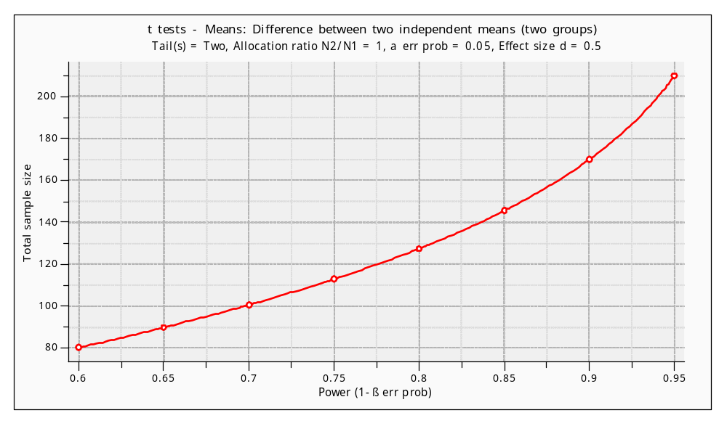
Power vs. sample size
Fix α=0.05, effect size d=0.50:

Slide 33
SPSS tips!
Plan out the characteristics of your variables before you start data-entry
You can reorder variables: cluster related ones
Create a var holding unique ID# for each case
Variable names may not have spaces: try “_”
Add descriptive labels to your variables
Code missing data using values like '999'
  Then tell SPSS about it in Variable View
Clean up your output file (*.spv) before turn-in
  Add text boxes, headers; delete junk

