Slide 1

Linear Regression
Please download from
“Example Datasets”:
Record2.sav
ExamAnxiety.sav
2 Oct 2009
CPSY501
Dr. Sean Ho
Trinity Western University

Slide 2
Outline for today
Correlation and Partial Correlation
Linear Regression (Ordinary Least Squares)
  Using Regression in Data Analysis
  Requirements: Variables
  Requirements: Sample Size
Assignments & Projects
Notes:
DATA SETS: Chapter 5, Field: p. 152 (record1) & p. 158 (record2);

Slide 3
Causation from correlation?
Ancient proverb: “correlation ≠ causation”
But: sometimes correlation can suggest causality, in the right situations!
  Need >2 variables, and it's
  Not the “ultimate” (only, direct) cause, but
  Degree of influence one var has on another
    (“causal relationship”, “causality”)
Is a significant fraction of the variability in one variable explained by the other variable(s)?

Slide 4
How to get causality?
Use theory and prior empirical evidence
  e.g., temporal sequencing: can't be T2 → T1
  Order of causation? (gender & career aspir.)
Best is a controlled experiment:
  Randomly assign participants to groups
  Change the level of the IV for each group
  Observe impact on DV
But this is not always feasible/ethical!
Still need to “rule out” other potential factors

Slide 5
Potential hidden factors
What other vars might explain these correlatns?
  Height and hair length
    e.g., both are related to gender
  Increased time in bed and suicidal thoughts
    e.g., depression can cause both
  # of pastors and # of prostitutes (!)
    e.g., city size
To find causality, must rule out hidden factors
    e.g., cigarettes and lung cancer

Slide 6


Example: immigration study
Level of
Acculturation
Psychological
Well-being
1 Year
Immigration
Follow-up

Slide 7
Partial Correlation
Purpose: to measure the unique relationship between two variables – after the effects of other variables are “controlled for”.
Two variables may have a large correlation, but
  It may be largely due to the effects of other moderating variables
  So we must factor out their influence, and
  See what correlation remains (partial)
SPSS algorithm assumes parametricity
  There exist non-parametric methods, though

Slide 8
Visualizing Partial Correlation
Direction
of Causation?
Variable 1
(e.g., pastors)
?
Variable 2
(e.g., prostitutes)
Partial
Correlation
Moderating Variable
(e.g., city size)

Slide 9
Practise: Partial Correlation
Dataset: Record2.sav
Analyze → Correlate → Partial,
  Variables: adverts, sales
  Controlling for: airplay, attract
Or: Analyze → Regression → Linear:
  Dependent: sales; Independents: all other var
  Statistics → “Part and partial correlations”
    Uncheck everything else
  All partial r, plus regular (0-order) r

Slide 10

Linear Regression
When we use correlation to try to infer
direction of causation, we call it regression:
Combining the influence of a number of variables (predictors) to determine their
total effect on another variable (outcome).
OLS Regression

Slide 11
Simple Regression: 1 predictor
Simple regression is predicting scores on an outcome variable from a single predictor variable
Mathematically equiv. to bivariate correlation
Regression

Slide 12
OLS Regression Model
In Ordinary Least-Squares (OLS) regression,
the “best” model is defined as the line that minimizes the error between model and data (sum of squared differences).
Conceptual description of regression line
(General Linear Model):
Y = b₀ + b₁X₁ + (B₂X₂ … + B_{n}X_{n}) + ε
Outcome
Gradient
Error
Predictor
Intercept

Slide 13
Assessing Fit of a Model
R²: proportion of variance in outcome accounted for by predictors: SS_{model} / SS_{tot}
  Generalization of r² from correlation
F ratio: variance attributable to the model divided by variance unexplained by model
  F ratio converts to a p-value,
  which shows whether the “fit” is good
If fit is poor, predictors may not be linearly related to the outcome variable

Slide 14
Example: Record Sales
Dataset: Record2.sav
Outcome variable: Record sales
Predictor: Advertising Budget
Analyze → Regression → Linear
  Dependent: sales; Independent: adverts
  Statistics → Estimates, Model fit,
  Part and partial correlations
Notes:
→ NO ASSUMPTIONS CHECKED, ETC.

Slide 15
Example: Interpreting Results
Model Summary: R Square = .335
  adverts explains 33.5% of variability in sales
ANOVA: F = 99.587 and Sig. = .000
  There is a significant effect
Report: R² = .335, F(1, 198) = 99.587, p < .001
Coefficients: (Constant) B = 134.140 (Y-intcpt)
  Unstandardized advert B = .096 (slope)
  Standardized advert Beta = .578
    (with all variables converted to z-scores)
  Linear model: Ŷ = .578 * AB_{z} + 134

Slide 16
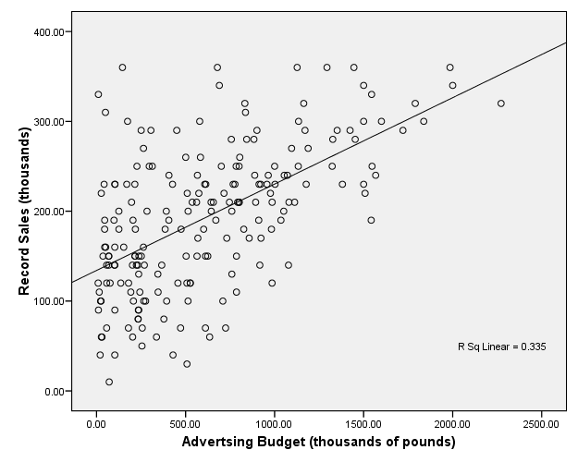

Slide 17
General Linear Model
Actually, nearly all parametric methods can be expressed as generalizations of regression!
Multiple Regression: several scale predictors
Logistic Regression: categorical outcome
ANOVA: categorical IV
  t-test: dichotomous IV
  ANCOVA: mix of categorical + scale IVs
  Factorial ANOVA: several categorical IVs
Log-linear: categorical IVs and DV
We'll talk about each of these in detail later

Slide 18
Regression Modelling Process
Develop RQ: IVs/DVs, metrics
  Calc required sample size & collect data
Clean: data entry errors, missing data, outliers
Explore: assess requirements, xform if needed
Build model: try several models, see what fits
Test model: “diagnostic” issues:
  Multivariate outliers, overly influential cases
Test model: “generalizability” issues:
  Regression assumptions: rebuild model

Slide 19
Selecting Variables
According to your model or theory, what variables might relate to your outcomes?
  Does the literature suggest important vars?
Do the variables meet all the requirements for an OLS multiple regression?
  (more on this next week)
Record sales example:
  DV: what is a possible outcome variable?
  IV: what are possible predictors, and why?

Slide 20
Choosing Good Predictors
It's tempting to just throw in hundreds of predictors and see which ones contribute most
  Don't do this! There are requirements on how the predictors interact with each other!
  Also, more predictors → less power
Have a theoretical/prior justification for them
Example: what's a DV you are interested in?
  Come up with as many possible good IVs as you can – have a justification!
    Background, internal personal,
    current external environment

Slide 21
Using Derived Variables
You may want to use derived variables in regression, for example:
Transformed variables (to satisfy assumptions)
Interaction terms: (“moderating” variables)
  e.g., Airplay * Advertising Budget
Dummy variables:
  e.g., coding for categorical predictors
Curvilinear variables (non-linear regression)
  e.g., looking at X² instead of X

Slide 22
Required Sample Size
Depends on effect size and # of predictors
  Use G*Power to find exact sample size
  Rough estimates on pp. 172-174 of Field
Consequences of insufficient sample size:
  Regression model may be overly influenced by individual participants (not generalizable)
  Can't detect “real” effects of moderate size
Solutions:
  Collect more data from more participants!
  Reduce number of predictors in the model

Slide 23
Requirements on DV
Must be interval/continuous:
  If not: mathematics simply will not work
  Solutions:
    Categorical DV: use Logistic Regression
    Ordinal DV: use Ordinal Regression,
    or possibly convert into categorical form
Independence of scores (research design)
  If not: invalid conclusions
  Solutions: redesign data set, or
    Multi-level modelling instead of regression

Slide 24
Requirements on DV, cont.
Normal (use normality tests):
  If not: significance tests may be misleading
  Solutions: Check for outliers, transform data, use caution in interpreting significance
Unbounded distribution (obtained range of responses versus possible range of responses)
  If not: artificially deflated R²
  Solutions:
    Collect more data from missing range
    Use a more sensitive instrument
Notes:
More on assumptions, see class#5 outline

Slide 25
Requirements on IV
Scale-level
  Can be categorical, too (see next page)
  If ordinal, either threshold into categorical or treat as if scale (only if have sufficient number of ranks)
Full-range of values
  If an IV only covers 1-3 on a scale of 1-10, then the regression model will predict poorly for values beyond 3
More requirements on the behaviour of IVs with each other and the DV (covered next week)

Slide 26
Categorical Predictors
Regression can work for categorical predictors:
If dichotomous: code as 0 and 1
  e.g., 1 dichotomous predictor, 1 scale DV:
  Regression is equivalent to t-test!
  And the slope B₁ is the difference of means
If n categories: use “dummy” variables
  Choose a base category
  Create n-1 dichotomous variables
  e.g., {BC, AB, SK}: dummys are isAB, isSK

