Slide 1

Multiple Regression
Please download from
“Example Datasets”:
Record2.sav
Domene.sav
7 Oct 2009
CPSY501
Dr. Sean Ho
Trinity Western University

Slide 2
Outline: Multiple Regression
Requirements on Variables: SampleSize, DV, IVs
Building a Regression Model
  Shared vs. Unique Variance
  Strategies for Entering IVs
  Interpreting Output
Diagnostic Tests:
  Residuals, Outliers, and Influential Cases
Checking Assumptions:
  Non-multicollinearity, independence, normality, homoscedasticity, linearity
Notes:
DATA SETS: Chapter 5, Field: p. 152 (record1) & p. 158 (record2);

Slide 3
Encouragement on Research
Undergrad students: “is this on the test?”
  “What do I need to do to pass?”
  Doing the bare minimum: 1 DV, 2 IVs, 1 test
Graduate students / prep for research:
  “What structure/effects are in the data?”
  Do whatever it takes to understand the data
You may need several RQs
Your RQs may change as you progress
Have a theme/goal and aim to tell a story about the effects in the dataset

Slide 4
Regression Modelling Process
RQ: IVs/DVs, metrics, sample size, collect data
Clean: data entry errors, missing data, outliers
Explore: assess requirements, xform if needed
Build model: order & method of entry from RQ
Test model: “diagnostic” issues:
  Multivariate outliers, overly influential cases
Test model: “generalizability” issues:
  Multicollinearity, linearity of residuals
Run final model and interpret results

Slide 5
Selecting Variables
According to your model or theory, what variables might relate to your outcomes?
  Does the literature suggest important vars?
Do the variables meet all the requirements for an OLS multiple regression?
Record sales example:
  DV: what is a possible outcome variable?
  IV: what are possible predictors, and why?

Slide 6
Choosing Good Predictors
It's tempting to just throw in hundreds of predictors and see which ones contribute most
  Don't do this! There are requirements on how the predictors interact with each other!
  Also, more predictors → less power
Have a theoretical/prior justification for them
Example: what's a DV you are interested in?
  Come up with as many possible good IVs as you can – have a justification!
    Background, internal personal,
    current external environment

Slide 7
Using Derived Variables
You may want to use derived variables in regression, for example:
Transformed variables (to satisfy assumptions)
Interaction terms: (“moderating” variables)
  e.g., Airplay * Advertising Budget
Dummy variables:
  e.g., coding for categorical predictors
Curvilinear variables (non-linear regression)
  e.g., looking at X² instead of X

Slide 8
Required Sample Size
Depends on effect size and # of predictors
  Use G*Power to find exact sample size
  Rough estimates on pp. 172-174 of Field
Consequences of insufficient sample size:
  Regression model may be overly influenced by individual participants (not generalizable)
  Can't detect “real” effects of moderate size
Solutions:
  Collect more data from more participants!
  Reduce number of predictors in the model

Slide 9
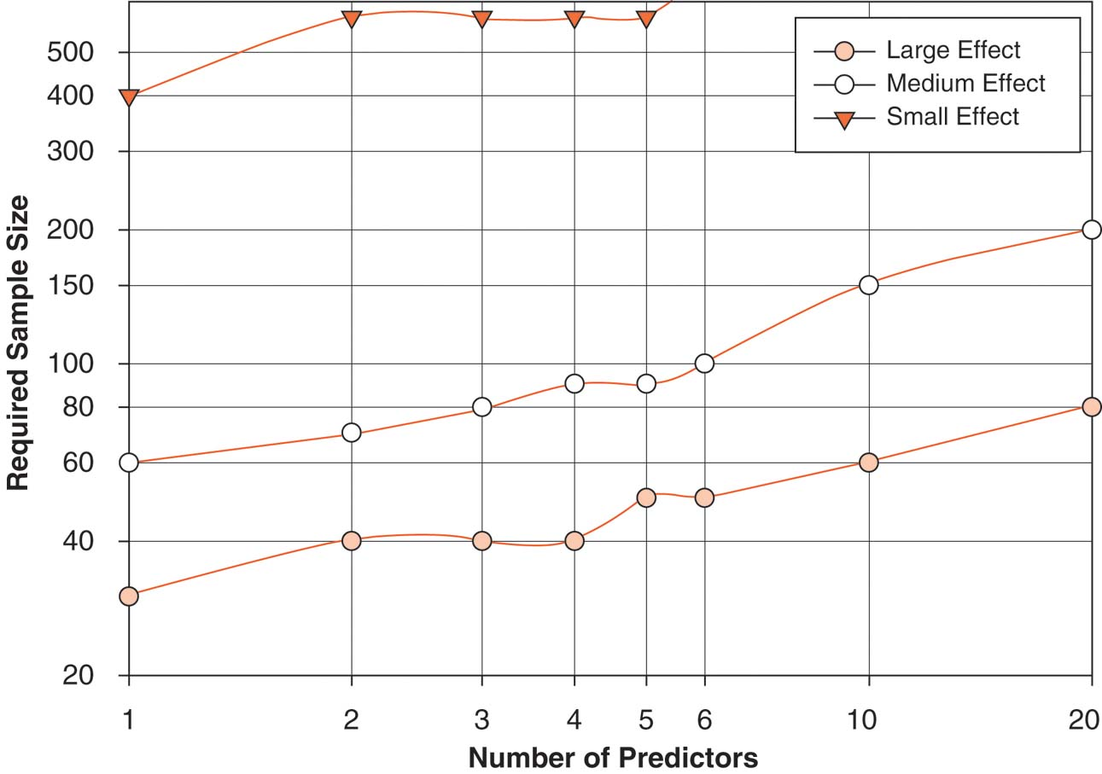
Sample Size Estimates (Field)

Slide 10
Requirements: Outcome var
Must be interval/continuous:
  Solutions:
    Categorical DV: use Logistic Regression
    Ordinal DV: use Ordinal Regression,
    or collapse into categories,
    or treat as interval (only if enough ranks)
Independence of scores (research design):
  If not: invalid conclusions
  Solutions: redesign data set, or
    Multi-level modelling instead of regression

Slide 11
Requirements: Outcome var
Normal (use normality tests):
  If not: significance tests may be misleading
  Solutions: Check for outliers, transform data, use caution in interpreting significance
Unbounded distribution (obtained range of responses versus possible range of responses):
  If not: artificially deflated R²
  Solutions:
    Collect more data from missing range
    Use a more sensitive instrument
Notes:
More on assumptions, see class#5 outline

Slide 12
Requirements: Predictors
Interval-level
  Can be categorical, too (see next page)
  If ordinal, can collapse into categories or treat as if scale (if have enough ranks)
Full range of variability
  Check histogram
  e.g., if an IV only covers 1-3 on a scale
  of 1-10, then the regression model will predict poorly for values beyond 3
  Eliminate/replace poor predictors

Slide 13
Categorical Predictors
Regression can work for categorical predictors:
If dichotomous: code as 0 and 1
  e.g., 1 dichotomous predictor, 1 scale DV:
  Regression is equivalent to t-test!
  And the slope B₁ is the difference of means
If n categories: use “dummy” variables
  Choose a base category
  Create n-1 dichotomous variables
  e.g., {BC, AB, SK}: dummys are isAB, isSK

Slide 14
Outline: Multiple Regression
Requirements on Variables: SampleSize, DV, IVs
Building a Regression Model
  Shared vs. Unique Variance
  Strategies for Entering IVs
  Interpreting Output
Diagnostic Tests:
  Residuals, Outliers, and Influential Cases
Checking Assumptions:
  Non-multicollinearity, independence, normality, homoscedasticity, linearity
Notes:
DATA SETS: Chapter 5, Field: p. 152 (record1) & p. 158 (record2);

Slide 15
Example: Record Sales data
Outcome (“criterion”): record sales (RS)
Predictors: advertising budget (AB), airtime (AT)
  Both have good ‘variability’, and n=200
Research Question: Do AB and AT both show unique effects in explaining Record Sales?
Research design: Cross-sectional, correlational study with 2 quantitative IVs & 1 quantitative DV (1 year data?)
Analysis strategy: Multiple regression (MR)
Notes:
Importance defined as largest unique variance? Or largest variance per se?

Slide 16
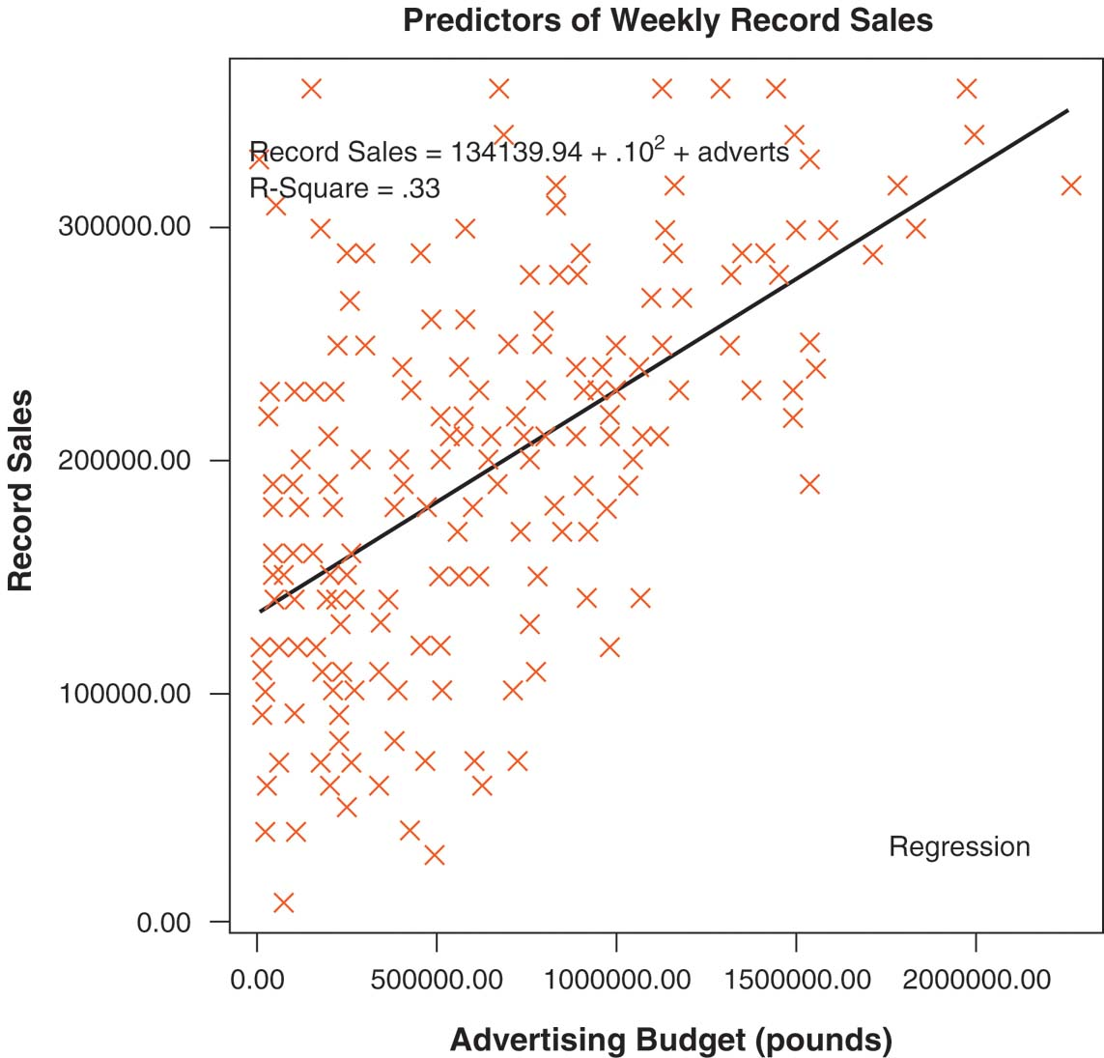
Regression Model with 1 IV

Slide 17
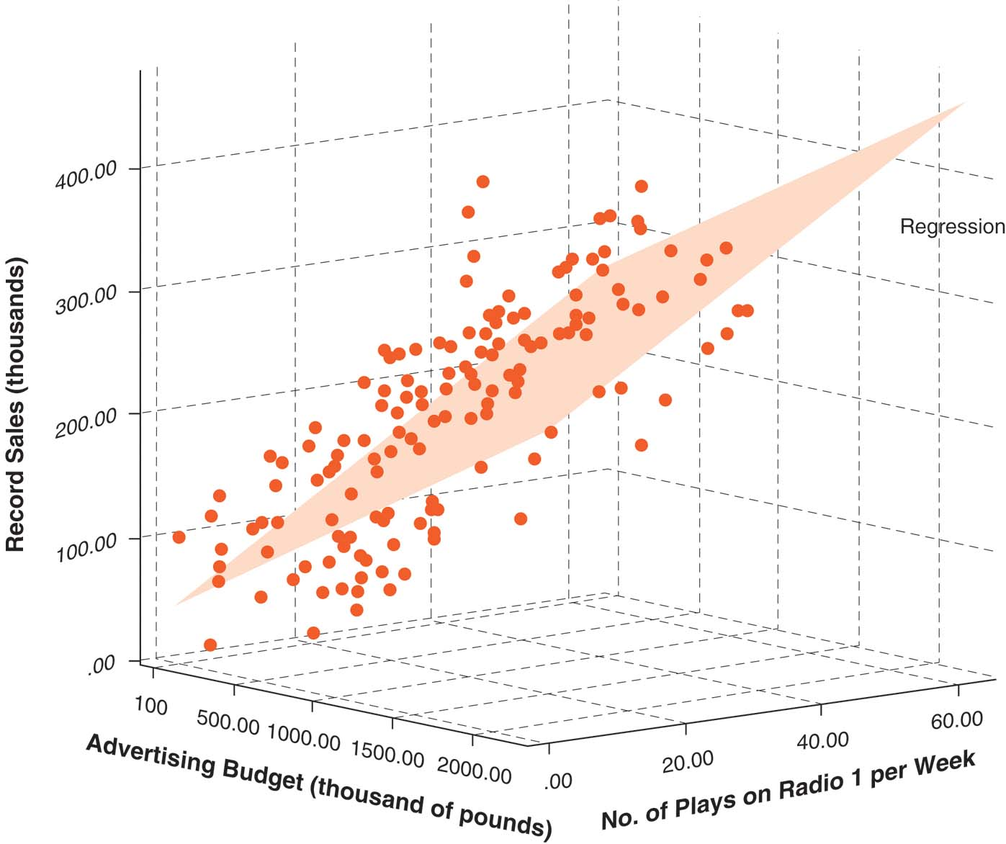
Regression Model with 2 IVs

Slide 18
Asking Precise RQs
What does literature say about AB and AT in relation to record sales?
  Previous lit may be theoretical or empirical
  May focus on these variables or others
  May be consistent or conflicting results
Contrast these two seemingly similar RQs:
  Is AB or AT more important for Sales?
  Do AB and AT both show unique effects in accounting for the variance of Sales?

Slide 19
Example: Record Sales
Dataset: Record2.sav
Analyze → Regression → Linear
Dependent: Record Sales (RS)
Independent: Advertising (AB) & Airtime (AT)
  This is a “simultaneous” regression
Statistics: check R² change and partial correl.
Review output: t–test for each beta coefficient tests significance of unique effects for each predictor

Slide 20
Outline: Multiple Regression
Requirements on Variables: SampleSize, DV, IVs
Building a Regression Model
  Shared vs. Unique Variance
  Strategies for Entering IVs
  Interpreting Output
Diagnostic Tests:
  Residuals, Outliers, and Influential Cases
Checking Assumptions:
  Non-multicollinearity, independence, normality, homoscedasticity, linearity
Notes:
DATA SETS: Chapter 5, Field: p. 152 (record1) & p. 158 (record2);

Slide 21
Shared vs. Unique Variance
When predictors are correlated, they account for overlapping portions of variance in outcome
  Redundant IVs, mediation,
  shared background effects, etc.
Order of entry will help distinguish
shared and unique contributions

Slide 22
Order of Entry
Predictors in same block are entered into model at the same time
Subsequent blocks only look at remaining variance after previous blocks have been factored out
To find a predictor's unique contribution, put it last after other predictors are factored out
Try several runs with different orderings to get each predictor's unique effect
Order for your final run should reflect theory about relative importance of predictors

Slide 23
Options for Variable Selection
Within each block, not all IVs need to be used:
  Manual method: “Enter” (forced entry)
    All specified IVs will be included
  “Stepwise” automatic methods:
    Forward: add significant IVs one-at-a-time
    Backward: eliminate non-significant IVs
Best to use “Enter”: manual control
  You decide order according to theory/lit
Automatic methods might not show
shared effects, interaction effects

Slide 24
Record Sales Example
Analyze → Regression → Linear
Dependent: Record Sales
Statistics: check R² change
Run 1: “simultaneous” regression
  Both AB and AT in Block 1
Run 2: AB in Block 1, and AT in Block 2
Run 3: AT in Block 1, and AB in Block 2

Slide 25
Calculating Shared Variance
Output from Run 1: Total effect size from both predictors together is 63%
Run 2: Airtime's unique effect size is 30%
  Look at last ΔR²: when airtime is added
Run 3: Advertising's unique effect size is 27%
Shared variance:
  = Total minus all unique effects
  = 63% – 30% – 27% ≈ 6%

Slide 26
Steps for Entering IVs
First, create a conceptual outline of all IVs and their connections & order of entry.
  Run a simultaneous regression: look at
  beta weights & t-tests for all unique effects
Second, create “blocks” of IVs (in order) for any variables that must be in the model
  Use “Enter” method to force vars into model
  Covariates may go in these blocks
  Interaction and curvilinear terms go in last of these blocks

Slide 27
Steps for Entering IVs (cont.)
Any remaining variables go in a separate block: try all possible combinations to sort out shared & unique variance portions.
  See record sales example above
  (no interaction terms were used)
Summarize the final sequence of entry that clearly presents the predictors & their respective unique and shared effects.
Interpret the relative sizes of the unique & shared effects for the Research Question
Notes:
Reminder: Stepwise (with “backward” method) of entry helps to confirm “suppressor” effects.

Slide 28
Entering IVs: SPSS tips
Plan out your order and method on paper
Each set of variables that should be entered in at the same time should be in a single block.
  Other vars & interactions go in later blocks
Usually choose “Enter” method (default)
  Try automatic (“Backward”) only if needed
Confirm correct order & method of entry in your SPSS output
  Usually only need a few blocks of IVs

Slide 29
Outline: Multiple Regression
Requirements on Variables: SampleSize, DV, IVs
Building a Regression Model
  Shared vs. Unique Variance
  Strategies for Entering IVs
  Interpreting Output
Diagnostic Tests:
  Residuals, Outliers, and Influential Cases
Checking Assumptions:
  Non-multicollinearity, independence, normality, homoscedasticity, linearity
Notes:
DATA SETS: Chapter 5, Field: p. 152 (record1) & p. 158 (record2);

Slide 30
Output: “Model Summary”
R²: the variance in the outcome accounted for by the model (i.e., combined effect of all IVs)
  Interpretation is similar to r² in correlation
  Multiply by 100 to convert into a percentage
  Adjusted R²: unbiased estimate of the model, always smaller than R²
R² Change (ΔR²): Increase in effect size from one block of predictors to the next.
  F-test checks whether this “improvement” is significant.

Slide 31
Output: “ANOVA” Table
Summarizes results for the model as a whole: Is the “simultaneous” regression a better predictor than simply using the mean score of the outcome?
Proper APA format for reporting F statistics (see also pp. 136-139 of APA publication manual):
  F(3, 379) = 126.43, p < .001
df-regression
F-ratio
statistical
significance
df-residual

Slide 32
Output: “Coefficients” Table
Individual contribution of each predictor, and whether its contribution is significant
B (b-weight, slope, gradient): Change in outcome, for every unit change of the predictor
beta (β): Standardized b-weight. Compares the relative strength of the different predictors.
t-test (p-value): Tests whether a particular variable contributes a significant unique effect in the outcome variable for that equation.

Slide 33
Non-significant Predictors
What if the t-test shows a predictor's unique effect is non-significant?
In general, the ΔR² will be small. If not, then you have low power for that test & must report that.
Remove the IV unless there is a theoretical reason for retaining it in the model (e.g.,
low power, help for interpreting shared effects)
Re-run the regression after any variables have been removed

Slide 34
Outline: Multiple Regression
Requirements on Variables: SampleSize, DV, IVs
Building a Regression Model
  Shared vs. Unique Variance
  Strategies for Entering IVs
  Interpreting Output
Diagnostic Tests:
  Residuals, Outliers, and Influential Cases
Checking Assumptions:
  Non-multicollinearity, independence, normality, homoscedasticity, linearity
Notes:
DATA SETS: Chapter 5, Field: p. 152 (record1) & p. 158 (record2);

Slide 35
Residuals in Regression
A residual is the difference between the actual score and the score predicted by the model
  I.e., the amount of error for each case
Examine the residuals in a trial run
  Include all IVs: simultaneous regression
  Save the residuals in a new variable:
Analyze → Regression → Linear → Save: “standardized” and/or “unstandardized”

Slide 36
Multivariate Outliers
Definition: Cases from a different population than what we want to study
  Combination of scores across predictors is substantially different from rest of sample
Consequence: distortion of regression line, reduced generalizability
Screening: Standardized residual ≥ ±3, and Cook’s distance > 1
Solution: remove outliers from from sample
(if they exert too much influence on the model)

Slide 37
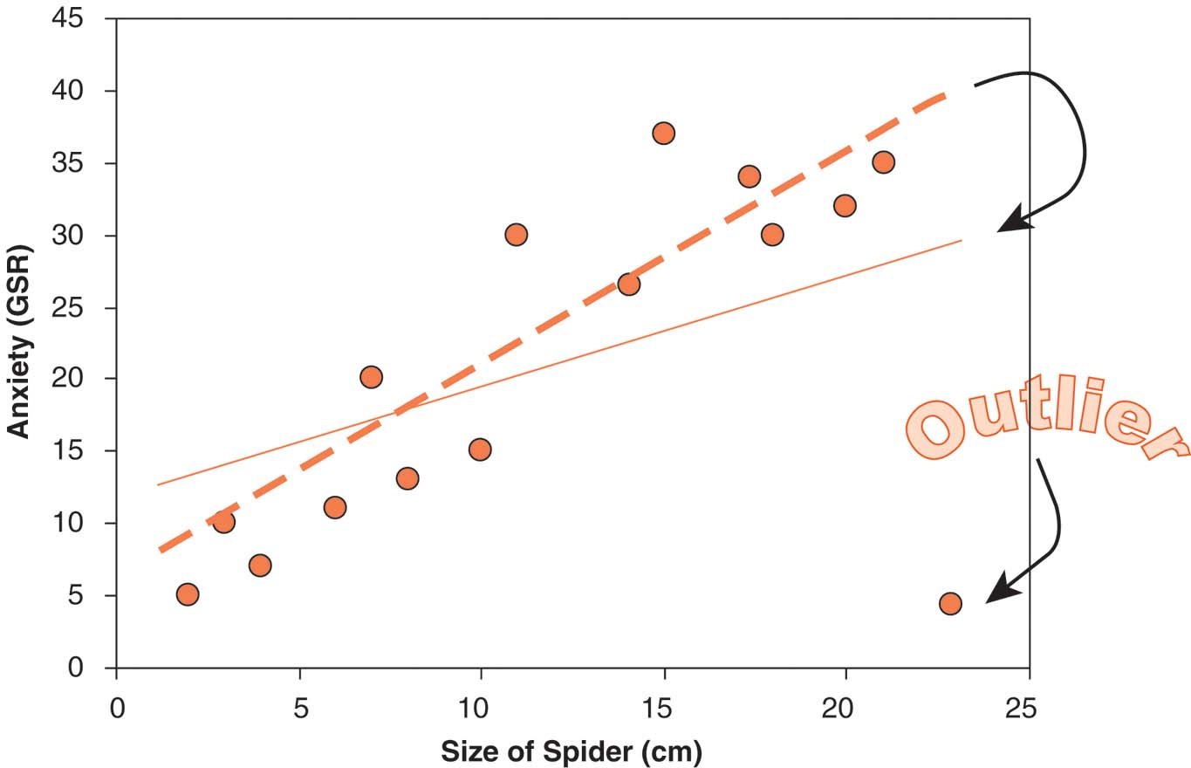
Effect of Multivariate Outliers

Slide 38
Overly-Influential Cases
Definition: A case that has a substantially greater effect on the regression “line” than the majority of other cases in the sample
Consequence: reduced generalizability
Screening & Solution:
  if max. leverage value ≤ 0.20 then safe;
  if leverage > 0.50 then remove;
  if in between,
  remove if max. Cook’s distance > 1
Notes:
Remind people to use SPSS “help” info: Cook's. A measure of how much the residuals of all cases would change if a particular case were excluded from the calculation of the regression coefficients. A large Cook's D indicates that excluding a case from computation of the regression statistics changes the coefficients substantially. Leverage values. Measures the influence of a point on the fit of the regression. The centered leverage ranges from 0 (no influence on the fit) to (N-1)/N.

Slide 39
Outliers & Influential cases
Outliers and influential cases should be examined and removed together
  Unlike other aspects of MR, screen only once
  Why shouldn't you repeat this screening?
SPSS: Analyze → Regression → Linear:
  Save: Standardized Resid, Cook’s, Leverage
  Will be saved as additional vars in dataset
Examine the Residual Statistics table
Examine the saved scores in the data set
  Try sorting: Data → Sort

Slide 40
Outline: Multiple Regression
Requirements on Variables: SampleSize, DV, IVs
Building a Regression Model
  Shared vs. Unique Variance
  Strategies for Entering IVs
  Interpreting Output
Diagnostic Tests:
  Residuals, Outliers, and Influential Cases
Checking Assumptions:
  Non-multicollinearity, independence, normality, homoscedasticity, linearity
Notes:
DATA SETS: Chapter 5, Field: p. 152 (record1) & p. 158 (record2);

Slide 41
Multicollinearity
Definition: Predictors covary too highly;
i.e., too much overlap of shared variance
Consequences: deflated R²; may interfere with evaluation of β (depending on RQ & design)
In “Statistics”: check “Collinearity Diagnostics”
Indicators of possible problems: any of:
    Any VIF (Variance Inflation Factor) score > 10
    Average VIF is NOT approximately = 1
    Tolerance < 0.2
Solution: delete, combine, or transform some of the multicollinear variables
Notes:
REVISE THIS point, esp. exceptions: some predictors, e.g., mediators & moderators, ARE & should be collinear.

Slide 42
Independence of Residuals
Definition: Residuals for different cases should not be systematically related
Consequence: Can interfere with α and power, although effect size is unaffected
Screening: Durbin-Watson scores that are relatively far away from 2 (on possible range of 0 to 4) indicate a problem with independence.
  D-W sensitive to case ordering, so ensure cases aren't inherently ordered in dataset
Solution: No easily implemented solutions. Possibly use multi-level modelling techniques.

Slide 43
Normally Distributed Residuals
Definition: Residuals normally distributed
  Predictors don't have to be normal!
Consequence: reduced generalizability
(predictive value of the model is distorted)
Screening: normality tests/plots on residuals
  save standardized residuals
  Analyze → Descriptives → Explore → “Normality tests with plots”
Solution: screen dataset for problems with the predictor variables (non-normal, or based on ordinal measurements), and deal with them

Slide 44
Homoscedastic Residuals
Definition: Residuals should have similar variances at every point on the regression line
  Generalisation of homogeneity of variance
Consequence: the model is less accurate for some people than others
Screening: fan-shaped residual scatterplots:
  Analyze → Regression → Linear → Plots:
  X: “ZPRED” Y: “ZRESID”
Solution: identify the moderating variable and incorporate it; use weighted OLS regression; or accept it and acknowledge the drop in accuracy

Slide 45
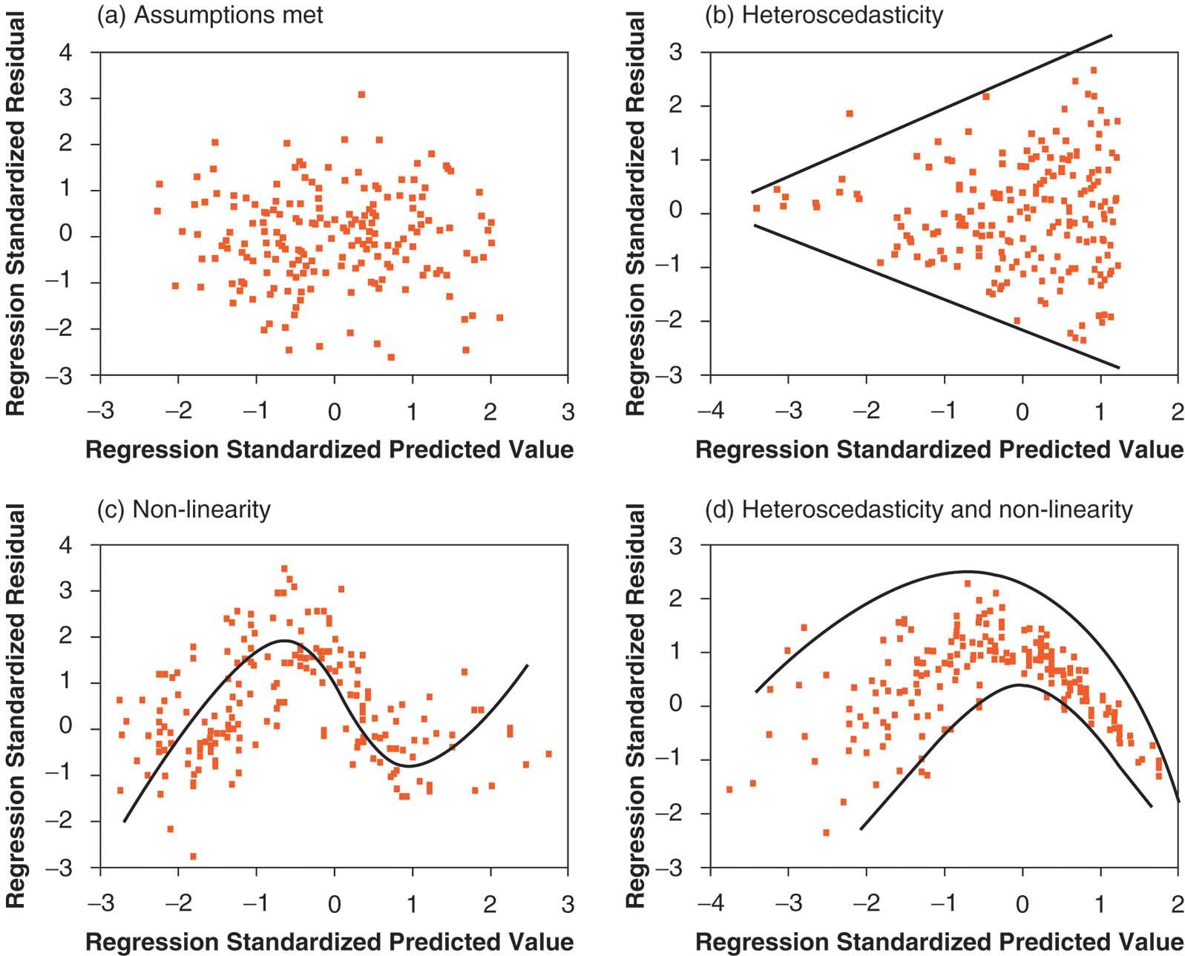
Heteroscedascticity

Slide 46
Non-linear Relationships
Definition: Relationship between predictor and outcome is not linear (i.e., a straight line).
Consequences: sub-optimal fit for the model
(R² is lower than it should be)
Screening: examine residual scatterplots OR use curve estimation:
  Analyze → Regression → Curve estimation
Solutions: Model the non-linear relationship by entering a polynomial term into the regression equation (e.g., IV², IV³)
  Or just accept the poorer fit

Slide 47
Exercise: Regression with SPSS
Dataset: Domene.sav
You try it! Build a regression model with:
  DV: “educational attainment”
  IV: Block 1: “academic performance”
  IV: Block 2: “educational aspirations” and “occupational aspirations”
  Use “Enter” method (force entry)
Ask SPSS for ΔR² and partial correlation scores

