Slide 1
MODERATION & MEDIATION
Download Data:
- Peattie
- Exam Anxiety
October 23rd, 2009

Slide 2
Mod/Med Lecture Outline
Review HMR
Moderation
  Moderation – Conceptual
  Example of Moderation – Peattie Data
  Interpreting Moderation Results
Mediation
  Mediation – Conceptual
  Example of Mediation – Exam Anxiety Data
  Interpreting Mediation Results
Practicewith Peattie Data – Assumptions etc.

Slide 3
Review of Regression
Simple Regression
  Test the predictive value of one variables on another
  Testing if a predictor variable can explain a significant portion of the variance in an outcome variable
Multiple Regression
  If an outcome variable can be predicted by several predictor variables

Slide 4
Review of Regression
Hierarchical Multiple Regression
  Use theoretical and conceptual strategies to guide the order of entry for predictor variables
  Allows us to determine the shared and unique effects of predictors
  R² = a measure of how much of the variability in the outcome is accounted for by the predictors
  ΔR² ⁼ a measure of how much additional variance in the outcome is accounted for by the new model

Slide 5

Moderation
Definition: When a 3rd variable interacts with the predictor variable (PV) to change the degree or direction of the relationship between the predictor variable (PV) and the outcome variable (OV)

Slide 6
Moderation
Predictor
Variable(s)
Outcome
Variable
Moderator
Variable(s)

Slide 7
Moderation
Predictor Variable: Primary Traumatic Stress
Moderator Variable:
Relationship Quality
Outcome Variable
Secondary Traumatic Stress
Interaction:
Primary Traumatic Stress x Relationship Quality

Slide 8
Moderation Question Example
(contrived graph)
Does relationship quality moderate the effect of primary traumatic stress on secondary traumatic stress?
Buffering effect of RQ Moderator
Low RQ
(mean - 1 SD)
High
Partner’s STS
Medium RQ
(mean)
High RQ
(mean + 1 SD)
Low
Low
High
Patient’s PTS

Slide 9
Moderation – Research Qs
Does relationship quality moderate
secondary traumatic stress?
Does relationship quality moderate
the effect of primary traumatic stress on secondary traumatic stress?

Slide 10
Testing for Moderators (Interactions)
Using Hierarchical Multiple Regression

Slide 11
Testing a Model of Moderation using HMR Requires:
Predictor Variable
  Continuous
Moderator Variable
  Continuous
  Categorical (would require dummy coding & is not centered)
Outcome Variable
  Continuous

Slide 12
Peattie Data
Research Question:
  Do joint religious activities buffer the relationship between negative life events and marital satisfaction?
  PV: Negative Life Events (NLE)
  OV: Marital Satisfaction (MS)
  Mod: Joint Religious Activities (JRA)

Slide 13
Preparing Variables
1st: Centre Predictor (NLE)
  Centering is done by subtracting the mean score of the variable from each person’s actual score on that variable
  Transform – Compute V: Formula: V – Mean of variable
2nd: Centre Moderator (JRA)
(DO NOT centre outcome variable)
3rd: Create Interaction Term
  Multiply the predictor & moderator (using the centred variables)
  Transform – Compute V: Formula: PV_Cent X MV_Cent

Slide 14
Testing Moderation using HMR
OV - MS
Block 1
  Enter Predictor variable(s) – Nle_Cent
Block 2
  Enter Moderating variable(s) – Jra_Cent
Block 3
  Enter Interaction term(s) – INT_nleXjra

Slide 15
Testing Moderation using HMR
Select optionsfor testing assumptions etc.
  Stats:
    R² Change, Part/Partial Corr, Collinearity, D-W
  Save:
    Stand. Resid., Cooks, Leverage
  Plots:
    ZRESID on Y-axis, ZPRED on X-axis
    SRESID on Y-axis, ZPRED on X-axis

Slide 16
Peattie Data: Model Summary
Model Summary^{d}
Model | R | R Square | Adjusted R Square | Std. Error of the Estimate | Change Statistics
 |  |  |  |  | R Square Change | F Change | df1 | df2 | Sig. F Change
1 | .335ª | .112 | .104 | 1.39996 | .112 | 13.911 | 1 | 110 | .000
2 | .350^{b} | .122 | .106 | 1.39834 | .010 | 1.256 | 1 | 109 | .265
3 | .391^{c} | .153 | .130 | 1.37987 | .031 | 3.937 | 1 | 108 | .050
a. Predictors: (Constant), NLE_Cent
b. Predictors: (Constant), NLE_Cent, JRA_Cent
c. Predictors: (Constant), NLE_Cent, JRA_Cent, NLE_JRA_Int
d. Dependent Variable: Marital Satisfaction
If interaction termis significant = there is a moderating effect

Slide 17
Peattie Data: Coefficients Table
Coefficientsª
Model |  | Unstandardized Coefficients |  | Standardized Coefficients | t | Sig.
 |  | B | Std. Error | Beta
1 | (Constant) | 5.601 | .132 |  | 42.338 | .000
 | NLE_Cent | -.120 | .032 | -.335 | -3.730 | .000
2 | (Constant) | 5.600 | .132 |  | 42.385 | .000
 | NLE_Cent | -.108 | .034 | -.302 | -3.195 | .002
 | JRA_Cent | .105 | .093 | .106 | 1.121 | .265
3 | (Constant) | 5.672 | .135 |  | 41.925 | .000
 | NLE_Cent | -.081 | .036 | -.224 | -2.220 | .028
 | JRA_Cent | .088 | .092 | .089 | .952 | .343
 | NLE_JRA_Int | .037 | .019 | .195 | 1.984 | .050
a. Dependent Variable: Marital Satisfaction

Slide 18
Reporting Results - APA Style
Participation in joint religious activities significantly moderates the association between negative life events and marital satisfaction, F(3, 108) = 6.52, p< .001.

Slide 19
Graphing Moderation
Paul Jose’s ModGraph
  A helpful tool to understand the moderating relationship, how the PV predicts the DV depending on the level of the MOD
Jose, P.E. (2008). ModGraph-I: A programme to compute cell means for the graphical display of moderational analyses: The internet version, Version 2.0. Victoria University of Wellington, Wellington, New Zealand. Retrieved October 10, 2009 from http://www.victoria.ac.nz/psyc/staff/paul-jose-files/modgraph/modgraph.php

Slide 20
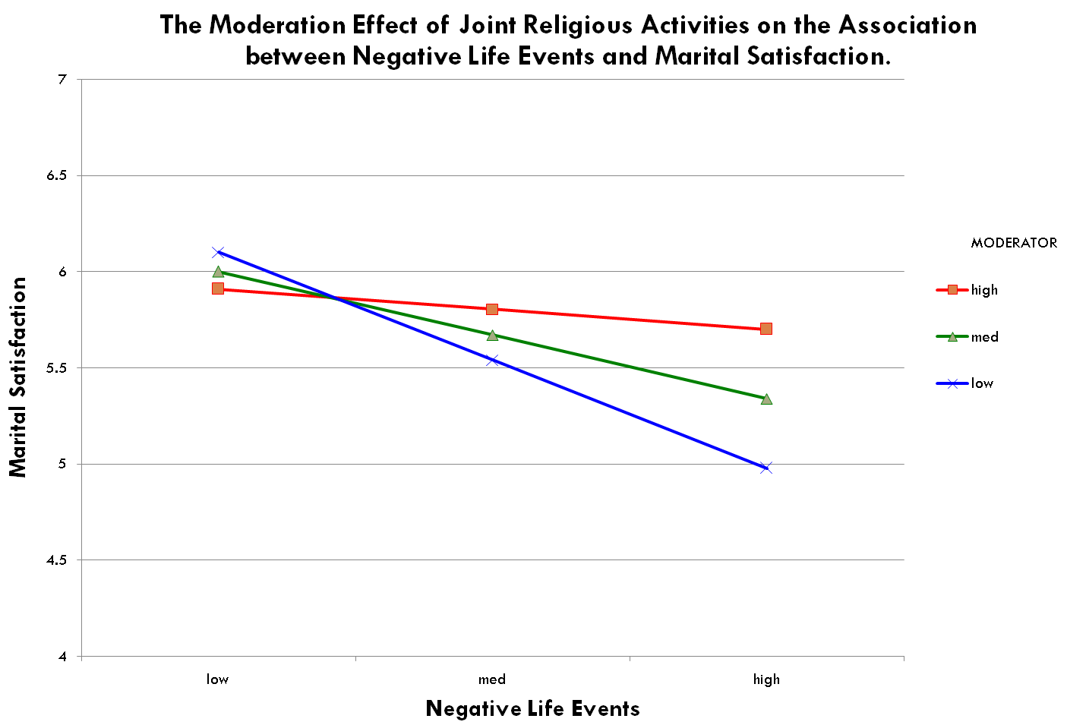

Slide 21
Mediation
Definition: Mediator variables are the mechanism through which the predictor variable (PV) impacts the dependent variable (DV)

Slide 22
Mediation
Predictor
Variable
Mediating
Variable
Outcome
Variable
Childhood Trauma
Eating Psychopath.
Depression
Disease Severity
Illness Intrusiveness
Psych.
Distress
E.g.?
E.g.?
E.g.?

Slide 23
Mediation
1
c
Predictor
Variable
Outcome
Variable
Mediating
Variable
a
b
2
Predictor
Variable
Outcome
Variable
c’

Slide 24
Testing for Mediation
Using Regression

Slide 25
Example – Exam Anxiety Data
Does exam anxiety mediate the relationship between time spent studying and exam performance?
  OV: Exam Performance
  PV: Time Spent Studying
  Med: Exam Anxiety
Time Spent Studying
ExamAnxiety
Exam Performance

Slide 26
Preconditions: What do we need?
Predictor, Mediator & Outcome variables must all be significantly correlated to each other
  Check this:
    Analyze - Correlate – Bivariate

Slide 27
Bivariate Correlations
Correlations
 |  | Time Spent Revising | Exam Performance (%) | Exam Anxiety
Time Spent Studying | Pearson Correlation | 1.000 | .397** | -.709**
 | Sig. (2-tailed) |  | .000 | .000
 | N | 103 | 103 | 103
Exam Performance (%) | Pearson Correlation | .397** | 1.000 | -.441**
 | Sig. (2-tailed) | .000 |  | .000
 | N | 103 | 103 | 103
Exam Anxiety | Pearson Correlation | -.709** | -.441** | 1.000
 | Sig. (2-tailed) | .000 | .000
 | N | 103 | 103 | 103
**. Correlation is significant at the 0.01 level (2-tailed).

Slide 28
Testing Mediation using Regression
1st: Run a the Main Regression Model with...
  Predictor V (Studying)
  Outcome V (Exam Performance)
Must be a relationship to mediate!

Slide 29
Testing Mediation using Regression
2nd: Run Regression Model with...
  Predictor as PV (Studying)
  Mediator as OV (Exam Anxiety)
3rd: Run Regression Model again with...
  Enter BOTH the Predictor & Mediating variable into the same block

Slide 30
1st Output: Main Regression Model
(c path)
Model Summary
Model | R | R Square | Adjusted R Square | Change Statistics
 |  |  |  | F Change | df1 | df2 | Sig. F Change
1 | .397ª | .157 | .149 | 18.865 | 1 | 101 | .000
a. Predictors: (Constant), Time Spent Studying
Coefficientsª
Model |  | Unstandardized Coefficients |  | Standardized Coefficients | t | Sig.
 |  | B | Std. Error | Beta
1 | (Constant) | 45.321 | 3.503 |  | 12.938 | .000
 | Time Spent Studying | .567 | .130 | .397 | 4.343 | .000
a. Dependent Variable: Exam Performance (%)

Slide 31
2nd Output: Pred – Med (a path)
Model Summary
Model | R | R Square | Adjusted R Square | Change Statistics
 |  |  |  | F Change | df1 | df2 | Sig. F Change
1 | .709ª | .503 | .498 | 102.233 | 1 | 101 | .000
a. Predictors: (Constant), Time Spent Studying
Coefficientsª
Model |  | Unstandardized Coefficients |  | Standardized Coefficients | t | Sig.
 |  | B | Std. Error | Beta
1 | (Constant) | 87.668 | 1.782 |  | 49.200 | .000
 | Time Spent Studying | -.671 | .066 | -.709 | -10.111 | .000
a. Dependent Variable: Exam Anxiety

Slide 32
3rd: Final Mediation Model
(b&c’ path)
Model Summary
Model | R | R Square | Adjusted R Square | Change Statistics
 |  |  |  | F Change | df1 | df2 | Sig. F Change
1 | .457ª | .209 | .193 | 13.184 | 2 | 100 | .000
a. Predictors: (Constant), Exam Anxiety, Time Spent Studying
Coefficientsª
Model |  | Unstandardized Coefficients |  | Standardized Coefficients | t | Sig.
 |  | B | Std. Error | Beta
1 | (Constant) | 87.833 | 17.047 |  | 5.152 | .000
 | Time Spent Studying | .241 | .180 | .169 | 1.339 | .184
 | Exam Anxiety | -.485 | .191 | -.321 | -2.545 | .012
a. Dependent Variable: Exam Performance (%)

Slide 33
Reporting
1
c
Predictor
Variable
β= .39, p< .001
Outcome
Variable
a
Mediating
Variable
b
β= -.71, p< .001
β= -.32, p< .05
2
Predictor
Variable
β= .17, p> .05
Outcome
Variable
c’

Slide 34
Interpreting Results
If you have a real mediator effect, the predictor variable should not be significant in the model, when the mediator is included.
  The previously significant effect between the predictor and outcome will become non-significant.
Interpreting Peattie Example:
  The influence of time spent studying on exam performance is indirect, more specifically, time spent studying influences exam performance through a third mediating variable, exam anxiety.

Slide 35
What to Report?
Report the standardized Betas and associated significance level for:
  The original influence of the predictor on the outcome V (c path)
  The influence of the predictor on the mediator (a path)
  The influence of the mediator on the outcome V (b path)
  The influence of the predictor on the outcome, when the mediator is included (c’ path)
Effect Size

Slide 36
Helpful Tool: Med Graph
In order to understand the mediating relationship, a helpful tool is Paul Jose’s MedGraph
http://www.victoria.ac.nz/psyc/staff/paul-jose-files/helpcentre/help1_intro.php

Slide 37
Quick Conceptual Review

Slide 38
Would you Use Moderation or Mediation to Test the Following Qs?
Does the level of dyadic coping employed by a couple change the impact emotional expression has on a couples’ stress level?
Is the relationship between quality of relationships and depression best understood by considering social skills?
Does psychotherapy reduce distress by its ability to inspire hope in clients?

Slide 39
The MacArthur Model
...only so you’re aware of it

Slide 40
The MacArthur Model
Baron and Kenny (1986) proposed definitions and analysis procedures to assess moderators and mediators
The MacArthur Model suggests modified definitions
  Kraemer, H. C., Kiernan, M., Essex, M., &Kupfer, D. J. (2008). How and why criteria defining moderators and mediators differ between the Baron & Kenny and MacArthur approaches. Health Psychology 27, S101–S108.

Slide 41
PRACTICE...on your own!!
Checking Assumptions in HMR using Peattie Data

Slide 42
Analyze Assumptions...here’s some...
(For more see p. 220 of Field Text)
Outliers (p. 215)
  Review standardized residuals
Influential Cases (p. 217)
  Cook’s distance
  Leverage
Independent Errors (p. 220)
  Durbin - Watson
Multicollinearity
  VIF & Tolerance (p. 241)
  Correlations between predictors (p. 220)
Heteroscedasticity&Homoscedasticity (p. 247)
  ZRESID on Y-axis, ZPRED on X-axis & SRESID on Y-axis, ZPRED on X-axis plots

Slide 43
Checking for Outliers
Outliers
Review the Standardized Residuals
  Over 3 ?
Create an outliers variable
  Data - Recode into diff. variable
    Recode standardized residual variable into an outlier variable: If old value = +or- 3, new value = 1
Select cases without outliers
  Data – Select Cases – If Outliers = 0

