Slide 1

Factorial ANOVA
Repeated-Measures ANOVA
6 Nov 2009
CPSY501
Dr. Sean Ho
Trinity Western University
Please download:
Treatment5.sav
MusicData.sav
For next week,
please read articles:
Myers&Hayes 06
Horowitz 07

Slide 2
Outline for Today
Factorial ANOVA
  Running in SPSS and interpreting output
  Main effects and interactions
  Follow-up analysis: plots & simple effects
Repeated-Measures ANOVA
  Assumptions: parametricity, sphericity
  Follow-up analysis: post-hoc comparisons

Slide 3
Intro to Factorial ANOVA
ANOVA with multiple “between-subjects” IVs
Describe number of categories/groups per IV:
  “5 x 4 x 4 design” means 3 IVs, with
  5 values (groups), 4 values, 4 values each
Each cell is a combination of categories:
  5 x 4 x 4 = 80 cells
  Each participant goes in exactly one cell, and is measured only once on the DV
  Cells are assumed to be independent
  “Balanced”: cell sizes all equal

Slide 4
Why Factorial ANOVA?
Why not just do One-way on each IV?
  IVs may have shared variance
  Interaction effects (moderation)!
Main effects: effect of just one IV (One-way)
Two-way interaction: Effects of one IV change depending on value of another IV (moderator)
3-way and higher interactions exist, too
Higher-order effects supercede low-order ones: interpret the highest significant interaction
Graphs may be needed to understand them

Slide 5
Outline for Today
Factorial ANOVA
  Running in SPSS and interpreting output
  Follow-up procedures
  Interactions, main effects, & simple effects
  Examples
Repeated-Measures ANOVA
  Assumptions, sphericity
  Follow-up analysis: post-hoc comparisons

Slide 6
Factorial ANOVA in SPSS
First check assumptions (see later slides)
Analyze → GLM → Univariate
  Enter all IVs together in “Fixed Factor(s)”
  Model: “Full Factorial” (default)
  (checks for all main effects & interactions)
  Options: Effect size & Homogeneity tests,
  Descriptives (and later, marginal means)
Examine each effect in the model separately
Treatment5.sav: IVs: Treatment Type, Gender
  DV: just depression at outcome for now

Slide 7
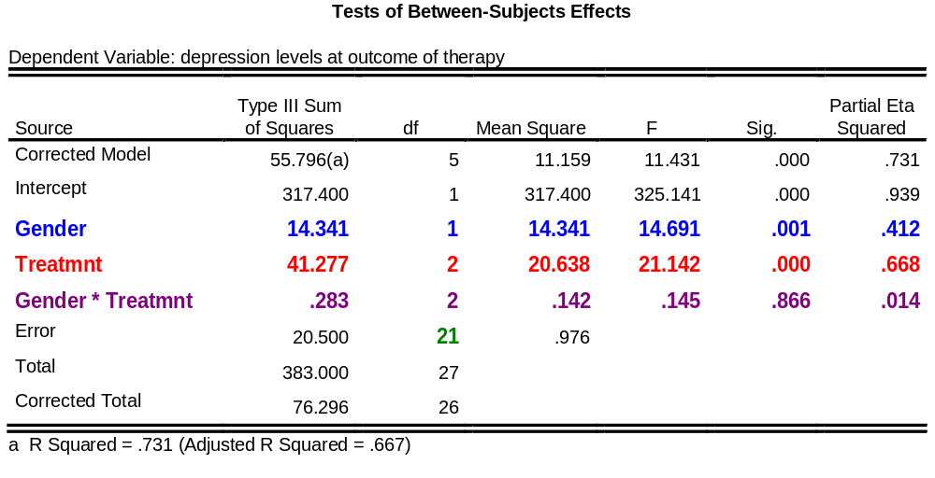
Interpreting Output: Treatment5
There were significant effects for treatment type,
F (2, 21) = 21.14, p < .001, η² = .668, and gender,
F (1, 21) = 14.69, p = .001, η² = .412, but
no significant interaction, F (2, 21) = 0.15,
p > .05, η² = .014
Notes:
NOTE: Type IV SS give identical results for this data set. The eta squared cannot be additive; recall upward bias.

Slide 8
Outline for Today
Factorial ANOVA
  Running in SPSS and interpreting output
  Follow-up procedures
  Interactions, main effects, & simple effects
  Examples
Repeated-Measures ANOVA
  Assumptions, sphericity
  Follow-up analysis: post-hoc comparisons

Slide 9
Follow-up Analysis: Main effects
If there are significant main effects:
  Analyze → GLM → Univariate → Post-hoc
  Post-hoc tests as in one-way ANOVA
  SPSS does post-hoc for each IV separately
  (i.e., as if doing multiple one-way ANOVAs)
Report means and SDs for each category of each significant IV (Options: Descriptives)
Or report marginal means for “unique effects” (Options: Estimated Marginal Means)
(more on this momentarily)

Slide 10
Post-hoc: Treatment5
Post-hoc on main effect for Treatment Type:
  Levene's is not significant, so can choose a post-hoc test that assumes equal variance:
  e.g., Tukey's HSD
No post-hocs needed for Gender – why?
Output on next slide:
  The Wait List control group has significantly higher depression levels at post-treatment
  (can graph means to visualize)

Slide 11
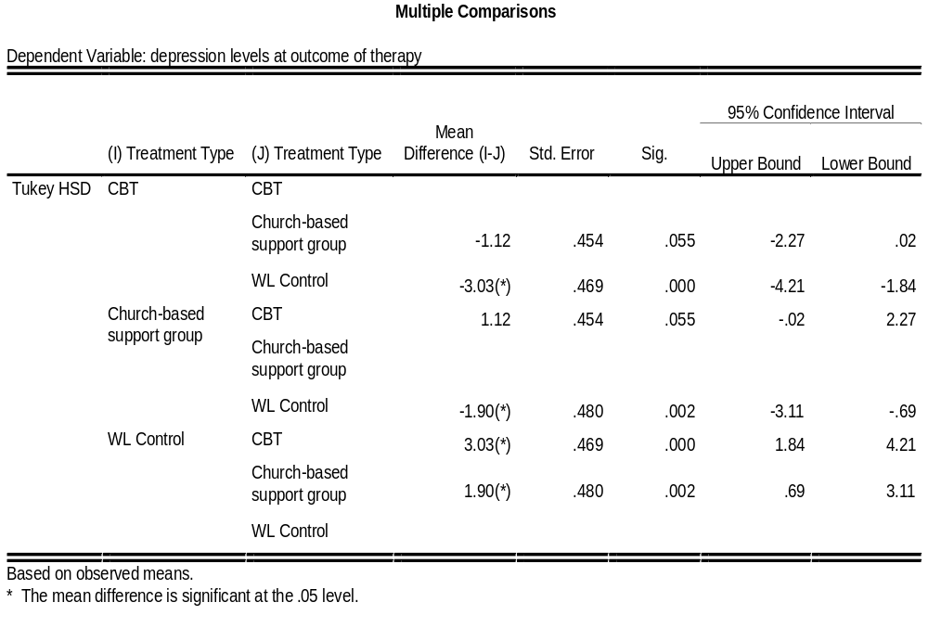

Slide 12
Estimated Marginal Means
Estimate of group means in the population rather than the sample, accounting for
effects of all other IVs and any covariates.
Analyze → GLM → Univariate → Options:
Move IVs and interactions to “Display means”
  Select “Compare main effects”
  Select multiple comparisons adjustment
Can be used to obtain estimated means for:
  (a) each group within an IV, and
  (b) each cell/sub-group within an interaction

Slide 13
Actual vs. Estimated Means
If instead we want to plot the
actual sample group means, just use:
Graph → Line → Multiple → Define:
  Enter DV in Lines Represent menu, as “Other Statistic”
  Enter IVs as “Category Axis” and
  “Define Lines By”
Usually, the estimated marginal means are close to the actual sample means

Slide 14
Graphing Interactions
For significant interactions: Graph the interaction to understand its effects:
  Analyze → GLM → Univariate → Plots
  SPSS plots estimated marginal means
The IV with the most groups usually goes into “Horizontal axis” (if makes sense conceptually)
For 3-way interactions, use “Separate plots”.
More complex interactions require more work

Slide 15
Interactions Ex.: MusicData
Dataset: MusicData.sav
DV: Liking (scale)
IV: Age (categorical: 0-40 vs. 40+)
IV: Music (cat.: Fugazi, Abba, Barf Grooks)
Run a 2x3 factorial ANOVA
  Any significant interactions & main effects?
  Plot the interaction of Age x Music

Slide 16
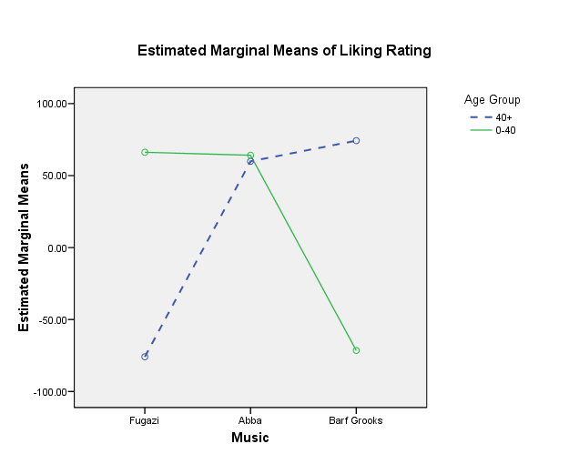

Slide 17
Follow-up: Simple Effects
If BOTH interaction and main effects are significant, report both but
  Interpret the main effects primarily
  “in light of” the interaction
How do we further understand effects?
Simple effect: look at the effect of certain IVs, with the other IVs fixed at certain levels
  e.g., do the old like “Barf Grooks” more than the young do? (fix Music = “Barf Grooks”)
May need advanced SPSS syntax tools to do
Notes:
http://www.ats.ucla.edu/stat/spss/faq/sme.htm
http://www.psych.nyu.edu/cohen/simpleff_SPSS1.pdf

Slide 18
Simple effects: MusicData
Data → Split file → “Compare groups”: Music
  Beware loss of power anytime we split data, due to small cell sizes
Run an ANOVA for each group in Music:
  GLM → Univariate: Liking vs. Age
  Options: Effect size, Levene's tests, etc.
Analogous to 3 t–tests for age:
one t-test for each music group

Slide 19
Non-significant Interactions
If the interaction is not significant,
we might not have moderation. Either:
  Leave it in the model (may have some minor influence, should be acknowledged), or
  Remove it and re-run ANOVA
  (may improve the F-ratios)
Analyze → GLM → Univariate → Model → Custom
  Change Build Term to “Main effects”
  Move all IVs into “Model”, but
  omit the non-significant interaction term
Notes:
Interactions often have lower power, so if interaction ESs are close to the size of main effects, one often leaves them in.

Slide 20
ANOVA: Parametricity
Interval-level DV, categorical IVs
Independent scores: look at study design
Normal DV: run K-S & S-W tests
Homogeneity of variances:
  Levene’s tests for each IV
  Really, need homogeneity across all cells
Use the same strategies for
(a) increasing robustness and
(b) dealing with violations of assumptions
as you would in one-way ANOVA

Slide 21
Assumptions: Practise
Dataset: treatment5.sav
DV: depression score at follow-up (scale)
IV: Treatment (categorical: CBT vs. CSG vs. WL)
IV: Age (scale, but treat as categorical)
What assumptions are violated?
For each violation, what should we do?
After assessing the assumptions, run the Factorial ANOVA and interpret the results.

Slide 22
Outline for Today
Factorial ANOVA
  Running in SPSS and interpreting output
  Follow-up procedures
  Interactions, main effects, & simple effects
  Examples
Repeated-Measures ANOVA
  Assumptions, sphericity
  Follow-up analysis: post-hoc comparisons

Slide 23
TREATMENT RESEARCH DESIGN | Pre-Test | Post-Test | Follow-up
Cognitive-Behavioural Therapy
Church-Based Support Group
Wait List control group
Factorial ANOVA
Repeated Measures ANOVA

Slide 24
Between- vs. Within- Subjects
Between-Subjects Factor/IV:
Different sets of participants in each group
  e.g., an experimental manipulation is done between different individuals
  One-way and Factorial ANOVA
Within-Subjects Factor/IV: The same set of participants contribute scores to each cell
  e.g., the experimental manipulation is done within the same individuals
  Repeated-Measures ANOVA

Slide 25
RM Example: Treatment5
DV: Depressive symptoms
  (healing = decrease in reported symptoms)
IV1: Treatment group
  CBT: Cognitive-behavioural therapy
  CSG: Church-based support group
  WL: Wait-list control
IV2: Time (pre-, post-, follow-up)
There are several research questions we could ask that fit different aspects of this data set

Slide 26
Treatment5: Research Qs
Do treatment groups differ after treatment?
  One-way ANOVA (only at post-treatment)
Do people “get better” while they are waiting to start counselling (on the wait-list)?
  RM ANOVA (only WL control, over time)
Do people in the study get better over time?
  RM ANOVA (all participants over time)
Does active treatment (CBT, CBSG) decrease depressive symptoms over time more than WL?
  Mixed-design ANOVA
  (Treatment effect over time)

Slide 27
Repeated-Measures ANOVA
One group of participants, experiencing all levels of the IV: each person is measured multiple times on the DV.
  Scores are not independent of each other!
RM is often used for:
  (a) developmental change (over time)
  (b) therapy / intervention (e.g., pre vs. post)
  Also for other kinds of dependent scores
  (e.g., parent-child)

Slide 28
Why Use RM ANOVA?
Advantages:
  Improve power: cut background variability
  Reduce MS-Error: same people in each cell
  Smaller sample size required
Disadvantages:
  Assumption of sphericity is hard to attain
  Individual variability is “ignored”
  rather than directly modelled:
  may reduce generalizability of results
Use RM when you have within-subjects factors

Slide 29
Outline for Today
Factorial ANOVA
  Running in SPSS and interpreting output
  Follow-up procedures
  Interactions, main effects, & simple effects
  Examples
Repeated-Measures ANOVA
  Assumptions, sphericity
  Follow-up analysis: post-hoc comparisons

Slide 30
Assumptions of RM ANOVA
Parametricity: (a) interval-level DV,
(b) normal DV, (c) homogeneity of variances.
  But not independence of scores!
Sphericity: homogeneity of variances of pairwise differences between levels of the within-subjects factor
  Test: if Mauchly’s W ≈ 1, we are okay
  If the within-subjects factors has only 2 cells, then W=1, so no significance test is needed.

Slide 31
Treatment5: 3-level RM
Analyze → GLM → Repeated Measures
  “Within-Subject Factor Name”: Time
  “Number of Levels”: 3, press “Add”
Define: identify specific levels of the
“within-subjects variable”: order matters!
For now, don’t put in treatment groups yet
(Look at overall pattern across all groups)
Options: Effect size
Plots: “Time” is usually the horizontal axis
Look through the output for Time only!

Slide 32
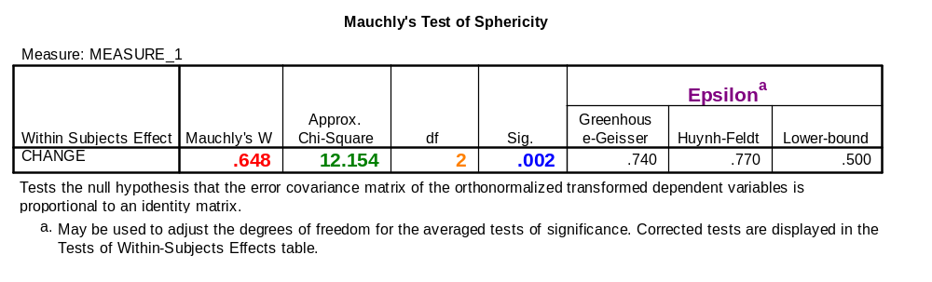
Check Assumptions: Sphericity
“The assumption of sphericity was violated,
Mauchly’s W = .648, χ²(2, N = 30) = 12.16, p = .002.”
If violated, use Epsilon (Greenhouse-Geisser) to adjust F-score (see later)
Scored from 0 to 1, with 1 = perfect sphericity

Slide 33
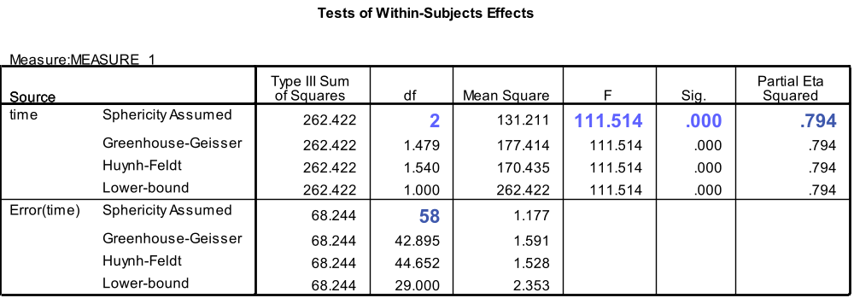
If Sphericity Is Satisfied:
Report F-ratio, df, p, and effect size from the line with Sphericity Assumed
APA style: “F(2, 58) = 111.5, p < .001, η² = .794”
If the omnibus ANOVA is significant, identify specific group differences using post hoc tests

Slide 34
If Sphericity Is Violated:
F-ratio and ANOVA results may be distorted
Consider multi-level modelling instead
(but it requires much larger sample size), or
Consider multivariate F-ratio results (MANOVA):
  But it loses power compared to RM ANOVA
  Need Greenhouse-Geisser epsilon ≤ .75
  Need sample size ≥ 10 + (# “within” cells)
  Report, e.g.: “Wilk’s λ = .157,
  F(2, 28) = 75.18, p < .001, η² = .843”
    (APA: Greek letters are not italicized)

Slide 35
Sphericity Violated: Adjust df
Use Greenhouse-Geisser epsilon if ≤ .75:
  If > .75, you may use the more optimistic Huynh-Feldt epsilon
  Multiply df by epsilon and update F and p
  This is given in the output tables
If the adjusted F-ratio is significant,
proceed to follow-up tests as needed
Report: e.g., “Greenhouse-Geisser adjusted F(1.48, 42.9) = 111.51, p < .001, η² = .794”
Notes:
Levine (1991), p. 29: if both epsilons are high, use the H-F; if both are low, use G-G; if they split, can calculate both Fs & compare.

Slide 36
Outline for Today
Factorial ANOVA
  Running in SPSS and interpreting output
  Follow-up procedures
  Interactions, main effects, & simple effects
  Examples
Repeated-Measures ANOVA
  Assumptions, sphericity
  Follow-up analysis: post-hoc comparisons

Slide 37
Follow-up analysis: post-hoc
If the overall RM ANOVA is significant, explore differences between specific cells/times:
  Analyze → GLM → Repeated Measures: Define → Options:
  Estimated Marginal Means:
  move RM factor to “Display means for”
  Select “Compare Main Effects”, use “Confidence interval adjustment”: Bonferroni
Plot the effects over time:
  Plots → IV in “Horizontal axis” → Add
  Or try error bar plots

Slide 38
Post hoc comparisons, cont.
Note: the Post-Hoc button applies only to between-subjects factors
  Hence not applicable here: we only have one IV (Time) and it is within-subjects
Interpret the output:
  Bonferroni results show that the mean
  Pre-test scores are significantly higher than the mean Post-test & Follow-up scores
  But the Post-test & Follow-up scores are not significantly different
  (see “Pairwise Comparisons”, “Estimates”)
Notes:
NOTE: THIS ANALYSIS IS ONLY OF INTEREST FOR DEMONSTRATION PURPOSES. SEE BELOW!

Slide 39
Practise: Field-Looks_Charis.sav
Dataset: “Looks & Charisma” (from Field text)
How does “attractiveness” change over time?
How does “charisma” change over time?
Combine both IVs in a factorial RM analysis (using both IVs)
Attending to sphericity issues, interpret the results
Conduct follow-up tests to see which kinds of people are evaluated more (and less) positively

