Slide 1

Mixed-Design ANOVA
13 Nov 2009
CPSY501
Dr. Sean Ho
Trinity Western University
Please download:
treatment5.sav

Slide 2
Outline: Mixed-Design ANOVA
Mixed-Design ANOVA: concept, SPSS, output
Interactions: finding significant effects
  Graphing, estimated marginal means
  Using simple effects to aid interpretation
  Extra main effects beyond the interactions
Exploring gender as a moderator
Misc: APA style
Misc: Practise mixed-design ANOVA
Misc: Covariates: Mixed-design ANCOVA

Slide 3
TREATMENT RESEARCH DESIGN | Pre-Test | Post-Test | Follow-up
Cognitive-Behavioural Therapy
Church-Based Support Group
Wait List control group
Factorial ANOVA
Repeated Measures ANOVA

Slide 4
Assumptions of RM ANOVA
Parametricity: (a) interval-level DV,
(b) normal DV, (c) homogeneity of variances.
  But not independence of scores!
Sphericity: homogeneity of variances of pairwise differences between levels of the within-subjects factor
  Test: if Mauchly’s W ≈ 1, we are okay
  If the within-subjects factors has only 2 cells, then W=1, so no significance test is needed.

Slide 5
Mixed-Design ANOVA
Advantages: More complete model
  Moderators!
  Treatment effects of interventions:
  Treatment groups (between-subjects) X
  Time (pre-/post-) (within-subjects)
  Any therapy study would use this!!
Disadvantages: “More work…”
  Tracking, interpreting interactions
  Can we trust complex results?
  May need larger sample sizes

Slide 6
Treatment5 Example
DV: Depressive symptoms
  (healing = decrease in reported symptoms)
IV1: Treatment group (between-subjects)
  CBT: Cognitive-behavioural therapy
  CSG: Church-based support group
  WL: Wait-list control
IV2: Time (pre-, post-, follow-up) (within-subj)
We will now do a full mixed-design study using both Treatment group and Time

Slide 7
Mixed-Design: SPSS
Analyze → GLM → Repeated measures → Define:
Add IVs to “Between Subjects Factor(s)”
Options: Effect size, Homogeneity tests, etc.
Check assumptions: Parametricity, sphericity
  Note: sphericity holds for treatment5 if we include the treatment groups in the design!

Slide 8
Output: ANOVA Tables
Output: first purely between-subjects effects
  Then within-subjects effects and
  interactions involving within-subjects factors
Main effects and interaction effects:
check F-ratios, significance level, and effect size
  Highest-order significant interactions first
For all significant effects, do follow-up:
  Graph interactions
  Post-hoc cell-by-cell comparisons
  See if main effects have an interpretation beyond the higher-order interactions

Slide 9
Examining Interactions
Graph significant interactions to understand
  Graphs plot the estimated marginal means
Confirm with the numbers behind the plots:
  Options: Estimated Marginal Means
  Examine confidence intervals
Treatment5: “The interaction of treatment group by time is significant, F(4, 54) = 7.28,
p < .001, η² = .350, demonstrating that …”
Notes:
More systematic options: Simple interaction effects, partioning effects, etc.

Slide 10
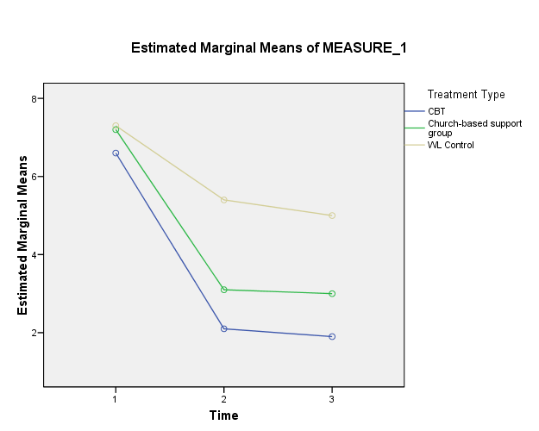

Slide 11
Interactions: Simple Effects
Follow-up on significant interaction:
Use simple effects to describe precisely which treatment groups differ significantly
  E.g., focus on just post-treatment time and do one-way ANOVA with Bonferroni post-hoc
  Confirm with estimated marginal means
The effect here is strong and clear, so even this conservative strategy shows that both treatment groups are lower than WL group, at post-treatment and follow-up times.

Slide 12
Interactions: Interpretation
We found a significant interaction:
  “The interaction of treatment group by time is significant, F(4, 54) = 7.28, p < .001,
  η² = .350, demonstrating that …”
Graphing + simple effects + est. marg. means give us the interpretation of the interaction:
  “…the decrease in symptoms of depression from pre-test to post-test and follow-up was greater for the treatment groups than it was for the WL control group.”

Slide 13
Main Effects with Interactions
Main effects are only meaningful if they tell us something beyond what the interaction tells us.
In Treatment5, both Treatment and Time main effects merely reflect the interaction effect.
  Only report the interaction with follow-up

Slide 14
Follow-up for Main Effects
To look for main effects beyond the interaction:
If there are only 2 levels of a repeated measure, no post-hoc is needed; the main effect is simply the pairwise difference between the two levels.
If there are more than 2 levels:
For between-subjects factors: “Post Hoc” button
  Select appropriate post-hoc test
For within-subjects factors:
Options: “Compare means”
  Remember to use Bonferroni correction

Slide 15
Treatment5: Interpretation
Last time, we ran a simple RM ANOVA on treatment5 and found a significant main effect for Time
But that is not the best model to explain the data, as we found today with Mixed-Design:
What's really going on is the interaction between Treatment Group and Time:
  Treatment effect over time

Slide 16
Other Moderators: Gender?
We found a clear treatment effect, but are there other potential moderators to add to the model?
In counselling psychology, gender often is an important variable in many analyses
RQ: Do the treatments seem to work
“the same” for both women and men?
  Look for 3-way: Gender * Time * Treatment
  2-way interaction may also be useful:
  Gender * Time or Gender * Treatment
  Main effect for gender not useful here

Slide 17
Gender as Moderator: SPSS
Clean and check assumptions on Gender
  We actually have missing data for gender
Analyze → GLM → Repeated measures → Define:
  “Between Subjects Factor(s)”:
  now add both Treatment Group and Gender
Interpret output tables for interactions:
  Remember that SPSS prints
  pure between-subjects effects separately from within-subjects effects and interactions

Slide 18
Output: Gender effects
Between-subjects effects:
  Gender * Group effect is not significant
Within-subjects effects:
  No 3-way interaction
  Time * Gender effect is significant
  (21% effect size)
Follow-up on Time * Gender:
  Graph and get estimated marginal means
  to try to understand the interaction

Slide 19
Summary: Moderation analysis
Women showed less improvement on average than did the men,
but that did not depend on treatment group.
So gender moderates response to treatment (but also to Waitlist!)
  Doesn't change our interpretation of the treatment effect – it still seems to “fit” both women and men
  For research publications, this “check” might not even be reported for the journal.

Slide 20
APA style notes
Provide evidence for your interpretations!
  Explain why you think something is true
  and report the statistics …
No space between F and (): “F(2, 332) = …”
R² is NOT the same as r²
Kolmogorov-Smirnov test: “D(105) = …”
Round to 2 decimal places for most stats
  Round to 3 for p and η²
Italicize Latin letters (p), not Greek letters (η²)

Slide 21
Practise: Mixed ANOVA
Treatment5: try a Mixed ANOVA with:
  Within-subjects: “outcome” and “follow-up”
  Between-subjects: “relationship status”
Check assumptions
Is there a significant interaction effect between pre/post treatment and relationship status?
  If so, interpret the interaction.

Slide 22
FYI: Covariates in Mixed-Design
ANCOVA + RM + Factorial:
  Enter “Covariates” in GLM → RM dialog
Covariates must remain constant across
all levels of the within-subjects (RM) factor
  “Varying” covariates: enter as second RM IV in the model (or use multi-level modelling)
Covariates should not be related to predictors
  Should have no significant interactions
  Need for homogeneity of regression slopes

