Slide 1

Categorical Data Analysis and Meta-Analysis
Download:
GenderDepr.sav
Fitzpatrick et al.
Hill & Lent
20 Nov 2009
CPSY501
Dr. Sean Ho
Trinity Western University

Slide 2
Outline for today
Categorical Data Analysis
  Entering frequency data
  Chi-squared test and effect sizes
  SPSS example
  Log-linear analysis example: Fitzpatrick 01
  Interactions
Meta-Analysis
  Combining effect sizes
  Example: Hill & Lent (2006)

Slide 3
Contingency Tables
When comparing two categorical variables, all observations can be partitioned into cells of the contingency table
  e.g., two dichotomous variables: 2x2 table
  Gender vs. clinically depressed:
 | Depressed | Not Depressed
Female | 126 | 154
Male | 98 | 122
  RQ: is there a significant relationship between gender and depression?

Slide 4
SPSS: Frequency Data
Usually, each row in the Data View represents one participant
  In this case, we'd have 500 rows
For our example, each row will represent one cell of the contingency table, and we will specify the frequency for each cell
Open: GenderDepr.sav
Data → Weight Cases: Weight Cases by
  Select “Frequency” as Frequency Variable

Slide 5
2 Categorical Vars: χ² and φ
Chi-squared (χ²) test: Two categorical variables
  Asks: is there a significant relationship?
  Requires no cells have expected count ≤ 1,
  and <20% of cells have expected count < 5,
  otherwise must resort to Fisher's exact test
Effect size:
  φ is akin to correlation: definition: φ² = χ² / n
  Cramer's V extends φ for more than 2 levels
  Odds ratio: #yes / #no

Slide 6
SPSS: χ² and φ
Analyze → Descriptives → Crosstabs:
  One var goes in Row(s), one in Column(s)
  Cells: Counts: Observed, Expected, and Residuals: Standardized, may also want Percentages: Row, Column, and Total
  Statistics: Chi-square, Phi and Cramer's V
  Exact: (runs Fisher's exact test; computationally intensive)
If χ² is significant, use standardized residuals
(z-scores) to follow-up which categories differ

Slide 7
Reporting χ² Results
As in ANOVA, IVs with several categories require follow-up analysis to determine
which categories show the effect
  The equivalent of a pairwise comparison is a 2x2 contingency table!
Report:
“There was a significant association between gender and depression, χ²(1) = ___, p < .001. Females were twice as likely to have depression as males.”
  Odds ratio: (#F w/depr) / (#M w/depr)

Slide 8
Log-Linear Analysis
Relationship among many categorical variables
  Need not have IV/DV distinction
Application of the General Linear Model (ANOVA, Regression) for several categorical variables
  [ For dichotomous (0/1) variables,
  use log of probability of getting a “1” ]
Look for moderation / interactions:
  e.g., Employment * Gender * Depression

Slide 9
Goodness of Fit
Two χ² metrics measure how well our model (expected counts) fits the data (observed):
  Pearson χ² and likelihood ratio (G) (likelihood ratio is preferred for small n)
Significance test looks for deviation of observed counts from expected (model)
  So if our model fits the data well, then the Pearson and likelihood ratio should be small, and the test should be non-significant
SPSS tries removing various effects to find the simplest model that still fits the data well

Slide 10
Hierarchical Backward Select'n
By default, SPSS log-linear regression uses automatic hierarchical “backward” selection:
Starts with all main effects and all interactions
  For a “saturated” categorical model, all cells in contingency table are modelled, so the “full-factorial” model fits the data perfectly: likelihood ratio is 0 and p-value = 1.0.
Then removes effects one at a time, starting with higher-order interactions first:
  Does it have a significant effect on fit?
  How much does fit worsen? (ΔG)

Slide 11
Example: Fitzpatrick et al.
    Fitzpatrick, M., Stalikas, A., Iwakabe, S. (2001).
    Examining Counselor Interventions and Client Progress in the Context of the Therapeutic Alliance. Psychotherapy, 38(2), 160-170.
Exploratory design with 3 categorical variables, coded from session recordings / transcripts:
  Counsellor interventions (VRM)
  Client good moments (GM)
  Strength of working alliance (WAI)
Therapy: 21 sessions, male & female clients & therapists, expert therapists, diverse models.

Slide 12
Fitzpatrick: Research Question
RQ: For expert therapists, what associations exist amongst VRM, GM, and WAI?
Therapist Verbal Response Modes:
  8 categories: encouragement, reflection, self-disclosure, guidance, etc.
Client Good Moments:
  Significant (I)nformation,
  (E)xploratory, or (A)ffective-Expressive
Working Alliance Inventory
  Observer rates: low, moderate, high
Notes:
N = 2007 statement pairs from those 21 sessions

Slide 13
Fitzpatrick: Abstract
Client “good moments” did not necessarily increase with Alliance
Different interventions fit with
good moments of client information (GM-I)
at different Alliance levels.
“Qualitatively different therapeutic processes are in operation at different Alliance levels.”
Explain each statement and how it summarizes the results.

Slide 14
Top-down Analysis: Interaction
As in ANOVA and Regression, Loglinear analysis starts with the most complex interaction (“highest order”) and tests whether
it adds incrementally to the overall model fit
  Compare with ΔR² in regression analysis
Interpretation focuses on:
  3-way interaction: VRM * GM * WAI
  Then the 2-way interactions: GM * WAI, etc.
Fitzpatrick did separate analyses for each of the three kinds of good moments: GM-I, GM-E, GM-A

Slide 15
Results: Interactions
2-way CGM-E x WAI interaction:
  Exploratory Good Moments tended to occur more frequently in High Alliance sessions
2-way WAI x VRM interaction:
  Structured interventions (guidance) take place in Hi or Lo Alliance sessions, while
  Unstructured interventions (reflection) are higher in Moderate Alliance sessions
  Describes shared features of “working through” and “working with” clients, different functions of safety & guidance.

Slide 16
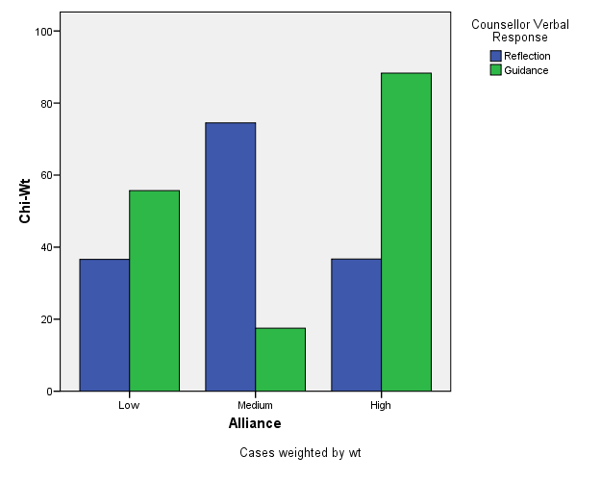
Notes:
From Table 5, p. 158; Fitzpatrick & al. (2001). Chi-square weights transformed in this graph can be interpreted as “relative deviation” descriptors, allowing comparability across cells, but without specific significance levels. (Parameter testing exaggerates experiment-wise error rates in this particular research design). N = 2007 T-C statement pairs in 21 therapy sessions, approx. 96 statements per session.

Slide 17
Meta-Analysis
The APA journal has basic standards for literature review in many areas
Meta-Analysis (MA) is a tool for combining results of quantitative studies in a systematic, quantitative way.
Example Meta-Analysis journal article:
  Hill, C. E., & Lent, R. W. (2006). A narrative and meta-analytic review of helping skills training: Time to revive a dormant area of inquiry. Psychotherapy: Theory, Research, Practice, Training, 43(2), 154–172.

Slide 18
MA Focuses on Effect Sizes
Choose groups of studies and subgroups of studies to combine and compare
g : difference between the means divided by the pooled standard deviation
d : unbiased estimates of the population effect size as reported by each study

Slide 19
Combining Effect Sizes: ex.
Example: two correlation studies, with
  r₁ = .22 and r₂ = .34
  N₁ = 125 and N₂ = 43
Combine studies to estimate r
Unweighted average: (.22 + .34) / 2 = .28
Weighted average by sample size:
[ .22(125) + .34(43) ] / (125 + 43) = .25
The larger sample has a smaller effect size!

Slide 20
Persuasiveness of MA
Quality of studies (design, etc.)
Comparability of studies
(variables, measures, participants, etc.)
  Especially moderating factors!
RQ: Differences among types of training? (instruction, modeling, feedback)
Do we know the “amount” of training time examined in each study?
What impact might these factors have on the interpretation of the meta-analysis?

Slide 21
Hill & Lent (2006)
p.159: Summary of strategy and symbols used
p.160: List of studies being summarized
(k = 14), including outcome measures, etc.
Multiple measures were aggregated within each study by calculating a mean effect size and standard error
Use Cohen’s (1988) criteria for effect size:
d=0.20 (small), d=0.50 (med), d=0.80 (large)

Slide 22
Global analysis: outlier
Hill & Lent chose to exclude one entire study as an outlier: p.161:
“Given its potential to disproportionately influence effect sizes, especially in a relatively small set of studies, the outlier study was omitted in our subsequent analyses.”
Now only 13 studies left …
Pros & cons of this omission?

Slide 23
Questions… pre-assignment
Note: The same group of studies is used in all sections of Hill & Lent…
How do the different research questions shape the MA calculations?
How do confidence intervals help us interpret effect sizes (ES)?
How do we integrate the results of different research questions?
Notes:
Being a professional means looking things up when you don’t know.

Slide 24
Formatting Tables in MS-Word
Use the “insert table” and “table properties” functions of Word to build your tables; don’t do it manually.
General guidelines for table formatting can be found on pages 147-176 of the APA manual.
Additional tips and examples: see NCFR site: http://oregonstate.edu/~acock/tables/
In particular, pay attention to the column alignment article, for how to get your numbers to align according to the decimal point.

