Slide 1

Non-Parametric Analysis
27 Nov 2009
CPSY501
Dr. Sean Ho
Trinity Western University
Please download:
relationships.sav
Field-Looks_Charis.sav

Slide 2
Outline for today
Non-Parametric Between-subjects Tests:
  2 groups: Mann-Whitney U
  Many groups: Kruskall-Wallis H
  Factorial variants
Non-Parametric Within-subjects Tests:
  2 repetitions: Wilcoxon Signed-rank
  Many repetitions: Friedman's ANOVA
There exist other non-parametric options, too!
Notes:
Ch. 13 & 16 in Field

Slide 3
When To Use Non-Parametric
Review: assumptions of ANOVA?
  If met, parametric methods more power
  ANOVA is pretty robust to non-normality
  Try transforming data, or multi-level model
Consider non-parametric alternatives if:
  DV is ordinal, or
  Violations are severe enough to affect result
Non-parametric often use ranks, not raw scores
  e.g., Spearman vs. Pearson correlation
  Comparing medians rather than means

Slide 4
Mann-Whitney U Test
DV: ordinal or scale, but non-parametric
IV: dichotomous, between-subjects (2 groups)
RQ: Is there a median difference between the two groups?
  Non-parametric alternative to t-test
What research designs might need this test?
Data entry format:
2 variables entered for each participant:
  IV: group membership (0 or 1)
  DV: outcome measure

Slide 5
Mann-Whitney U: SPSS
Dataset: relationships.sav
Analyze → Nonparametric → 2 Independent:
  Test Variable: DV (quality of communication)
  Grouping Variable: IV (having counselling)
  Use “Define Groups” to choose two groups for comparison: 1= no counsel; 2 = had counsel
  Test Type: “Mann-Whitney U”
Optional SPSS module for Exact Tests:
Computationally-expensive but more precise, especially for small / unbalanced designs

Slide 6
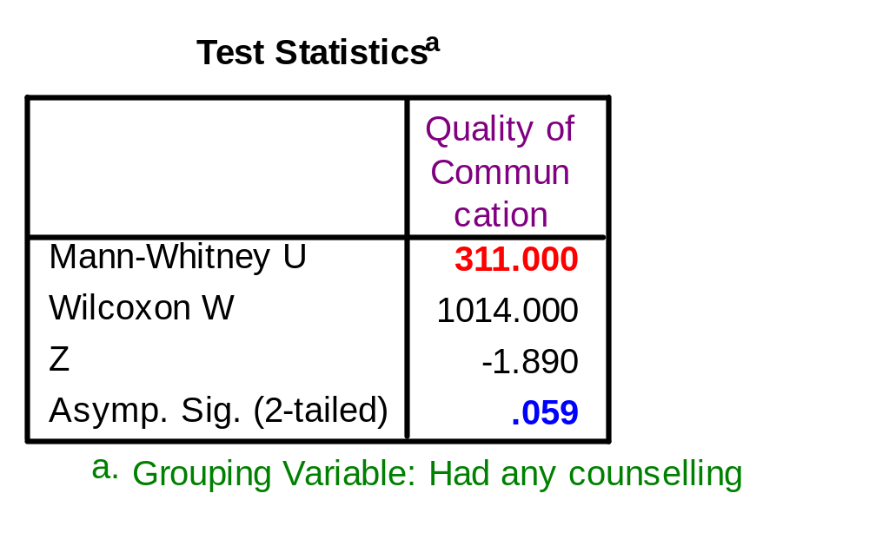
Mann-Whitney U: Output
“There was no significant effect of Having Counselling on Quality of Communication,
U = 311.00, p = .059, Mdn_{H} = 4.0, Mdn_{N} = 3.0.”
Use Analyze → Descriptives → Explore to get
group medians

Slide 7
Mann-Whitney U: Effect Size
Effect size must be calculated manually, using the following formula:
  r = Z / √N
  e.g., r = -1.89 / √60 ≈ -0.24499
Use existing research or Cohen’s effect size “estimates”:
  “There is a small difference between the therapy and no therapy groups, r = -.24”

Slide 8
Practise: Mann-Whitney U
You try it!
Is there a significant difference between spouses who report communication problems and spouses who have not (“Com_prob”),
in terms of the level of conflict they experience (“Conflict”)?
What is the size of the effect?

Slide 9
Kruskal-Wallis Test
DV: ordinal or scale, but non-parametric
IV: categorical, between-subjects (many groups)
RQ: Is there a median difference amongst the groups?
  Alternative to One-way ANOVA
What research designs might need this test?
Data entry format:
2 variables entered for each participant:
  IV: group membership
  DV: outcome measure

Slide 10
Kruskal-Wallis: SPSS
Analyze → Nonparametric → K Independent:
  Test Variable: DV (level of conflict)
  Grouping Variable: IV (type of counselling)
  Test Type: “Kruskal-Wallis H”
  Define Groups: specify highest and lowest group numbers to be compared
Optional SPSS module for Exact Tests:
Computationally-expensive but more precise, especially for small / unbalanced designs

Slide 11
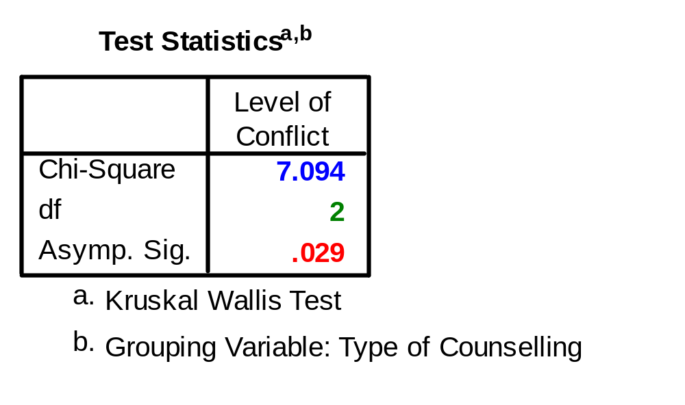
Kruskal-Wallis: Output
“Type of counselling has a significant effect on participants' level of conflict,
χ²(2) = 7.09, p = .029.”
Also report medians and post hoc results...
Notes:
Note: Asymptotic significance vs. Exact vs. Monte Carlo estimation

Slide 12
Kruskal-Wallis: Follow-up
K-W test is omnibus: if significant, follow-up with Mann-Whitney tests on pairs of groups
  Must do Bonferroni correction manually, or else Type 1 error inflates: lower the level of significance to 0.05 / (# comparisons)
Try planned contrasts based on
  Theory / literature,
  Your research question; or
  Ordering groups by mean ranks, and comparing each group to next highest group

Slide 13
Kruskal-Wallis: Effect Size
Overall effect size not so useful; instead,
Calculate effect size for each pair of groups that differs significantly (in Mann-Whitney follow-up)
  r = Z / √n
  Where the sample size n is the total number of participants in this pair of groups

Slide 14
Kruskal-Wallis: Reporting
“Type of Counselling has a significant effect on participants' level of conflict, χ²(2) = 7.09,
p = .029.”
“Specifically, the No Counselling group had higher conflict scores, Mdn_{N} = 4.0, than did the Couples Counselling group, Mdn_{C} = 3.0,
Mann-Whitney U = 176.5, Z = -2.61,
p = .009, r = -.37.
Field uses “H” for the K-W: H(2) = 7.09
Note: Bonferroni correction: α = .05 / 3 ≈ .017

Slide 15
Kruskal-Wallis: Non-signifcant
If Kruskal-Wallis gives a non-significant result, but the research question behind the analysis is still “important”:
The problem might be with low power, so
Descriptive follow-up analyses can be helpful.
See the illustration for Friedman’s ANOVA below for some clues.

Slide 16
Parametric vs. Non-Parametric
There's nothing wrong with running both parametric and non-parametric tests!
Comparison of non-parametric tests with the corresponding ANOVA may be able to lend more confidence in the overall adequacy of the patterns reported.
Nonparametric analyses tend to have
less power for well-distributed DVs, but they can be more sensitive to effects when the DV is, for instance, truly bimodal!

Slide 17
Param vs. Non-Param: ex.
If we do the same analysis parametrically:
  DV: Level of Conflict
  IV: Type of Counselling
  One-way ANOVA, with Levene's test and Bonferroni post-hoc
Results are similar: F(2, 57) = 4.05, p = .023
  The No Counselling group shows more conflict than the Couples Counselling group, M_{N} = 3.87 and M_{C} = 3.04
Confirms results with non-parametric analysis

Slide 18
Factorial Between-Subjects
SPSS doesn't have factorial between-subjects non-parametric analyses built-in!
Try creating one IV that encodes all cells:
e.g., 2x3 factorial → 6-level one-way, use K-W
  (-) Follow-up gets hard with lots of groups
  (-) Moderation/interaction analysis is harder
  (+) Flexibility in defining groups
  (+) Target specific cells / interactions
Or: Run separate K-W tests for each IV
Or: Convert to ranks and use log-linear analysis

Slide 19
Factorial Analysis: Example
Research question: How do Marital Status and Type of Counselling relate to Conflict Levels?
Check cell sizes with Analyze → … → Crosstabs:
  The smallest cells (Individual Counselling) have 5-6 people per group, that is enough
2x3 factorial → convert to 1 IV with 6 levels:
  Indiv. Counsel & Married; Indiv & Divorced; Couples Couns. & Marr; Couple & Div; etc.
  Transform → Recode into Different,
  try the “If” conditions

Slide 20
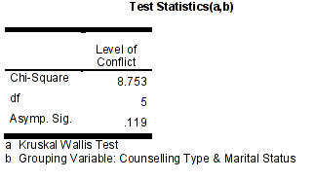
Factorial Analysis: Output
The Kruskall-Wallis test for the combined variable is not significant.
This suggests that the significant effect for Counselling Type is masked when
combined with Marital Status.

Slide 21
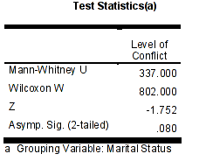
Factorial Analysis: Main effect
The idea of a “masking effect” of Marital Status shows as well when we test that main effect alone.

Slide 22
Theory-Guided Interaction Test
Divorced & No counselling group:
  We might assume this group should have high conflict levels!
  Compare with some of the other 5 groups using Mann-Whitney U tests
This can be a “theoretically guided” replacement for interaction tests in
non-parametric factorial analysis.
The choice depends on conceptual relations between the IVs.

Slide 23
Kruskall-Wallis: Practise
Does number of children (range 0-3) have a significant effect on quality of marital communication?

Slide 24
Wilcoxon Signed-rank Test
DV: ordinal or scale, but non-parametric
IV: within-subjects, with 2 repetitions
RQ: Is there a median change between times?
  Parallel to paired-samples t-test
What research designs might need this test?
Data entry format:
2 variables entered for each participant:
  DV at first measurement
  DV at second measurement

Slide 25
Wilcoxon Signed-rank: SPSS
Analyze → Nonparametric → 2 Related Samples:
  Test Pairs: DV before and DV after
  Test Type: Wilcoxon
Practise: does level of conflict decrease from pre-therapy (Pre-conf) to post-therapy (Conflict)?
Multiple pairs may be specified in one analysis
  But no built-in Bonferroni correction
Exact tests also available with add-on module

Slide 26
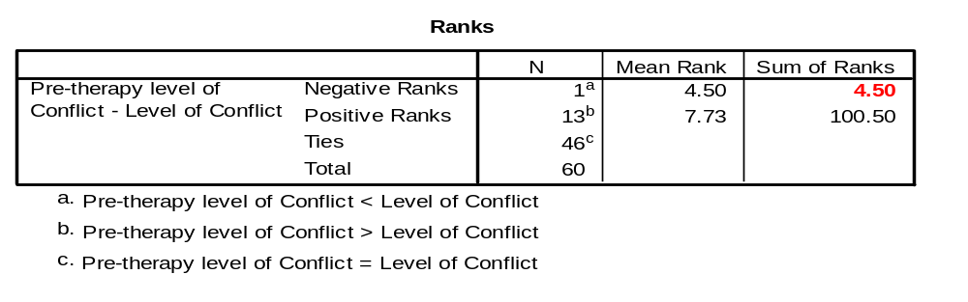
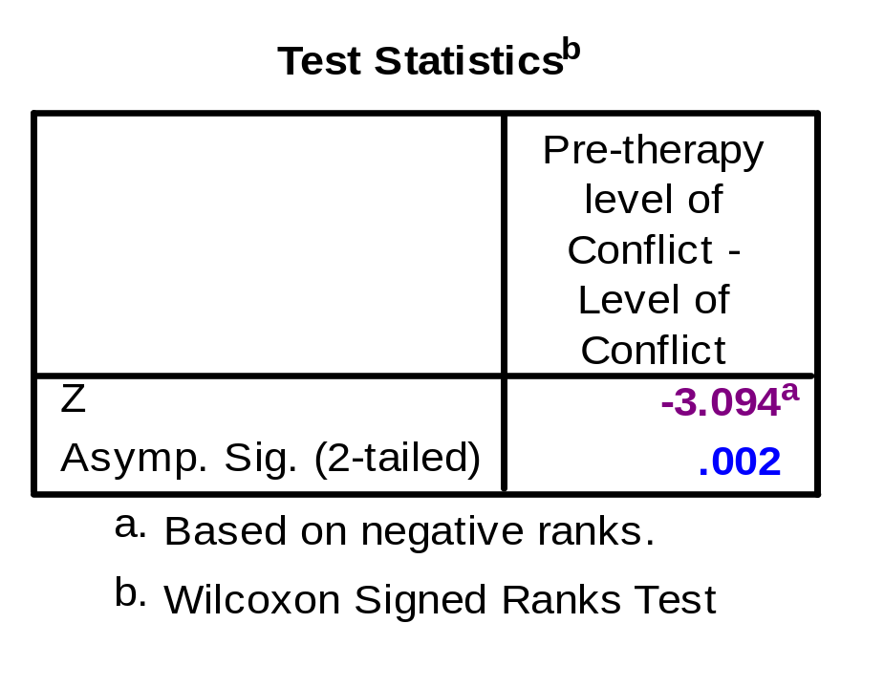
Wilcoxon Signed-rank: Output
There was a significant reduction in level of conflict after therapy, T = 4.5, p = .002.
  Or: Z = -3.09, p = .002 (& calc. effect size)
Notes:
T = the smallest of the sums of ranks (Field).

Slide 27
Wilcoxon Signed: Effect Size
Effect size must be calculated manually, using the following formula:
  r = Z / √N
  e.g., r = -3.09 / √120 ≈ -0.28
N is total number of observations, not participants! (60 participants) * (2 observation)
Use existing research or Cohen’s effect size “estimates”:
  “The reduction in level of conflict after therapy was significant but small, r = -.28”

Slide 28
Wilcoxon Signed-rank: Practise
Do levels of conflict change significantly between pre-therapy (Pre_conf) and
1 year after therapy (Follow_conf)?
If so, calculate the size of the effect.
  Participant attrition at time 3 (Follow_conf) affects the total number of observations!
Example reporting: “There was a significant reduction in level of conflict after therapy,
T = 4.5 [or: Z = -3.09], p = .002, r = -.28.”

Slide 29
Friedman’s ANOVA
DV: ordinal or scale, but non-parametric
IV: within-subjects, several repetitions
RQ: Is there a median change over time?
  Parallel to repeated-measures ANOVA
What research designs might need this test?
Data entry format:
one variable for each repetition of the measure
  DV at first measurement
  DV at second measurement
  DV at third measurement, etc.

Slide 30
Friedman’s ANOVA: SPSS
Analyze → Nonparametric → K Related Samples:
  Test Variables: each repetition of DV
  Test Type: “Friedman”
No easy way in SPSS to do non-parametric mixed-design analysis
Optional SPSS module for Exact Tests:
Computationally-expensive but more precise, especially for small / unbalanced designs

Slide 31
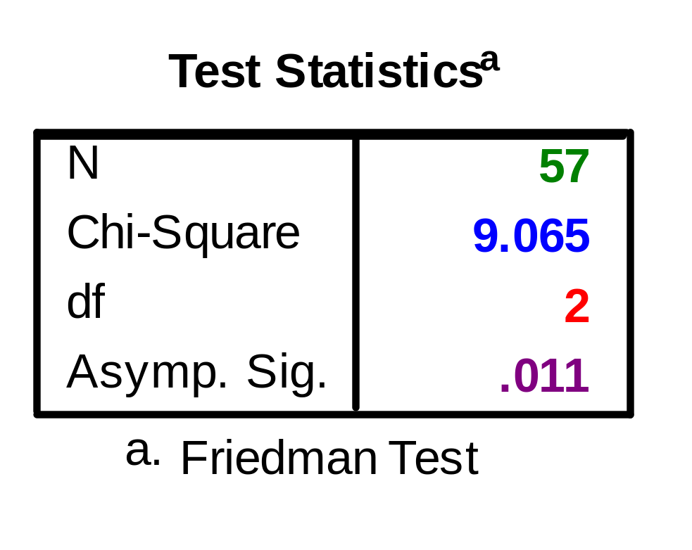
Friedman's ANOVA: Output
“Levels of conflict changed significantly over time, χ²(2, N = 57) = 9.07, p = .011.”
“Specifically…” [report post hoc results...]

Slide 32
Friedman's ANOVA: Follow-up
If Friedman’s is significant, follow-up with a series of Wilcoxon Signed-ranks tests:
Either do all pairs of levels of the RM (post-hoc):
  Remember manual Bonferroni correction:
  α = .05 / (# comparisons)
  But Bonferroni is often too conservative
Or target specific planned comparisons (better):
  e.g., (time1 vs. time2), (time2 vs. time3), …
  k-levels of IV → only k-1 comparisons
  Useful if power is low, e.g. many cells: control Type II error

Slide 33
Friedman's ANOVA: Example
IV: Time (3 cells)
Targeted follow-up analyses:
  Run 3 Wilcoxon’s signed-rank tests
  Bonferroni correction: α = .05 / 3 ≈ .017
Pre vs. Post: Z = - 3.09, p = .002, r = -.28
Pre vs. 1yr: Z = - 2.44, p = .015, r = -.22
Post vs. 1yr: not significant
Conclusion: improvement after therapy is maintained at the follow-up assessment.

Slide 34
Friedman's ANOVA: Reporting
“Levels of conflict significantly changed
over time, χ² (2, N = 57) = 9.07, p = .011.
“Specifically, conflict decreased from
pre-therapy levels at post-therapy observations,
Z = -3.09, p = .002, r = -.28,
“and levels remained below pre-therapy conflict levels one year later,
Z = -2.44, p = .015, r = -.22.”
Notes:
<There was no additional decrease in conflict levels after therapy was completed, Z = -.28, p = .782.>

Slide 35
Friedman's: Non-significance
If Friedman’s is not significant:
  Is it because of low power (Type II error)?
Run a series of Wilcoxon Signed-ranks tests, but
  Focus on effect sizes, not significance levels
If the effect sizes are “moderate”, say > .25, then the results could be worth reporting.
Enough detail should be reported to be useful for future meta-analyses.
This could be true of any analysis;
we just use Friedman's to illustrate

Slide 36
Friedman's ANOVA: Practise
Dataset: Field-Looks_Charis.sav
  “Looks or Personality” (Field text)
  Two RM IVs in the dataset
RQ: Is there a significant difference between participants’ judgements of people who are of average physical appearance,
but present as dull (“ave_none”);
somewhat charismatic (“ave_some”),
or as having high charisma (“ave_high”)?
If so, conduct follow-up tests to identify where the specific differences lie.

Slide 37
Summary: Between-Subjects
Parametric
t-test between groups
(1 IV, dichotomous)
One-way ANOVA
(1 IV, many levels)
  Post-hoc: t-tests
Factorial ANOVA
(several IVs)
  Post-hoc: t-tests
Non-Parametric
Mann-Whitney U test
Kruskal-Wallis H test
  Post-hoc: M-W
K-W with encoding of cells in one IV
  Post-hoc: M-W

Slide 38
Summary: Within-Subjects
Parametric
Paired/related t-test
(1 RM IV w/2 levels)
Repeated-ms ANOVA
(1 RM IV with
many levels)
  Post-hoc:
  paired t-tests between levels of RM
Non-Parametric
Wilcoxon Signed-Rank
Friedman's ANOVA
  Post-hoc:
  Wilcoxon Signed-rank between levels of the RM

