Slide 1

MANOVA
4 Dec 2009
CPSY501
Dr. Sean Ho
Trinity Western University
Please download:
chicken.sav
Range et al. paper

Slide 2
Outline for today: MANOVA
MANOVA: Concepts
  Assumptions: multivariate normality
  Assumptions: variance-covariance matrices
  Running it in SPSS: chicken.sav example
  Interpreting output
MANOVA journal article: Range, et al. (2000)
  Study design: particip., process, measures
  Results and conclusions
Further reading: Factor Analysis

Slide 3
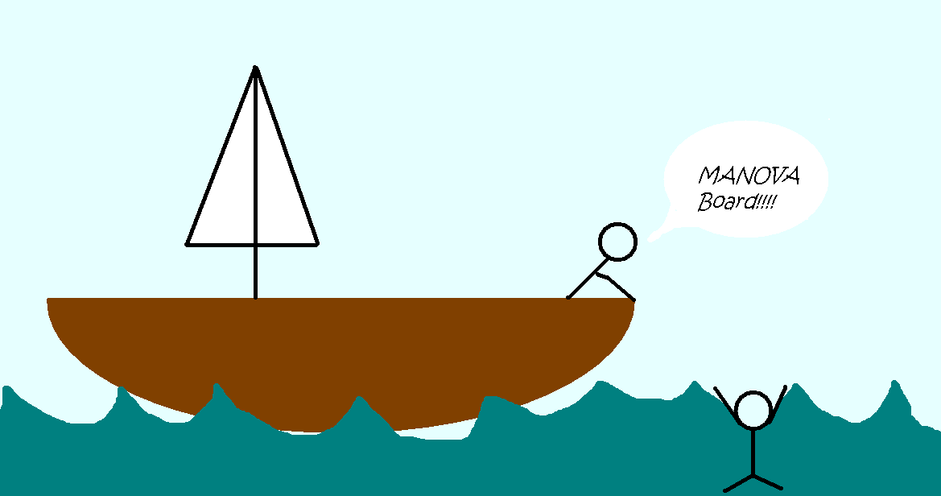
I think we all liked this one (-:
Notes:
I think we all liked this one

Slide 4
MANOVA: Multiple DVs
Theory developed by Wilks in 1932
  But not practically computable until recently
ANOVA with multiple (possibly correlated) DVs
DVs should be theoretically related
  e.g., subscales of one measure:
  Beck Depression Inventory (BDI-II) has affective and physiological subscales
  e.g., two measures of same outcome: BDI (self-rated) and Hamilton (clinician-rated)
DVs should be correlated but not collinear

Slide 5
Hotelling's T² and MANOVA
ANOVA with just 2 groups is the t-test
MANOVA with just 2 groups is Hotelling's T²:
  1 dichotomous IV; several continuous DVs
  Null hypothesis: both groups score the same on all the DVs
General MANOVA compares several groups
  Omnibus: do the groups differ on the DVs?
  Follow-up: post-hoc (for several categories)
  Follow-up: univariate ANOVA (single DV)
  Follow-up: simple effects (for interactions)

Slide 6
MANOVA: Assumptions
Same as ANOVA: parametricity
  But now multi-dimensional!
DVs all scale-level
All observations are independent
Normality → Multi-normality
Homogeneity of variances →
homogeneity of variance-covariance matrices
Sample size: need min cell count > #DVs
  If min cell count ≥ 30, then it is robust to
  non-normality and variances

Slide 7
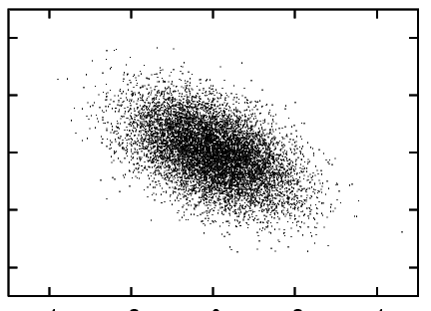
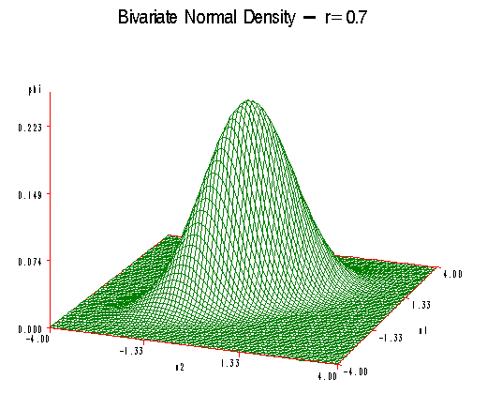
Multivariate Normality
A set of DVs are multi-variate
normally distributed if every
linear combination of the DVs is normally distrib
The DVs may be correlated (tilted ellipse)
The mean of the distribution is a vector
The variance is described by a symmetric matrix: the variance-covariance matrix
  Diagonal entries are the
  variances of indiviual DVs

Slide 8
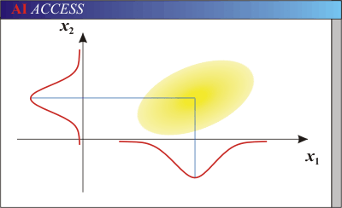
Checking Multi-Normality
Check that each DV is normal (univariate)
  Technically, we should check this per-cell, but most articles just combine all groups
  If all cell counts ≥ 20, multi-normality is roughly met (by Central Limit Theorem)
Check that the DVs do not have non-linear relationships to each other
  Examine scatterplots of all
  pairs of DVs (matrix scatter)
  Watch for any curvilinear
  structure

Slide 9
Multi-Normality & Collinearity
Also check the correlations amongst all DVs:
If too low, then the DVs are not related:
  We won't gain anything by doing MANOVA instead of separate ANOVAs on each DV
If too high (|r|>0.8 or so), risk of collinearity: two DVs that give the same info
  We don't gain anything by adding the DV, only lose power:
  Should remove that DV or combine them
  SPSS will abort if it detects collinearity of DV

Slide 10
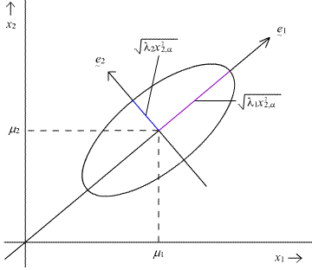
Variance-Covariance
The Variance-Covariance matrix
describes multidimensional spread of the DVs
  Different multi-normal distribution of DVs in each cell of the factorial model
  MANOVA looks for differences
  in the means of those multi-normals
MANOVA assumes the variance-covariance matrices of those multi-normals are equal across all cells
  This is the multi-dimensional equivalent of homogeneity of variance

Slide 11
Checking Variance-Covariance
Homogeneity of variance-covariance matrices:
First, if all cell sizes are roughly equal, skip this test and just use Pillai's trace (see output)
Next, if all cell sizes are ≥ 30, we are reasonably robust to violations of this assum.
Next, ensure we have multi-normality
Then run Levene's test on each DV (univariate)
Lastly, run Box's Test: we want insignificance
  Box's Test is not reliable if we don't have multi-normality

Slide 12
MANOVA: Chicken example
Example dataset: chicken.sav (from Field)
IV: Group (Manic Psychosis vs. Sussex Lecturer)
DV: Quality of chicken impers. (score out of 10)
DV: Quantity of chicken impers. per day
RQ: Do manic psychotics show a difference from Sussex lecturers in quality+quantity of chicken impersonations?
Analysis: One-way MANOVA
  Only two groups: equivalent to Hotelling's T²

Slide 13
Chickens: Check Multi-Normality
Univariate normality by group: Explore:
  Dependents: DVs; Factors: IVs
  Display: Plots
  Plots: Histogram, Normality plots with tests
    Result: Lecturers non-normal on Quality (p=.021)
Check linearity: Graphs → Legacy → Scatter:
  Simple Scatter (or Matrix if >2 DVs)
Check correlation: An. → Correlate → Bivariate:
    Result: 0.788 (almost worry about collinearity)

Slide 14
MANOVA: SPSS (Chickens)
Analyze → GLM → Multivariate:
  Dependent Variables: Quality, Quantity
  Fixed Factor(s): Group
  Options:
  Descriptives, Effect Size, Homogeneity
Other buttons for Model, Plots,
Planned Contrasts,
Post-Hoc (multiple comparisons),
Save (residuals, etc.)
are as in regular ANOVA/Regression

Slide 15
Output: Check Variance/Covar
Cell sizes are roughly equal: can use Pillai's tr
Cell sizes not > 30
Not so sure about multi-normality
Levene's Test (univariate):
  inhomogeneity of variance on Quality
Box's Test (covar matrices):
  Inhomogeneity of variance-covariance matrices
But we are okay because of balanced design

Slide 16
MANOVA: Output
Multivariate Tests:
  Wilks’ Lambda (most commonly used)
  Pillai’s Trace (robust to inhomogeneity of variance, as long as cells are balanced)
  Roy's Largest Root (too optimistic)
    (see Tabachnick & Fidell, 2007)
Tests of Between-Subjects Effects
  Use a Bonferroni adjustment
Effect size Partial η²: proportion of variance in DV

Slide 17
MANOVA: Follow-Up
Remember MANOVA is omnibus: need follow-up
  Try univariate ANOVAs: which DVs show differences?
  (Possibly none show diffs individually, only when taken together!)
  Try post-hoc multiple comparisons: if an IV has several groups, which groups differ?
  Try simple effects: if there is a significant interaction of multiple IVs, try to understand it by fixing one of the Ivs
Try plots: Scatter → Panel by: IVs
Notes:
Weinfurt, K. P. (1995). Multivariate analysis of variance. In L. G. Grimm, & P. R. Yarnold (Eds.), Reading and understanding multivariate statistics (pp. ____). Washington, DC: APA. [QA278 .R43 1995]

Slide 18
MANOVA: Further Reading
Hair, J. F., Anderson, R. E., Tatham, R. L., & Black, W. C. (1998).
Multivariate data analysis (5th ed.).
New York: Macmillan.
Weinfurt, K. P. (1995).
Multivariate analysis of variance.
In L. G. Grimm & P. R. Yarnold (Ed.),
Reading and understanding multivariate statistics (pp. 245-276).
Washington, DC: APA. [QA278.R43 1995]

Slide 19
MANOVA Article: Range et al.
Range, L. M., Kovac, S. H., & Marion, M. S. (2000). Does writing about the bereavement lessen grief following sudden, unintentional death?
Death Studies, 24, 115-134.
Writing about traumatic events produces improvement even after intervention ends:
  physical health, psychological functioning
Need more systematic research to assess with specific populations
Writing about events/emotions surrounding death of a loved one by sudden, unintentional causes

Slide 20
Range: Participants
N = 64 undergraduate students
  (20 did not complete…)
Bereaved within the past 2.5 years:
  due to an accident or homicide,
  mildly to extremely close to the deceased,
  and upset by the death
Experimental design: random assignment
to 2 different writing conditions:
  Profound
  Trivial (control condition)

Slide 21
Range: Therapy Procedure
Pre-test measures: depression, anxiety, grief, impact, and non-routine health visits
Wrote 15 min per day for 4 days on either
  profound (on death of loved one) OR
  trivial (unrelated topic) topics
Post-test with same measures
Follow-up after 6 weeks
IVs? Between-subjects? Within-subjects?

Slide 22
Range: Measures (DVs) (p.120)
Self-rating Depression Scale (SDS)
Impact of Event Scale (IES)
Grief Recovery Questions (GRQ)
Grief Experience Questionnaire (GEQ)
Multiple Affect Adjective Checklist-Revised (MAACL-R)
  5 subscales grouped into 2 summary scales:
  Dysphoria: Anxiety, Depr, Hostility
  PASS: Positive Affect, Sensation Seeking

Slide 23
Range: Research Question
RQ: Does writing about the accidental or homicidal deaths of loved ones improve bereavement recovery in the areas of
physical and psychological functioning?
Hypotheses – The profound condition will show:
  More negative emotions and mood at
  post-testing than trivial condition
  More positive mood,
  more bereavement recovery, and
  fewer health centre visits at follow-up
  than trivial condition
Notes:
Sociotropy: the degree to which an individual’s sense of self is dependent on his or her social relationships.

Slide 24
Why not multiple ANOVAs?
Separate 2 (Condition: Profound/Trivial)
x 3 (Time: Pre/Post/Follow) ANOVA for each DV?
If Anxiety and Depression had a correlation of
r = .80, how would we interpret the ANOVAs?
Groups | F(2,38) | p | Time Difference
Anxiety | 5.35 | 0.009 | Pre > F
Depression | 4.66 | 0.016 | Pre > F

Slide 25
Why MANOVA?
Controlling against Type I error
Multivariate analysis of effects
  If outcome measures (DV) are correlated,
  they may be partially redundant:
MANOVA takes these correlations into account, removing redundancy
  Dependent variables treated as a whole system rather than as separate variables
Notes:
Concrete example of or illistration of
2 correlated dependent variable
if we do two univariate analyses on them how can we interpret the results?
e.g. Use Anxiety and Depression subscales
how would we interpret their ANOVAs?
What might their correlation be?
Hypothetical instance:
e.g. Correlation between anxiety & depression of MAACL of .8
if we have two significant ANOVAs, is the best interpretation that what's changing is anxiety or depression or both?
Another depression measure (SDS) that's not significant
is depression really changing? Or is it just the correlation
in counselling, if impacts only anxiety and not depression, want to know that

Slide 26
Range: Research Design
2x3 (Condition x Time) mixed-design MANOVA
DVs: SDS (depr), IES (impact), GRQ (recovery), GEQ (exp), and MAACL-R (affect adjectives)
 | Pre-Test |  |  |  |  | Post-Test |  |  |  |  | Follow-Up
 | SDS | I ES | GRQ | GEQ | MAACL | SDS | I ES | GRQ | GEQ | MAACL | SDS | I ES | GRQ | GEQ | MAACL
Profound
Trivial

Slide 27
Range: Results
Did not report multivariate statistic (Wilks' Λ)
“No significant interaction”
“No significant main effect for condition”
“Significant main effect for time” (p.125)
  F(18, 22) = 4.80, p = .001
Follow-up: Separate 2 (Condition) x 3 (Time) ANOVAs for each DV (see Tables 3 & 4)
  Focus on Time main effect in each one
  Post-hoc (Tukey's HSD) to find which times differ (Pre- / Post- / Follow-up)
Notes:
Type out table

Slide 28
Range: Conclusions
Original RQs: The profound condition will show:
  More negative emotions and mood at
  post-testing than trivial condition
  More positive mood,
  more bereavement recovery, and
  fewer health centre visits at follow-up
  than trivial condition
Hypotheses not supported!
Only conclusion: “Time heals all wounds”?

Slide 29
Factor Analysis
Typically in Psych, can have lots of IVs!
  Which are important?
  Exclude non-useful IVs → increase power
Exploratory factor analysis (EFA)
  Explore the interrelationships among a given set of variables, w/o a-priori ideas
Confirmatory factor analysis (CFA)
  Confirm specific hypotheses or theories concerning the structure underlying a set of variables

Slide 30
Factor Analysis: References
Kristopher J. Preacher & Robert C. MacCallum (2003).
Repairing Tom Swift’s Electric Factor Analysis Machine.
Understanding Statistics, 2(1), 13–43.
Anna B. Costello & Jason W. Osborne (2005).
Best Practices in Exploratory Factor Analysis: Four Recommendations for Getting the Most From Your Analysis.
Practical Assessment Research & Evaluation, 10(7), 1-9.

Slide 31
FA References: Categorical
Maraun, M. D., Slaney, K., & Jalava, J. (2005). Dual scaling for the analysis of categorical data. Journal of Personality Assessment, 85, 209–217.
  This is an “introductory” discussion, for disseminating descriptions of this procedure to professionals

