Slide 1
CMPT 166: Object-Oriented
Programming, using C++
7 January 2009
CMPT166
Dr. Sean Ho
Trinity Western University

Slide 2
What's on for today
Languages: machine, assembly, high-level
C++ compilers and IDEs
A first C++ program
Comments and doc-comments
Compiling and running a C++ program

Slide 3
Review: Languages
Machine language
  “Native tongue” of computer (CPU, etc.)
  Highly specific to machine (P4, Atom, ...)
Assembly language
  English-like abbreviations for operations
High-level language
  More “English-like” instructions
    Common operations: arithmetic, I/O, etc.
  Compiler converts to machine language
Interpreter: execute high-level w/o compile

Slide 4
Compiling
Python is an interpreted language:
  When you press F5 in IDLE to run,
  Code is first compiled into bytecode, then
  Executed by the Python virtual machine
    Bytecode: *.pyc files (e.g., compile libs)
C++ is a compiled language:
  C++ compiler produces object files (*.o)
  Linked together with libraries
  To produce executable (*.exe)

Slide 5
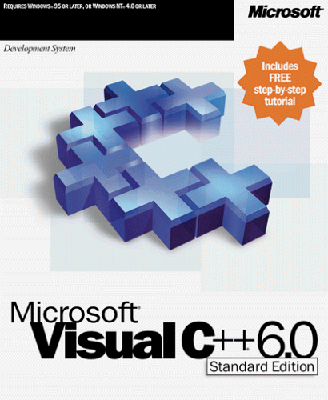

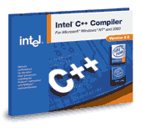
C++ compilers
A few popular C++ compilers:
Microsoft Visual C++ 2008:
  Installed on senior lab PCs
  Industry standard, but expensive
GNU GCC/G++ 4.3:
  Installed on senior lab PCs w/Cygwin
  Free, can install on your own computer
Intel C++ Compiler (ICC):
  Well-optimized for Intel CPUs, commercial

Slide 6

Development environments
Source code is just plain-text, all we need is a text editor and the compiler
But integrated development environments (IDEs) make life easier
  IDLE for Python is a basic one
  MS Visual Studio 2008 is a very
  complex and expensive one
  Eclipse is also sophisticated, and free
Manage multiple projects, classes, and files
Syntax highlighting, indent, auto-complete

Slide 7
Class policy on IDEs
For class purposes, you are free to use any development environment you feel comfortable with, but:
I have to be able to re-compile and run your code!
  Many incompatibilities between compilers
  I will be using Visual Studio 2008, same as installed on senior lab PCs
  I also have G++ 4.3.2 on my laptop
The only officially-supported setup is
Visual Studio / Visual C++ in the senior lab

Slide 8
Object-oriented principles
Alan Kay's Smalltalk (1980): very pure OO
  C++ is not so pure: OO bolted-on to C
Five basic principles:
  Everything is an object: attribs, methods
  A program is a set of objects passing messages
  Each object has its own memory,
  storing other objects
  Every object has a type (class)
  All objects of a type can receive the same messages

Slide 9
C++ is object-oriented
Everything is an object
  Objects are instances of classes
Write your program by defining classes
  Attributes (variables; data)
  Methods (behaviour; functions)
  Interfaces (collections of methods)
    A class may implement more than one interface
    An interface may be implemented by more than one class

Slide 10
A first C++ program
#include reads in a library header file
  Akin to Python 'import'
  #: C pre-processor directive, not comment!
using namespace: otherwise would have to prefix cout and endl with 'std::' namespace
  #include <iostream>
  using namespace std;
  int main() {
  cout << "Hello, World! I am "
  << 8 << " Today!" << endl;
  }

Slide 11
Comments and doc-comments
Comments can either be
  old-style: /* hi there! */
  new-style: // hi there!
Doc-comments start with /** (note two stars)
  Structured comments can be interpreted by doxygen
  Similar to Python docstrings
  @keywords: e.g., @author, @copyright
  Pre/post-conditions: @param, @return

Slide 12
Compile and run: G++
Compile: g++ HelloWorld.cpp -o HelloWorld
Run: ./HelloWorld
In Visual Studio or Eclipse:
more complicated, but once you get the project set up, press F5 to compile and run
(VS: Ctrl-F5 to run without debugging)

