Slide 1
UML diagrams and
Modules vs. Classes
14 Jan 2009
CMPT166
Dr. Sean Ho
Trinity Western University

Slide 2
UML: Unified Modeling Language
Diagrams for use in designing your programs
Main diagram types:
  Static: Class diagram, object, package
  Dynamic: Use case diagram, sequence diagram, state chart
Handy for diagramming by hand, or
UML software tools, e.g., Visio, Sun JSEnterprise
Developed by Booch, Rumbaugh, and Jacobson, of OMG (Object Management Group)
Current version is 2.0: www.uml.org

Slide 3

UML: Class diagram
Each box represents a class (type)
  Name, attributes, methods
Lines show relationships between classes

Slide 4
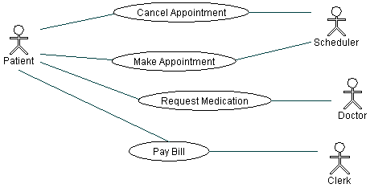
UML: Use case diagram
Describes relationships between actors:
    Patient calls the clinic to make an appointment
    Receptionist books timeslot
    Patient sees doctor and requests medication
    Patient pays bill to clerk
See Borland's UML tutorial for more details

Slide 5
Design patterns
Commonly used software designs
Not reinventing the wheel
  Similar to libraries, but for program design
Similar to architectural elements: arch, column
“Gang of Four” standard reference (1995):
  Gamma, Helm, Johnson, Vlissides, “Design Patterns: Elements of Reusable OO Software”
  Creational patterns: e.g., abstract factory
  Structural patterns: e.g., proxy
  Behavioural patterns: e.g., observer, MVC

Slide 6
Modules vs. Classes
Both modules (M2) and classes (OO):
  Have both a public interface (DEF) and
  a private implementation (IMP)
  Allow data hiding (in the private portion)
But there are differences:
  Data items in modules are singletons;
    Each instance of a class has its own data items
  Modules in M2 are not types; OO classes are
  Modules cannot be derived from other modules
    Classes can inherit (subclass) from other classes

Slide 7
Declaring classes: OO-M2
Declaring a class in object-oriented M2:
CLASS Rectangle;
CONST
sides = 4;
VAR
length, width: INTEGER;
PROCEDURE SetDims (l, w: INTEGER);
BEGIN
length := l;
width := w;
END SetDims;
BEGIN
SetDims (0, 0);
END Rectangle;

Slide 8
Declaring classes: C++
Header (public definition) file:
class Rectangle {
const int sides = 4;
int length, width;
void SetDims (int l, int w);
}
Code (private implementation) file:
void Rectangle::SetDims (int l, int w) {
length = l;
width = w;
}

