Slide 1
Graphical User Interfaces, FLTK
9 Feb 2009
CMPT166
Dr. Sean Ho
Trinity Western University

Slide 2
Review last time: exceptions
Constructor intializer list
  Calling the superclass constructor
Exceptions: throw, try/catch
  Catching by name, getting auxiliary info
  Re-throwing exceptions
  Class hierarchies for exceptions
  Standard exception classes

Slide 3
Standard exception classes
Any object in C++ may be thrown, but the Standard C++ Library does include some standard exception classes for you to subclass:
    #include <stdexcept>
The superclass is exception; two subclasses include runtime_error and logic_error
    class Error : public runtime_error { ....
Constructors can take a string argument
  Read it using the .what() method

Slide 4
What's on for today
An excerpted history of GUIs
  Sutherland, Engelbart, PARC, Apple, MS
GUI toolkits
Events and callbacks
FLTK and Fluid
  BankInterest example

Slide 5
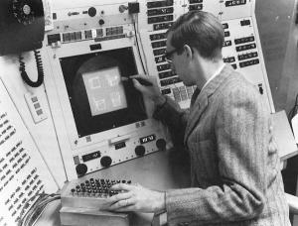
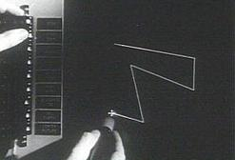
Sutherland's SketchPad (1963)
Ivan Sutherland
Ph.D. thesis at MIT
Used light pen to directly
manipulate graphical objects on screen
Pioneer of computer-aided drafting (CAD):
  Draw “master” diagram once
  Instantiate multiple copies, tweak
  (OO design)
  Constraint-based system
  (e.g., keep two lines at fixed angle)

Slide 6
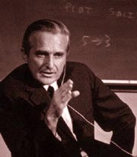


Engelbart's NLS demo (1968)
NLS (oNLine System) innovations:
  Mouse
  Windowing system
  Collaborative document editing with email, IM, and video conferencing
  Hyperlinks
  Chording keyboard
Douglas Englebart,
Stanford Research Inst.

Slide 7
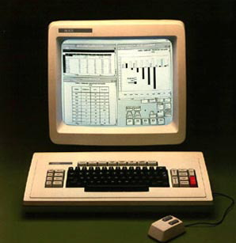
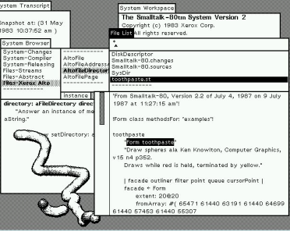
Xerox PARC in the 1970's
Smalltalk
on the Star
Xerox Palo Alto:
  Towards “paperless office”
  Microcomputers: Alto (1973), Star (1981)
  WIMP model: windows, icons, menus, pointer
  Desktop
  Smalltalk (1974):
    Pure OO language
    Integrated graphical
    development
    and runtime environment

Slide 8
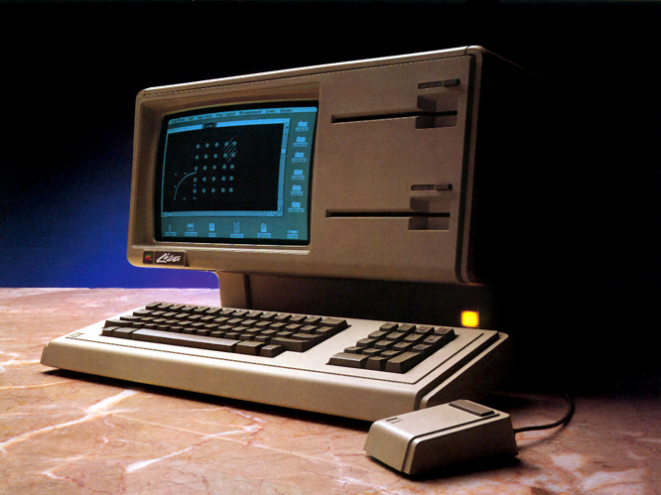
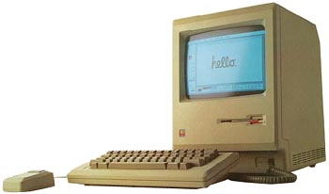
Apple in the 1980's
Lisa (1983):
  Drag-and-drop
  Double-click to open/run
Macintosh (1984):
  Much cheaper ($2,495 vs. >$10k)
  Accessible to the public
  Mass-marketing ad
  campaign during
  SuperBowl and
  1984 Olympics in L.A.

Slide 9
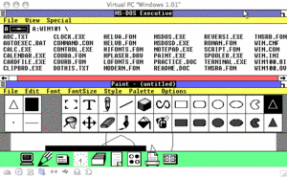
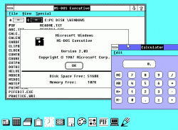
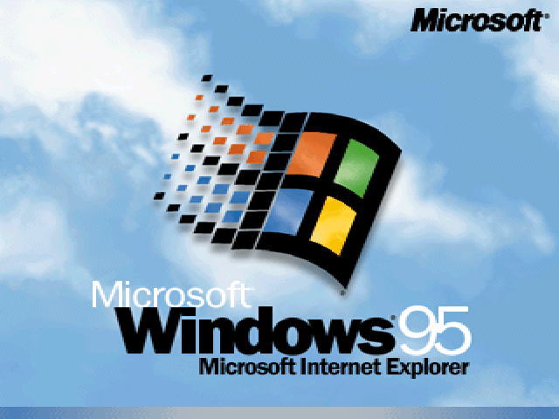
Microsoft Windows (1980's)
Windows 1.0 (1985):
  Mostly character-based graphics
  Tiled windows
  Popularity dwarfed by Mac
Windows 2.0 (1987):
  Overlapping windows
  Apple sues MS over “look and feel” (loses)
Windows 3.11 (1992), Win95:
  Looks pretty; wildly popular

Slide 10
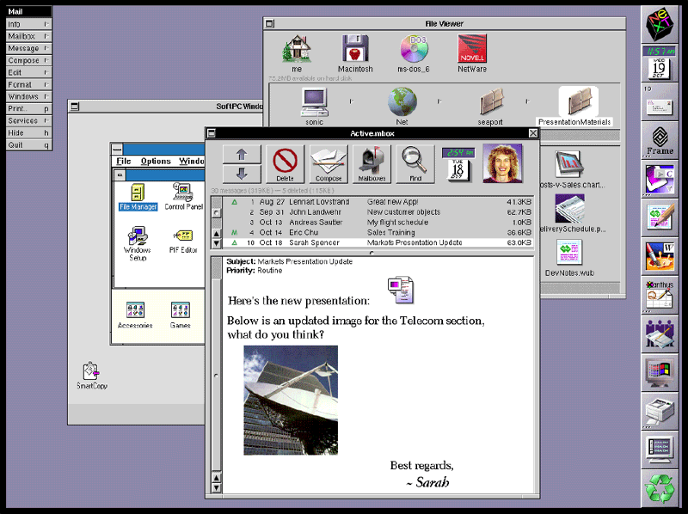
Other GUI environments
GEM (Digital Research) for Atari (1985)
Amiga Workbench (1985)
NeXTstep (Steve Jobs) (1988)
  Pretty, but CPU-intensive
OS/2 (IBM) (1988):
  competed with Windows
Unix X10 (1984), X11 (1987)
  Network transparency (Xwin32)
  Multiple libraries on top: Athena, Motif/CDE, OpenLook, KDE/Qt, Gnome/gtk, FLTK
NeXTstep

Slide 11
OS environment vs. toolkit
In the past, the only GUI was what was provided by the operating system
Now, we can write programs that link to various GUI toolkits:
  Libraries that provide a way to build a GUI program
  Menus/windows that look just like Windows:
    Link with MFC or Visual Basic or .NET
  Other options: FLTK, Qt, wxWidgets, gtk, ...
    Cross-platform: can run on Linux, Mac, etc.

Slide 12
Compiling with GUI toolkits
Libraries provide GUI components as objects
  Windows (Fl_Window), menus, tabs, etc.
  Widgets: buttons, textboxes (Fl_Input), sliders, scrollbars, dials, etc.
Link your program with the toolkit library
  Static linking: libfltk.a
    Needed objects are bundled into the executable
  Dynamic linking: libfltk.dll.a / libfltk.so
    Need separate shared library
  FLTK-1 libs: fltk, fltk_gl, fltk_images, fltk_forms

Slide 13
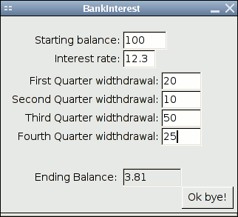
Events and callbacks
An event is a user action:
  Click a button
  Fill in a text box
  Press a key
  Move the mouse
A callback is a procedure invoked by an event:
  Close the window when user clicks “Ok bye!”
  Draw a circle where the user clicks the mouse

Slide 14
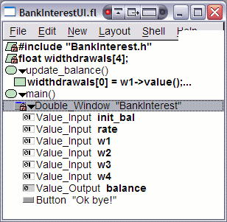
Using Fluid
Fluid is FLTK's interactive GUI
designer
  Drag and drop widgets
  Write code blocks / callbacks
Saves *.fl Fluid files; exports *.cxx/*.h code
Compile and link this code into your program
It is possible to write a whole program in Fluid
But better to separate GUI from main program logic: form vs. function
  Akin to HTML/CSS vs. PHP/ASP/JS

Slide 15
FLTK example: BankInterest
BankInterestUI:
  Just the user interface
  Get values from the widgets
  Minimal program logic
    But I did choose to put main() here
BankInterest:
  Main program functionality
  Provides functions invoked
  by UI callbacks
    calc_balance()

Slide 16
Fluid and C++ program design
Two ways of structuring your FLTK program:
BankInterest example: main() in Fluid
  #include separate file for core logic
CubeView example: main() in separate C++ file
  Fluid file: defines CubeViewUI class
    which contains an Fl_Window
    which contains a CubeView
      which is a subclass of Fl_Gl_Window
  CubeMain.cxx:
    main() instantiates a CubeViewUI

