Slide 1
FLTK: Fast Light ToolKit
11 Feb 2009
CMPT166
Dr. Sean Ho
Trinity Western University

Slide 2
Compiling with GUI toolkits
Libraries provide GUI components as objects
  Windows (Fl_Window), menus, tabs, etc.
  Widgets: buttons, textboxes (Fl_Input), sliders, scrollbars, dials, etc.
Link your program with the toolkit library
  Static linking: libfltk.a
    Needed objects are bundled into the executable
  Dynamic linking: libfltk.dll.a / libfltk.so
    Need separate shared library
  FLTK-1 libs: fltk, fltk_gl, fltk_images, fltk_forms

Slide 3
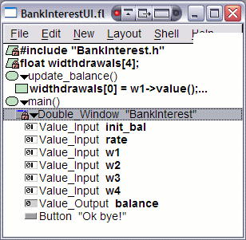
Using Fluid
Fluid is FLTK's interactive GUI
designer
  Drag and drop widgets
  Write code blocks / callbacks
Saves *.fl Fluid files; exports *.cxx/*.h code
Compile and link this code into your program
It is possible to write a whole program in Fluid
But better to separate GUI from main program logic: form vs. function
  Akin to HTML/CSS vs. PHP/ASP/JS

Slide 4
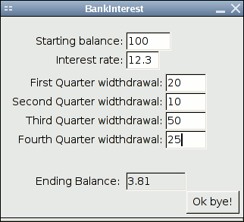
FLTK example: BankInterest
BankInterestUI:
  Just the user interface
  Get values from the widgets
  Minimal program logic
    But I did choose to put main() here
BankInterest:
  Main program functionality
  Provides functions invoked
  by UI callbacks
    calc_balance()

Slide 5

UI design principles
  Constantine+Lockwood http://www.foruse.com/
Structure: hierarchy, layout: windows, tabs, etc.
Simplicity: make common tasks easy
  Epicentre: design around primary purpose
Visibility: need-to-know basis
Feedback: current state, errors, etc.
Tolerance: be flexible to user mistakes,
save user data / user's hard work
Reuse: consistent naming, behaviour

