Slide 1
2D Drawing in FLTK, cont.
2 Mar 2009
CMPT166
Dr. Sean Ho
Trinity Western University
See Scribble example
and FLTK ch5

Slide 2
Review: Drawing in FLTK
Subclass an FLTK widget like Fl_Box
  Override the draw() method
Window coordinate system: pixel-based
Fast shapes:
  point, line, rect/rectf, loop/polygon, arc/pie
Complex shapes: (fl_begin_* / fl_end_*)
  points, line, loop, polygon
  complex_polygon

Slide 3
Specifying the path
Each of the complex objects (points, line, loop, polygon, complex_polygon) takes a path in between its begin and end. A path may have:
Vertices: fl_vertex(float x, float y)
Smooth “Bezier” curves:
  fl_curve(x, y, x1, y1, x2, y2, x3, y3)
  Interpolates through (x,y) and (x3,y3)
  Other two are control points
Circular arc: fl_arc(x, y, r, a1, a2)
Complete circle: fl_circle(x, y, r)

Slide 4
Transformation matrix
The complex drawing shapes use a transform matrix to determine where they are drawn
Coordinate system need not be tied
to screen pixels
e.g., create object with dimensions 1.0x1.0, and have it scale to fill the widget
Matrix stack: a way to save/restore current transform matrix
  fl_push_matrix(); // save old matrix
  fl_pop_matrix(); // restore old matrix

Slide 5
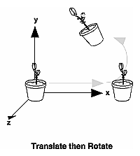
Combining transformations
    fl_scale( float x, y=1 );
    fl_translate( float x, y );
    fl_rotate( float degrees );
Multiplies another transformation
into the current transform matrix
Operations are done in reverse order:
    fl_rotate( 30. );
    fl_translate( 100., 0. );
    fl_begin_polygon(); .....
  Translate is done first, then rotate!

Slide 6
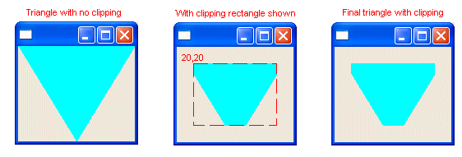
Clipping
When you draw, only the portion within the current clip is actually rendered
Usually you can draw anywhere in the window
Use the clip to restrict drawing to only a portion of the window
eclipse.org

Slide 7
FLTK clipping commands
FLTK provides a clip stack: push/pop regions
fl_push_clip(x, y, w, h)
  Intersects current clip with the given rectangle and pushes it onto the stack
fl_pop_clip()
  Restore prevous clip
  Every fl_push_clip() must have a corresponding fl_pop_clip()
    fl_push_clip(50, 50, 100, 200);
    // draw stuff
    fl_pop_clip();

Slide 8
Drawing images
Two ways of drawing an image using FLTK:
Direct drawing: store image as an array of unsigned chars (bytes), uncompressed
  RGB: e.g., a 100x200 pixel image is stored as an array of 60000 bytes
  Faster if image changes often
Or create an Fl_Image object
  Faster for static: cached on display server
  Functions to read JPG, PNG, etc. from file

Slide 9
Direct image drawing
Do Fl::visual(FL_RGB); in main(), before show()ing any window
Create your image as a flat array of uchars
  size is width*height*3 for RGB image
fl_draw_image(img, x, y, w, h)
  img points to the image data
  This is also overloaded so img may point to a function callback you write, which generates the image one line at a time

Slide 10
Using Fl_Image
An Fl_Image object may be cached, reused several times easily, used as button icon, etc.
  Use .data() to get at the pixel data
Fl_Image is the superclass, has 3 subclasses:
  Fl_Bitmap (black and white)
  Fl_Pixmap (colour-mapped)
    Each pixel of image has an index into the colourmap
  Fl_RGB_Image (grayscale, RGB colour, with optional alpha transparency)
    check: fl_can_do_alpha_blending()

Slide 11
Reading common image format
Fl_Image also has subclasses whose constructors can load an image from file, according to its image file format:
  GIF, JPEG, PNG, PNM, XBM, XPM
    #include <FL/Fl_JPEG_Image.H>
    Fl_JPEG_Image img(“myface.jpg”);
  Need to link with -lfltk_images
  See Erco's Fl_JPEG_Image example

Slide 12
Drawing an Fl_Image
Methods: .copy() and .copy(w, h)
  copy the image, optionally resizing it
.draw(x, y, w, h, ox=0, oy=0)
  Draws the image to the rectangle (x,y,w,h) in the window
  Optional (ox,oy) specify where to start reading from the image:
  source rectangle is (ox,oy,w,h)

