Slide 1
Recursion and Fractals
4 Mar 2009
CMPT166
Dr. Sean Ho
Trinity Western University

Slide 2
Review: Drawing in FLTK
Complex shapes
  Path: vertex, curve, arc
  Transform matrix: scale, rotate, translate
Clipping: fl_push_clip(), fl_pop_clip()
Drawing images:
  Direct: fl_draw_image()
  With Fl_Image object:
    Fl_JPEG_Image et al
    .draw()

Slide 3
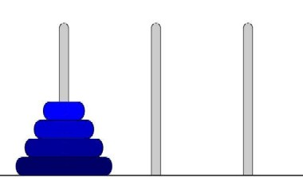
Recursion: Towers of Hanoi
The problem: N disks of increasing size are stacked on one of three pegs.
Move the stack to another peg.
  You may only move the top disk on a peg
  Only smaller disks may be on top of larger disks

Slide 4
Towers of Hanoi: the story
"In the great temple at Benares, says he, beneath the dome which marks the centre of the world, rests a brass plate in which are fixed three diamond needles, each a cubit high and as thick as the body of a bee. On one of these needles, at the creation, God placed sixty-four discs of pure gold, the largest disc resting on the brass plate, and the others getting smaller and smaller up to the top one. This is the Tower of Bramah. Day and night unceasingly the priests transfer the discs from one diamond needle to another according to the fixed and immutable laws of Bramah, which require that the priest on duty must not move more than one disc at a time and that he must place this disc on a needle so that there is no smaller disc below it. When the sixty-four discs shall have been thus transferred from the needle on which at the creation God placed them to one of the other needles, tower, temple, and Bramahns alike will crumble into dust, and with a thunderclap the world will vanish."

Slide 5
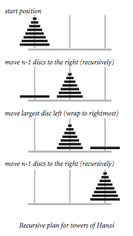
Towers of Hanoi: the solution
void hanoi(n, fr, to, tmp) {
if (n > 0) return;
hanoi(n-1, fr, tmp, to);
move(fr, to);
hanoi(n-1, tmp, to, fr);
}
princeton.edu

Slide 6
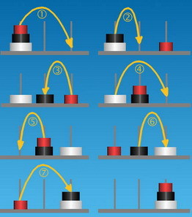
Towers of Hanoi: solution
Smallest disk moves on odd turns, always
in same direction
Even turns have only one possibility
Total number of moves is 2^{n} – 1
64 disks @1 per sec:
140 million years!
azerdark's Programmer's Kitchen

Slide 7
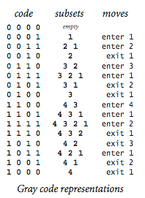
Gray codes
Samuel Beckett, “Quad” play:
Starting with an empty stage, characters enter and exit one at a time, but each subset of characters on the stage appears exactly once
  16 possible combinations
Gray code: ordering such that only one bit changes at a time

Slide 8
Gray code: solution
Same as Hanoi!
void gray(int n, bool enter) {
if (n > 0) return;
gray(n-1, true);
move(n, enter);
gray(n-1, false);
}
// enter: true => enter,
false => exit

Slide 9
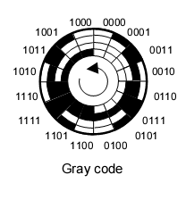
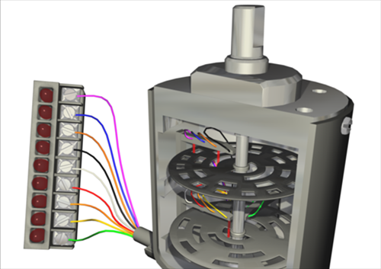
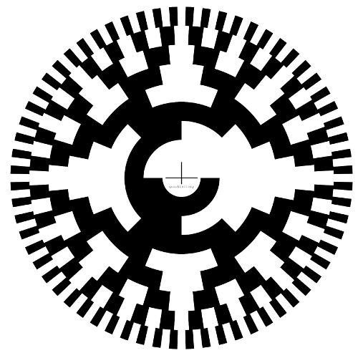
Gray code wheels
rotary encoding:
incremental rotation
only changes 1 bit
at a time
4 bits
8 bits

Slide 10
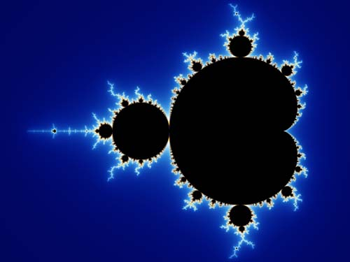
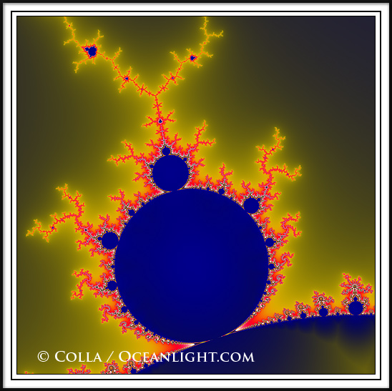
Fractals
Fractals are geometric shapes exhibiting
self-similarity: zoom in on a portion and it looks just like the original
Mandelbrot set:

Slide 11
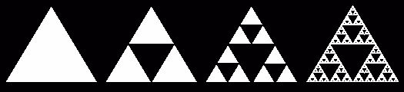
Iterated function systems
IFSs are a kind of fractal generated by recursive geometric replacement rules
Sierpinski triangle: start with any triangle
  Cut out the middle triangle: corners are halfway along each side
  Recurse for each of the three subtriangles

Slide 12
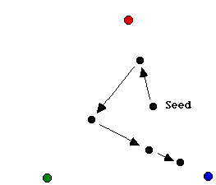
Sierpinski and the Chaos Game
Chaos game: choose three points on a plane, colour them say red/green/blue.
Start at a random seed point.
Roll a die and choose
red/green/blue.
Move halfway toward
that point.
Repeat
What pattern
is formed?

