Slide 1
An OO Design Exercise
11 Mar 2009
CMPT166
Dr. Sean Ho
Trinity Western University

Slide 2
Steps to OO design: wADes
  (Prereq: understand client requirements)
System behaviour
  Use-case scenarios
  User interface mockups
Components
  Self-contained blocks with
  narrow interactions
From components to classes
  Attributes, methods

Slide 3
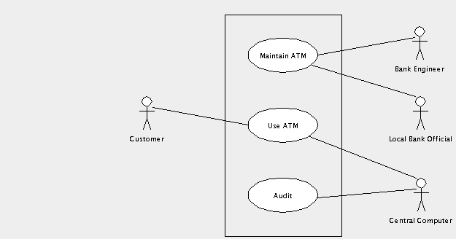
(1) System behaviour: use-case
UML use-case diagrams show:
  The actors involved (may be nonhuman!)
  Ways in which the actors interact: relationships,
  actions,
  use cases, etc.
Example: ATM
(thanks to
ArgoUML)

Slide 4
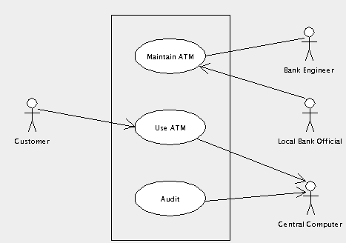
Use case diagram: navigation
Direction of arrows indicates which actor is passive and which is active:
What
direction
should the
arrows point
between
“Maintain ATM”
and
“Engineer”?

Slide 5
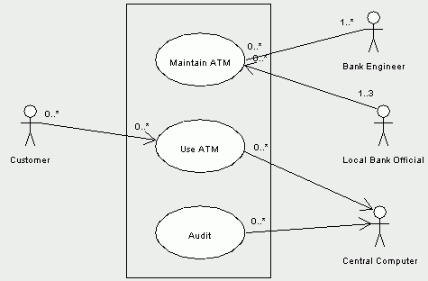
Use case diagram: multiplicity
Numbers indicate how many instances of an actor can be doing how many instances of the use case
e.g., only
allow up to 3
Bank Officials

Slide 6
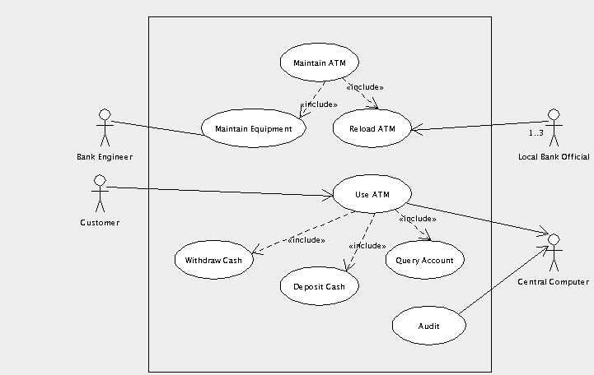
Use case diagram: includes
We may need to break down each use case into smaller chunks to implement

Slide 7
Specifying a use case
Each use case should have:
  Short name
  Goal: what does it achieve for its actors?
  Names of actor(s) involved
  Pre/post-conditions?
  Basic flow: break down into steps (pseudocode!)
  Alternate flows: what if user inputs something different from the usual?

Slide 8
Ex. use case: Withdraw Cash
Name: Withdraw cash
Goal: Customer gets cash; Computer ensures account has enough money and keeps a record
Actors: Customer, Central Computer
Basic flow:
  Customer selects account to withdraw from
  Customer inputs dollar amount of cash
  ATM verifies with Computer enough money
  ATM dispenses cash to Customer
  ATM prints receipt

Slide 9
Ex. use case: alternate flows
How might the basic flow not work? What might go wrong?
  input ($) too big or too small
  can't give out coins (e.g., $4)
  not enough $$$ in account
  user cancels
  no paper, or no cash, or ATM on fire
  dropped connection to Computer
Each results in an alternate flow: how to handle that alternate situation

Slide 10
Example (midterm q. #10)
Problem statement:
Design a student enrolment database
like we have at TWU

Slide 11
(1) Actors and actions
Use-case scenarios: actors and actions
Who are the actors? Who will interface with us?
  .Student, Alumni, Other students/public, Registrar, Database, Advisor, Instructor
What are the actions? Scenarios of use?
  ask for GPA, add class, drop class, change address, change advisor

Slide 12
(1) Use-case diagrams
Actor
Actor
Use-case
Use-case
Actor
Actor

Slide 13
(1) UI mockup
For each use-case (action), describe/mockup what the user interface will be like:
  Text Q&A? Windows? Interactivity?

Slide 14
(2) Component design
This is often the hardest part!
Components need not be classes
Thinly coupled: describe all interfaces between components
Component
Component
Component
Component

Slide 15
Component: ....
Name: …
Description: …
Interface to (component):
  ...
Interface to (component):
  ...

Slide 16
Component: ....
Name: …
Description: …
Interface to (component):
  ...
Interface to (component):
  ...

Slide 17
(3) From components to classes
Each component may need several classes to implement it
Component: …
  Class: …
    Attributes: …
    Methods: …
  Class: …
    Attributes: …
    Methods: ...

