Slide 1
Introduction to Networks
18 Mar 2009
CMPT166
Dr. Sean Ho
Trinity Western University
See:
socket/ example code

Slide 2
Review last time: sockets
TCP: connection-oriented, streams
UDP: connection-less, unreliable:
may arrive out of order, duplicated, or not at all
Client-server model
  Server: socket(), bind(), listen(), then
  accept(), send()/recv(), and finally
  shutdown(), close()
  Client: socket(), connect(), then
  send()/recv(), and finally
  shutdown(), close()

Slide 3
Networking layers
OSI 7-layer model of networking
7: Application (HTTP, SMTP)
6: Presentation: data repr., encryption (SSL)
5: Session: auth, session checkpointing/restore, stream synchronization (sockets, SSH, RPC)
4: Transport: reliability, connection (TCP, UDP)
3: Network: routing, addressing (IP)
2: Data link: physical address (Ethernet MAC)
1: Physical: signals (twisted-pair, fiber, radio)

Slide 4
IP addresses
Every public Internet host has an IP address:
  Four bytes: e.g., 64.114.134.52
IP addresses are partitioned into networks (blocks of addresses), according to netmask:
  e.g., 64.114.134.52 / 255.255.255.0 (or /24)
  means range: 64.114.134.0 – 64.114.134.255
Large chunks of the IP address space have been given out to countries, organizations, companies, etc.
  IBM has 9.0.0.0 / 8 (1/256th of the IP space!)

Slide 5
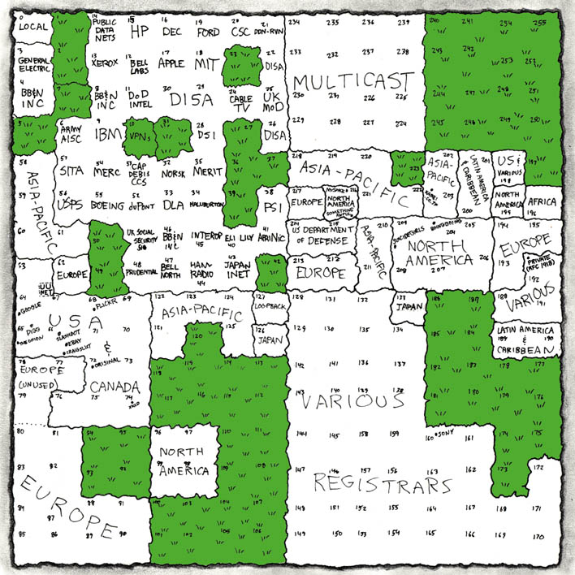
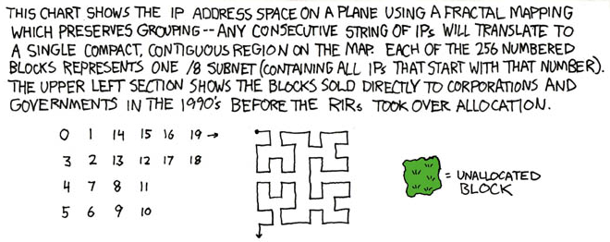
xkcd visualization of IP space
http://xkcd.com/195/

Slide 6
Running out of IP space: NAT
Very few public IP addresses left! Solutions?
NAT (Network Address Translation)
  LAN goes through router to get to Internet
  Router gets one public IP address
    64.114.134.52 is TWU's
  LAN gets private IP addresses:
    192.168.*/16, 172.16.*/12, 10.*/8
  Connections mapped to ports on the router
  How to run public services on a LAN host?

Slide 7
Running out of IP space: IPv6
Another solution: IPv6
128-bit addresses instead of 32-bit
  Each known star in the sky could get 4.5*10¹⁵ addresses!
64 bits to identify the subnet
  Hierarchy simplifies routing
  Easier to do multicast, etc.
64 bits to identify host uniquely
  Every network card has a unique 64-bit MAC (media access control) address

Slide 8
From names to numbers: DNS
Want to say “twu.ca” instead of 64.114.134.52
Top-level domains: .com, .org, .ca, etc.
DNS (Domain Name System):
  Query local server for host's IP address
    May return several IP addresses!
    Also info on mail server, owner, etc.
  Authoritative for its own domain
  If it doesn't know, it asks other servers
    Which may tell it which server to ask
  Root servers: [a-m].root-servers.net

