Slide 1
Intro to POSIX Threads with FLTK
25 Mar 2009
CMPT166
Dr. Sean Ho
Trinity Western University
See:
FlChat/ example code

Slide 2

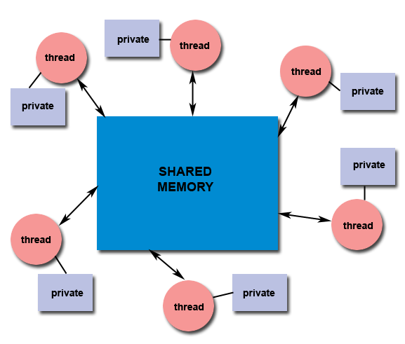
Threads and parallelism
Threads are lightweight processes
Threads allow concurrency
  Make use of multiple processors
  But still useful even on uniprocessor
Threads use shared memory
  Synchronization issues
  for shared objects
    Thread-safe code?
  May also have
  local (private) variables

Slide 3
Parallel program models
How to divide work amongst threads?
Master/worker:
master thread assigns work to worker threads
  Master typically handles UI, input
  Static or dynamic worker pool
Coworkers: all threads are peers:
  Main thread participates in doing work
Pipeline: each thread works on a different part of the task: e.g., automobile assembly line
  Function parallelism vs. data parallelism

Slide 4
Threads model: PThreads
POSIX threading: fork/join model
Start with parent thread (main program)
Create child thread(s):
  Specify a callback for the child to execute
  Optional parameter to callback: (void*)
  Shared memory access to same data
  Children may send messages to parent
    May trigger parent to execute a callback
  Child threads exit when callback finished

Slide 5
PThreads API
pthread_create():
  Parent calls this to start new child
  Specify start function for child to run
pthread_exit():
  Signals this thread is done
  Implicit at end of child's start function
pthread_join():
  Parent calls to wait for result from a child
pthread_self(): returns my thread ID (pthread_t)

Slide 6
PThreads: get results from child
Thread callbacks are subroutines declared to return void* and take one void* parameter
    void* workerThread(void* d) { … }
Parent may pass any user data to child via the void* parameter
Child may pass user data back to parent via pthread_exit(void *)
Parent calls pthread_join() to wait for child to finish and fetch child's returned data

Slide 7
When to call pthread_exit()
Children usually don't need to call pthread_exit(); it's implicit at end of callback
  Unless want to pass data back to parent
Parent may want to call pthread_exit() after it's done spawning the children
  Otherwise when parent (main()) finishes, all child threads are closed!
  Children might not be done with work yet

Slide 8
PThreads vs Windows threads
PThreads (POSIX threads) are a standard:
    #include <pthread.h>
But Windows has its own threading library:
    #include <process.h>
FLTK provides a small wrapper around both:
    #include “fl_threads.h”
    fl_create_thread( tid, callback, userdata );
  Fl_Thread tid lets parent track child
  callback is function for child to execute
  userdata (optional) is passed to callback

Slide 9

Issues with threads: locking
Big problem whenever we have concurrent threads accessing shared data: data corruption
  e.g., threads == children playing;
  shared resources == toys/blocks
Mutual exclusion (mutex): only one
thread accesses shared object at a time
Locks: a way to implement mutex
    Thread asks for lock before modifying object
    If it gets the lock, it can modify
    If not, wait (block) until the lock is freed
    Free the lock when done modifying

Slide 10
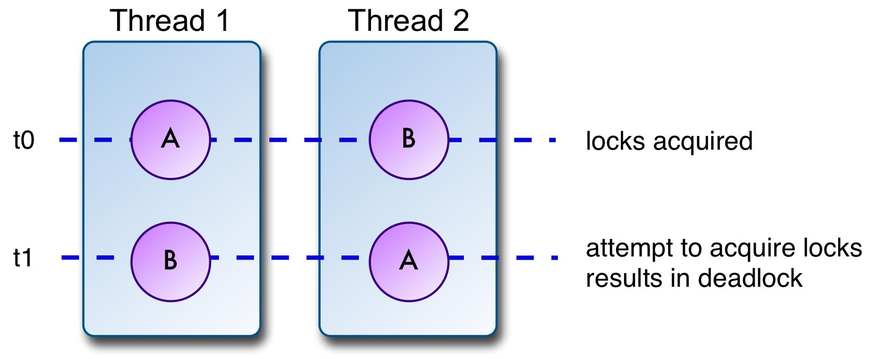
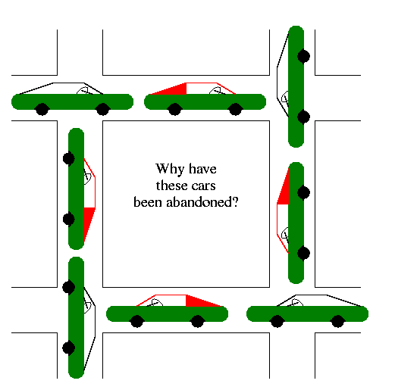
Problem with locks: deadlock
Shared resources A, B
each have own lock
Thread 1 locks A,
then asks to lock B
Thread 2 locks B,
then asks to lock A
→ both threads
hang forever! Deadlocked
→ be careful with locks;
only hold lock for
minimum time needed

Slide 11
Locking in FLTK
FLTK provides one global lock so that multiple threads won't change the GUI simultaneously
First call Fl::lock() in main() to enable threads
Then before a thread modifies any shared object:
    Fl::lock();
    myWindow->show(); // or other shared
    Fl::unlock();
See FLTK doc ch10.

Slide 12
When to use Fl::lock()
Before a shared resource is modified
  e.g., both parent and child want to write to a string buffer
Before any FLTK windowing operation
  show()/hide()
  timers (fl_add_timeout())
  changing window decorations
  In general, only the parent thread should do these

Slide 13
Fl::awake()
Children can send messages to the parent:
    void* msgToParent;
    Fl::awake( msgToParent );
Parent (doing main FL event loop) checks for messages with
    void* msgFrChild = Fl::thread_message();
Message may be pointer to any object (void*)
Child may also ask parent to run a callback:
    void* runMe( void* u ) { … }
    Fl::awake( runMe, userdata );

Slide 14
Example code: FlChat
Each of client and server has its own UI and main class: Client, ClientUI, Server, ServerUI
ServerUI: creates Server object and initializes
  Splits off a thread to wait and listen
ClientUI: creates Client object
  Upon connect, splits thread to receive
This is still a serial server:
  Can't handle multiple simultaneous clients
  Extension: use threads to do switchboard

