Slide 1
Unit Testing
27 Mar 2009
CMPT166
Dr. Sean Ho
Trinity Western University
More reading:
C++ text vol2 ch2,
UMD lecture,
Meyer article on Ariane5

Slide 2
Review of last time: PThreads
Thread model: shared memory
Programming models:
  Master-worker, coworkers, pipeline
PThreads: create, exit, join
  3 args to create: ID, callback, argument
  Getting results from a child
Locks, deadlock
  with FLTK: Fl::lock/unlock()
Threads in FLTK: Fl::awake()

Slide 3
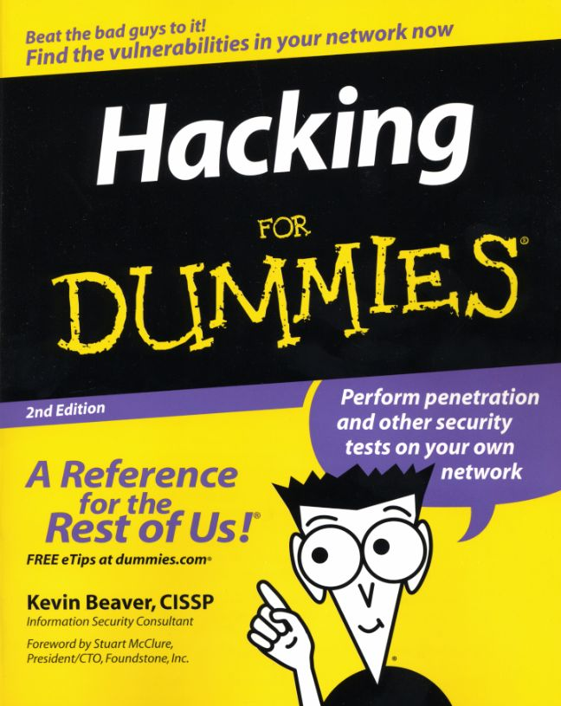
Designing, not hacking
Good, complex software is not easy!
A little more time spent designing
saves a lot more time debugging:
  Requirements
    Use-case scenarios
    Pre/post-conditions
  Component design
  Class hierarchy
  Class design
  … then fill in the code!

Slide 4
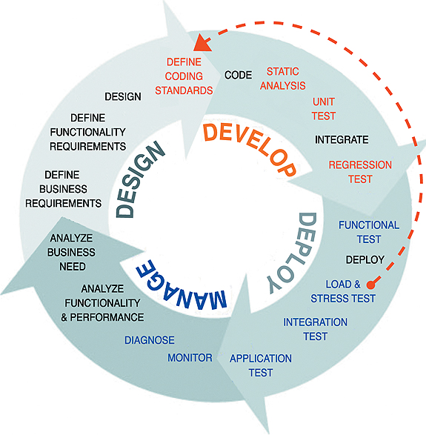
Complete software life-cycle
code
test
design
start
scrutinize
sys-con.com

Slide 5
How to ensure your code works?
How do we usually make sure our program is doing the right thing?
Stare at the code and convince yourself it works
  Easy to miss errors
  Easy to be lazy!
  “Tunnel vision” – same person codes+tests
Prove that it is correct
  Very difficult; not always possible
Ship it first and wait for customers to complain
  Not very nice!

Slide 6
Ensuring your code works
Testing!
Design your software with testing in mind:
  Catch bugs early on
  Easier development process
  Better design, higher-quality code
  Easier to maintain/upgrade
Ensures your program does what it's supposed to
Ensures you know what it's supposed to do!
Testing + coding is faster than just coding

Slide 7
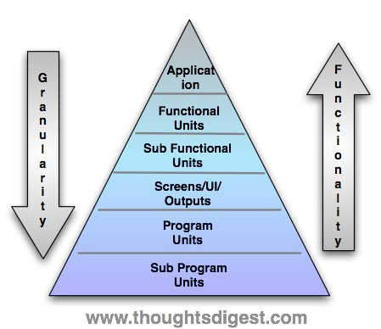
Unit testing: testing at all levels
Modular design:
break large task down into smaller tasks
Smallest granularity:
C++ functions, or
even lines of code
Smaller granularity
modules have
less functionality,
but are easier to test
Make sure each unit works!

Slide 8
Unit tests vs. integration tests
Unit testing tests each component in isolation
  At high levels, units may be
  whole programs (e.g., client vs. server)
  At low levels, units may be individual classes or methods (e.g., disconnect() )
Integration testing tests whether all the components interact correctly with each other
  Very high level, coarse granularity
  Often harder to design the tests
  Assumes each component works properly

Slide 9
Coding to a contract
The requirements for a unit form its contract:
  Preconditions, postconditions
  Promise to whoever interacts with it
Test against the contract:
  You can write tests before you code!
Design to the contract (Bertrand Meyer, Airane5)
  Structure the code to satisfy the contract
Code to the contract:
  Test as you code to ensure correctness

Slide 10

Ariane5 case
June 4, 1996: maiden flight of ESA Airane5 space launch vehicle: self-destructs after 40sec
  Estimated cost: $500 million USD (uninsured)
Autopilot correcting for illusory severe off-course
  Both redundant inertial guidance systems had shut down and were spewing error messages
  Overflow when converting big number
  from 64-bit long to 16-bit short
The real error: reusing code from Ariane4 that had no preconditions
  e.g., “ensure value fits in a 16-bit short”

Slide 11
Example contracts: Stack
Stack that takes any type object:
    template <typename Elt> class Stack {
    public:
push() method with pre/post-conditions:
    Elt push( Elt item );
    // pre: none. post: item is at top of stack
pop() method:
    Elt pop();
    // pre: stack has at least one item
    // post: returns top item from stack;
    top item is removed from stack

Slide 12
Testing against the contract
Black-box testing:
don't know/care how the unit is implemented
  Information hiding: cf. library: *.h vs. *.cpp
Test cases can be written just from the contract
Tester and coder may be different people
  In fact, it's better if they are!
  Implementation may change; if the contract is same, the tests can be same
test
cases
component
test
results

Slide 13
When to write tests
As soon as you have a contract
Before you start to code (helps clarify design)
As you code (code a chunk, test a chunk)
Right after you code (instant gratification)
Do NOT wait until the whole program is done!
  You will run out of time or motivation
  Testing is a design aid –
  it helps you design more modular code

Slide 14
Assertions
Automated testing: write code to test your code
One way to express test cases is by assertions:
    #include <cassert>
assert(): tests a given Boolean expression
    assert( size > 0 );
  Prints error message if assertion fails
Don't change program state in an assertion!
Set NDEBUG macro to disable asserts
    #define NDEBUG // disable tests
  Or compile with: g++ -DNDEBUG

Slide 15
Testing the test code
Test code may be buggy, too!
Test it by deliberately breaking your program code and seeing if the tests catch it
Example: AssertTest.cpp
  Simple stack using <vector>
  g++ AssertTest.cpp -o AssertTest.exe

