Slide 1
Design Patterns: Structural
30 March 2009
CMPT166
Dr. Sean Ho
Trinity Western University
See also:
Vince Huston

Slide 2
Review last time: testing
Testing + coding is faster than just coding
Ensures your code does what it's supposed to do
  Ensures you know what it's supposed to do!
Unit testing vs. integration testing
Coding to a contract:
  Contract → tests → design → code
Make it run → make it right
→ make it fast → make it small

Slide 3
UML: Unified Modelling Language
Developed at same time as OO
Many kinds of diagrams
  Class diagram
  Inheritance hierarchy
  Use-case scenarios
Original idea from Christopher Alexander, “Notes on the Synthesis of Form”, Harvard University Press, 1964
Ref: Gamma, Helm, Johnson, Vlissides, “Design Patterns: Elements of Reusable OO Software”

Slide 4
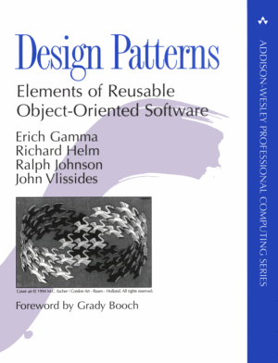
Design patterns
A pattern is a named abstraction
  from a recurring concrete form
  that expresses the essence of
  a proven general solution
A pattern has three parts:
  some recurring problem from the real world
  the context of the problem (when to solve it)
  the rule telling us how to solve it
Describe a class of problems and how to solve

Slide 5
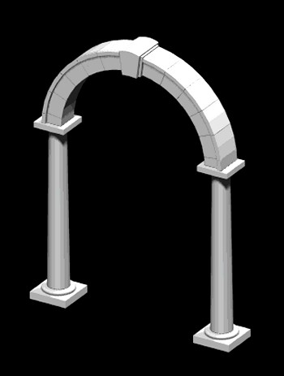
Parts of a design pattern
Name: should be meaningful
Problem: desired goal and obstacles
Context: preconditions on problem
Forces: relevant constraints, trade-offs, caveats
Solution: structure, relationships, how-to
Related patterns: codependencies, “see also”
Known uses: example applications

Slide 6
Classes of patterns (high to low)
Conceptual/architectural
  Structural organization of software systems
  Set of predefined components
  Relationships between components
Design
  How to refine each component
  Commonly recurring structure of components
Programming idiom
  How to code a particular component feature

Slide 7
Classes of patterns (GoF)
Creational patterns
  Interfaces to generate new objects
Structural patterns
  How to organize a large system in components
Behavioural patterns
  How components interact with each other to accomplish a common goal

Slide 8
Creational: factory method
Define an interface for creating an object, but let subclasses decide which class to instantiate
  “Virtual constructor”
Analogy: plastic injection-mould
e.g., need to create a new Person; don't know in advance if it's Student, Staff, or Faculty
PersonCreator
makePerson()
Person
StudentCreator
makePerson()
Student

Slide 9
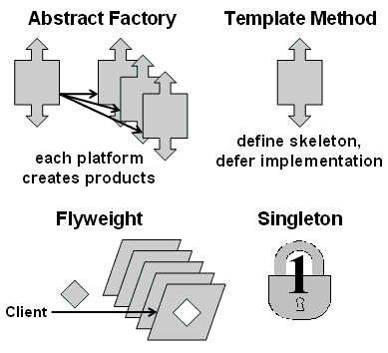
Creational: abstract factory
Provide an interface to create families of related or dependent objects without specifying their concrete classes (“kit”)
  e.g., adaptable look-and-feel of GUI widgets
Analogy: press to stamp out auto parts
May use a collection of factory methods
GUIFactory
newScrollbar()
Scrollbar
MacGUIFactory
newScrollbar()
MacScrollbar

Slide 10
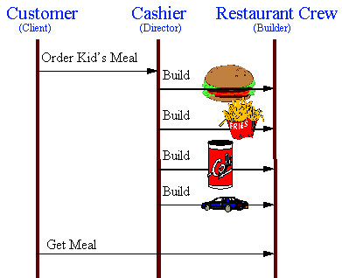
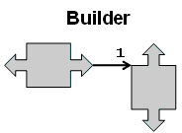
Creational pattern: builder
Separate construction of a complex object
from its representation
  Analogy: assembling fast food kids' meals
Director class parses the
request and representation
Hierarchy of Builder classes
actually makes the objects

Slide 11
Creational pattern: prototype
Create new objects by copying a prototype
  Analogy: biological cell division
  e.g., sheet-music editor: copy and paste notes
    Staves are objects; each note is an object
  Design each object so it knows how to copy itself: clone() method
MusicElement
clone()
Note
clone()
Rest
clone()
Fermata
clone()

Slide 12
Creational pattern: singleton
Ensure a class only has one instance,
and provide a global point of access to it.
    Analogy: only one President
Often implement by making constructor private
  Instantiate using static (class) method
    Method checks if instance already exists
    class President {
private:
President thePrez;
President() {}
public:
static getPrez() { if (thePrez) return thePrez; }

Slide 13
Structural patterns: facade
Provide a unified interface to a set of interfaces in a subsystem
  High-level interface: system is easier to use
  e.g., web front-end to complex database:
    want minimal number of widgets, input boxes
complex subsystem
user
facade

Slide 14
Other structural patterns
Adapter/ wrapper: Convert the interface of a class into another interface clients expect
  Lets otherwise incompatible classes cowork
Bridge: decouple an abstraction from its implementation so they can vary independently
Proxy: surrogate/placeholder for another object
Decorator: dynamically add responsibilities / functionality to an object
Flyweight: use sharing to support large numbers of fine-grained objects efficiently

Slide 15
Behavioural patterns: observer
One-to-many dependency between objects so
that when the subject changes state,
all its observers are notified and updated
  e.g., many students checking TWU website for snow closures
  e.g., server message “send to all” clients
subject
observer
observer
observer

Slide 16
Other behavioural patterns
Mediator: an object that encapsulates how a set of other objects interact.
  Promotes loose coupling by keeping objects from referring to each other directly
Chain of responsibility: avoid coupling sender directly to receiver by passing through chain
Iterator: access all elements of a collection
Memento: save/restore state of an object
Command: make requests objects
  queue/log requests, support undo, etc.

