Slide 1
Design Patterns:
Structural and Behavioural
3 April 2009
CMPT166
Dr. Sean Ho
Trinity Western University
See also:
Vince Huston

Slide 2
Review last time: creational
Design patterns:
Reusable templates for designing programs
May be very high-level, indep. of prog. language
Creational patterns
  Factory method
  Abstract factory
  Builder
  Prototype
  Singleton

Slide 3
Structural patterns
Adapter/ wrapper: Convert the interface of a class into another interface clients expect
Bridge: split abstraction from implementation
Composite: organize objects into trees
Decorator: dynamically add responsibilities / functionality to an object
Facade: hide complexities behind simple interface
Flyweight: use sharing to support large numbers of fine-grained objects efficiently
Proxy: surrogate/placeholder for another object

Slide 4
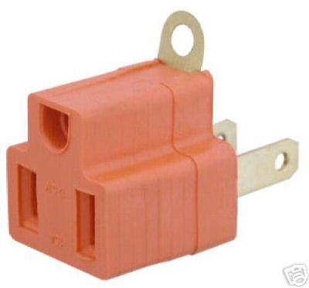

Structural pattern: Adapter
Convert interface of a class so that two incompatible classes can work together
Like converting 3-prong plug to 2-prong socket, or impedance matching electrical signals
e.g., buy prepackaged software system,
get it working with your
existing system
e.g., ClassClimate →
TWU Student Portal

Slide 5
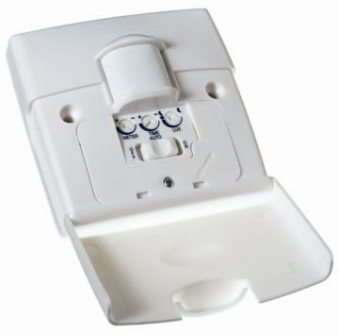
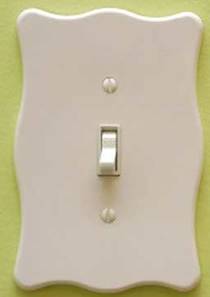
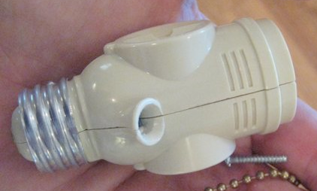
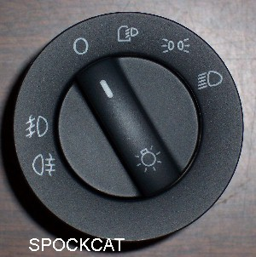
Structural pattern: Bridge
Decouple an abstraction from its implementation so that the two can vary independently
e.g., light switch abstract concept vs.
implementation of kinds of switches
client
abstraction
implementor
refinement
refinement

Slide 6
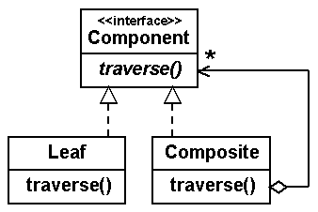
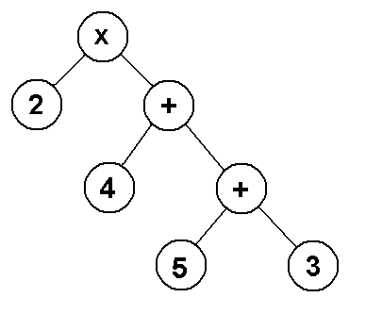
Structural pattern: Composite
Tree structure for objects: treat individual objects and composites in the same way
e.g., file directories have entries, each of which may themselves be directories
e.g., expression trees

Slide 7
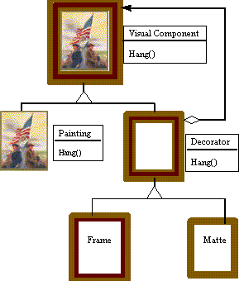

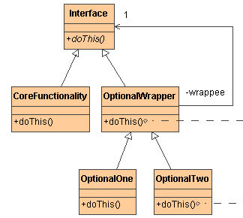
Structural pattern: Decorator
Dynamically add functionality to an object
Use a wrapper around the object to hide core
Wrapper may be subclassed
to add functionality
Decorating a Christmas tree

Slide 8
Structural pattern: Facade
Provide a unified interface to a set of interfaces in a subsystem
  High-level interface: system is easier to use
  e.g., web front-end to complex database:
    want minimal number of widgets, input boxes
complex subsystem
user
facade

Slide 9
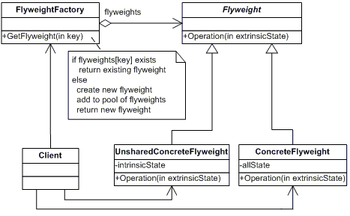
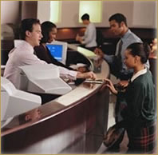
Structural pattern: Flyweight
Use sharing to support lots of “small” objects
When more objects needed, draw from
shared pool on demand
e.g., multithreaded server:
pool of threads
e.g., array of
bank tellers

Slide 10
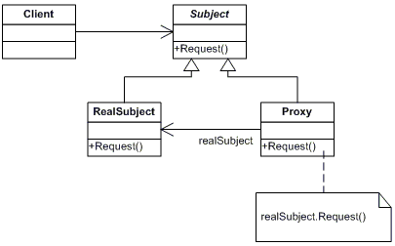
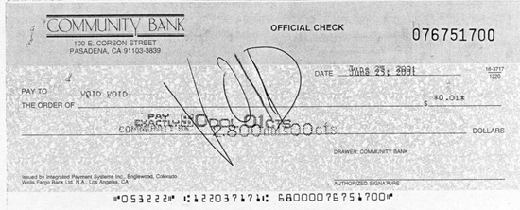
Structural pattern: Proxy
Surrogate for the real object
Control access to the real object, but still let clients think they are talking directly to it
Use superclass over both real object and proxy
e.g., proxy HTTP server
e.g., bank cheque

Slide 11
Structural patterns
Adapter/ wrapper: Convert the interface of a class into another interface clients expect
Bridge: split abstraction from implementation
Composite: organize objects into trees
Decorator: dynamically add responsibilities / functionality to an object
Facade: hide complexities behind simple interface
Flyweight: use sharing to support large numbers of fine-grained objects efficiently
Proxy: surrogate/placeholder for another object

Slide 12
Behavioural patterns
Chain of responsibility: avoid coupling sender directly to receiver by passing through chain
Command: make requests into objects
Iterator: access all elements of a collection
Mediator: object encapsulating the interactions of a set of objects: promotes loose coupling
Observer: decouple viewers from the subject
(also: Interpreter, Memento, State, Strategy,
Template Method, Visitor)

Slide 13
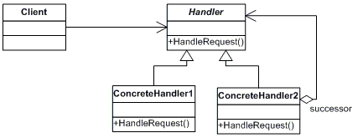
Behavior: Chain of responsibility
Decouple sender from receiver by passing request along a chain of intermediate handlers
Chain may be reconfigured dynamically
Single pipeline, but many possible handlers
e.g., coin passing through vending machine
me
my boss
2nd level mgr
regional mgr
vice president
CEO

Slide 14
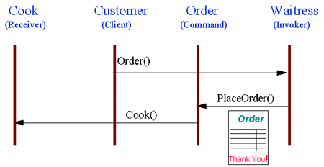
Behavioural pattern: Command
Encapsulate a request as an object
cf. C++ function objects, callbacks
Specify: object, method, arguments
e.g., meal order at restaurant
client
callback
interface
concrete
callback
receiver
concrete
callback

Slide 15
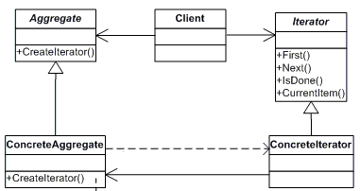
Behavioural pattern: Iterator
Abstract interface to traverse a collection
Hide how the collection is stored
Client interface: first, next, isDone
e.g., secretary knows her own filing system;
boss only needs ask for “next document”
Python for loop
through dictionaries:
  Order irrelevant

Slide 16
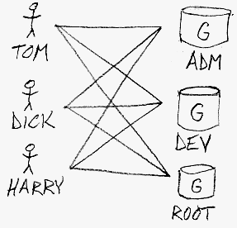
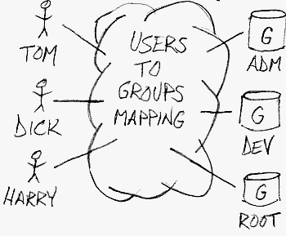
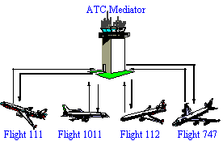
Behavioural pattern: Mediator
Simplify many-to-many relationships with one central object that all actors interact with
  Loose coupling of peers
Encapsulate many interactions (e.g., methods) into one object
e.g., ATC
w/o mediator
with mediator

Slide 17
Behavioural pattern: Observer
One-to-many dependency between objects so
that when the subject changes state,
all its observers are notified and updated
  e.g., many students checking TWU website for snow closures
  e.g., server message “send to all” clients
subject
observer
observer
observer

Slide 18
Behavioural patterns
Chain of responsibility: avoid coupling sender directly to receiver by passing through chain
Command: make requests into objects
Iterator: access all elements of a collection
Mediator: object encapsulating the interactions of a set of objects: promotes loose coupling
Observer: decouple viewers from the subject
(also: Interpreter, Memento, State, Strategy,
Template Method, Visitor)

