Slide 1
History of GUIs, cont., and
FLTK: Fast Light ToolKit
8 January 2009
CMPT370
Dr. Sean Ho
Trinity Western University

Slide 2
What's on for today
An excerpted history of GUIs, cont.
  Sutherland, Engelbart, PARC, Apple, MS
GUI toolkits
Events and callbacks
FLTK and Fluid
  BankInterest example
  Template lab write-up
Next time: UI/HCI design issues

Slide 3
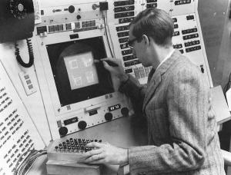
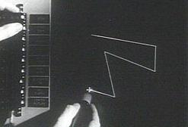
Sutherland's SketchPad (1963)
Ivan Sutherland
Ph.D. thesis at MIT
Used light pen to directly
manipulate graphical objects on screen
Pioneer of computer-aided drafting (CAD):
  Draw “master” diagram once
  Instantiate multiple copies, tweak
  (OO design)
  Constraint-based system
  (e.g., keep two lines at fixed angle)

Slide 4
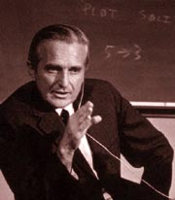

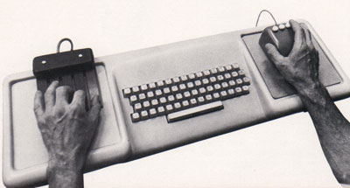
Engelbart's NLS demo (1968)
NLS (oNLine System) innovations:
  Mouse
  Windowing system
  Collaborative document editing with email, IM, and video conferencing
  Hyperlinks
  Chording keyboard
Douglas Englebart,
Stanford Research Inst.

Slide 5
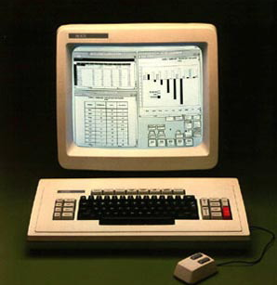
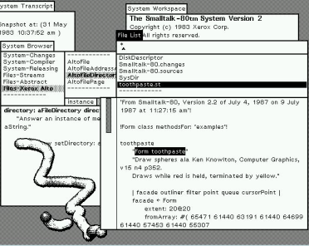
Xerox PARC in the 1970's
Smalltalk
on the Star
Xerox Palo Alto:
  Towards “paperless office”
  Microcomputers: Alto (1973), Star (1981)
  WIMP model: windows, icons, menus, pointer
  Desktop
  Smalltalk (1974):
    Pure OO language
    Integrated graphical
    development
    and runtime environment

Slide 6
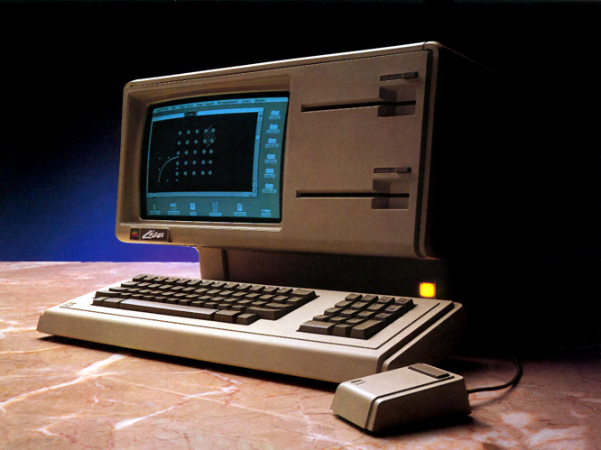
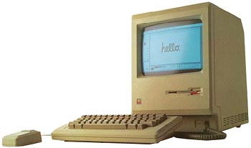
Apple in the 1980's
Lisa (1983):
  Drag-and-drop
  Double-click to open/run
Macintosh (1984):
  Much cheaper ($2,495 vs. >$10k)
  Accessible to the public
  Mass-marketing ad
  campaign during
  SuperBowl and
  1984 Olympics in L.A.

Slide 7
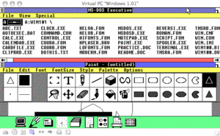
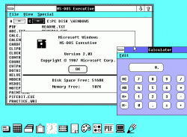
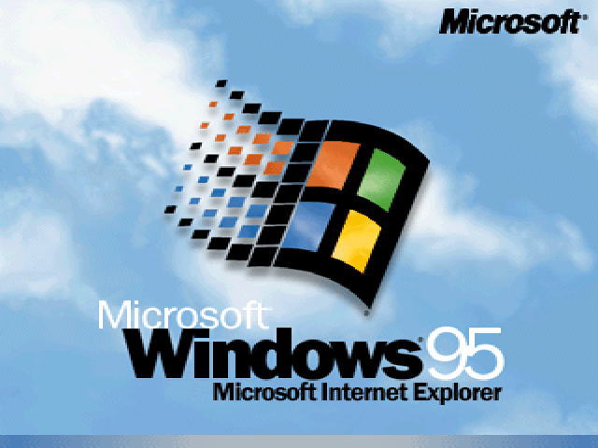
Microsoft Windows (1980's)
Windows 1.0 (1985):
  Mostly character-based graphics
  Tiled windows
  Popularity dwarfed by Mac
Windows 2.0 (1987):
  Overlapping windows
  Apple sues MS over “look and feel” (loses)
Windows 3.11 (1992), Win95:
  Looks pretty; wildly popular

Slide 8
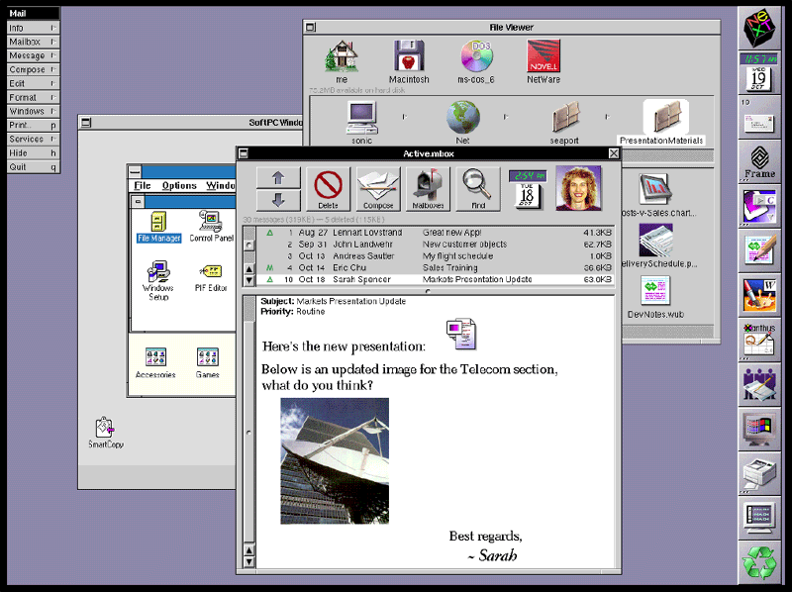
Other GUI environments
GEM (Digital Research) for Atari (1985)
Amiga Workbench (1985)
NeXTstep (Steve Jobs) (1988)
  Pretty, but CPU-intensive
OS/2 (IBM) (1988):
  competed with Windows
Unix X10 (1984), X11 (1987)
  Network transparency (Xwin32)
  Multiple libraries on top: Athena, Motif/CDE, OpenLook, KDE/Qt, Gnome/gtk, FLTK
NeXTstep

Slide 9
OS environment vs. toolkit
In the past, the only GUI was what was provided by the operating system
Now, we can write programs that link to various GUI toolkits:
  Libraries that provide a way to build a GUI program
  Menus/windows that look just like Windows:
    Link with MFC or Visual Basic or .NET
  Other options: FLTK, Qt, wxWidgets, gtk, ...
    Cross-platform: can run on Linux, Mac, etc.

Slide 10
Compiling with GUI toolkits
Libraries provide GUI components as objects
  Windows (Fl_Window), menus, tabs, etc.
  Widgets: buttons, textboxes (Fl_Input), sliders, scrollbars, dials, etc.
Link your program with the toolkit library
  Static linking: libfltk.a
    Needed objects are bundled into the executable
  Dynamic linking: libfltk.dll.a / libfltk.so
    Need separate shared library
  FLTK-1 libraries: fltk, fltk_gl, fltk_images, fltk_forms

Slide 11
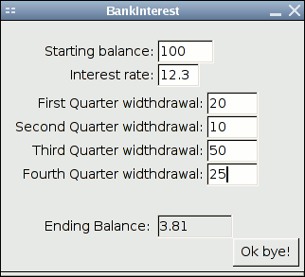
Events and callbacks
An event is a user action:
  Click a button
  Fill in a text box
  Press a key
  Move the mouse
A callback is a procedure invoked by an event:
  Close the window when user clicks “Ok bye!”
  Draw a circle where the user clicks the mouse

Slide 12
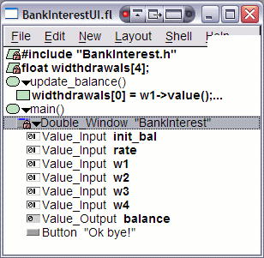
Using Fluid
Fluid is FLTK's interactive GUI
designer
  Drag and drop widgets
  Write code blocks / callbacks
Saves *.fl Fluid files; exports *.cxx/*.h code
Compile and link this code into your program
It is possible to write a whole program in Fluid
But better to separate GUI from main program logic: form vs. function
  Akin to HTML/CSS vs. PHP/ASP/JS

Slide 13
FLTK example: BankInterest
BankInterestUI:
  Just the user interface
  Get values from the widgets
  Minimal program logic
    But I did choose to put main() here
BankInterest:
  Main program functionality
  Provides functions invoked
  by UI callbacks
    calc_balance()

Slide 14
Lab write-ups (see BankInterest)
Purpose: a sentence or two
Suitability: do we even need a computer to do this? Or a GUI? Or carmel?
Restatement: given, todo, result
Libraries: libfltk, GL, etc. (w/versions if possible)
Program Design
User Manual
Test Cases
Bugs / Limitations / future work
Screenshots

Slide 15
Carmel
Next topic (next Thu): parallel programming
We'll be using carmel's “8” processors
  OpenMP under gcc4
  Linux command-line (ssh/PuTTY); no GUI
If you don't have a carmel login yet, Dave Friesen can get you one for this class
We'll get to this next week, but you can get started early if you like:
  Download nbody and runtest to carmel
  './runtest' and watch the results

Slide 16
TODO
Brush up on your C++
  Links at bottom of our IDE policy sheet
Lab0 due next Tues 14Jan
  FLTK orientation, tutorials
  No write-up needed
  Upload ZIP/tarball to myCourses by midnight
Lab1 due Tue 21Jan
  Design + implement your own FLTK program
  Should be “cool” and somewhat “useful”

