Slide 1
Parallel computing memory models
22 January 2009
CMPT370
Dr. Sean Ho
Trinity Western University

Slide 2
Review last time
Parallel computing concepts
  Why do parallel?
  vonNeumann abstraction: instructions, data
  Instruction parallelism vs. data parallelism
    Flynn's taxonomy: SISD, SIMD, MISD, MIMD
  Measuring speedup
  Design issues
See tutorial from LLNL (Livermore) supercomputing centre

Slide 3
What's on for today
Memory models:
  Shared (SMP)
  Distributed (cluster)
  Hybrid
Programming models:
  Threads (PThreads, OpenMP)
  Message passing (MPI)
  Data-parallel (HPF)
  Hybrids
Automatic vs. manual parallelization

Slide 4
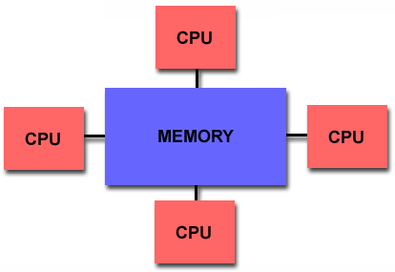
Shared memory
All processors share a
global memory space:
  Uniform addressing
Communication is easy: read/write to fixed addr
  Still need locking/synchronization
UMA: uniform memory access (SMP)
  Equal latency, bandwidth to memory
NUMA: non-uniform memory access
  Access to local memory is faster
  CC-NUMA: cache-coherent (SGI Origin hypercube)

Slide 5
Pros/cons of shared memory
Pros:
  Simpler model: easier to program (OpenMP)
  Multi-processor SMP boards make for fast memory access
    Carmel's “8” processors: One board, two Intel Xeon chips, each with dual-core, each core with two HyperThreads
Cons:
  Doesn't scale well to hundreds of processors
    Geometric explosion of communication links between CPUs and memory

Slide 6
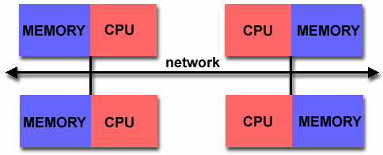
Distributed memory
Each processor has its
own memory space
Access other memory
by passing messages to its controlling CPU
Coarse-granularity parallelism is desired
Network fabric is important:
  Ethernet (802.3): CSMA-CD: doesn't scale well!
  Myrinet: low latency, low packet overhead
  InfiniBand: switched; has features like QoS
  SCI (Scalable Coherent Interconnect):
  low overhead bus

Slide 7
Pros/cons of distributed memory
Pros:
  Scales well to hundreds or thousands of CPUs
    LLNL BlueGene/L
Cons:
  Complex to program! (MPI)
    Explicit parallelism: programmer's responsibility to coordinate communication between processors
    How to span a big data structure across memories?
  Memory access times very non-uniform
    Importance of the network fabric:
    Sun: “the network is the computer”

Slide 8
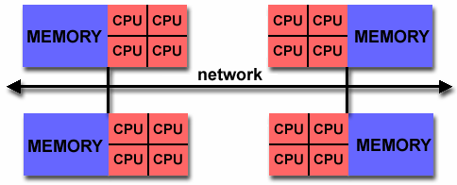
Hybrid shared/distributed
Most large supercomputers today use a hybrid:
  Each node is cache-coherent SMP (shared)
  Link nodes via network (distributed)

Slide 9
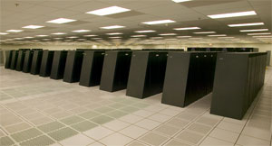
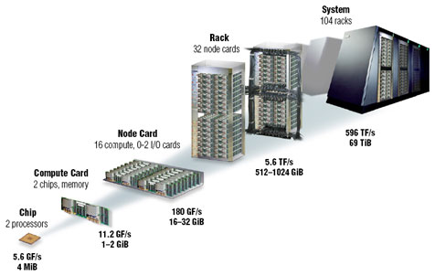
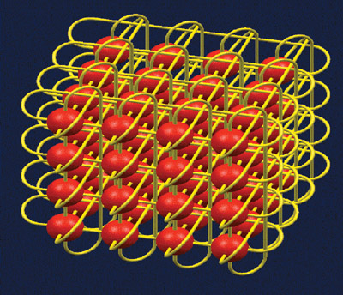
Case study: BlueGene/L
(BlueGene/L homepage)
Made by IBM/Watson, site at LLNL
Applications: fluid flow, nanotech,
molecular biochemistry, etc.
106,496 nodes (dual-proc), 478 Tflops sustained,
69 TB RAM, 1.5 MW in 2500 sqft
Nodes networked as a
32x32x64 3D torus
Also 12 login nodes (SuSE)
and 1204 disk I/O nodes (800 TB)

Slide 10
Programming a parallel machine
The shared/distributed memory model deals with the address space visible by each processor
The parallel programming model used is a separate issue:
  Threads (PThreads, OpenMP)
  Message passing (MPI)
  Data parallel (HPF)
  Hybrids of these models

Slide 11
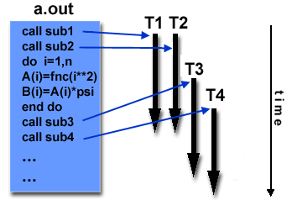
Threads
Start with master thread
Master forks off worker threads
  Each thread can be running same code or different code (e.g., subroutines)
Scatter/gather: when worker threads complete, send results back to master thread
Two implementations:
  POSIX Threads: library-based, explicit parallel
  OpenMP: compiler directives,
  easier to “add-on” to serial code
    #pragma omp parallel

Slide 12
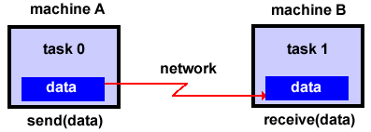
Message passing
All communication between nodes is via messages
Explicit parallelism:
  Serial program must be restructured by programmer
One unified standard implementation: MPI (Message Passing Interface)
  Library routines: MPI_Bcast(), MPI_Reduce()
MPI homepage

Slide 13
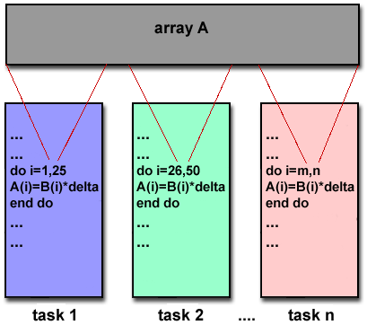
Data parallel model
Each parallel task does same
work on a different portion
of a large regular data struct
  Vector, n-D array, etc.
Use either compiler directives
or library routines to specify
parallelism
Implementations: HPF (High performance Fortran)

Slide 14
Hybrid programming models
Memory models: shared vs. distributed
Programming models: threads, MPI, data-parallel
For clusters (distributed memory model),
MPI is most commonly used
However, hybrid programming models exist:
  OpenMP to the programmer (ease of use)
  MPI at lower layer (cluster communications)
HPF (data-parallel) on clusters often uses MPI as a transparent back-end

Slide 15
Writing a parallel program
Designing a program to work and make full use of multiple processors is tough
Fully automatic parallelizing compilers exist:
  Analyzes your code for parallel opportunities
  For loops, iteration over arrays, etc.
Directives can make the compiler's job easier:
  #pragma delimits portions of code that have minimal dependencies (coarse granularity)
The most control and speedup is from manually programming it: explicit parallelism

Slide 16
Summary of today
Memory models:
  Shared (SMP)
  Distributed (cluster)
  Hybrid
Programming models:
  Threads (PThreads, OpenMP)
  Message passing (MPI)
  Data-parallel (HPF)
  Hybrids
Automatic vs. manual parallelization

