Slide 1
Issues in Parallel Programming
29 January 2009
CMPT370
Dr. Sean Ho
Trinity Western University

Slide 2


Slide 3
2009 Career Fair Exhibitors
Acts Seminaries
Adventure Teaching
African Children's Choir
Angus One Professional Recruitment
BC Corrections
BC Ferries
BC Human Resources Management Association
BC Transit Police
Bethesda Christian Association
BOP Korea Connections
Canada Revenue Agency
Canadian Forces
Certified General Accountants
Certified Management Accountants
Communitas Supportive Care Society
Community Employment Resource Centre
Corporate Express
Correctional Service Canada
Creative Memories
Developmental Disabilities Association
Dulay Burke Financial Recruitment
Edward Jones
EV Logistics
Fraser Health Authority
Freedom 55 Financial
Institute of Chartered Accountants
of BC
Logos Bible Software
Kintec Footlabs
Meyers Norris Penny LLP
New Westminster Police
Northern Health
Pampered Chef
Power to Change
Retirement Concepts
Royal Bank of Canada
Royal Canadian Mounted Police
Southwestern Company
Studibudi Professional Networking Inc.
Sun Life Financial
TD Canada Trust
Township of Langley
UHY International
Vancouver Fire and Rescue Services

Slide 4


Slide 5
Lab2: Your OpenMP program
Ideas:
  Numerical integration (like pi-leibniz.c)
  Generating fractals:
    See mandelbrot/ example
  Dictionary/brute force encryption cracking?
  Prime number generation?

Slide 6
Review last time
OpenMP
  #pragma omp parallel: begin parallel section
    #pragma omp for
    #pragma omp sections
  Shared vs. private variables
    private(), reduction()
  #pragma omp critical/single/barrier
  OMP_NUM_THREADS,omp_get_num_threads()
  Timing: omp_get_wtime()
  schedule(static/dynamic/guided/runtime)

Slide 7
Addendum: timing
<time.h> clock(): CPU time w/ tick resolution
  Usually 100 or 1000 ticks/sec
<time.h> time(): wall-clock time w/ second res
<sys/time.h> gettimeofday():
  Wall-clock time in seconds w/ tick resolution
double omp_get_wtime():
  Wall-clock time in seconds w/ tick resolution
  Platform independent
  Thread dependent

Slide 8
Issues in parallel prog. design
When designing parallel programs:
  Understand the problem to be solved
    Data dependencies
  Partition the work
    Domain vs. functional partitioning
    Granularity
  Communications!
    Synchronization
  Load balancing
  I/O

Slide 9
Understand the problem
Parallelizable:
  e.g., find next position of 500k atoms
Not (easily) parallelizable:
  e.g., find Fibonacci sequence:
    fib(n) = fib(n-2) + fib(n-1)
  Data dependence
Find bottlenecks to performance
  Optimize inner loops
  Use profiling when necessary

Slide 10
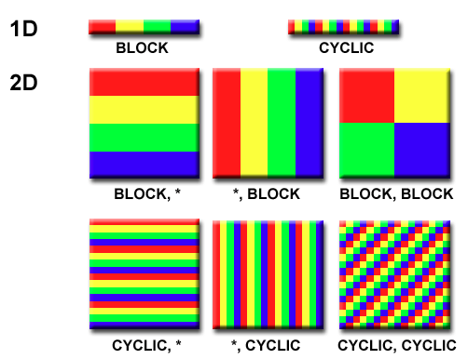
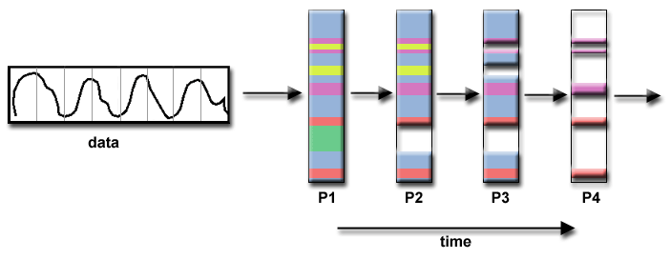
Partition the work
Data partitioning
  “SIMD” philosophy
  Each task operates
  on part of dataset
Functional decomposition (“MIMD” philosophy)
  Each task does different work
  e.g., series of audio filters

Slide 11
Communication issues
I/O often bottleneck: minimize communication
  Coarse-grain parallelism: e.g., FoldingAtHome
Latency vs. bandwidth
Unicast (point-to-point) vs. multicast
Synchronous (blocking) (“phone call”) vs.
asynchronous (non-blocking) (“letter”)
Ease of programming
  OpenMP abstracts away from programmer
  MPI makes communication more explicit

Slide 12
Types of synchronization
Barrier
  Wait for all tasks to catch up: slowest task
  Implicit barrier at end of each parallel section
Lock (semaphore/mutex)
  Only one thread can hold the lock at a time
  Wait (block or non-block) for lock to free
  e.g., #pragma omp critical
Synchronous communications
  Both parties must synchronize
  Blocking → idle CPU → bad!

Slide 13
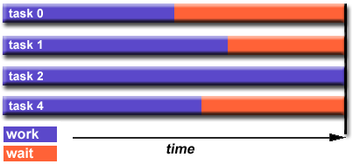
Load balancing
Want to keep all processors
busy as much as possible
Easy if tasks are fixed in computation time:
  Array/matrix operations
  Loops (#pragma omp for)
Often hard to predict how long a task will take
  Sparse arrays: most entries zero
  Adaptive refinement
  N-body (e.g., gravity) simulations

Slide 14
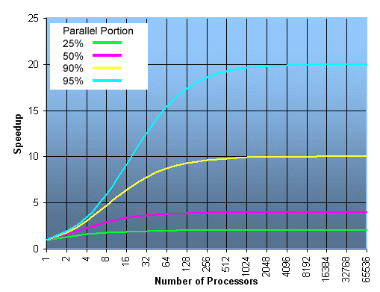
Amdahl's law: speedup
If P is the fraction of code that is parallelizable
and N is the number of processors:
Speedup = 1 / ( P/N + (1-P) )
The fraction of code
that is parallelizable
is very important!
Limits maximum
speedup

Slide 15
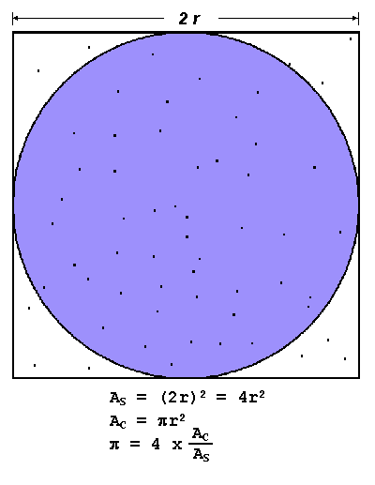
Sample application: Pi
Generate random dot
See if it's within unit circle
Fraction of dots inside circle
approximates pi/4
The more dots,
the better precision
Parallelizable? What does each thread do?
Granularity?

Slide 16
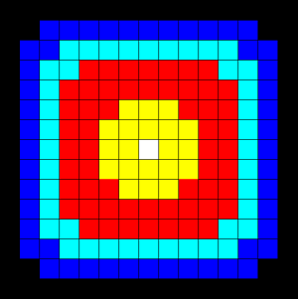
Data Parallelism
Some programs are embarassingly parallel:
  e.g., add two vectors
Data dependency: order of execution matters
Some are parallelizable, but need some communication:
  Heat equation on a 2D grid
  Each pixel U_{x,y} +=
    C_{x} (U_{x-1,y} + U_{x+1,y} – 2*U_{x,y}) +
    C_{y} (U_{x,y-1} + U_{x,y+1} – 2*U_{x,y})
  Used for blurring images

Slide 17
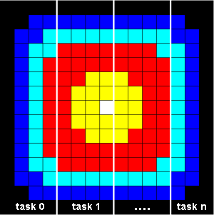
Heat equation: boundaries
Divide work by region of image:
  Data parallelism
Interior of region can be done
independently
Boundaries need information
from neighbouring threads
Use non-blocking communication to send/receive boundary pixels from neighbours while processing interior

