Slide 1
Introduction to
Computer Graphics
3 February 2009
CMPT370
Dr. Sean Ho
Trinity Western University

Slide 2
What's on for today
Visual computing:
  Computer graphics and image analysis
Objectives of visual computing
  Capture and understand reality
  Emulate and enhance reality
  Parthenon video
Image formation
  Camera model
  Light and colour models

Slide 3
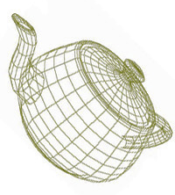
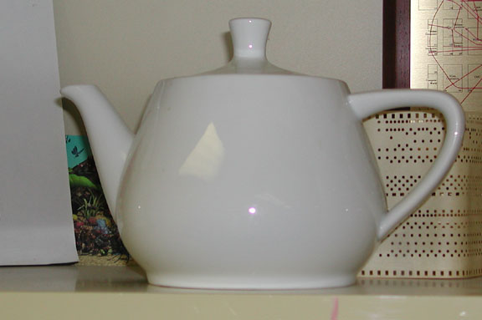
Graphics vs. image analysis
Computer graphics is synthetic:
  From an internal data structure (representation):
    Triangle mesh, VRML, etc.
  Produce (render) an image
Image analysis is analytic:
  From an image of real world:
    Digicam, video, MRI/CT, satellite
  Produce an representation
  of the objects of interest
Graphics
Image
Analysis

Slide 4
Objectives of graphics/analysis
Image Analysis:
  Capture reality
    Image acquisition: camera, laser rangefinder, etc.
  Understand reality
    Object recognition: segmentation
Graphics:
  Emulate reality
    Photorealistic rendering, physically-based modelling
  “Enhance” reality
    Special effects, unrealistic physics

Slide 5
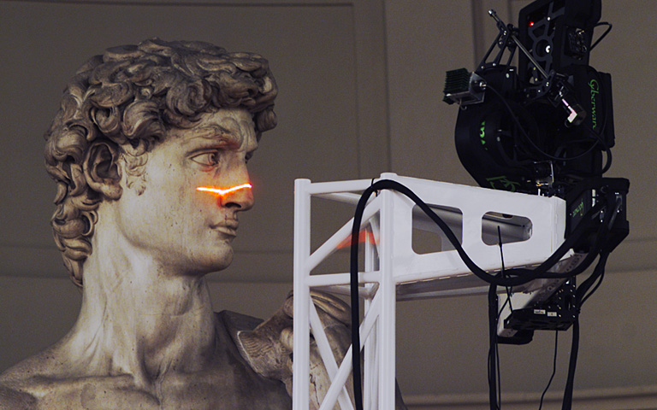
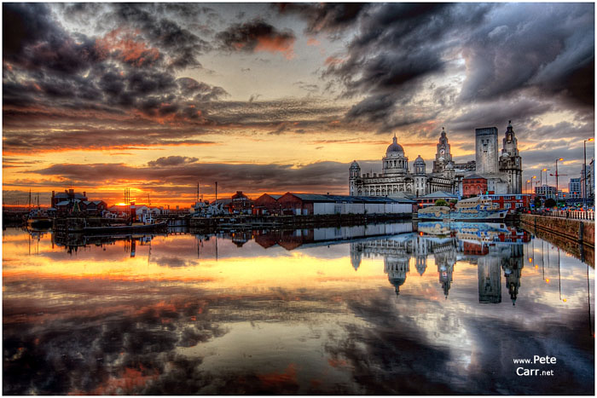
Objectives: Capture reality
Acquire a representation of the world
  Want it as faithful as possible to reality
  Higher resolution, broader dynamic range
  Optics/engineering/hardware
Digital Michelangelo
High Dynamic Range (HDR) image

Slide 6
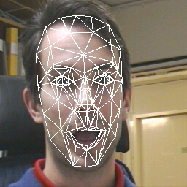
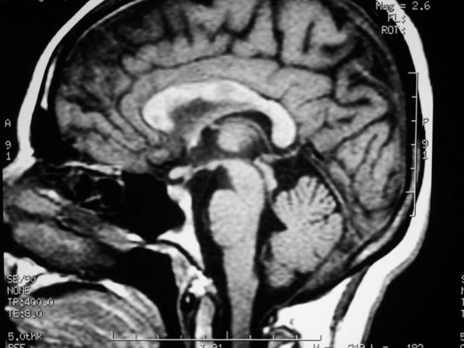
Objectives: Understand reality
Interpretation and segmentation:
  Finding objects of interest within an image
Object representation:
  Compact data structures suitable for, e.g.
    Population analysis and discrimination
Face recognition (AAM)
MS lesions in MRI

Slide 7

Objectives: Emulate reality
Try to get as close to reality as possible
  Modelling: geometry, texture, etc. of objects
  Lighting/shading: behaviour of light
  Animation: natural motion of objects
The “uncanny valley”:
not-quite-realistic
human characters are
very disconcerting
Soanala: 3DSMax
using sub-surface
scattering for skin

Slide 8
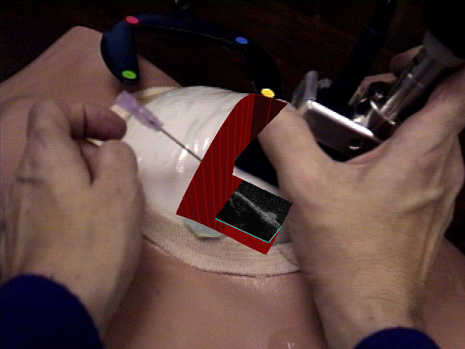
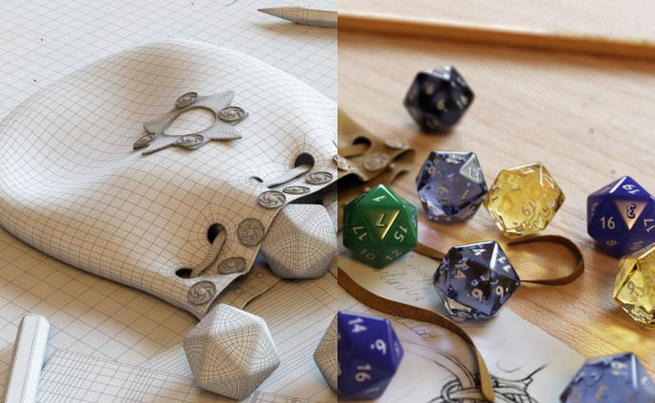
Objectives: “Enhance” reality
Combine real and generated elements
Movie special effects
Augmented reality HUD for telesurgery, manufacturing/design, etc.
Photorealistic rendering
UNC AR
ultrasound breast biopsy

Slide 9
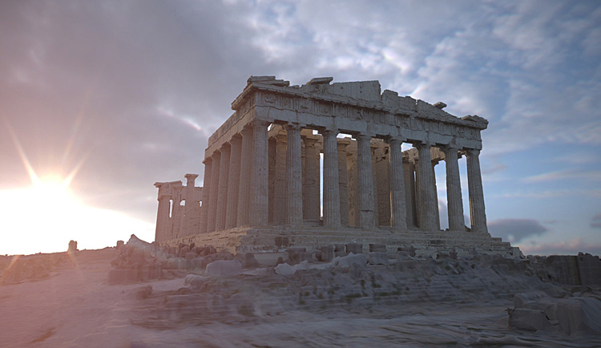
Parthenon ex. (SIGGRAPH 04)
The Debevec/USC Parthenon is just one example of combining image analysis and computer graphics
  53 pano laser scans
  90 million polygons
  Custom scanning rig for
  sculptures in London's
  Parthenon Museum
  Time-lapse daylight
  sequence uses HDR images taken in Marina Del Rey
  Total production time: 58 days (37-CPU render farm)

Slide 10
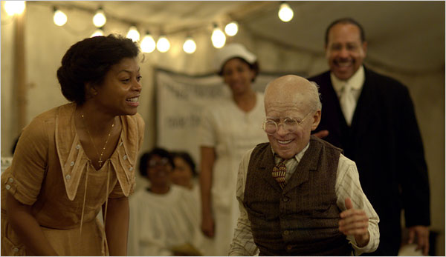
“Benjamin Button” example
Body uses various
petite actors
Face is modelled in 3D
Facial expressions of
Brad Pitt captured and
pasted onto 3D model
Database of ~120 emotional expressions
portrayed by Pitt, motion-captured in 3D
Match subject motion, lighting, background, camera lens, ...
Merrick Morton / Paramount
CG Society article
RopeOfSilicon /
BenjaminButtonFX.com

Slide 11
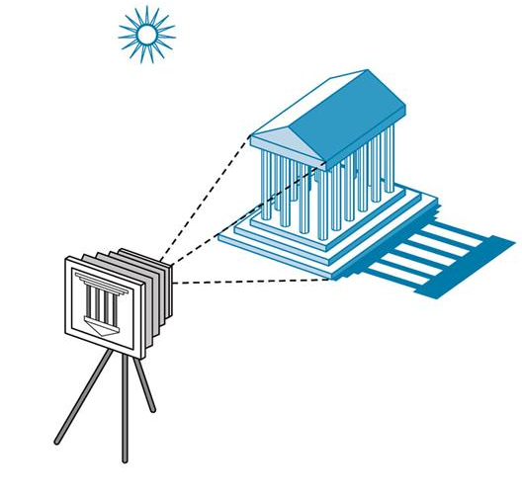
Image formation
Components to produce a static image:
  Objects
    Material properties: colour, shininess, bumpiness, etc.
  Light sources
    Colour spectrum,
    direction, area, etc.
  Viewer
    Camera model:
    lens, depth of field, etc.

Slide 12
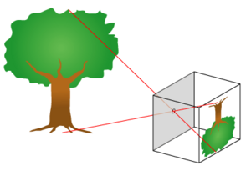
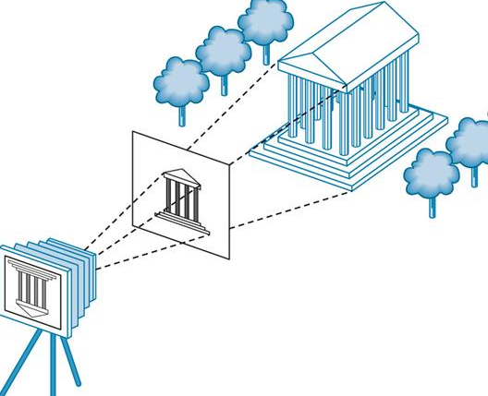
Camera model
The most basic is a pinhole camera:
  Image produced is upside down and flipped
  Larger hole yields smaller depth-of-field (more blurry)
Synthetic camera model:
  Image plane is in front of
  center of projection
  Cast rays from CoP through
  each pixel of image plane,
  into the scene
Control depth of field? Lens distortion?

