Slide 1
Architecture of a Graphics Pipeline
5 February 2009
CMPT370
Dr. Sean Ho
Trinity Western University

Slide 2
Review last time
Visual computing:
  Computer graphics and image analysis
Objectives of visual computing
  Capture and understand reality
  Emulate and enhance reality
  Parthenon video
Image formation
  Camera model

Slide 3
What's on for today
Light and colour models
Geometric representation: trimesh
Off-line rendering: raytracing, radiosity
Real-time interactive graphics pipeline:
  Vertex processing
  Clipping and culling
  Rasterizing
  Fragment processing

Slide 4
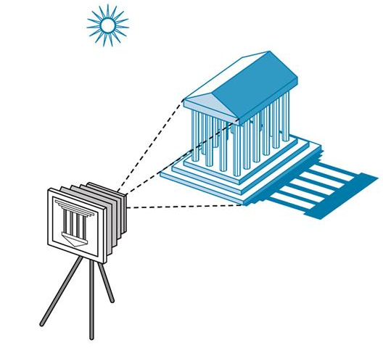
Image formation
Components to produce a static image:
  Objects
    Geometry (vertices, faces, etc.), material properties: colour, shininess, bumpiness, etc.
  Light sources
    Colour spectrum, direction,
    area, etc.
  Viewer
    Camera model: lens,
    depth of field, etc.

Slide 5
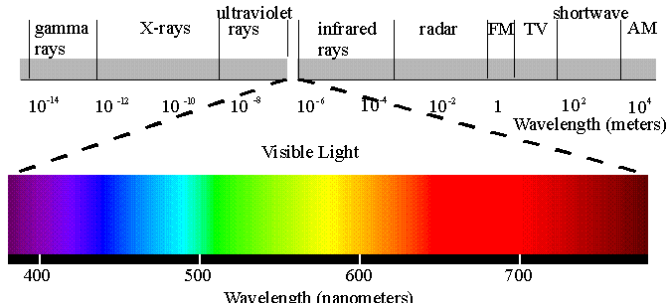
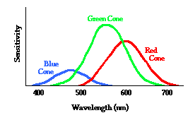
Light
Visible light
is electromagnetic radiation about 350-750nm in wavelength (~400 to 850 THz in frequency)
Light colour is a frequency distribution of energy
  Lasers: monochromatic
But our eyes only have four kinds of sensors:
  Rods: luminance (shades of grey)
  R,G,B cones: chrominance (colour)
  Each sensor has its own
  frequency response curve

Slide 6
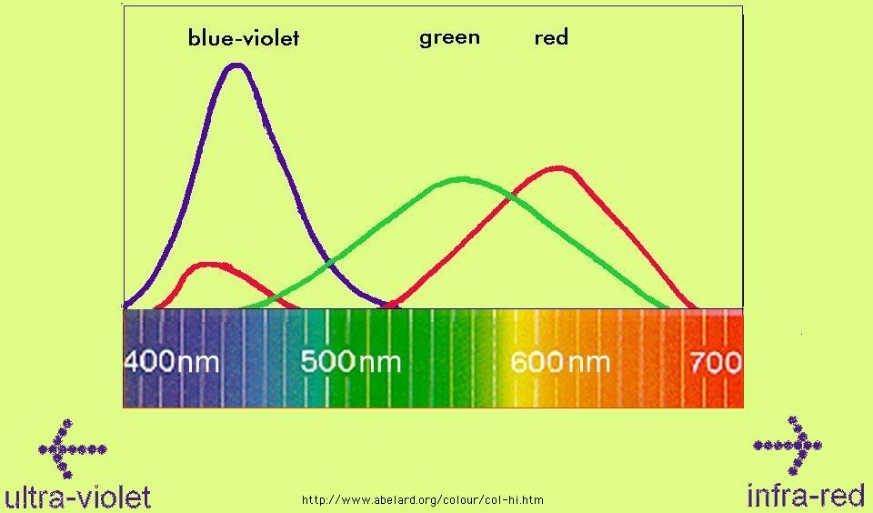
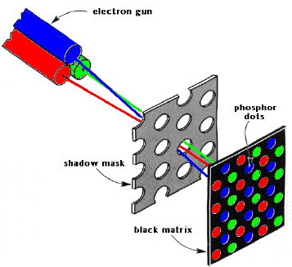
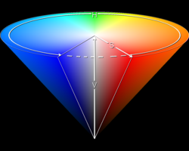
Colour models
Frequency distribution at each pixel
RGB: matches our cones
  Additive colour: CRTs use 3 electron guns
  Must still define chromaticities of R,G,B
CMYK: subtractive colour: C/R, M/G, Y/B
  Inks/pigments: newspaper, paint
HSV: hue, saturation, value
CIELAB: lightness, a/b chrominance:
  Absolute colour space: only depends on whitepoint
  Convert to absolute via profile: AdobeRGB, sRGB

Slide 7
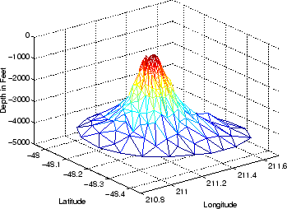
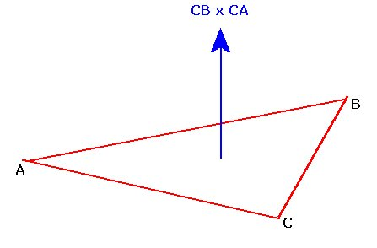
Geometric representation: trimesh
The most common representation for the geometry of 3D surfaces is a triangle mesh:
  Vertex list (point cloud): (x,y,z) coordinates
    {0.2, 0., 2.7}, {0.2, -0.112, 2.7}, {0.112, -0.2, 2.7},
  Face list: indexes into vertices
    {12, 13, 14}, {13, 14, 15}, ...
Can also use other polygons
  But triangle is a 2D simplex:
  Always flat
Faces have normal vectors

Slide 8
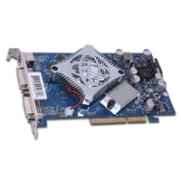
Off-line vs. real-time graphics
Off-line rendering
  Render time is not very important
    Use big parallel render farms
  Photo-realism is the priority
  Raytracing, radiosity, other rendering methods
Real-time (interactive) graphics
  Perfect photo-realism is not so important
  Frame rate is the priority: at least 60Hz
  3D modelling, CAD, scientific visualization
  Graphics pipeline in video card or software

Slide 9
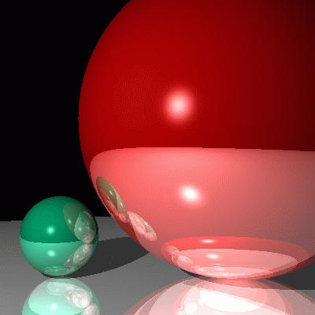
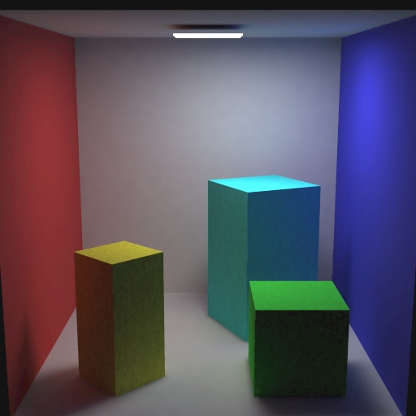
Off-line rendering
Raytracing:
  Cast rays from camera into scene
  until either absorbed or go to infinity
    Sky sphere handles infinity
  Reflections, translucency, refraction
  Only trace rays that are needed
Radiosity:
  Light sources emit energy
  Follow light energy as it bounces in scene
  Global illumination: not view-dependent

Slide 10
Real-time graphics pipeline
This is what your graphics card hardware does
Input: scene objects, lighting, camera
  Most of the data is the vertex list
Output: pixels stored in the framebuffer
  Raster graphics
Usually processes objects one at a time:
local lighting
Vertex
list
Vertex
processor
Clipping /
assembly
Rasterizer
Fragment
processor
Pixels

Slide 11
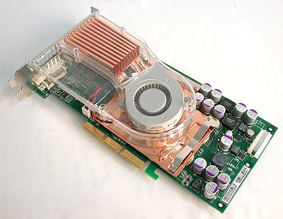
Vertex processor: T&L
The vertex processor operates on each vertex independently: parallel processor
  NVIDIA FX 5800 has 240 cores
Its basic tasks are:
  Transform: changing
  position/geometry
  of the vertex
  Lighting: determining a
  RGB colour for the
  vertex: vertex shading

Slide 12
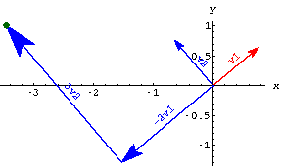
Vertex processor: transform
Much of the work is in transforming vertices from one coordinate system to another:
  Object-based coords
  Camera-based coords
  Screen-based coords
Each transform is a matrix multiplication
GPUs are highly optimized to do matrix multiply very fast in parallel
  Vertex shaders can be programmed to do fancy effects (GLSL, HLSL, Cg)

Slide 13
Kinds of coordinate transforms
The transformations done on vertices include:
  Translation: shift in (x,y,z)
  Rotation: e.g., 3 Euler angles
  Scaling: uniform or along 3 axes
  (Perspective, affine)
3D points are projected onto 2D image plane:
  Perspective projection:
    Projection lines meet at center of projection
  Parallel projection:
    Projection lines are all parallel

