Slide 1
Graphics Pipeline and OpenGL
10 February 2009
CMPT370
Dr. Sean Ho
Trinity Western University

Slide 2
Review last time
Light and colour models
Geometric representation: trimesh
Off-line rendering: raytracing, radiosity
Real-time interactive graphics pipeline:
  Vertex processing
  Clipping and culling
  Rasterizing
  Fragment processing
Graphics API overview (OpenGL)

Slide 3
Real-time graphics pipeline
This is what your graphics card hardware does
Input: scene objects, lighting, camera
  Most of the data is the vertex list
Output: pixels stored in the framebuffer
  Raster graphics
Usually processes objects one at a time:
local lighting
Vertex
list
Vertex
processor
Clipping /
assembly
Rasterizer
Fragment
processor
Pixels

Slide 4
Kinds of coordinate transforms
The transformations done on vertices include:
  Translation: shift in (x,y,z)
  Rotation: e.g., 3 Euler angles
  Scaling: uniform or along 3 axes
  (Perspective, affine)
3D points are projected onto 2D image plane:
  Perspective projection:
    Projection lines meet at center of projection
  Parallel projection:
    Projection lines are all parallel

Slide 5
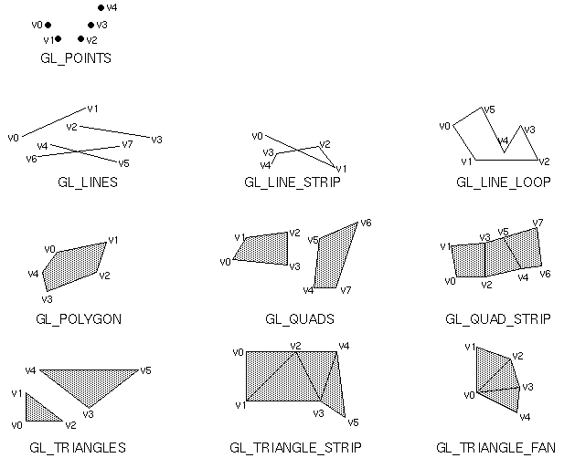
Primitive assembly
The vertex processor
also assembles vertices
into primitives:
  Lines/curves
  Triangles/polygons/
  surfaces
Uses the face list to index into the vertex list
OpenGL primitives
Vertex
list
Vertex
processor
Clipping /
assembly
Rasterizer
Fragment
processor
Pixels

Slide 6
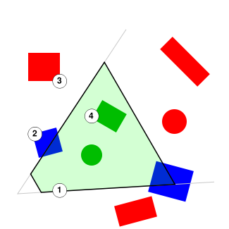

Clipping and culling
Don't render what we can't see
Clipping
  Remove primitives outside of
  the camera's view frustrum
Backface culling
  Remove triangles facing away from camera
  Usually cuts down # of triangles
  by about 50%!
Other optimizations also possible

Slide 7
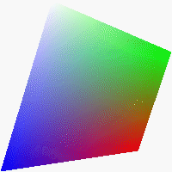
Rasterization
Convert a primitive into a fragment:
  Set of pixels just for that primitive
  Each pixel has both RGB colour and depth
  Interpolate vertex colours over the fragment
  Might not correspond to pixels on screen:
  e.g., occluded pixels
Vertex
list
Vertex
processor
Clipping /
assembly
Rasterizer
Fragment
processor
Pixels

Slide 8
Fragment processing
Assemble the fragments into final framebuffer
Hidden-surface removal:
  Some fragments may occlude parts of others
  Z-buffer sorts pixels by distance
  Handle transparency
Vertex
list
Vertex
processor
Clipping /
assembly
Rasterizer
Fragment
processor
Pixels

Slide 9



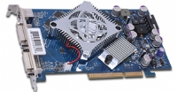

Programmer's interface
A graphics API allows a program to interact with the graphics pipeline
Library subroutines (see CubeView.cxx)
  Specify the scene (models)
  Specify the lighting
  Specify the camera
Application
program
API: OpenGL,
Direct3D
GPU: graphics card

Slide 10
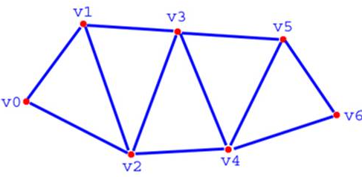
Graphics API: Model
Geometry: vertices (0D)
  Line segments, curves (1D)
  Polygons (2D), parametric surfaces
Material properties: colour, specularity, etc.
Example:
glBegin(GL_TRIANGLE);
glColor3f(0.0, 1.0, 0.0);
glVertex3f(0.0, 0.0, 0.0);
glVertex3f(1.0, 0.0, 0.0);
glVertex3f(0.0, 1.0, 0.0);
glEnd();
GL_TRIANGLE_STRIP

Slide 11




Graphics API: Lighting
Type of light:
  Ambient (uniform, everywhere)
  Directional (e.g., sunlight)
  Spotlight (cone with falloff)
  Point vs. area light
Material properties:
  Ambient colour
  Diffuse colour
  Specular colour
  Emissive colour

Slide 12
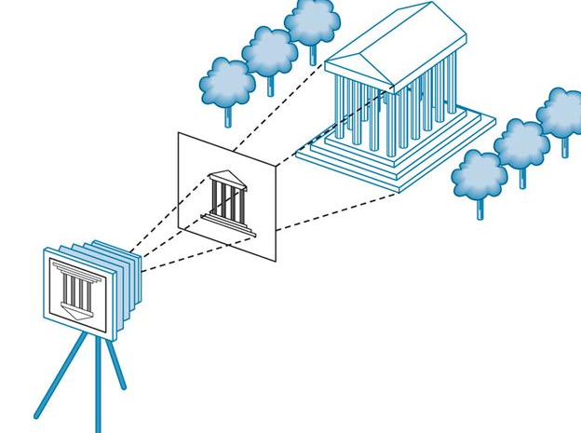
Graphics API: Camera
6DOF camera model:
  Position of center of projection (3DOF)
  Orientation (3DOF)
Also: location and size of image plane
Could also consider
modelling lens distortion

Slide 13

History of OpenGL
Silicon Graphics (SGI) was one of the first to implement graphics pipeline in hardware (1982)
  In-house library: GL
OpenGL (1992): platform-independent API
  Architectural Review Board / Working Group
    SGI, IBM, HP, MS, Nvidia, 3DLabs
  Stable, widely-accepted standard (now 2.1)
    New changes just for new hardware capabilities
  Lots of documentation and sample code
    “Red book” and “Blue book”

Slide 14
OpenGL libraries
OpenGL core library
  On Windows: opengl32.dll
  On Linux/Unix: libGL.a, libGL.so
OpenGL utility library: GLU
  Higher-level drawing routines that use OpenGL core primitives
OpenGL utility toolkit: GLUT
  Basic GUI toolkit, very small footprint
  FLTK is much more powerful
  Also freeglut, OpenGLUT, GLUI

Slide 15

Interface with window system
OpenGL links with the native window system
  Windows: WGL, GDI
  MacOS: AGL (for Carbon), NSOpenGL (Cocoa)
  Unix: GLX
This makes it possible to run an OpenGL program over the network:
  Run Xwin32 on local PC (has GLX)
  ssh -x carmel
  run program on carmel, primitives get sent to local PC, uses local hardware acceleration

Slide 16
Software architecture
Application program
X, Win32, MacOS
GL
FLTK, Qt,
MFC, .NET
Fl_Gl_Window,
GLUT
GLU
GLX, AGL, WGL
Rendering pipeline (usually hardware)

Slide 17
OpenGL pipeline architecture
CPU
Display
lists
Polynomial
evaluator
Vertex
processor
Pixel
operations
Rasterize
Fragment
proc.
Frame
buffer
Texture
memory

Slide 18
OpenGL state machine
Two kinds of OpenGL functions
  Generate primitives
    Vertex, line, triangle, polygon, etc.
  Change state
    Current colour
    Material properties (shininess, etc.)
    Transformations: view, model
Each primitive gets whatever state was current when it was drawn

Slide 19
OpenGL functions
Most core OpenGL functions look like this:
  glVertex3f( x, y, z )
    gl: belongs to core OpenGL library (glu for GLU)
    Vertex: name of function
    3f: argument type: 3 floats
Not overloaded, for efficiency
  glVertex3fv( vec )
    takes a pointer to an array of 3 floats
  glVertex3i( x, y, z ): ints
  glVertex3d( x, y, z ): doubles

Slide 20
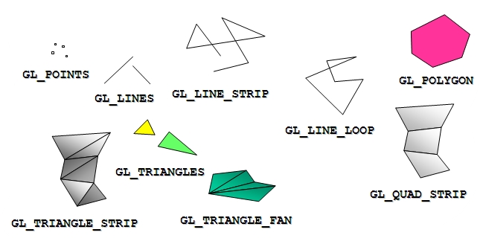
OpenGL primitives
glBegin(GL_*) starts a set of primitives
Polygons must be simple: edges cannot cross
Must be convex
Must be flat: all vertices in the same plane

Slide 21
Drawing in OpenGL (cf CubeView)
Start the set of primitives:
    glBegin( GL_TRIANGLES );
Set the colour and other attributes:
    glColor3f( 0.0, 0.0, 1.0 );
Create the vertices:
    glVertex3f( 0.0, 0.1, 0.2 );
    glVertex3f( 0.1, 0.0, 0.2 );
    glVertex3f( 0.0, 0.0, 0.2 );
End the set of primitives:
    glEnd();

Slide 22
Projection matrix
The coordinates of glVertex are in world coords
  OpenGL converts to camera coords, then to screen coords
The projection matrix specifies the camera:
    glMatrixMode( GL_PROJECTION );
Specify the viewing volume:
    glLoadIdentity();
    glOrtho(left, right, bottom, top, near, far)
  Orthographic (parallel) projection

