Slide 1
Transform Matrices,
Viewing,
Modelling
19 February 2009
CMPT370
Dr. Sean Ho
Trinity Western University

Slide 2
Review last time
Scalars, vectors, points
Vector spaces, affine spaces (+point)
Lines, rays, line segments
Curves, surfaces
Normal vectors
Convex hull
Linear independence
Basis, frame (+point)

Slide 3
What's on for today
Math for 3D graphics: homogeneous coordinates
  4x4 transform matrices
  Translate, scale, rotate
Viewing: (see RedBook ch3)
  Positioning the camera: model-view matrix
  Selecting a lens: projection matrix
  Clipping: setting the view volume
Modelling: vertex lists, face lists, edge lists
  OpenGL vertex arrays and display lists

Slide 4
Homogeneous coordinates
We use a 4-tuple as a homogeneous representation for both vectors and points
  [ α₁ α₂ α₃ 0 ]^{T} is a vector
  [ β₁ β₂ β₃ 1 ]^{T} is a point
  Relative to current coordinate frame
  Any 4-tuple [ x y z w ]^{T} maps to a point as
    [ x/w y/w z/w 1 ]^{T}
    If w=0, the 4-tuple represents a vector
  Each point in 3D maps to
  a line through the origin in 4D

Slide 5
Changing coordinate systems
Say we have a vector whose representation in one basis (e₁, e₂, e₃) is v = {α₁ α₂ α₃}.
  What is the representation for the same vector in a different basis, {d₁, d₂, d₃} ?
Represent each old basis vec e_{i} in the new basis:
  e₁ = γ₁₁d₁ + γ₁₂d₂ + γ₁₃d₃
  e₂ = γ₂₁d₁ + γ₂₂d₂ + γ₂₃d₃
  e₃ = γ₃₁d₁ + γ₃₂d₂ + γ₃₃d₃

Slide 6
3x3 vector transform matrix
These nine coefficients form
a 3x3 vector transform matrix M:
  w = M^{T}v, where
    v = {α₁ α₂ α₃} is representation in old basis
    w = {β₁ β₂ β₃} is representation in new basis

Slide 7
Change of frames
Something similar happens to change frames:
  Old frame is (P, e₁, e₂, e₃)
  New frame is (Q, d₁, d₂, d₃)
  Represent old frame in new basis
  12 degrees of freedom in affine transform

Slide 8
Translation matrix
Translate a point p by multiplying by T (=M^{T}):
  p' = Tp

Slide 9
Scaling matrix
Scale a point p by multiplying by T:
  p' = Tp
Fixed point of origin (scaling away from origin)
Reflection is via negative scale factors

Slide 10
Rotation matrix
Rotate by an angle θ about the z axis
Similar matrices for rotating about x, y axes
3 Euler angles
Order of operations is important!
  Rotation in 3D is non-Abelian

Slide 11
What's on for today
Math for 3D graphics: homogeneous coordinates
  4x4 transform matrices
  Translate, scale, rotate
Viewing: (see RedBook ch3)
  Positioning the camera: model-view matrix
  Selecting a lens: projection matrix
  Clipping: setting the view volume
Modelling: vertex lists, face lists, edge lists
  OpenGL vertex arrays and display lists

Slide 12
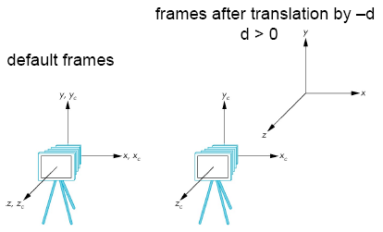
Placing the camera: model-view
The model-view matrix describes where the world is relative to the camera
  Initially identity matrix: camera is at origin of world, facing in negative z direction
Say we want to see an object at the origin: either
  Move the camera in the +z direction, or
  Move the world frame
  in the -z direction
  Both are equivalent:
  glTranslatef( 0., 0., -d );

Slide 13
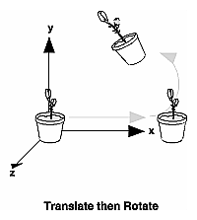
Order of transformations
    C: current model-view matrix
    M: new additional transformation,
    via glMultMatrix, glTranslate, glRotate, etc.
    v: vertex to be transformed
OpenGL applies transforms in the order: CMv
So the last transform is applied first!
    glMatrixMode( GL_MODELVIEW );
    glLoadIdentity();
    glRotatef( 60., 0., 0., 1. );
    glTranslatef( 10., 0., 0. );
    glBegin( GL_POINTS );
      glVertex3fv( vert );

Slide 14
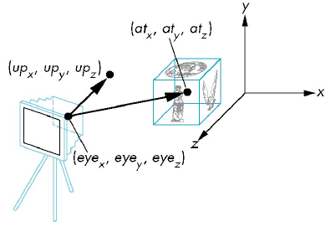
gluLookAt
Handy helper function for setting up model-view
    #include <GLU.h>
Specify eye coords, where you want to look at, and direction of “up” vector:
    glMatrixMode( GL_MODELVIEW );
    glLoadIdentity();
    gluLookAt( eye_{x}, eye_{y}, eye_{z},
    at_{x}, at_{y}, at_{z}, up_{x}, up_{y}, up_{z} );

Slide 15
Selecting a lens: Projection
The projection matrix maps 3D points in the camera's frame to 2D points on the image plane
  Input to projection matrix is homogeneous coords after model-view matrix is applied
  After multiplying by projection matrix,
    Divide to ensure homogeneous coords: [x y z 1]
    Take just the (x, y) coords as coords on image plane
  Default projection matrix is the identity
    Orthographic projection onto the xy plane

Slide 16
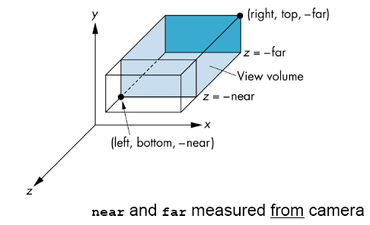
Orthographic projection
The manual way:
    glMatrixMode( GL_PROJECTION );
    glLoadIdentity();
    glMultMatrix(...);
The easier way with glOrtho():
    glMatrixMode( GL_PROJECTION );
    glLoadIdentity();
    glOrtho( left, right,
    bottom, top, near, far );

Slide 17
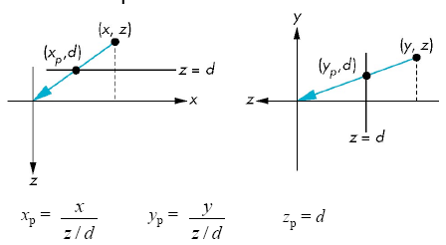
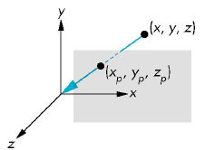
Perspective projection
Consider a perspective projection with center of projection (CoP) at origin, and
image plane at z=d:
view from top
view from side
A point p = (x,y,z)
projects to
q = (x_{p}, y_{p}, z_{p}=d) via:

Slide 18
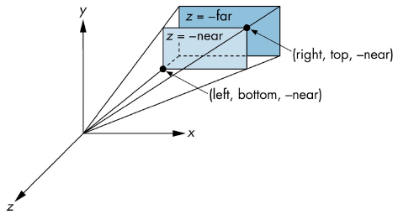
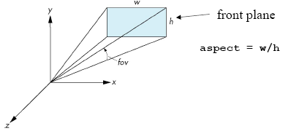
Setting perspective in OpenGL
Can also do this manually with glMultMatrix()
Or use glFrustum():
  glFrustum( left, right,
  bottom, top, near, far)
Or use gluPerspective():
  gluPerspective(
  fov, aspect, near, far );
  Easier to use than glFrustum()
glFrustum()
gluPerspective()

Slide 19
What's on for today
Math for 3D graphics: homogeneous coordinates
  4x4 transform matrices
  Translate, scale, rotate
Viewing: (see RedBook ch3)
  Positioning the camera: model-view matrix
  Selecting a lens: projection matrix
  Clipping: setting the view volume
Modelling: vertex lists, face lists, edge lists
  OpenGL vertex arrays and display lists

Slide 20
Modelling polygons
Simple representation (see CubeView):
glBegin( GL_POLYGON );
glVertex3f( 0.0, 0.0, 0.0 );
glVertex3f( 1.0, 1.5, 2.2 );
glVertex3f( -2.3, 1.5, 0.0 );
glEnd();
Problems: inefficient, unstructured
  What if we want to move a vertex to a new location?
v₃
v₂
v₁

Slide 21
Inward/outward facing polygons
The normal vector for a polygon follows
the right-hand rule
Specifying vertices in order (v₁, v₂, v₃) is same as (v₂, v₃, v₁) but different from (v₁, v₃, v₂)
When constructing a closed surface, make sure all your polygons face outward
Backface culling may mean
inward-facing polygons
don't get rendered
v₃
v₁
v₂

Slide 22
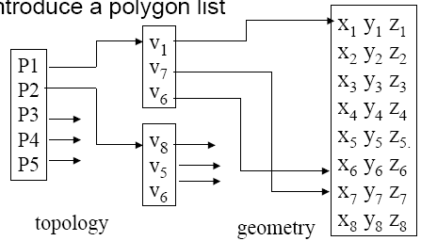
Vertex lists and face lists
v₃
P2
v₂
P1
v₁
Separate geometry from topology
  Vertex coords are geometry
  Connections between vertices (edges, polygons) are topology
Vertex list:
    v₁ = {x₁, y₁, z₁}
    v₂ = {x₂, y₂, z₂}
Polygon/face list:
    P₁ = {v₁, v₂, v₃}
    P₂ = {v₁, v₄, v₂}
v₄

Slide 23
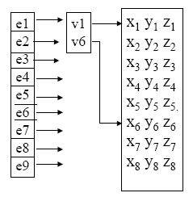
Edge lists
If only drawing edges (wireframe):
  Many shared edges may be duplicated
  Similar to face list but for edges:
    Does not represent the polygons!
Vertex list:
    v₁ = {x₁, y₁, z₁}
    v₂ = {x₂, y₂, z₂}
Edge list:
    e₁ = {v₁, v₂}
    e₂ = {v₁, v₄}
v₃
e₁
v₂
v₁
e₂
v₄

Slide 24
OpenGL vertex arrays
Stores a vertex list in the graphics hardware
    Six types of arrays: vertices, colours,
    colour indices, normals, texture coords, edge flags
Our vertex list in C:
    GLfloat verts[][3] = {{0.0, 0.0, 0.0},
    {0.1, 0.0, 0.0}, ...}
Load into hardware:
    glEnableClientState( GL_VERTEX_ARRAY );
    glVertexPointer( 3, GL_FLOAT, 0, verts );
      3: 3D vertices
      GL_FLOAT: array is of GLfloat-s
      0: contiguous data
      verts: pointer to data

Slide 25
Using OpenGL vertex arrays
Use glDrawElements instead of glVertex
Polygon list references indices in the stored vertex array
    GLubyte cubeIndices[24] = {0,3,2,1, 2,3,7,6, 0,4,7,3, 1,2,6,5, 4,5,6,7, 0,1,5,4};
    Each group of four indices is one quad
Draw a whole object in one function call:
    glDrawElements( GL_QUADS, 24, GL_UNSIGNED_BYTE, cubeIndices );

Slide 26
OpenGL display lists
Take a group of OpenGL commands (e.g., defining an object) and store in hardware
Can change OpenGL state, camera view, etc. without redefining this stored object
Creating a display list:
    GLuint cubeDL = glGenLists(1);
    glNewList( cubeDL, GL_COMPILE );
      glBegin(...); ....; glEnd();
    glEndList();
Using a stored display list:
    glCallList( cubeDL );
See RedBook ch7

