Slide 1
Virtual Trackball: Quaternions
3 March 2009
CMPT370
Dr. Sean Ho
Trinity Western University

Slide 2
Review last time
Math for 3D graphics: homogeneous coordinates
  4x4 transform matrices
  Translate, scale, rotate
Viewing: (see RedBook ch3)
  Positioning the camera: model-view matrix
  Selecting a lens: projection matrix
  Clipping: setting the view volume

Slide 3
OpenGL vertex arrays
Stores a vertex list in the graphics hardware
    Six types of arrays: vertices, colours,
    colour indices, normals, texture coords, edge flags
Our vertex list in C:
    GLfloat verts[][3] = {{0.0, 0.0, 0.0},
    {0.1, 0.0, 0.0}, ...}
Load into hardware:
    glEnableClientState( GL_VERTEX_ARRAY );
    glVertexPointer( 3, GL_FLOAT, 0, verts );
      3: 3D vertices
      GL_FLOAT: array is of GLfloat-s
      0: contiguous data
      verts: pointer to data

Slide 4
Using OpenGL vertex arrays
Use glDrawElements instead of glVertex
Polygon list references indices in the stored vertex array
    GLubyte cubeIndices[24] = {0,3,2,1, 2,3,7,6, 0,4,7,3, 1,2,6,5, 4,5,6,7, 0,1,5,4};
    Each group of four indices is one quad
Draw a whole object in one function call:
    glDrawElements( GL_QUADS, 24, GL_UNSIGNED_BYTE, cubeIndices );

Slide 5
OpenGL display lists
Take a group of OpenGL commands (e.g., defining an object) and store in hardware
Can change OpenGL state, camera view, etc. without redefining this stored object
Creating a display list:
    GLuint cubeDL = glGenLists(1);
    glNewList( cubeDL, GL_COMPILE );
      glBegin(...); ....; glEnd();
    glEndList();
Using a stored display list:
    glCallList( cubeDL );
See RedBook ch7

Slide 6
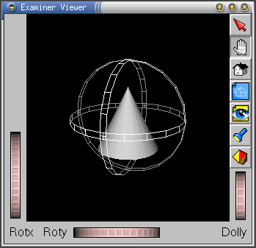
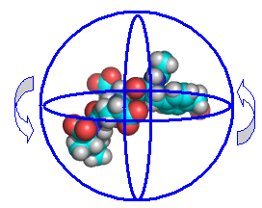
Rotations in 3D
Euler angles: angles about x, y, z axes
  Needs an order: e.g., first x, then y, then z
  User interface to specify three angles clunky
Virtual trackball: like an upside-down mouse
  Motion in 2D determines rotation of trackball

Slide 7
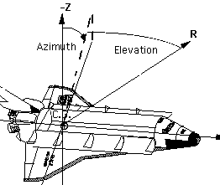
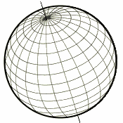
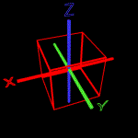
Gimbal lock
One naïve way to do get a rotation
from 2D mouse motion is:
  Vertical motion --> elevation (latitude)
  Horizontal --> azimuth (longitude)
Problem: gimbal lock!
  At the North/South poles,
  longitude has no meaning
  Lose a degree of freedom
  Apollo 11 landing on Moon nearly had an accident due to gimbal lock

Slide 8
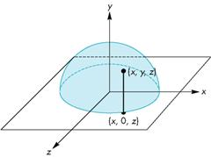
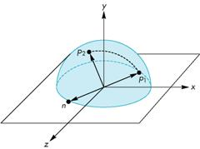
Virtual trackball
Let the mouse position be in x-z plane
Project up to the hemisphere of radius r:
    y = sqrt( r² – x² – z² )
Mouse motion corresponds to moving
from p₁ to p₂ on the hemisphere
Draw a “great circle” from p₁ to p₂
  This determines the rotation
Update in the event handler:
every mouse-move yields a small rotation

Slide 9
Axis and angle of rotation
The axis of rotation is found by the
cross-product of p₁ and p₂
The angle between p₁ and p₂ is
found by: |sin θ| = |n| / (|p₁| * |p₂|)
  If the mouse is moved slowly enough and we sample frequently, sin θ ≈ θ
glRotatef( θ, n₁, n₂, n₃): angle+axis
Problem: how to compose two rotations?
Convert axis+angle to a quaternion.

Slide 10
Quaternions
Extension of complex numbers from 2D to 4D
    (an example of a Clifford Algebra)
  One real, three imaginary components i, j, k:
    b = q₀ + q₁i + q₂j + q₃k = (q₀, q)
    q = q₁i + q₂j + q₃k is the pure quaternion part
Properties:
    a + b = (p₀ + q₀, p + q)
    i² = j² = k² = -1
    ij = k, ji = -k, jk = i, kj = -i, ki = j, ik = -j
    |b|² = q₀² + q₁² + q₂² + q₃² (magnitude)

Slide 11
Multiplying quaternions
a x b = (p₀q₀ – p*q), q₀p + p₀q + pxq)
  p*q: dot-product (treat p, q as 3D vectors)
  pxq: cross-product (yields a quaternion)
Order matters: multiplication is not commutative!
  a x b ≠ b x a
We'll represent composing multiple rotations by multiplication of the corresponding quaternions

Slide 12
Properties of quaternions
Conjugate: b(conj) = (q₀, -q)
Negative: -b = (-q₀, -q)
Multiplicative inverse: b⁻¹ = b(conj) / |b|²
Unit quaternions: |b|=1, so b⁻¹ = b(conj)
  We'll represent rotations with unit quaternions

Slide 13
Rotations with quaternions
From the axis-angle form:
  Rotate about the unit vector u by angle θ:
  q = ( cos(θ/2), u sin(θ/2) )
A point P in 3D space is represented by the quaternion p = ( 0, P )
The rotated point P' is represented by the quaternion p':
  p' = q * p * q⁻¹
These are quaternion multiplications; convert to matrix notation:

Slide 14
Converting to 4x4 matrix
Rotate P by q: p' = q * p * q⁻¹
Left-multiplication of a point P = (x_{p}, y_{p}, z_{p})
by a rotation quaternion
q = (x, y, z, w):
  q * P:
Followed by
right-multiplication by q⁻¹:
  P * q⁻¹:

Slide 15
Putting it all together
Hence, rotating a point P by a quaternion
q = (x, y, z, w) is equivalent to multiplying by a 4x4 matrix:

