Slide 1
Lighting and Shading
5 March 2009
CMPT370
Dr. Sean Ho
Trinity Western University

Slide 2
What's on for today
Lighting and shading
  The global rendering equation
  Light-material interaction
  Kinds of light sources
The OpenGL local illumination model
  Ambient term
  Diffuse term
  Specular term
  Specifying in OpenGL
See RedBook ch5

Slide 3
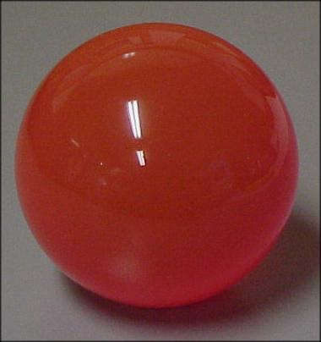
Shading for realism
Colour is part of the OpenGL state
  Specify glColor (glColor3f, glColor4b, etc.)
  before adding vertex
Red ball:
    glColor3f(1.0, 0.0, 0.0);
    glVertex3f( ... ); ...
Flat-shaded:
Not realistic!

Slide 4
Factors involved in shading
What makes the real sphere look
like this?
Interactions between
light and material:
  Light sources
  Material properties
  Location of viewer
  Surface orientation

Slide 5
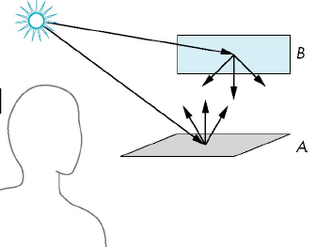
The rendering equation
Light originates from light sources
Each time light strikes a surface:
  Some absorbed, some scattered
Cannot be solved analytically in general
Global illumination: all objects, all light sources
OpenGL pipeline is local: one polygon at a time

Slide 6
Light – material interaction
Light striking a material is
  Partially absorbed
  Partially scattered (reflected):
    Depends on smoothness, orientation of surface
A surface looks red because it absorbs everything else and reflects the red component of light

Slide 7
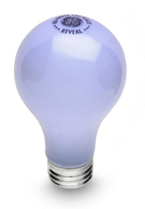
Light sources
General (area) light sources: must integrate light from all points of light source: hard!
Simple kinds of light sources:
  Ambient light: uniform light everywhere
    Models contribution of many sources
  Point source: has position and colour
    Directional light: position is infinitely far away
  Spotlight: restrict light to a cone
    Can have falloff at edges of cone

Slide 8
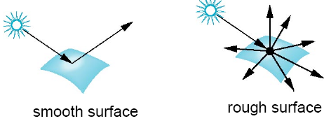
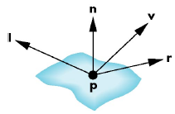
OpenGL local illumination
Smooth: reflect concentrated in one direction
  Rough surfaces scatter light in all directions
The OpenGL illumination model has 3 parts:
  Ambient light
  Diffuse scattering (rough)
  Specular reflection (smooth)
Uses four vectors:
  To source (l), To viewer (v)
  Surface normal (n), Ideal reflection (r)

Slide 9
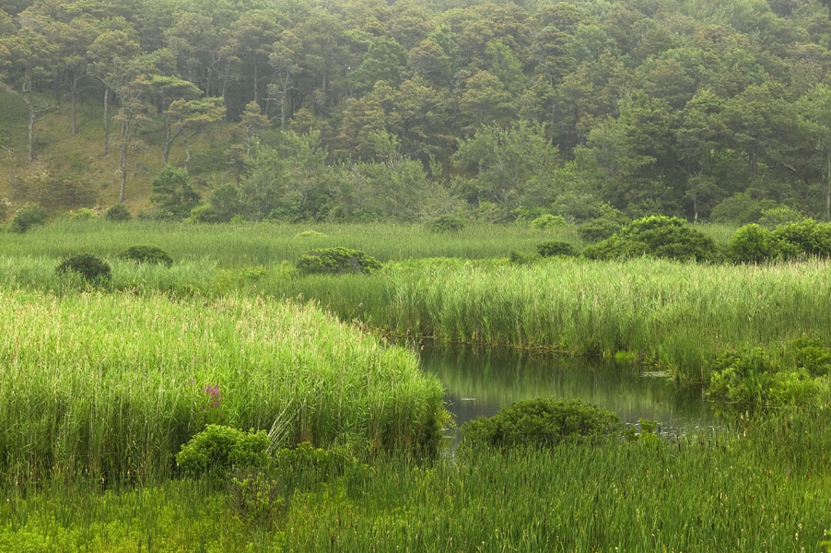
Ambient light
Simple model of multiple interactions between large area light sources and many objects
  Shadowless
Intensity and colour depends on:
  Colour of ambient
  light: k_{a}
  Reflectivity of surface
  material with respect
  to ambient light: I_{a}
Ambient term is k_{a}I_{a}

Slide 10
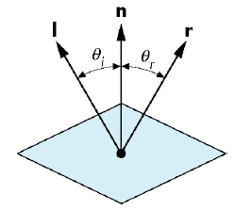
Lambertian surfaces
An perfectly specular surface reflects all incident light in the direction of reflection
  Angle of incidence equals angle of reflection
A perfectly diffuse (Lambertian) surface scatters all incident light equally in all directions
  Light reflected is proportional to
  cos(θ_{I}) = l * n
  Diffuse colour of surface k_{d} also
  modulates reflected light
Diffuse term is k_{d} I_{d} (l * n)

Slide 11
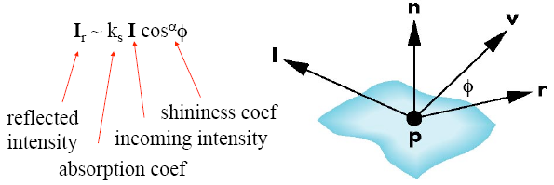
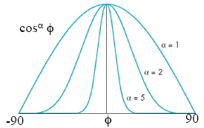
Shininess
If viewer is looking along the reflection vector, we see the specular highlight
Phong added falloff if viewer is slightly off from ideal reflection vector: shininess coefficient
cos(φ) is dotproduct of
view vector v and reflection r
Specular term is: k_{s} I_{s} ( v * r )^{α}

Slide 12
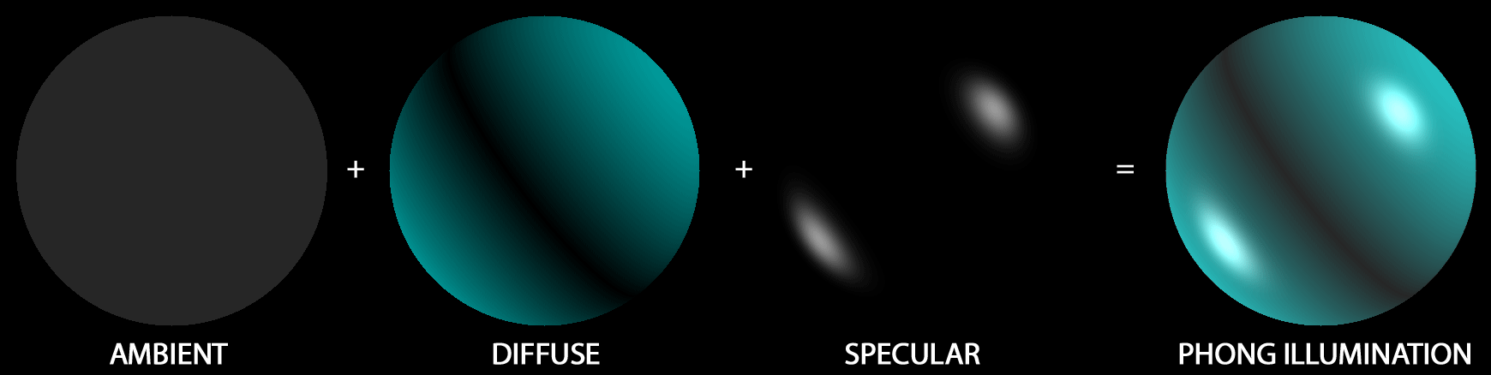
Putting it together
Intensity of a surface patch from our view is
I = k_{a}I_{a} + k_{d} I_{d} (l * n) + k_{s} I_{s} (v * r)^{α}
Light properties (9):
Ambient colour I_{a}
Diffuse colour I_{d}
Specular colour I_{s}
Material properties (10):
Absorption coefficients:
Ambient k_{a}, diffuse k_{d},
specular k_{s}
Shininess coefficient α

Slide 13
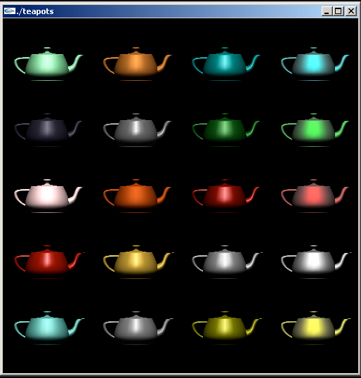
Doing this in OpenGL
Enable shading and select shading model
Specify lights
Specify material
properties
Specify geometry
and normals

Slide 14
Selecting lighting model
Enable lighting (otherwise only flat-shading):
    glEnable( GL_LIGHTING );
  Also have to enable each light source:
    glEnable( GL_LIGHT0 );
    glEnable( GL_LIGHT1 );
    Up to GL_MAX_LIGHTS lights (at least 8)
Set lighting model parameters:
  Set global ambient light colour
    glLightModelif( GL_LIGHT_MODEL_AMBIENT, r, g, b )
    Other params: GL_LIGHT_MODEL_LOCAL_VIEWER, GL_LIGHT_MODEL_TWO_SIDED

Slide 15
Defining lights
Point source: position, colours (amb, diff, spec)
    GLfloat diffuse0[] = {1.0, 0.0, 0.0, 1.0}; // RGBA
    GLfloat ambient0[] = {1.0, 0.0, 0.0, 1.0};
    GLfloat specular0[] = {1.0, 0.0, 0.0, 1.0};
    Glfloat light0_pos[] = {1.0, 2.0, 3,0, 1.0};
    // homogeneous coords
    glEnable( GL_LIGHTING );
    glEnable( GL_LIGHT0 );
    glLightv( GL_LIGHT0, GL_POSITION, light0_pos );
    glLightv( GL_LIGHT0, GL_AMBIENT, ambient0 );
    glLightv( GL_LIGHT0, GL_DIFFUSE, diffuse0 );
    glLightv( GL_LIGHT0, GL_SPECULAR, specular0 );

Slide 16
Directional light source
The position of a point source is specified in homogeneous coordinates:
  w=1.0: light is a point source
    (x,y,z) give coordinates of position
  w=0.0: light is a directional source
    (x,y,z) give vector
    Glfloat light0_pos[] = {1.0, 2.0, 3,0, 1.0};
    glLightv( GL_LIGHT0, GL_POSITION, light0_pos );
Light sources are geometric objects, too:
  Affected by current model-view matrix

Slide 17
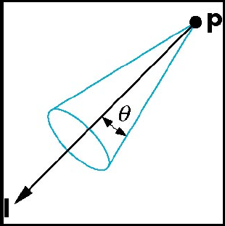
Spotlights
Spotlights have:
  RGBA colour (amb, diff, spec)
  Position
  Direction
  Cutoff distance
  Attenuation exponent α
    Falloff is proportional to
    cos^{α}φ

Slide 18
Material properties
Part of the OpenGL state: specify before the vertices/polygon to which they apply
    GLfloat ambient[] = {0.2, 0.2, 0.2, 1.0};
    GLfloat diffuse[] = {1.0, 0.8, 0.0, 1.0};
    GLfloat specular[] = {1.0, 1.0, 1.0, 1.0};
    GLfloat shine = 100.0;
    glMaterialfv( GL_FRONT, GL_AMBIENT, ambient );
    glMaterialfv( GL_FRONT, GL_DIFFUSE, diffuse );
    glMaterialfv( GL_FRONT, GL_SPECULAR, specular );
    glMaterialfv( GL_FRONT, GL_SHININESS, shine );

Slide 19
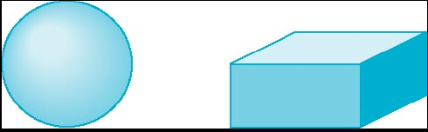
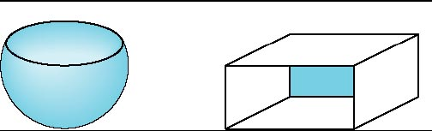
Front and back face materials
Recall back-face culling: don't render faces which point away from camera (v * n > 0)
Two-sided lighting disables back-face culling
  Front and back faces can get different material properties
  Use GL_FRONT, GL_BACK, or GL_FRONT_AND_BACK in glMaterialf()

Slide 20
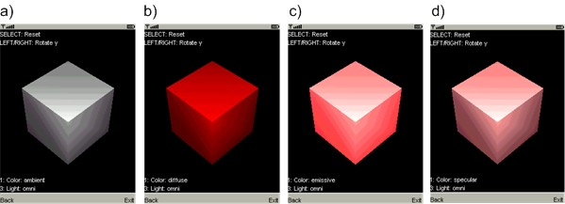
Emissive light
An extra feature OpenGL throws in is the emissive term:
    GLfloat emission[] = 0.0, 0.3, 0.3, 1.0);
    glMaterialf( GL_FRONT, GL_EMISSION, emission );
  Extra light added to the shading equation:
    I = (amb) + (diffuse) + (specular) + (emissive)
  Simulates glowing object
  Does not shine light on other objects
(a) ambient
(b) diffuse
(c) emissive
(d) specular

Slide 22
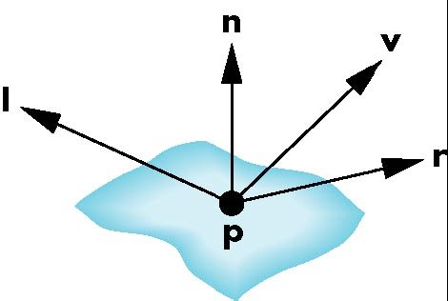
Shading needs normal vectors
The illumination model relies on four vectors:
  To light (l): specified by the model/scene
  To viewer (v): specified by model-view matrix
  Surface normal (n)
  Reflection (r): compute from l, n
Computing normals is not always easy
  Depends on how we represent
  the surface
  OpenGL leaves this up to us
  (in our application)

Slide 23
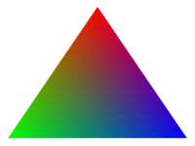
Shading polygons
We specify in our model for each vertex:
  Vertex coordinates
  Vertex colours
  Vertex normal
Use lighting model to calculate vertex shades
Smooth shading: vertex shades are interpolated across the polygon
    glShadeModel( GL_SMOOTH );
Flat-shading uses the colour of the first vertex:
    glShadeModel( GL_FLAT );

Slide 24
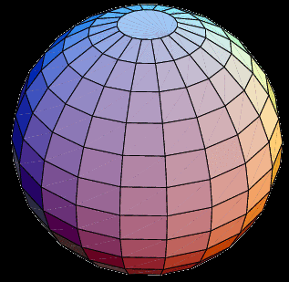
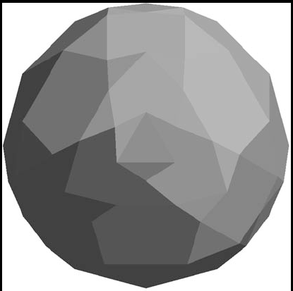
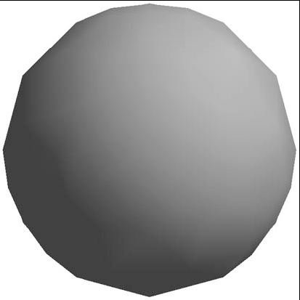
Calculating normals
OpenGL expects us to find the normals
Some shapes can be done analytically:
  Sphere: normal points from centre
  No vertex normals:
  flat-shaded
  With vertex normals:
  smooth-shaded
    Note silhouette edge
How to find normals for general surfaces?

